Slide 1
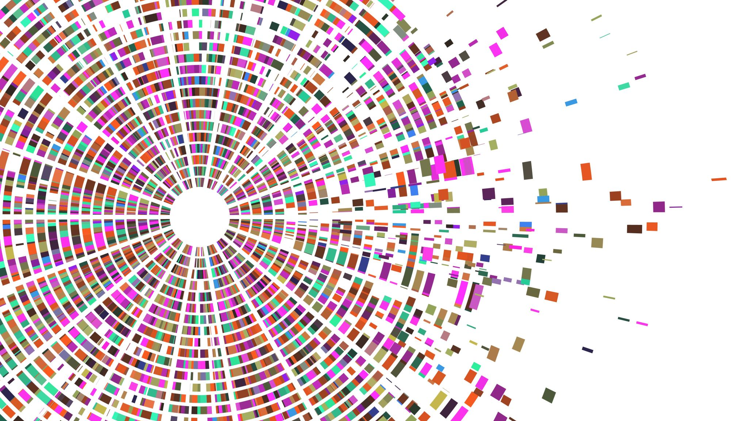
Data Understanding
Using Yelp dataset to create a Recomender System

Slide 2
Dataset Description

