Slide 1
Freeway control and useful traffic gradients
What information changes a useful control decision?
Variable speed limits at a lane drop
Ramp metering at a local freeway merge
Methodology and findings • 2 October 2026
Notes:
Weekly colleague presentation requested in feedback item 6. Scope starts with VSL task definition and ends with the current method-first ramp review. The VSL result is a closed conditional analytical certificate; the ramp information/action test remains open. This is presentation synthesis, not a new review or experiment.
Sources:
misc/differentiable_freeway_bottleneck_task_review/reporting/s13/s13_99_m2_certificate_sprint_closure.md
misc/selective_discreteness_ramp_metering_review/reporting/rm9_current_handoff.md

Slide 2
Contents
1. Review principle and core questions
2. VSL task, hidden information and decision mechanism
3. VSL gradient and research-readiness boundary
4. Ramp-metering task, mechanism and information test
5. Ramp gradient and the current evidence boundary
Notes:
The order mirrors the requested syllabus. Method-first principles and research questions frame both tasks. VSL includes its causal mechanism, exact conditional information/action result, gradient and study boundary. Ramp metering receives the same treatment where evidence exists, with open claims clearly identified.
Sources:
temp_content/feedback/feedback.md

Slide 3
Start from the control question
Earlier project anchoring
Existing model
Compatible task
Evaluate
Method-first review
Task +
strong baseline
Information value?
Minimum state
+ gradients
Let decision evidence justify traffic detail.
Notes:
The historical implementation-anchored approach sought a compatible freeway task. The independent reviews instead start with a task and a strong aggregate comparator, then ask whether unavailable information changes useful actions. Current project code is not a model-family admission constraint. This does not claim existing simulator implementation was invalid.
Sources:
misc/differentiable_freeway_bottleneck_task_review/01_review_recap_through_s06.md
misc/selective_discreteness_ramp_metering_review/reporting/rm7_20_method_first_task_formulation_and_gate.md

Slide 4
Three questions guide both control tasks
1. What traffic information can be hidden from aggregate history?
2. Can that information change a useful control action?
3. Can retaining it provide relevant gradient information?
The required traffic resolution is an outcome of the review.
Match actions, known forcing and complete travel/waiting accounting.
Notes:
These are the persistent core review questions. Information loss means a difference unavailable to the complete declared aggregate observation history, not merely different lane snapshots. All comparisons use the same action family, known forcing and complete population objective. Useful gradient evidence differs from differentiability or lower internal loss.
Sources:
misc/differentiable_freeway_bottleneck_task_review/reporting/s13/s13_35_study_sufficiency_and_extension_audit.md
misc/selective_discreteness_ramp_metering_review/synthesis/rm8_predecessor_and_information_map.md

Slide 5
VSL task: a permanent three-to-two lane drop
One common speed advice
Mandatory merge
Preparation zone
Permanent narrowing gives the smallest clear mandatory-merge task.
One action for all lanes isolates information value from extra control.
Outcome: complete cohort travel and waiting time through clearance.
Notes:
One shared lane-uniform infrastructure advice speed is varied over a bounded interval. The selected analytical branch converts advice to traversal time; this is not an assertion of universal field compliance. The permanent drop removes reopening/recovery bookkeeping. Keeping one actuator avoids confounding information value with extra lane-specific control authority. The final proof uses ending-versus-continuing groups under continuing-group symmetry.
Sources:
misc/differentiable_freeway_bottleneck_task_review/synthesis/s13/s13_m2_model_contract.tex
misc/differentiable_freeway_bottleneck_task_review/extraction/s13_m2_source_to_equation_audit.md

Slide 6
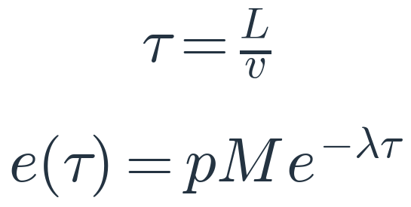
Preparation time can change receiving work
More time → more early merging
Less merge work at choke
L: zone length; v: common advice speed; τ: time in the zone.
p: ending-lane fraction; M: cohort mass; λ: transfer rate; e: remaining mass.
Slowing costs travel time; early merging can save receiving time.
Fixed action-independent service instead favors fastest advice.
Notes:
In the accepted fixed smooth branch, slower advice increases L/v and permits more mandatory ending-lane mass to transfer before the choke. The constant-rate exponential is an explicit analytical adaptation. Remaining mandatory-merge mass consumes alpha>1 receiving-work units per vehicle-equivalent under proportional homogeneous batch service. Receiving work is not additional vehicle mass. All action-induced traversal time and complete clearance are charged. If service is independent of action, the earlier fixed-service obstruction restores a common fastest action.
Sources:
misc/differentiable_freeway_bottleneck_task_review/synthesis/s13/s13_m2_model_contract.tex
misc/differentiable_freeway_bottleneck_task_review/reporting/s13/s13_20_m2_certificate_findings_and_gate.md

Slide 7
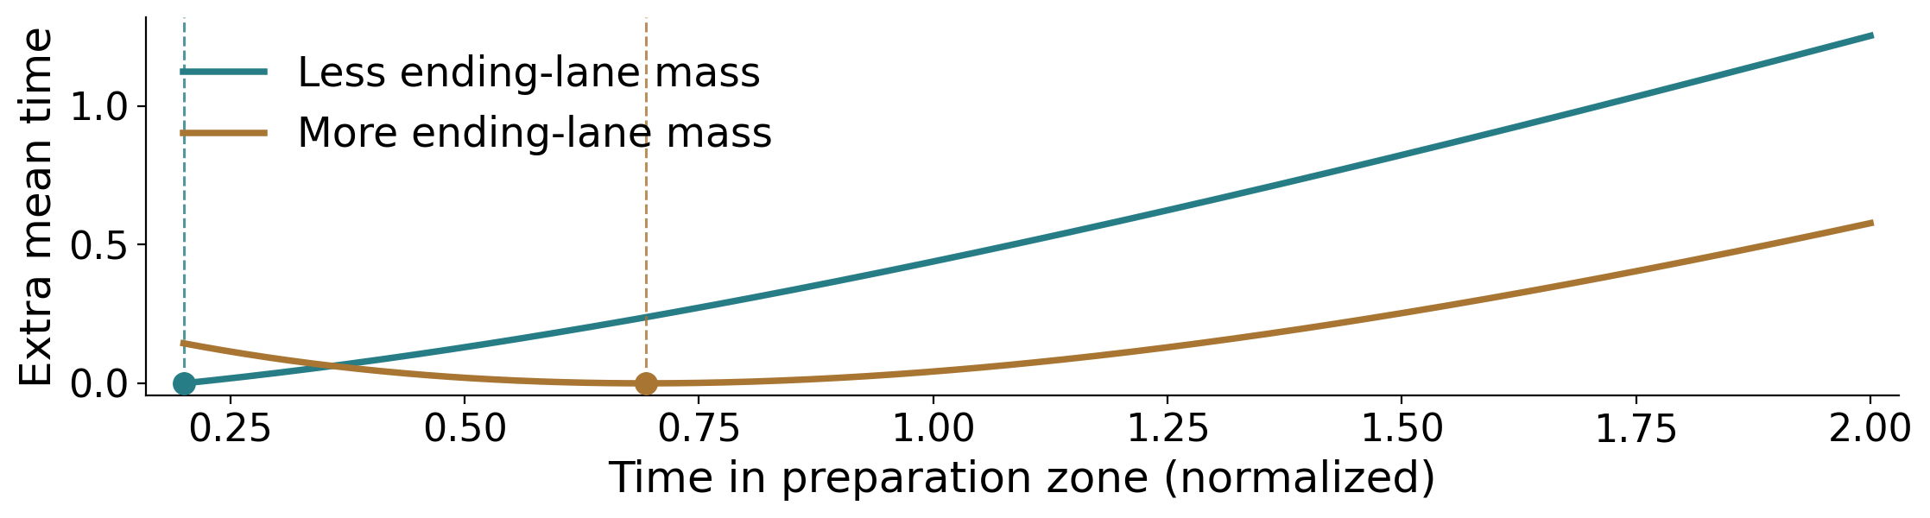
Hidden allocation can change the best advice
Different lane fractions; identical declared predecision aggregate history.
Less ending-lane mass: fastest advice. More: a slower interior optimum.
One aggregate-history-only initial action cannot be optimal for both.
Conditional analytical illustration; normalized values, not traffic data.
Notes:
This is the accepted conditional VSL certificate, not a field finding. The two ending-lane fractions inherit exact predecision density, flow, speed and count history equality from the homogeneous conservative upstream construction. The spatial decision boundary is first entry to the common preparation zone. For the open parameter regime, unique actions differ over the entire speed interval: low p selects fastest, high p an interior slower action. Aggregate-history-only initial action has positive worst-state regret; later feedback may see divergence. The plot reproduces the certificate's normalized illustration: lambda=1, tau range [0.2,2], K=4, p_low=0.2, p_high=0.5. Curves are excess analytical mean time relative to each state's optimum, not simulation or calibration.
Sources:
misc/differentiable_freeway_bottleneck_task_review/synthesis/s13/s13_m2_certificate_analysis.tex
misc/differentiable_freeway_bottleneck_task_review/reporting/s13/s13_99_m2_certificate_sprint_closure.md

Slide 8
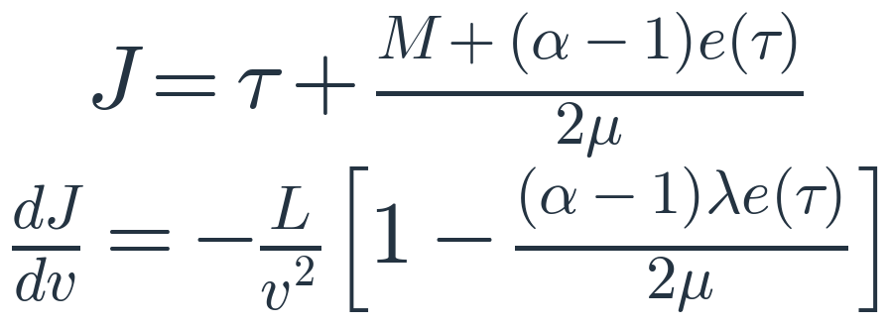
VSL: follow the causal gradient path
Common
speed
Residence
time
Remaining
merge mass
Receiving
work
Complete
time
J: total cohort time / M; all mass starts together and clears completely.
M: cohort mass; e(τ): mass still in the ending lane at the choke.
α>1: merge-work multiplier; μ: receiving work per unit time.
Linear batch discharge: mean choke time = clearance duration / 2.
Transfer: Nagalur Subraveti; receiving: Carey; common VSL: Zhang.
Exponential transfer and batch reduction: analytical adaptations.
Notes:
Fixed-active-regime chain: advice speed -> traversal time -> remaining mandatory-transfer mass -> receiving workload -> complete mean time. The displayed cost and derivative are exact for the proportional fluid batch. Hidden p changes e and can reverse the locally improving speed direction near fastest advice. Structural lane topology is not differentiated. Lane transfer structure is grounded in Nagalur Subraveti/Knoop/van Arem; gap-weighted receiving and proportional sharing in Carey/Balijepalli/Watling; common VSL lane-drop setting in Zhang et al. The exponential active branch, batch handoff and information/action/gradient certificate are review adaptations and deductions, not jointly established by one literature work. No AD/FD or independent reference evaluation occurred. J is total cohort system time divided by fixed cohort mass M, not last-departure time. All mass travels for tau and is then discharged as a homogeneous proportional batch. W=(M-e)+alpha*e is receiving work; discharge duration is W/mu. Linear mass discharge gives mean post-arrival time W/(2*mu). Hold M,p,L,lambda,alpha,mu fixed: de/dtau=-lambda*e and dtau/dv=-L/v^2 yield the displayed chain-rule derivative. Alpha is the total merge-work multiplier; alpha-1 is the extra part.
Sources:
misc/differentiable_freeway_bottleneck_task_review/extraction/s13_m2_source_to_equation_audit.md
misc/differentiable_freeway_bottleneck_task_review/synthesis/s13/s13_m2_certificate_analysis.tex
misc/differentiable_freeway_bottleneck_task_review/synthesis/s13/s13_mean_time_and_speed_derivative_explained.tex
https://doi.org/10.1080/21680566.2019.1700846
https://eprints.whiterose.ac.uk/id/eprint/77315/7/Carey%20et%20al%202013_with_coversheet.pdf
https://doi.org/10.1080/23249935.2022.2033878

Slide 9
VSL: an analytical task, with a study still ahead
Established: a conditional hidden-state → action → gradient chain.
One continuous merge-preparation statistic may be sufficient.
Not established: calibrated transfer law or real-world regime prevalence.
Still needed: ablations, model-family robustness and stronger baselines.
Then: a traffic-valid reference, derivative checks and independent usefulness.
Further VSL review is deferred pending colleague discussion.
Notes:
VSL S13 is properly closed as a conditional decision-relevant certificate. It is more than just admitting a model family: observer, action, dynamics, complete accounting and gradient relevance are specified for one analytical member. It remains incomplete as a model-family or empirical research study. Remaining mandatory-merge mass compresses the consequential information to a scalar; full lanes, order, gaps and vehicle identity have not been shown necessary. Robustness/causal deletion, minimum-state comparison, traffic-domain and reference admission, derivative verification and held-out independent usefulness are deferred. Further VSL review is set aside for colleague discussion.
Sources:
misc/differentiable_freeway_bottleneck_task_review/reporting/s13/s13_99_m2_certificate_sprint_closure.md
misc/differentiable_freeway_bottleneck_task_review/reporting/s13/s13_35_study_sufficiency_and_extension_audit.md
misc/differentiable_freeway_bottleneck_task_review/synthesis/s13/s13_deferred_research_readiness_review_plan.md

Slide 10
Ramp metering: one local merge
Meter
Finite ramp queue
Release ≠ downstream entry
Local lane-aware CTM: longitudinal cells with finite storage and lane exchange.
Open-loop rate changes isolate model sensitivity before controller design.
Count ramp waiting, mainline time, external waiting and all residual traffic.
Notes:
The branch is reopened method-first, not as a compatible implementation extension. One finite-storage on-ramp enters a two-mainline-lane local merge candidate. The common action is a bounded open-loop infrastructure release-rate schedule. Open-loop isolates model gradient correctness and one-step usefulness before a feedback/PID/MPC controller is introduced. Meter permission caps upstream release, not necessarily downstream instantaneous entry after propagation/storage. Complete road-total density/flow/speed/count history and ramp history, common known forcing/geometry/parameters, all-stream time through clearance are retained. Multiple ramps and detailed gap-timed/CAV control are not this first task.
Sources:
misc/selective_discreteness_ramp_metering_review/reporting/rm7_20_method_first_task_formulation_and_gate.md
misc/selective_discreteness_ramp_metering_review/synthesis/rm7_post_selection_design_inventory.md
misc/selective_discreteness_ramp_metering_review/reporting/rm9_current_handoff.md

Slide 11
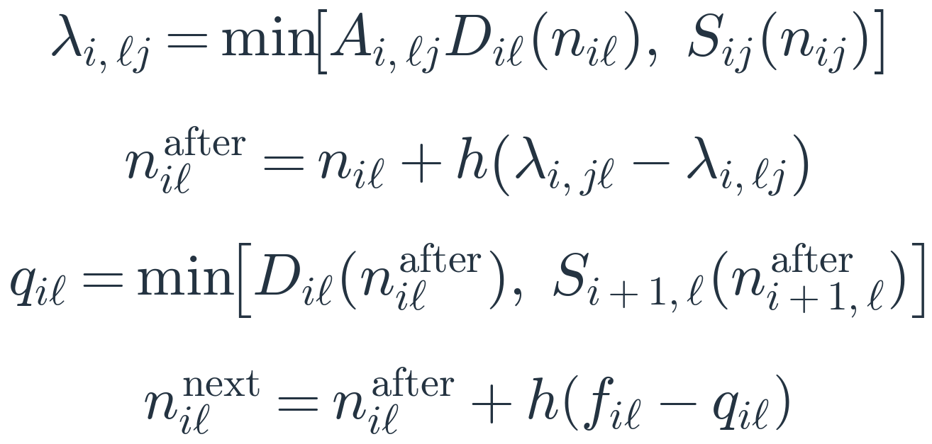
Ramp CTM: lateral and forward flow
Cell i − 1
Cell i
Cell i + 1
Lane 1
Lane 2
Within cell: paired lateral exchange
Across cells: forward transmission
Lateral
Forward
n: lane-cell mass; i: cell; ℓ, j: lanes; h: time step; after: post-exchange.
A: bounded density preference; λ: directed lateral rate; D/S: sending/receiving.
q: forward rate; f: accepted inflow; ramp + mainline share receiving.
Lane CTM/exchange: Nagalur Subraveti; node priorities: Wright. Adapted.
Notes:
The adopted kernel is a lane-aware cell-transmission model, with continuous vehicle-equivalent mass in each physical mainline lane and longitudinal cell, and discrete time steps. It is not one lumped mass for an entire lane or individual vehicle dynamics. Three adjacent cells are shown schematically, not as an approved cell count or completed network geometry. First apply bounded paired density-driven lateral transfers within every cell; these conserve its two-lane total. Then recompute ordinary CTM sending and receiving from post-lateral masses. At an ordinary interface, accepted lane flow is the minimum of upstream sending and downstream receiving. The time-step mass balance adds h times total accepted inflow f and subtracts h times outflow q. The ordinary min formula is not applied independently to each input at a merge: mainline and ramp still share one receiver under positive input priorities with unused-supply redistribution. Metered ramp releases must propagate through storage before entering that junction; exact ramp geometry and boundary transcription remain open. Transverse and longitudinal resources are separate in the approved adaptation: no original-budget-minus-lateral cap remains. Lane exchange changes occupancy and therefore flow offers and storage availability, not physical lane capacity; throughput improvement is not guaranteed. Nagalur Subraveti supplies lane-wise CTM/exchange antecedents and Wright et al. supplies the node allocator; their composition is an approved review adaptation, not a reproduced calibrated paper. The FD functions and accepted time-step/storage bounds are in the source audit. Diagram blocks are symbolic occupancy, not computed mass or traffic results. The visible lateral equations now retain the accepted bounded operator: A is a directed preference between zero and one, positive only when the density advantage passes the approved threshold; lambda is limited by that fraction of the donor pre-exchange sending and by recipient pre-exchange receiving in the same longitudinal cell. Multiplying the incoming-minus-outgoing lateral rate by h gives each lane's post-exchange mass. The terms cancel when summing lanes. This D/S-bounded exchange inherits the approved time-step/storage restrictions. A is not a new control action; the open-loop meter rate remains the common actuator. The exact normalized density-contrast preference, its propensity/threshold parameters and empty-cell convention remain defined by the existing source audit. Forward D/S are recomputed after the lateral stage, as displayed.
Sources:
misc/selective_discreteness_ramp_metering_review/discussion/rm9_resource_b_approval_and_continuation.md
misc/selective_discreteness_ramp_metering_review/synthesis/rm9/rm9_separate_resource_and_observer_audit.tex
https://repository.tudelft.nl/file/File_2c4359e7-5e5a-4651-964f-6f3610ab89ae
https://horowitz.me.berkeley.edu/Publications_files/All_papers_numbered/Wright_node_models_transportation_networks_Transportation_research_B_2017.pdf

Slide 12
Ramp lane contrast is not yet certified hidden
Free-flow illustration: normalized lane mobilities 1 and 1.5.
2
6
8
4
Total mass 10; forward flow 14
Total mass 10; forward flow 12
Different lane mobilities make aggregate flows distinguishable.
Candidate omission: target-lane occupancy and local redistribution.
Free-flow density and flow can already reveal the lane split.
Congestion requires a precise independent speed-and-history map.
No equal-history pair with different useful metering actions is established.
Notes:
Lane contrast is a candidate state omission, not an established hidden-information result. On the strict ordinary free-flow B branch, total post-lateral mass and aggregate actual flow reconstruct the two-lane split when known mobilities differ. A separate passage-speed observation is retained, not replaced by Q/K. The geometric illustration uses normalized c1=1,c2=1.5, masses (2,8) versus (6,4), both total 10 but flows 14 and 12. This is hand algebra, not matched history or calibrated traffic. A pre-transfer map can also collapse states; if all remaining state/forcing agree and actions act only afterwards, that lost coordinate cannot change actions. Congested/receiving-limited states need the full observation map and complete prior-history audit.
Sources:
misc/selective_discreteness_ramp_metering_review/synthesis/rm9/rm9_separate_resource_and_observer_audit.tex
misc/selective_discreteness_ramp_metering_review/extraction/rm9_separate_resource_claims.md
misc/selective_discreteness_ramp_metering_review/reporting/rm9_50_separate_resource_findings_and_observer_gate.md

Slide 13
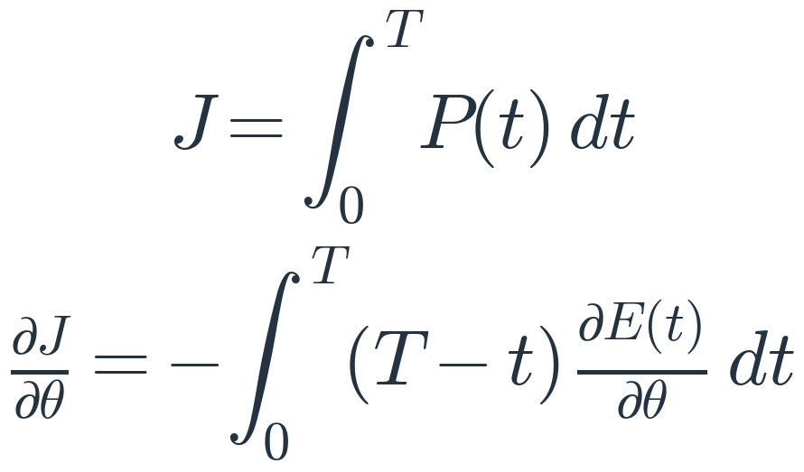
Ramp gradients follow final departure timing
Meter
rate
Release +
storage
Accepted
merging
Final
departures
All-stream
time
J: total system time; P: all traffic still in system; E: final exit flow.
T: common clearance horizon; θ: open-loop meter-schedule parameter.
Moving waiting from mainline to ramp alone does not reduce total time.
Piecewise sensitivity is formulated; correctness and usefulness remain open.
Notes:
The conceptual chain is common meter parameter theta -> releases -> post-meter storage/propagation -> shared receiving -> accepted merge and lane response -> complete final departures -> all-stream system time. The displayed sensitivity identity assumes fixed common arrivals/initial mass and clearance horizon, complete population accounting and fixed active branches. E is final system exit flow, not local ramp merge entry; P is all waiting/road/ramp mass. Blocked meter perturbations may have zero derivative. Queue relocation with identical departures cannot improve total time. Smooth active-branch composition is available but whole-chain numerical correctness and independent usefulness remain unestablished; no numerical traffic or gradient tests are claimed.
Sources:
misc/selective_discreteness_ramp_metering_review/synthesis/rm9/rm9_separate_resource_and_observer_audit.tex
misc/selective_discreteness_ramp_metering_review/synthesis/rm8_task_gradient_reference_screen.md

Slide 14
Different evidence levels; one common test
VSL: conditional proof of hidden information changing action and gradient.
Ramp metering: conservative formulation; information value remains open.
Both: a continuous scalar may suffice; full lane detail is not presumed.
Next ramp question: what does speed measure, and when is it observed?
An idealized benchmark or a measurement-first review remains to be chosen.
Research-ready claims need robustness and independent outcome testing.
Notes:
Synthesis as of 2 October 2026: VSL S13 closed positively only as a conditional analytical member. Ramp RM9 is active at the G1 observer-contract gate; UG3.B resource amendment is approved, observer alternatives UG4.A/B are not. Idealized FD passage-speed benchmark is recommended but not adopted; measurement/source-first review is the other route. No complete ramp history/action witness or independently useful gradient exists. The next measurement decision may alter identifiability and therefore cannot be assumed. Both tasks allow aggregate-plus-scalar sufficiency rather than require full lane resolution, vehicle identity or discreteness. This slide deck does not advance any research gate or authorize experiments.
Sources:
misc/differentiable_freeway_bottleneck_task_review/reporting/s13/s13_99_m2_certificate_sprint_closure.md
misc/selective_discreteness_ramp_metering_review/reporting/rm9_current_handoff.md
misc/selective_discreteness_ramp_metering_review/reporting/rm9_50_separate_resource_findings_and_observer_gate.md

