Slide 1
From Selective Discreteness
to a Testable Control Task
Literature positioning · baseline design · green-allocation derivative contract
Weekly research review | 11 September 2026

Slide 2
Contents
01
Why task-first changes the research workflow
02
Review 1 — novelty, gap, and baseline ladder
03
Review 2 — downstream task and controlled variants
04
Derivative paths and current decision boundary

Slide 3
Why anchor the model to a downstream task?
MODEL-FIRST
TASK-ANCHORED
Method
Build
Find task
Methodological
model
Risk: retain detail without knowing whether it changes a decision.
Risk: a convenient task may not isolate the proposed mechanism.
Implementation
Task + evidence
Task defines which information and gradient paths must survive.
Matched baselines make every extra state earn its place.

Slide 4
Review 1: is the scientific position credible?
Purpose
Test novelty and define a safe claim
Method
Protocol search + screening + full-text extraction + snowballing
Evidence
37 extracted studies across aggregate, mesoscopic, micro, and hybrid models
Conclusion
A narrow open intersection—not a universal priority claim
The strongest threat is empirical: lane/storage aggregates may already provide equally useful control information.

Slide 5
The defensible gap and contribution
Inherited
LWR/LTM propagation · node constraints · continuous service · route commodities
Adapted
Divisible mass + persistent semantic order · localized lane/storage detail
Potentially novel
Selective-discreteness stack + matched evidence of better decision gradients
Unsafe
“First differentiable simulator” · universal mesoscopic fidelity · usefulness from finite gradients
Claim: preserve selected local order/access information in a continuous-mass derivative path—and test whether it matters.

Slide 6
Baseline ladder: make the contribution falsifiable
B0
Homogeneous macro
Seo differentiable LTM + van de Weg signal allocation → matched effective-service/TST macro; controls implementation-only gain.
B1
Movement / partial FIFO
Wei turn queues + Wright partial FIFO → adopt one movement-queue/restriction formulation; tests whether movement structure suffices.
B2
Lane + finite storage
Gong multilane allocation + Liu/Wong/Gao storage → transcribe a declared aggregate lane/bay model; tests storage sufficiency.
B3
Selective semantic order
Individual-tracking LTM + differentiable-simulation precedents → project-owned composition; tests exact realized accessibility.
R1 / R2
Ordered / microscopic reference
Individual/event mesoscopic models + SUMO → reproduce bounded order cases and directly reuse SUMO; tests external transfer.
Direct adoption is limited: equations anchor B0–B2, composition defines B3, and maintained software supports the external evaluator.

Slide 7
Why these three mesoscopic ingredients?
ORDER
ACCESS
STORAGE
FIFO rank / semantic ledger
Lane intent ≠ realized reachability
Finite bay occupancy + spillback
+
+
Literature: individual LTM + LIFT retain realized order.
Evolution: adapt identity/order into a continuous-mass semantic ledger.
Literature: Wright + Wei establish restricted movement service.
Evolution: modify and glue it to ledger-conditioned exact accessibility.
Literature: Liu–Chang, Wong–Lee, Gao + Gong establish storage and lane effects.
Evolution: adopt these locally and couple them to aggregate LTM.
No ingredient is claimed as invented alone: the novelty candidate is their selective continuous-mass composition plus the matched derivative/usefulness test.

Slide 8
Scope boundary by example
IN SCOPE
OUT OF SCOPE
✓ Continuous vehicle-equivalent mass
× Integerizing vehicles or microscopic car-following
✓ Lane-local order/access near a node
× Full-network lane expansion or lane-changing dynamics
✓ Fixed routes, permissions, phase order
× Dynamic route choice or phase-sequence decisions
✓ Effective green/service allocation
× Executable cycle, yellow/all-red, offsets, actuation
✓ Matched gradients + richer evaluation
× Claiming usefulness from differentiability alone
The project tests a selective representation—not a universally richer traffic simulator.

Slide 9
Review 2: which downstream task can expose the mechanism?
Primary family
fixed-time green allocation
First meaning
continuous effective service
Deferred meaning
executable signal timing
Candidate families reviewed: signal allocation, gradient perturbation, corridor coupling, multi-fidelity optimization, and robust evaluation.
First target: allocate service among fixed protected movement groups at one junction.
Why first: low-dimensional action, direct capacity path, and clean matching across model representations.
Current state: near the end of task definition, still open to implementation-driven calibration and approved refinements.

Slide 10
Concrete task: symmetric four-leg service allocation
North
West
East
g₁ N–S through/right
g₂ N–S protected left
Junction
g₃ E–W through/right
g₄ E–W protected left
Fixed topology and routes
Clearance is not a fifth group
South

Slide 11
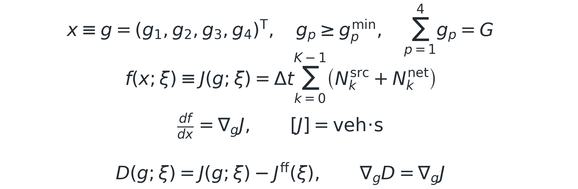
Derivative contract: what do x, f, and df/dx mean?
x
physical service fractions
f
clearance-complete total system time
df/dx
vehicle-seconds per service fraction
Nnet counts every vehicle-equivalent inside the network—moving or queued; it is not a queue-only objective.

Slide 12
V0–V4: add one causal challenge at a time
V0
exclusive lanes
macro equivalence
none
V1
shared lane
head-of-line order
+ ordered prefix
V2
finite left bay
storage + spillback
+ bay state
V3
same finite bay
order-conditioned access
+ exact access
V4
held-out family
robustness by stratum
+ scenario bank
V3 is decisive only after V0 verifies equivalence and V2 isolates storage without binding order.

Slide 13
Which literature-backed baseline enters each variant?
Variant
Required comparison
Method / engineering affinity
V0
B0–B3
Seo: differentiable LTM patterns · van de Weg/COS: signal-node equations
V1
B0–B3 + R1
Wei: turn queues · Wright: partial FIFO · individual LTM: ordered reference
V2
B0, B2, B3 + R1
Gong: multilane allocation · Liu/Wong/Gao: finite storage and blockage
V3
B0–B3 + R1/R2
Same aggregate controls · selective order · SUMO external evaluation
V4
B0–B3 + R2
Matched scenario bank · replicated SUMO seeds · optimizer kept separate
Adoption unit: equations for B0–B2; documented composition for B3; direct software reuse for SUMO.

Slide 14
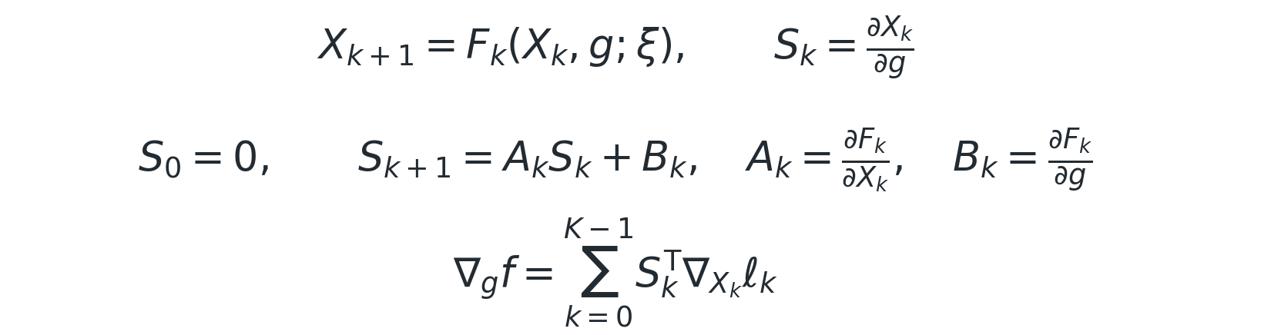
General gradient path: control → physics → time
g
cₘ(g)
yₘ,ₖ
Xₖ₊₁
Nsrc,Nnet
f
service
allocation
movement
capacity
realized
discharge
next traffic
state
system
occupancy
total system
time
Aₖ transports earlier control effects; Bₖ adds the current step’s direct control effect. Reverse-mode AD computes the same chain.

Slide 15
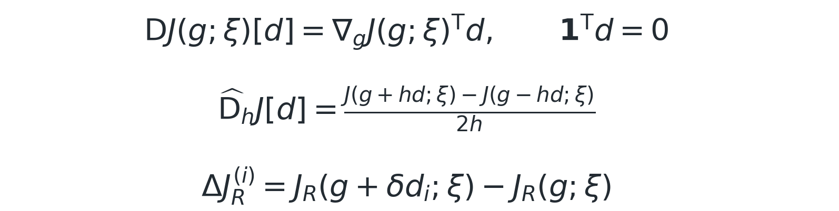
Derivative validity and usefulness are different tests
1 Internal correctness
AD ≈ central difference
2 Direction quality
sign + ranking
3 External usefulness
realized improvement in R
Differentiate continuous mass only within a stable active-set / prefix signature. Report event-boundary cases separately; do not invent derivatives through labels, permutations, or branch changes.

Slide 16
Representative V1 path: shared-lane order changes future service
g
yₖ
residual head
Eₖ₊₁
yₖ₊₁
f
service
discharge
continuous mass
eligible prefix
future discharge
system time
Fixed structural scenario
route labels · movement labels · ordering skeleton
Differentiated quantities
prefix mass · partial removal · residual mass
Aggregate-matched order pairs share totals and g, but their fixed order scenarios can produce different f and ∂f/∂g.

Slide 17
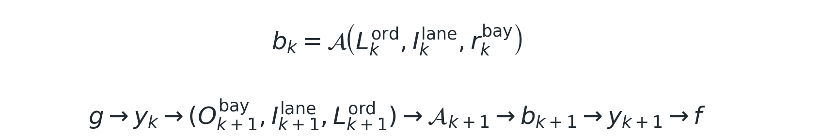
Representative V3 path: order-conditioned bay accessibility
BAY STORAGE
occupancy → receiving room
REALIZED ACCESS
which intended users reach bay
ORDERED LEDGER
continuous masses, fixed labels
B2 can share occupancy and receiving room, but lacks the exact ledger-conditioned accessibility path.
The exact Jacobian of A depends on the approved operator design and must be fixed during development.

Slide 18
Where the task review stands
DEFINED
scientific input, objective, scope
STRUCTURED
V0–V4 + matched baseline ladder
OPEN TO EVIDENCE
calibration + exact operators
Framework-level gradient chain is complete and acts as a model-design anchor.
Exact lane-allocation, storage, ordered-access, and service derivatives follow their milestone equations.
Numerical geometry, demand regimes, tolerances, seeds, and budgets are calibrated after interfaces exist—then frozen before confirmation.
The review is near its endpoint, but implementation evidence may trigger the smallest explicit refinement rather than silent adaptation.
Target conclusion remains conditional: learn where selective semantic order improves decisions—and where simpler aggregates are enough.

