Slide 1
Differentiable Minimal Mesoscopic Traffic Simulation
Weekly implementation update
M0 closure · visualizer · M1 · M2 planning | 4 September 2026

Slide 2
Contents
01
Milestone 0 closure
02
Headless visualizer and two cases
03
Milestone 1 ordered route-mass ledger
04
Milestone 2 interaction-zone planning

Slide 3
Milestone 0 closed: trusted differentiable macro backbone
Triangular FD
+ LTM links
Movement maps
+ node solver
Continuum signal
+ rollout
Objectives
+ gradient checks
Component 0.5 completed signal service; Components 0.6–0.7 closed rollout and evidence.
Continuous vehicle-equivalent mass; fixed topology and phase permissions remain structural.
Hand references → conservation/admissibility → reverse/JVP/finite-difference agreement.
Outcome: a reproducible aggregate baseline against which mesoscopic refinements can be isolated.

Slide 4
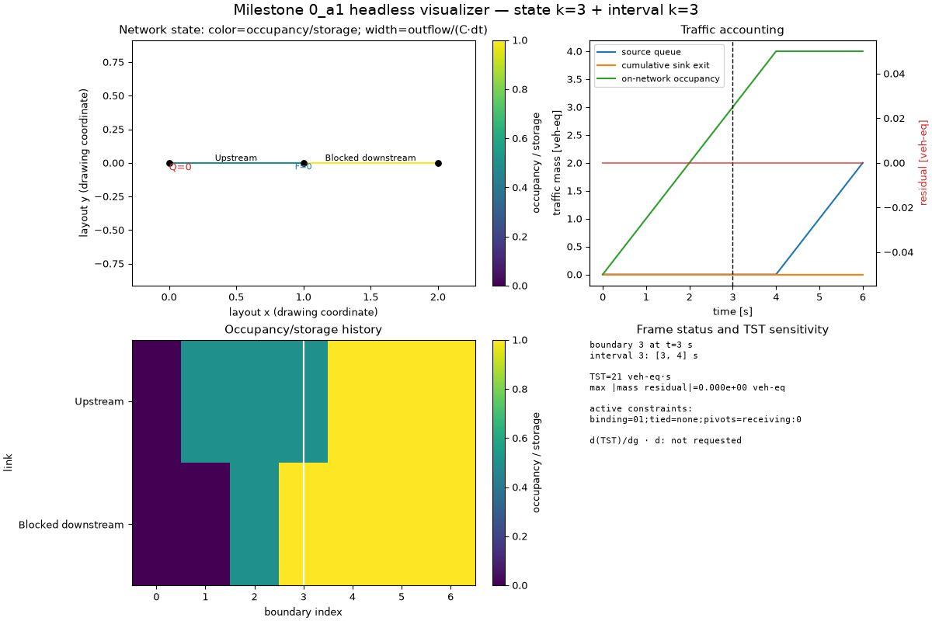
M0_a1 visualizer: make dynamics inspectable
Headless Matplotlib renderer over recorded simulator histories—not a second simulator.
Shows topology, occupancy/storage, boundary flow, queues, signal service, and conservation.
Deterministic frames and manifests support review, regression diagnosis, and presentations.
Branch-isolated optional tool: no change to the accepted M0 numerical path.

Slide 5
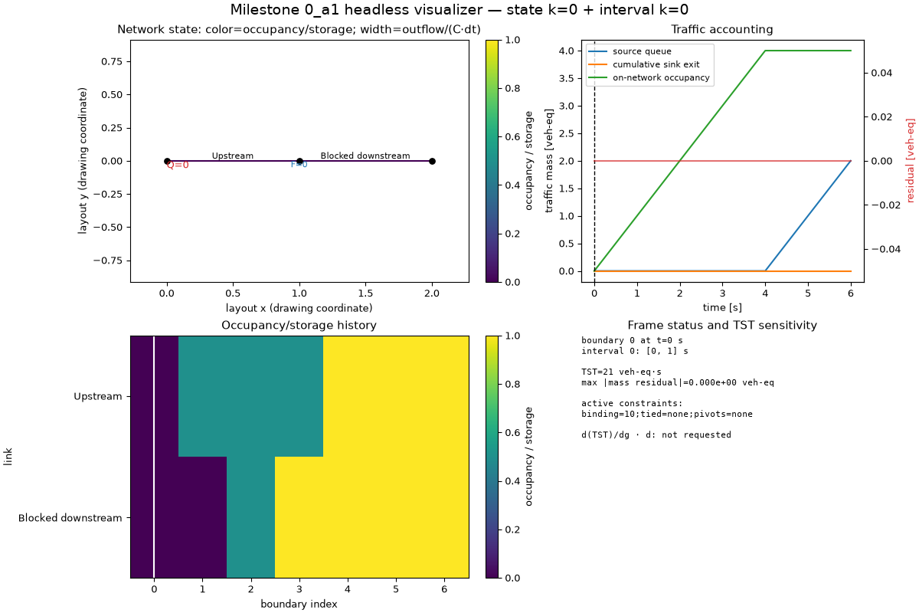
Visualizer case 1: two-link spillback chain
Embedded MP4 at ~1 frame/s; click to play in slide-show mode
Downstream storage fills first.
Receiving falls and constrains upstream inflow.
The queue propagates backward without losing mass.
6 intervals; TST = 21 veh-eq·s; residual = 0.

Slide 6
Spillback case: what the accounting proves
Arrivals
enter source accounting
Resident mass
links + source queue
Departures
enter sink accounting
Every internal boundary uses the same realized mass as upstream outflow and downstream inflow.
Storage limits receiving; rejected inflow remains upstream rather than being clipped.
Cumulative arrivals = resident mass + cumulative exits at every recorded boundary.
The animation connects the causal queue pattern to an exact zero conservation residual.

Slide 7
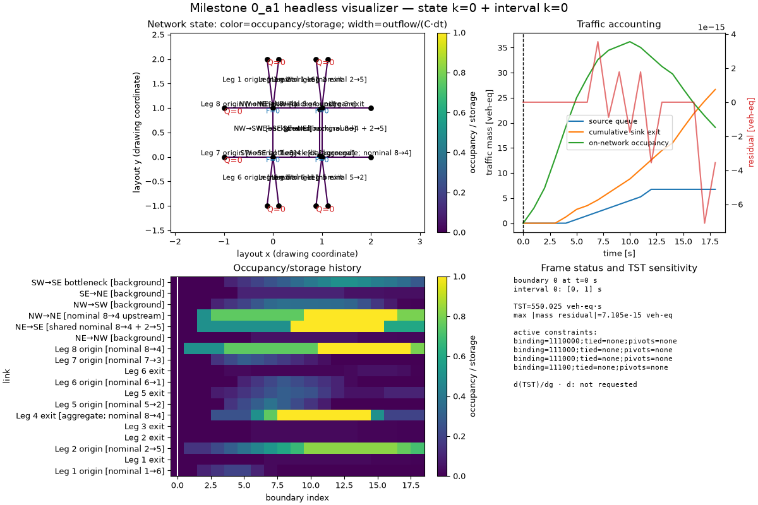
Visualizer case 2: full 2×2 network
Embedded MP4 at ~1 frame/s; click to play in slide-show mode
Four intersections share a network-wide flow history.
Selected and background routes compete through common nodes.
Signals regulate movement service and downstream occupancy.
18 intervals; TST = 550.025 veh-eq·s.

Slide 8
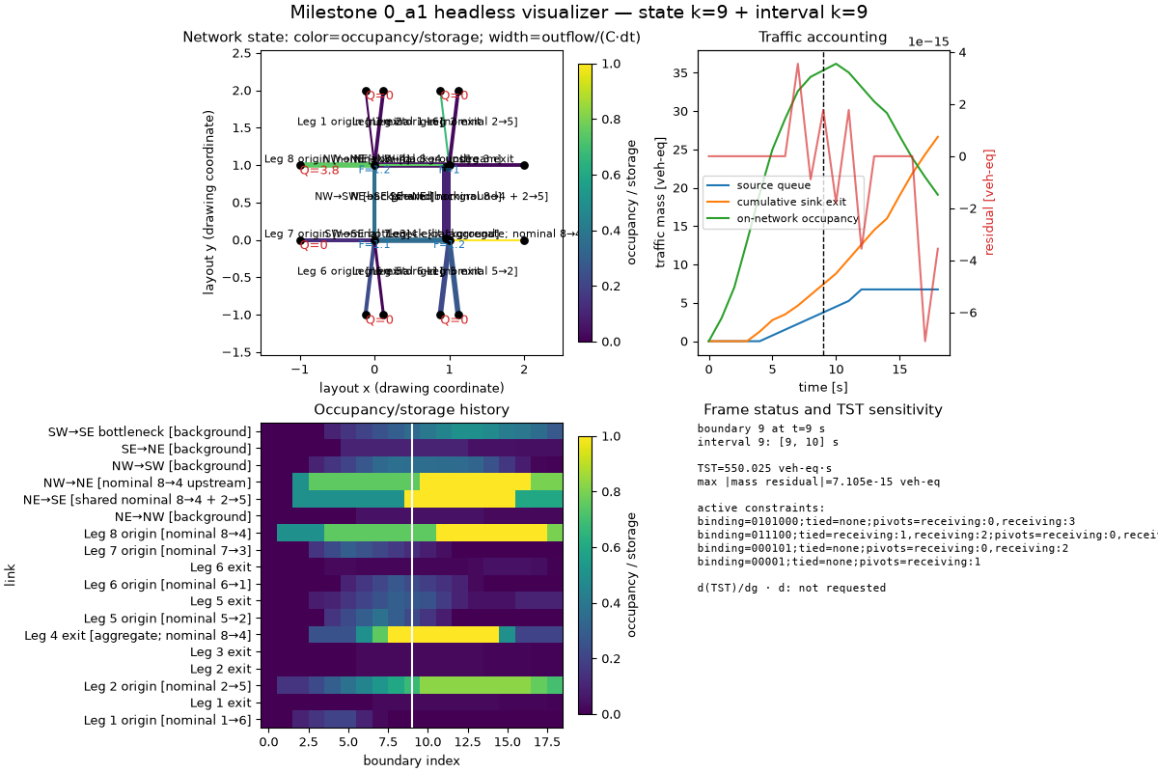
2×2 grid: network-wide traffic accounting
18 directed links are accounted consistently across sources, internal nodes, and sinks.
Each node movement is simultaneously an input-link exit and output-link entry.
Source queues retain demand rejected by entry capacity; sink totals retain completed mass.
Network identity: generated mass = source queues + link occupancy + cumulative sink exits.
Maximum recorded residual: 7.105×10⁻¹⁵ veh-eq (floating-point scale).

Slide 9
Milestone 1: why retain ordered route mass?
Macro state
continuous totals
+ ordered route ledger
continuous mass blocks
Future meso behavior
route/order-aware service
Question: retain semantic discreteness without integerizing physical vehicle flow.
Routes remain structural table references; each local entry stores route position and divisible mass.
Current movement is projected from route metadata rather than duplicated in persistent state.

Slide 10
M1 component chain and accepted interfaces
Route table
Ordered ledger
Movement
projection
Split / forward /
exact merge
Route-aware
rollout
Evidence
One exact ordered authority per location; aggregate LTM remains the physical backbone.
Continuous partial transfers split mass and interpolate eligibility time affinely.
Only adjacent entries with identical route state and continuous timing merge losslessly.
Every component closed through implementation, validation, and user checkpoint.

Slide 11
M1 case: state, notation, and time boundary
Network and routes
source 0 → link 0 ↘
link 2 → link 3 (A) / link 4 (B)
source 1 → link 1 ↗
Boundary b
complete state after interval [b−1,b)
Boundary 0 is empty; Δt = 1 s
Where mass can exist
S0/S1 = source queues
L0…L4 = link ledgers
C = completed route mass
One entry: A@p0 : 0.25 [−1.0,−0.5]
route A · position 0 · mass 0.25 veh-eq · front/tail eligibility times in seconds
Entries inside [ … ] are ordered downstream-first; the order is exact FIFO metadata.
Route table
A: L0 → L2 → L3
B: L1 → L2 → L4
p increments after each node crossing
Nodes are transactions, not storage: during an interval they transfer mass; at a boundary every pack is in S, L, or C.
When a pack enters a link, its eligibility profile is shifted by that link's 1 s free-flow delay.

Slide 12
M1 case: complete quantitative state evolution
INTERVAL [0,1) → B1
Before transfer at sources:
S0=[A 0.25(−1,−0.5), A 0.25(−0.5,0)]
S1=[B 0.50(−1,0)]
Admit all; shift +1 s; exact-merge A
B1: L0=[A@p0 0.50(1,2)]
L1=[B@p0 0.50(1,2)]
INTERVAL [1,2) → B2
New S0=[A@p0 0.125(0,1)]
New S1=[B@p0 0.125(0,1)]
Source entry capacity is zero: retain both
L0/L1 cross merge node; p0→p1
B2: S0=A0.125; S1=B0.125
L2=[A 0.50(2,3), B 0.50(2,3)]
INTERVALS [2,4) → B3/B4
Queued 0.125 packs enter L0/L1
L2 order [A,B] is preserved; no merge
Diverge projects A→L3, B→L4
B3: L0=A0.125(3,4); L1=B0.125(3,4)
L3=A0.50(3,3.5); L4=B0.50(3.5,4)
B4: C=[0.50,0.50]; L2=[A0.125,B0.125]
INTERVALS [4,6) → B5/B6
Remaining [A0.125,B0.125] diverges
B5: L3=A@p2 0.125(5,5.5)
L4=B@p2 0.125(5.5,6)
B6: all S/L ledgers empty
C=[A 0.625, B 0.625]
B7: unchanged terminal check
Closure: generated 1.25 = completed A 0.625 + B 0.625; all queues/links empty; residual = 0.
L2 keeps [A,B] and route positions: correct divergence, one exact merge, route mismatch safely not merged.

Slide 13
M1 key choices and engineering difficulty
Selective discreteness
IDs/order fixed; mass continuous
Two synchronized views
ledger authority; totals derived
Piecewise AD
check stable signatures
The hard boundary is semantic: exact lossless merge is allowed; behavioral compression is not.
Immutable tuples and differentiable tensors must preserve graphs through split/forward operations.
A corrective integration pass repaired coupling evidence without weakening scientific criteria.

Slide 14
Milestone 2: per-lane cumulative-mass interaction zone
Uₐ
aggregate upstream LTM
Zₐ
per-lane rank grid + ledger
Node
neutral M2 service seam
Physical link is partitioned once: upstream propagation plus downstream lane-local refinement.
Equal-width bins index cumulative traffic mass, not physical distance; partial final bins preserve storage.
M2 builds conservative representation/coupling; M3 owns lane allocation and FIFO/blockage behavior.

Slide 15
M2 planning: 6 global + 19 component questions
GLOBAL BACKBONE — CLOSED
2.1 GEOMETRY / TOPOLOGY
2.2 ORDERED LANE STATE
2.3 RANK GRID
G1 Physical partition + storage/delay
G2 U/Z transfer + time indexing
G3 Equal-bin tensor/cache contract
G4 Neutral node-service boundary
G5 Matched equivalence evidence
G6 Differentiability + signatures
Closed first; these constrain every
component-local decision below.
Q1 Record + reconciliation owner
Q2 Per-lane physical heterogeneity
Q3 Lane order + permission coverage
Q1 Lane-ledger record boundary
Q2 Commitment map + validation
Q3 Exact merge + fragmentation
Q1 Bin/partial-capacity schema
Q2 Edge convention + signature
Q3 Cached-grid ownership
2.4 INTERNAL PHYSICS
2.5 ROLLOUT
2.6 EVIDENCE
Q1 Lane capacity + delays
Q2 Commitment-feasible receiving
Q3 Zone eligibility representation
Q4 Storage roundoff/failure policy
Q1 Scenario/state/result histories
Q2 Refined/unrefined orchestration
Q3 Boundary conservation context
Q1 Independent scalar-oracle floor
Q2 FD/tolerance/signature schema
Q3 Artifact + provenance contract
Dependency order: 2.1 → 2.2 → 2.3 → 2.4 → 2.5 → 2.6
Phase B is resolving the interfaces before implementation.

