Slide 1

District Wheels
Dispatch Directory
Repeat orders should not mean digging through old chats.
Meta messages can be slow and laggy. I search the name taped to the car, then copy the saved details into the courier booking site.
Final presentation · PARK HERO
Notes:
Sources: README.md, docs/proposal.md, images/dcw_icon.png. The name placeholder is intentional because the repository does not provide a verified personal name.

Slide 2
Who uses it
I use it when a repeat buyer orders a car for shipping.
01
Read the buyer name on the tape on the car
02
Search that name and open the saved record
03
Check and copy the shipping details
04
Paste them into the courier booking website
Notes:
Sources: user description of the repeat-order workflow, README.md, and client/src/App.jsx. The app does not book shipments or fill courier forms automatically.

Slide 3
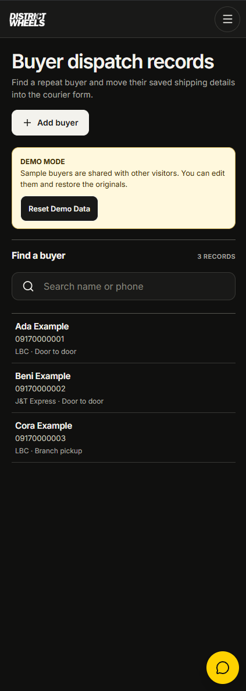
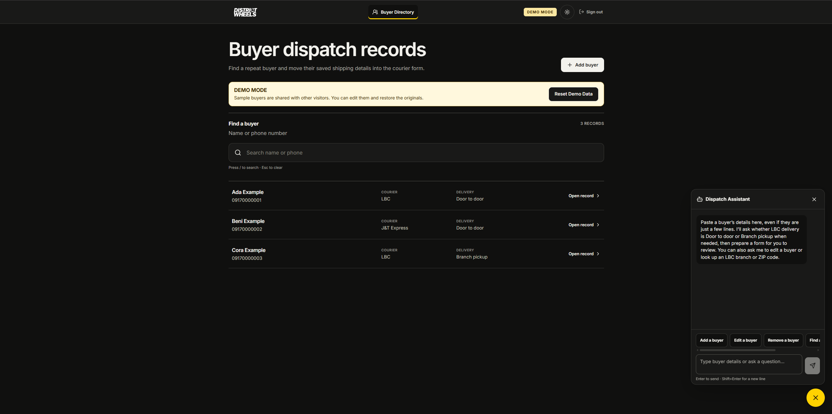
App demo
Fictional records in the deployed demo
Notes:
Source images: docs/screenshots/directory-desktop-2026-10-04.png and directory-mobile-2026-10-04.png. The names and phone numbers are fictional demo examples.

Slide 4
How the app works
The deployed browser uses Supabase directly.
Browser app
Supabase
Edge Functions
React + Vite
Hosted on Vercel
Auth + PostgreSQL
Access policies
Demo session
Dispatch Assistant
A separate Express API remains for local development and tests.
Notes:
Sources: README.md architecture and setup; client/src/lib/supabase.js; server/index.js; supabase/functions/. Express is not part of the Vercel deployment.

Slide 5
Challenges I worked through
01
Phone numbers came in different formats
I wrote the early storage and copy normalization, then tested formatted and plain numbers.
02
The assistant chose branch pickup for a door address
I reported the failing example and required the delivery choice to stay explicit. Codex changed the parser and added a test.
I built the first website and directed and tested much of the later Codex-built work.
Notes:
Sources: AI-USAGE.md; client/src/utils/phone.js; server/phone.js; test/phone.test.js; supabase/functions/dispatch-assistant/delivery-method.ts. The delivery-type correction was implemented by Codex after user feedback.

Slide 6
What I would improve next
01
Make fresh Supabase setup and demo seeding repeatable.
02
Automate checks for deployed sign-in, demo, and assistant flows.
03
Decide whether to retire the separate Express API or secure it for public use.
Notes:
Source: README.md, What I would do next. These are proposed improvements, not completed features.

