Slide 1


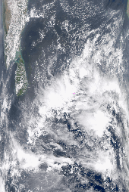
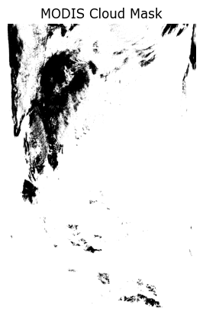
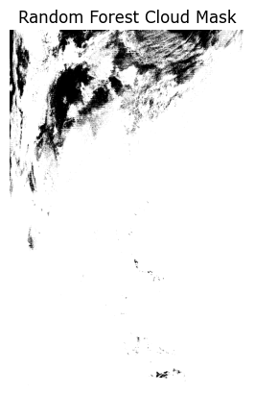
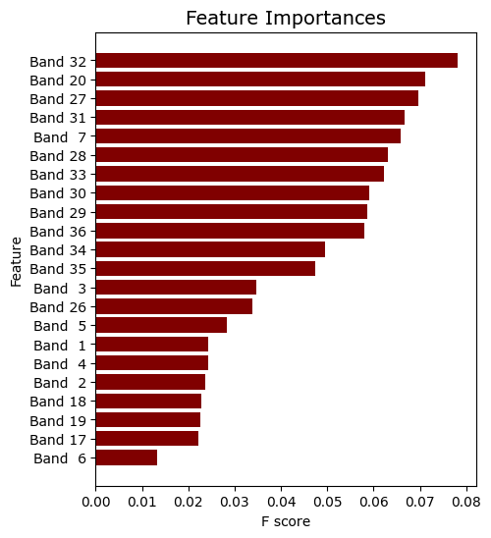
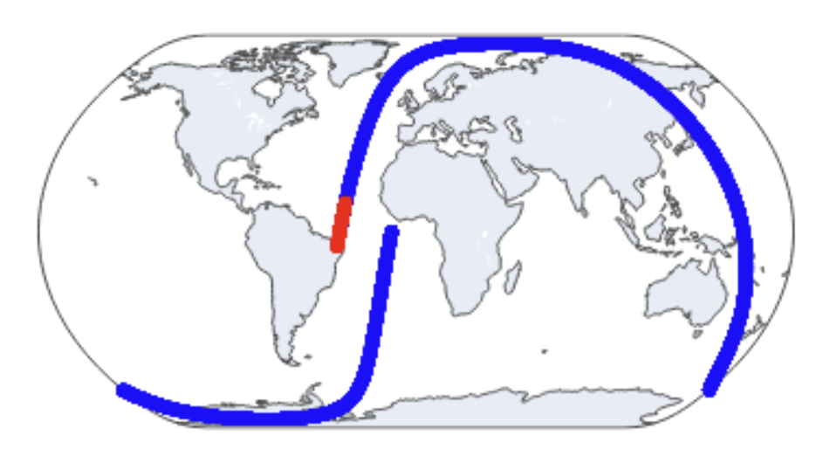
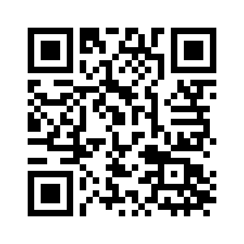
Quantum Machine Learning for Cloud Detection
Ethan Cruz^{1 (cruze6@rpi.edu)}
¹Rensselaer Polytechnic Institute, Troy, NY, United States,
Abstract
Random Forest & Artificial Neural Network Training/Analysis
Most satellite imagery requires an indicator of when a cloud covers its observation, named a “cloud mask”. NASA’s Aqua and Terra satellites use the MODIS (Moderate Resolution Imaging Spectroradiometer) sensor to develop their cloud masks. NASA uses a series of physics equations to detect and flag clouds. Unfortunately, these physics algorithms have weaknesses. It does badly at nighttime, has trouble when snow covers the ground, and is lost when the sun reflects into the satellite’s sensor (also known as sun-glint).
Compared to more specialized sensors aboard the CloudSat and CALIPSO satellites, MODIS’ cloud detection is average. Using raw MODIS data, researchers of cloud detection have turned to machine learning for better results. The Random Forest (RF) and Artificial Neural Network (ANN) approaches are popular for outpacing physics algorithms. With the introduction of quantum computing to RPI, big data problems such as satellite imaging can be trained with a Quantum Support Vector Machine (QSVM). This poster dives into quantum machine-learning methods and compares them with traditional machine-learning models.
After completing training on C-C cloud mask, the models returned promising accuracy values. The RF model achieved 92.4% accuracy on cloud/no-cloud classification while the ANN got 88.9%. To further analyze the model’s abilities, we compared it’s output against MODIS’ own cloud mask and the true color outputs from MODIS.
White Pixels = Cloudy Cloud Mask Comparison
Black Pixels = Clear MODIS dataset: MAC035S0
The difference is most notable at the top of the image. The Random Forest model has a better ability to identify thin, sparse clouds against.
Support Vector Machine & QSVM Training/Analysis
Data Selection
Support Vector Machine training would take too long using all available bands & samples. Using the RF’s Feature Importance, bands 32 and 20 were used for training. The dataset was also downsampled.
Using this smaller dataset, QSVM & SVM were trained. ANN and RF were retrained for comparison.
Two datasets were used for training.
The first dataset is the raw spectral bands available to the MAC021S0 dataset. This dataset contains MODIS observations that overlap with CloudSat-CALIPSO (C-C) observations.
The second dataset is the C-C joint cloud identification dataset, known as 2B-CLDCLASS-LIDAR. C-C cloud mask is more accurate at cloud identification than the MODIS cloud mask.
The models will learn to use MODIS observations to identify cloud mask. The C-C dataset will be used as a target variable.
 | Accuracy Downsample | Accuracy Full Dataset
Random Forest | 74.8% | 92.4%
Artificial Neural Net | 77.3% | 88.9%
Support Vector Machine | 77.4%
Quantum SVM | 74.8%
Preprocessing
MODIS and C-C data had to be co-located as the MODIS swaths were separated in 5-minute chunks while C-C was separated by each rotation around the earth.
Conclusion
Project Code [QR]
The QSVM and SVM both display competitive accuracies against the ANN and RF. Unfortunately, the downsampled QSVM took an hour and three minutes to train and predict.
The addition of quantum computing at RPI opens the door to much faster training. A fully trained QSVM, could outpace the Random Forest’s accuracy.
Additionally, new Quantum models like the Quantum Random Forest hold exciting potential. The compiled dataset included with the GitHub is prepared for these new models.
All the code for this project is available on the GitHub:
C-C
MODIS
Glossary:
MODIS (Moderate Resolution Imaging Spectroradiometer): Satellite sensor which gathers large images of the earth at multiple light wavelengths
C-C: Abbreviation for CloudSat-CALIPSO joint dataset
Aqua/Terra: Earth observation satellites with MODIS instruments on board
Qiskit: Python Library for Quantum Computing & Quantum Machine Learning, Developed by IBM
Resources:
NASA MODIS Truecolor Image Archive: https://oceancolor.gsfc.nasa.gov/cgi/browse.pl
MODIS/Aqua Calibrated Radiences 1km (MAC021S0): https://disc.gsfc.nasa.gov/datasets/MAC021S0_002/summary
CloudSat-CALIPSO Cloud Classifications (2B-CLDCLASS-LIDAR): https://www.cloudsat.cira.colostate.edu/data-products/2b-cldclass-lidar
MODIS/Aqua Cloud Classifications (MAC035S0): https://disc.gsfc.nasa.gov/datasets/MAC35S0_002/summary?keywords=mac35s0
Qiskit Library (used for modeling the Quantum Support Vector Machine): https://qiskit.github.io/ecosystem/
Scikit-Learn Library (used for modeling the Random Forest & Support Vector Machine): https://scikit-learn.org/stable/
Tensorflow Library (used for modeling the Artificial Neural Network): https://www.tensorflow.org/

