Slide 1
INTERNATIONAL FOOTBALL MATCH ANALYSIS
Exploratory Data Analysis & Executive Insights (150+ Years)
Hareesh Patel | MBA Graduate | Data Analytics Intern
Dataset Used:
• International Football Results
• Goalscorers
• Penalty Shootouts
Tools Used:
✔ Python
✔ Pandas
✔ NumPy
✔ Matplotlib
✔ Seaborn
✔ Plotly
Project Overview:
This project explores more than 150 years of international football history by analyzing team performances, tournament statistics, goal-scoring trends, host nations, and penalty shootouts. The analysis transforms historical football data into meaningful insights through statistical exploration and interactive visualizations.

Slide 2
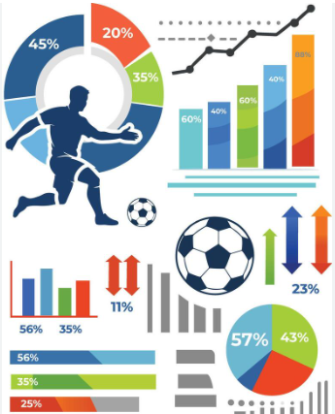
Project Objectives
•Analyze historical international football data to uncover long-term performance trends.
• Evaluate team dominance, winning efficiency, and performance consistency across international competitions.
• Identify top-performing nations, international goal scorers, and attacking efficiency
• Compare tournaments based on participation trends, goal-scoring behavior, and competitiveness.
• Assess the contribution of normal goals, penalty goals, and own goals to match outcomes.
• Examine goal differentials and scoring efficiency across teams and tournaments.
• Analyze host nation influence and the distribution of major international tournaments.
• Investigate penalty shootout success rates in high-pressure knockout competitions.
• Explore the evolution of international football through historical match and tournament analysis.
• Generate data-driven insights using statistical analysis and advanced data visualization techniques.

Slide 3
Dataset Analysis & Integration
📊 Results Dataset
Match outcomes, team performance, tournament trends, and scoring patterns.
⚽ Goalscorers Dataset
Player performance, goal contributions, and goal type analysis.
🥅 Shootouts Dataset
Penalty shootout outcomes and tournament competitiveness
🔗 Data Integration
Results + Goalscorers → Team Performance + Player Scoring Analysis
Results + Shootouts → Knockout Performance + Tournament Competitiveness
Goalscorers + Shootouts → Top Scorers in High-Pressure Matches
Key Outcome
Combining all three datasets enabled comprehensive football analytics by linking match results, player performance, and penalty shootout outcomes into a unified analytical framework.

Slide 4
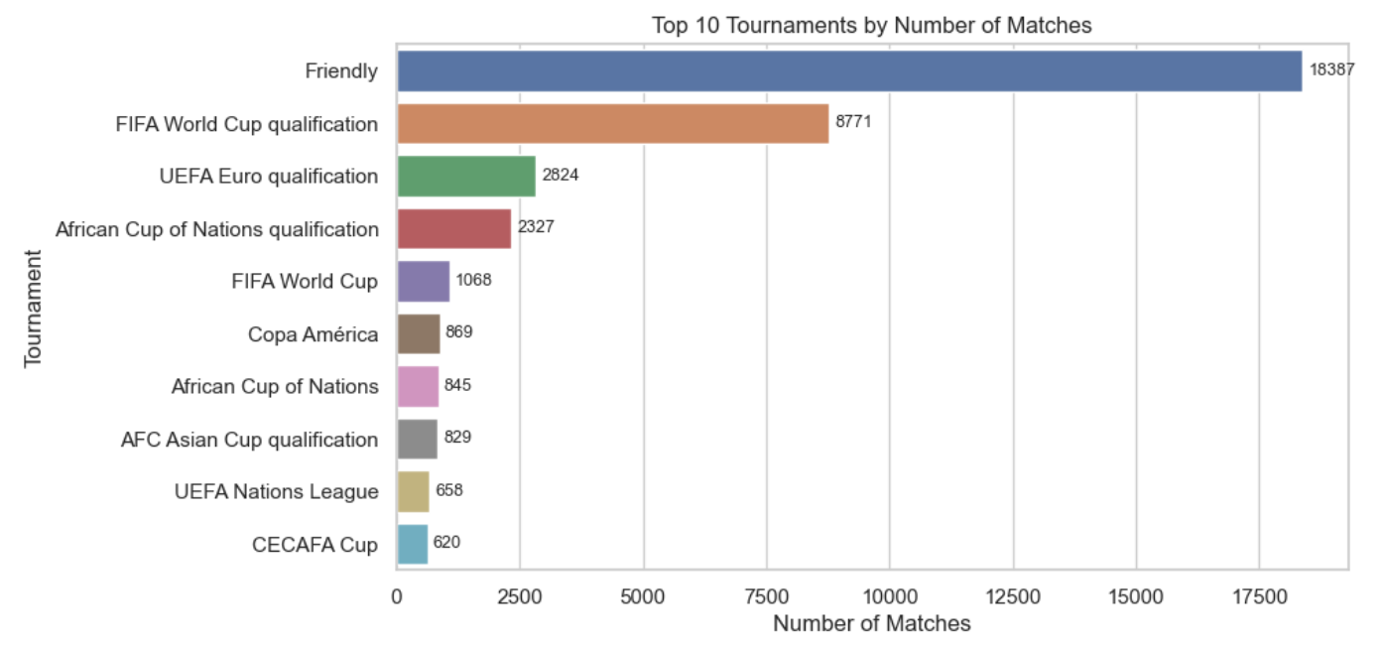
Top 10 tournaments by number of matches
Key Insights:
• Friendly matches dominate international football, accounting for the highest number of matches compared to competitive tournaments.
• Regional tournaments such as the UEFA European Championship Qualifiers and FIFA World Cup Qualifiers contribute significantly to the international match calendar due to their multi-stage qualification format.

Slide 5
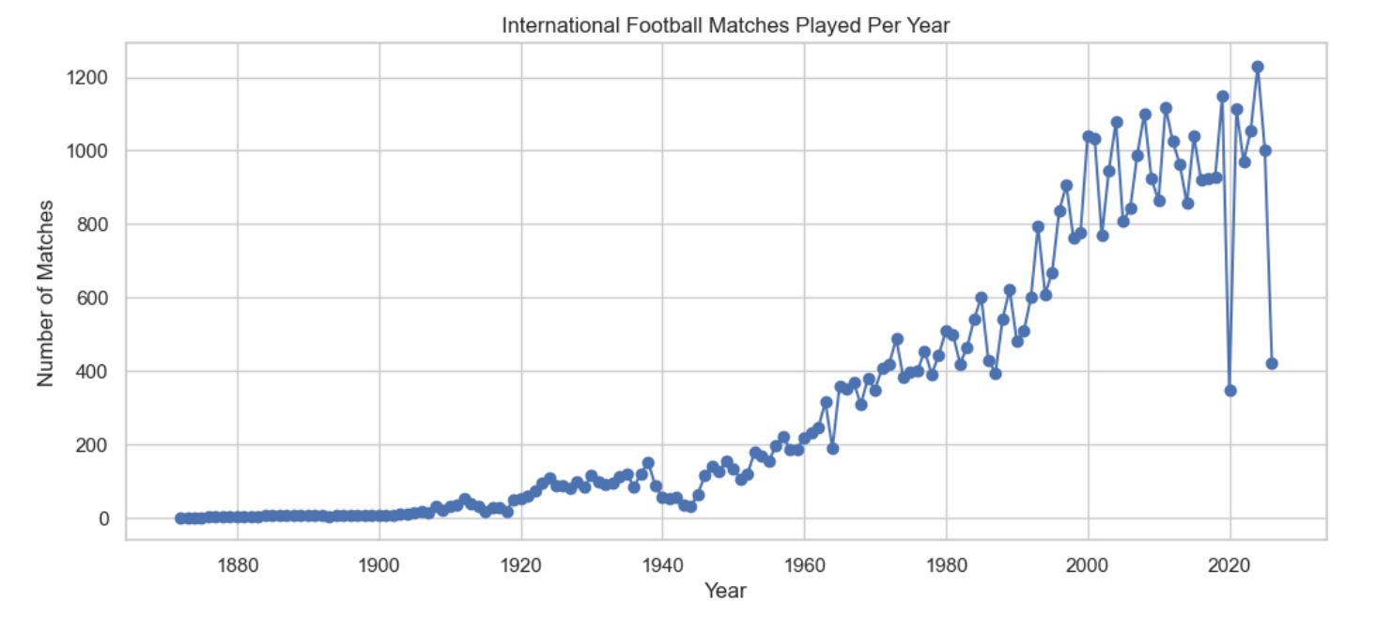
Matches Played Per Year
Key Insights:
•The number of international football matches has increased significantly over time.
•Earlier years had very few matches because international football had just begun.
•Modern football has a much higher number of matches due to more international tournaments, qualification matches, and friendly games.

Slide 6
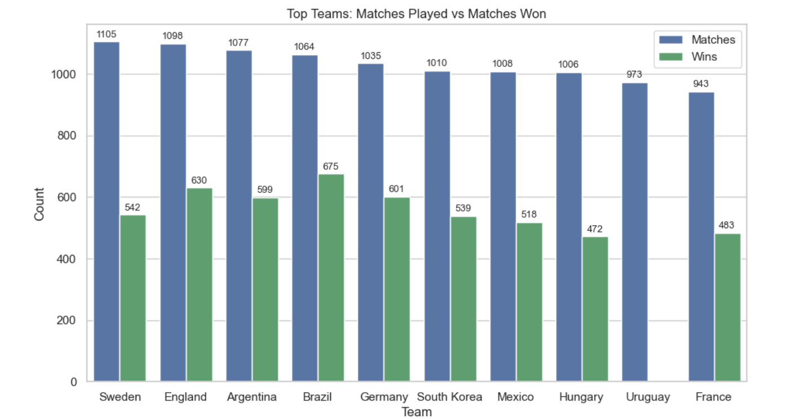
Top Teams: Matches Played vs Matches Won
Key Insights:
• Sweden has the highest number of international appearances, while Brazil has established itself as the most successful nation by recording the highest number of victories. Brazil's superior win count underscores its sustained competitive excellence on the global stage.
• Hungary and Uruguay's high appearance count but comparatively lower win total suggests that longevity alone does not guarantee sustained success at the international level
• The rankings are dominated by traditional football powerhouses from Europe and South America, while the presence of South Korea and Mexico reflects their long-term regional dominance and consistent participation in major international competitions.

Slide 7
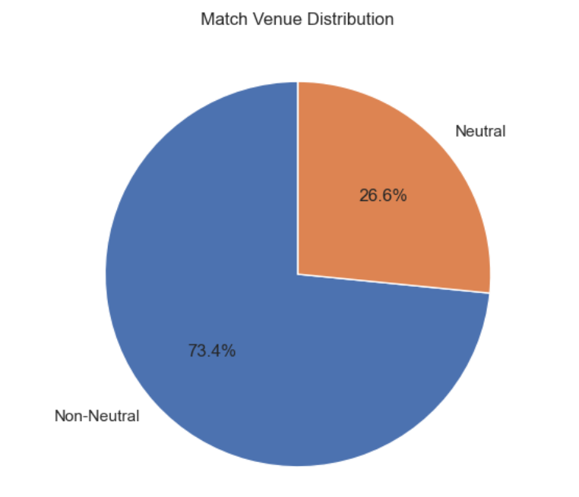
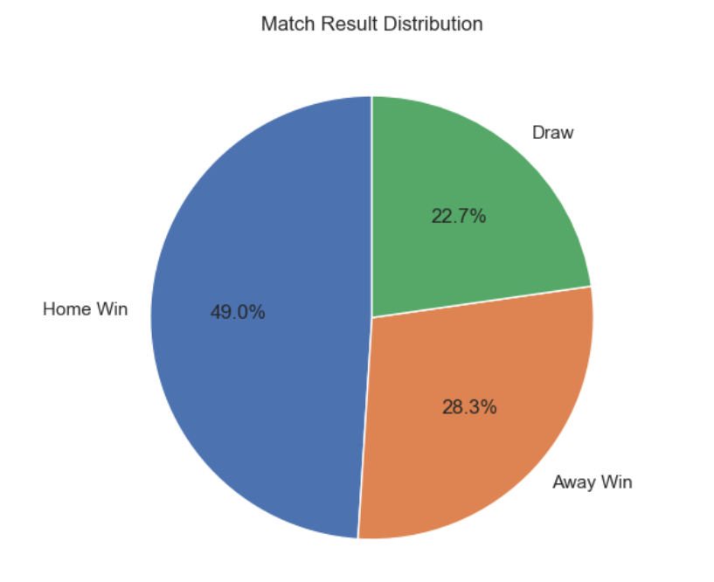
Home Wins vs Away Wins vs Draws
Neutral vs Non-Neutral Matches
Observation:
This quantifiable "home advantage" proves that match environment directly dictates competitive outcomes. Factors like pitch familiarity, the absence of travel fatigue, and intense collective crowd support structurally boost home-team attacking efficiency while forcing visitors into lower-scoring, defensive structures.
Observation:
Most international football matches are played at non-neutral venues. Neutral venues account for a smaller proportion of the total matches. This indicates that international football is predominantly played at teams home venues rather than at neutral locations.

Slide 8
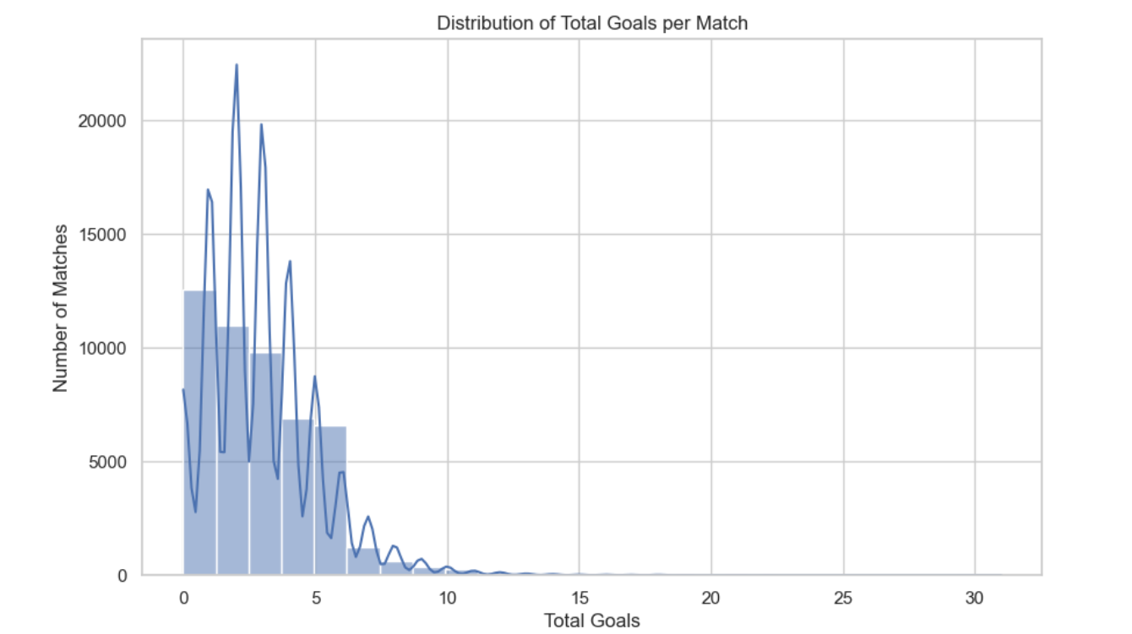
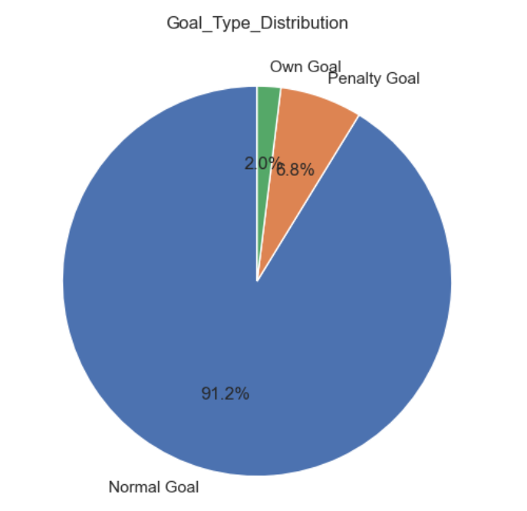
Goals per Match Distribution
Goal Type Analysis
Key Insights:
• Most international matches have between 1 and 3 total goals. The distribution is right-skewed, indicating that low-scoring matches are far more common than high-scoring ones, with extremely high-scoring matches are very rare acting as outliers.
• It shows that International football relies heavily on strict tactical discipline and defensive organization, making goals inherently difficult to score between evenly matched teams.
Observation:
This distribution proves that international football success relies primarily on open-play execution, while low penalty and own-goal counts underscore elite defenders' strict tactical restraint and technical competence.

Slide 9
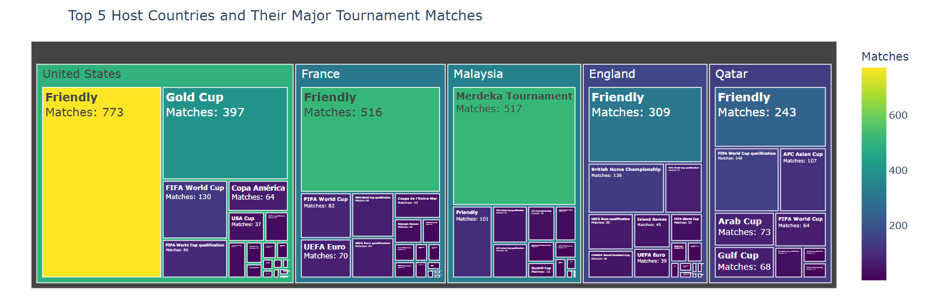
Major Tournament Distribution by Host Country
•Observation:
The United States and France show the highest concentration of hosted matches, mainly driven by Friendly fixtures, reflecting their strong international football presence and hosting capacity. Malaysia's high hosting count is largely influenced by the Merdeka Tournament, an international invitational competition that contributed significantly to its match activity.

Slide 10
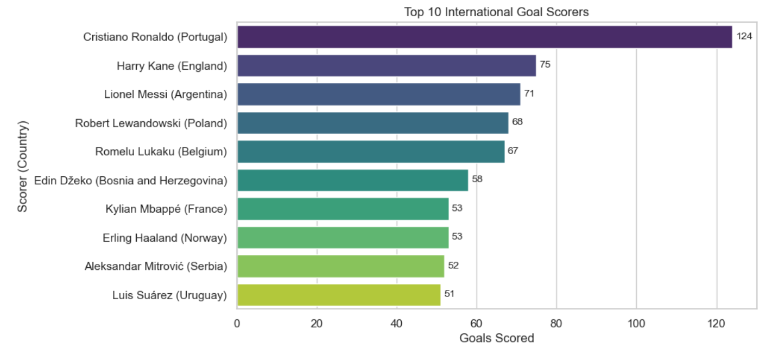
Top Goal Scorers
Key Insights:
• Cristiano Ronaldo stands in a league of his own, maintaining a remarkable 49-goal lead over the second-highest international goal scorer, highlighting his exceptional longevity and consistency.
• Lionel Messi and Harry Kane lead the chasing pack, reflecting sustained elite-level goal-scoring performances across international competitions.
• European players dominate the rankings, occupying 8 of the top 10 positions, underscoring Europe's long-standing strength and depth in international football.

Slide 11
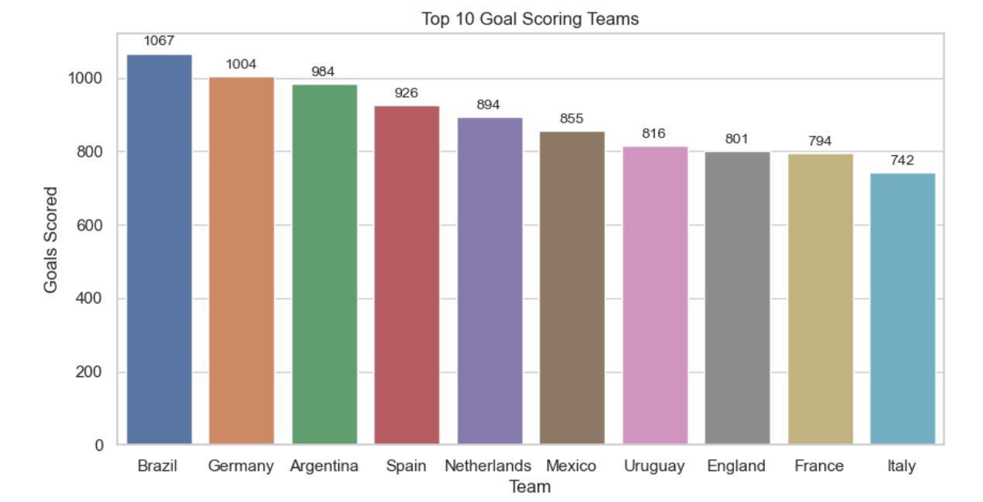
Top 10 Goal Scoring Teams
Observation:
The top-ranked teams have scored the highest number of international goals. These teams have consistently displayed strong attacking performances across different tournaments and eras. Their high goal totals reflect both frequent participation and elite offensive consistency.

Slide 12
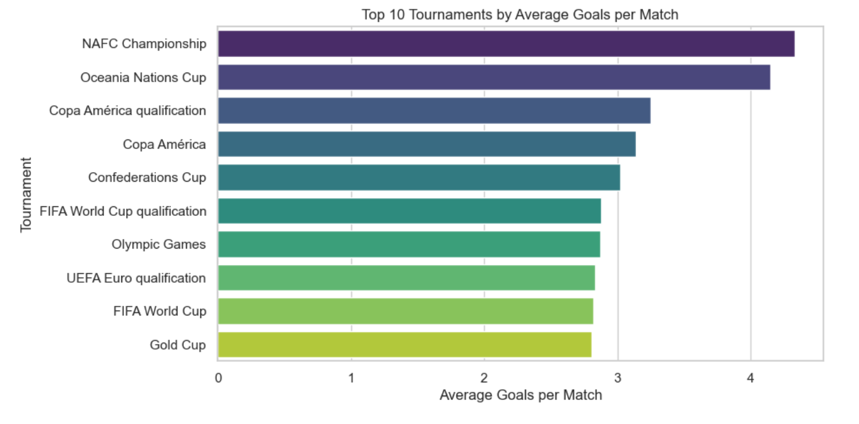
Average Goals per Match by Tournament
Observation:
Smaller regional tournaments such as NAFC Championship and Oceania Nations Cup show higher average goals per match, suggesting that high tournament goal averages are driven by a combination of small sample sizes where a few high-scoring games skew the data, stark regional skill gaps that produce massive mismatches, and loose defensive tactics that lead to highly open, attacking football.

Slide 13
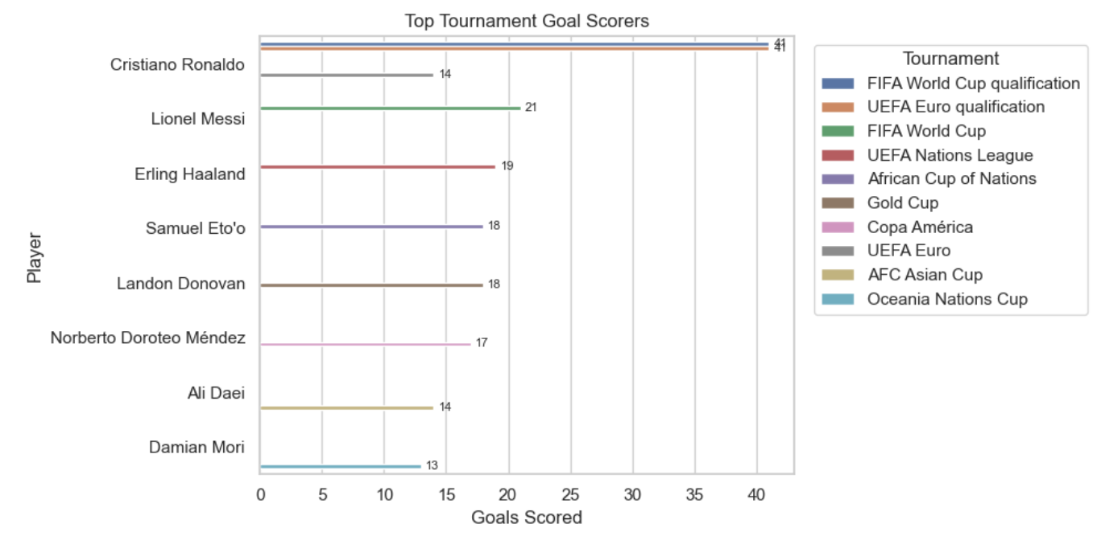
Top Goal Scorers by Tournament
Observation:
Cristiano Ronaldo dominated international football by emerging as the top scorer in both FIFA World Cup Qualification and UEFA Euro Qualification, highlighting his exceptional consistency in qualification campaigns, while Lionel Messi led the scoring charts in the FIFA World Cup, emphasizes his efficiency and clutch delivery during football's most critical knockout matches that maximizes the competitive value of his goals.

Slide 14
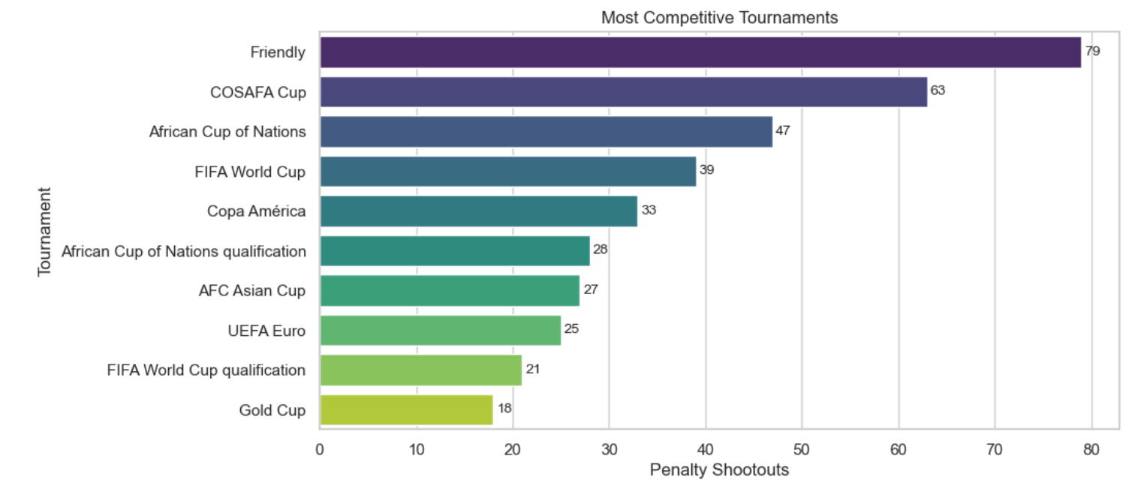
Most Competitive Tournaments
•Key Insights:
• Friendly matches (79) recorded the highest number of penalty shootouts, primarily due to their large match volume, as observed in the results dataset.
• Regional competitions such as the COSAFA Cup (63) also witnessed frequent shootouts, reflecting closely contested matches and tournament formats that often proceed directly to penalties.
• Major international tournaments, including the African Cup of Nations (47), FIFA World Cup (39), Copa América (33), and UEFA Euro (25), regularly reached penalty shootouts, highlighting the intense competition and narrow margins in knockout-stage football.

Slide 15
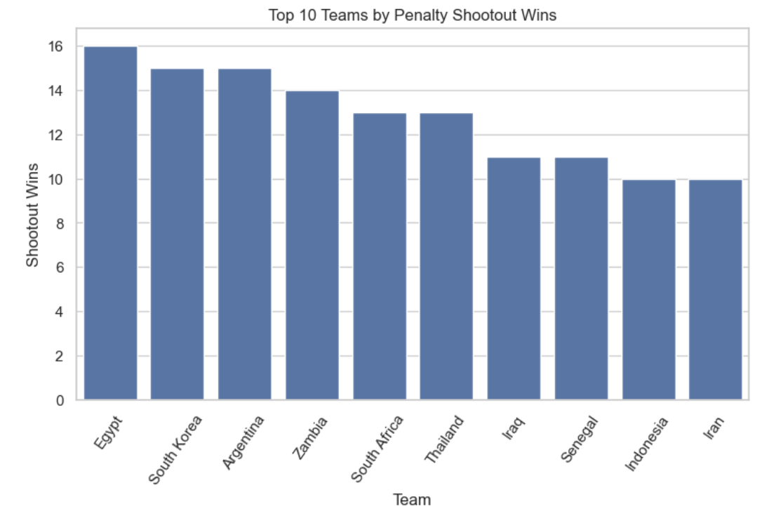
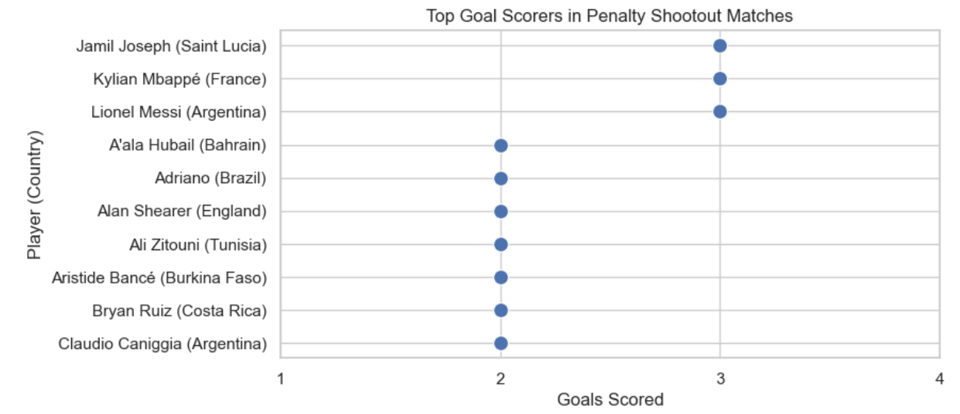
Top Shootout Winners
Top Goal Scorers in Penalty Shootout Matches
Key Insights:
• The low goal counts indicate that penalty shootout matches are generally tightly contested, with most players scoring only 2–3 goals across such high-pressure encounters
• Jamil Joseph, Lionel Messi, and Kylian Mbappe jointly top the list with three goals each, demonstrating the importance of key attacking players inclosely contested matches that eventually extend to penalty shootouts.
Observation:
Egypt leads the ranking with the highest penalty shootout victories, while South Korea and Argentina also demonstrate remarkable consistency in high-pressure knockout matches, reflecting strong composure during decisive moments..

Slide 16
Future Scope & Advanced Analytics
Conclusion
• Integrate FIFA Rankings, Elo Ratings, and player market values for advanced performance evaluation.
• Build machine learning models to predict match outcomes and penalty shootout success.
• Analyze home advantage, venue effects, and environmental factors influencing team performance.
• Incorporate advanced metrics such as Expected Goals (xG), possession, and passing accuracy for tactical analysis.
• Create interactive dashboards for real-time exploration of teams, tournaments, and player statistics.
• Develop a Composite Football Performance Index to rank teams using offensive, defensive, and competitive performance metrics.
• Analyzed international football data to uncover key match and tournament trends.
• Identified top-performing teams based on winning efficiency and scoring consistency.
• Evaluated tournament participation, host nations, and match outcome patterns.
• Assessed penalty shootout performance and tournament competitiveness.
• Integrated multiple datasets to generate deeper football performance insights.
• Demonstrated the value of EDA and visualization in sports analytics.

