Slide 1
Project-2
Zipf distribution & Edit distance
張信雄

Slide 2
Project-2
Parse Txt file
Sentence, word, char
根據 word number and word ASCII 來排序
作 Porter's algorithm, 再根據 word number and word ASCII 來排序
最後再做 Edit distance, 依據distance 由最小排到最大

Slide 3
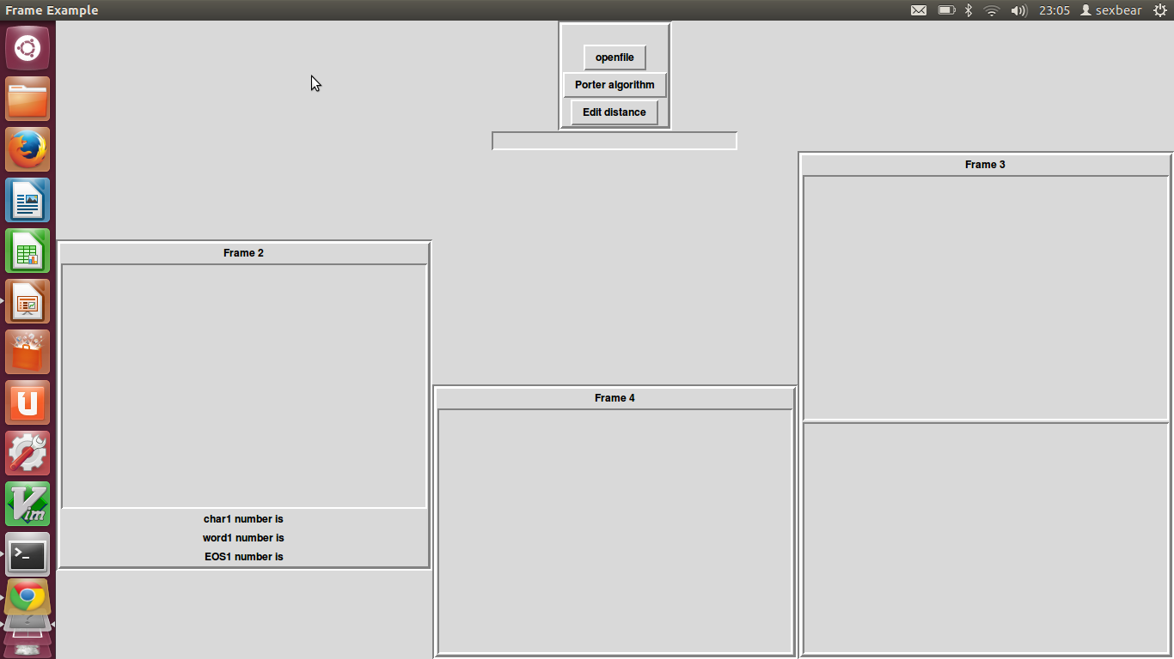

Slide 4
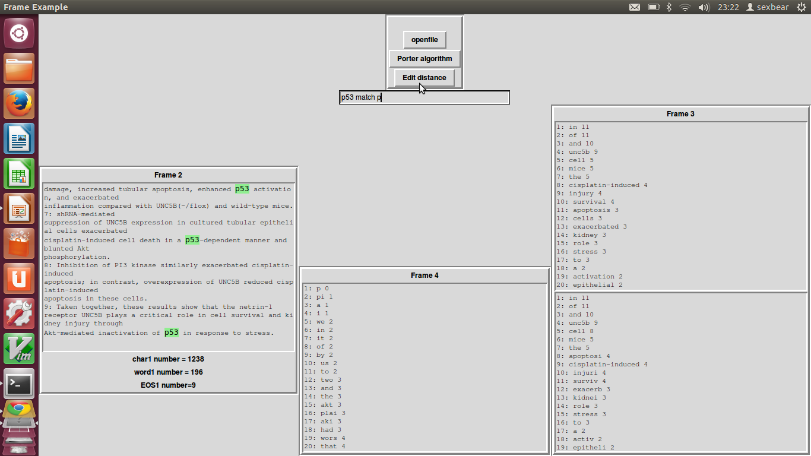

Slide 5
