Slide 1
Concurrency Control
1. Interference
Even if all transactions are individually correct, it is still possible in a shared (multiuser) system that interference on the concurrently executed transactions can cause an overall incorrect result.
Types of Concurrency:
Interleaved concurrency: in a uni-CPU environment
(we focus on this)
Simultaneous concurrency: in a multi-CPU
environment (can in general be extended from
interleaved concurrency))

Slide 2
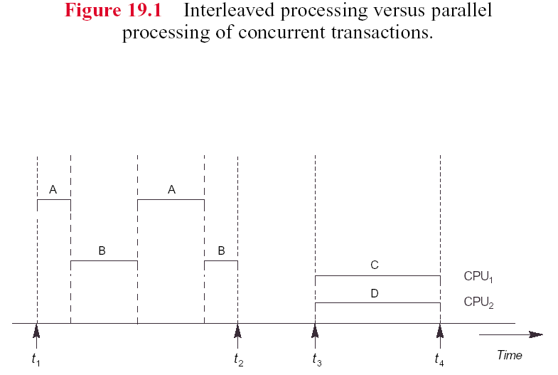

Slide 3
Why Concurrency Control Is Needed
The Lost Update Problem
The Temporary Update Problem
The Incorrect Summary Problem

Slide 4
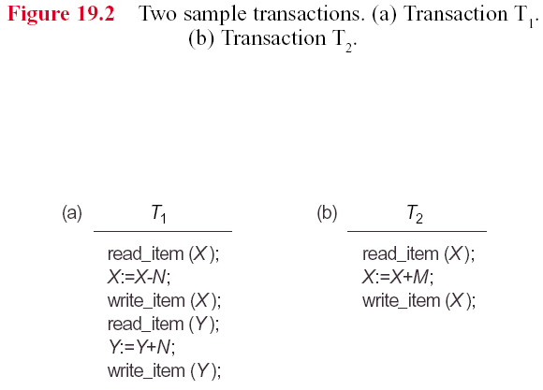

Slide 5
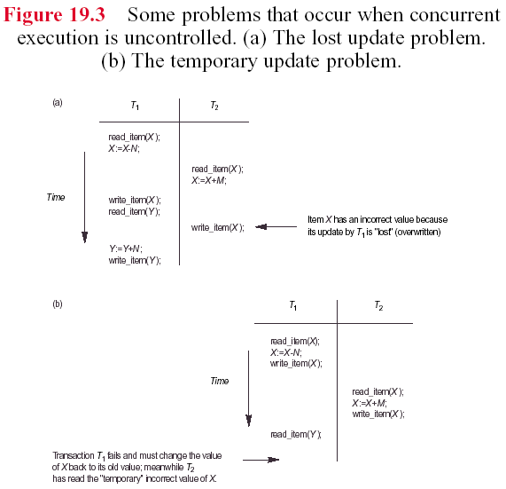

Slide 6
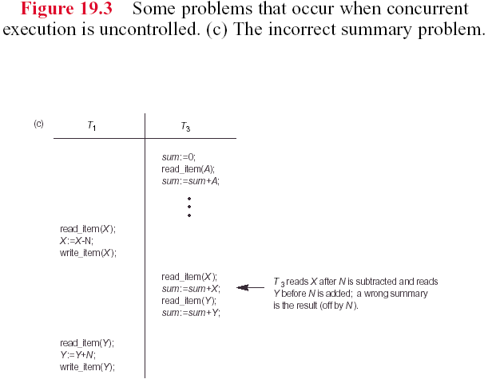

Slide 7
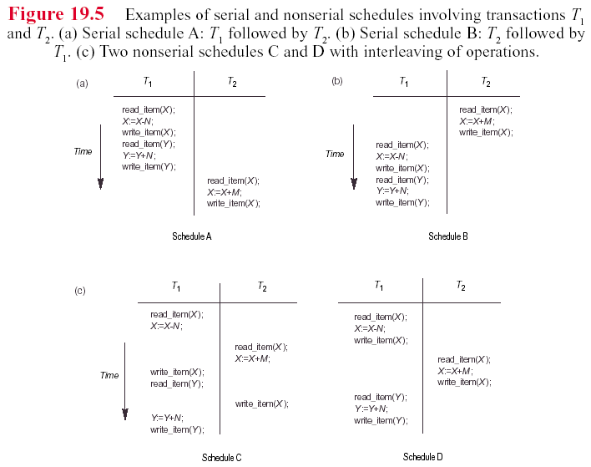
Transaction Execution Schedules

Slide 8
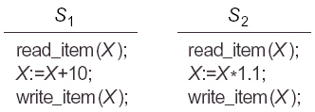
Equivalence of Schedules
Result equivalence
Equivalent schedules (This is what we concern. See the next slide)

Slide 9
Equivalent schedules
Two schedules S1 and S2 in which exactly the same transactions T1, T2, ..., Tn participate are equivalent if:
For each read_item(X) operation executed by transaction Ti in S1, if the value of X read by this operation was last written by a write_item(X) operation executed by transaction Tj in S1, then the same read_item(X) operation of Ti in S2 must read the value of X written by the same write_item(X) operation of Tj in S2.
For each item X on which a write_item(X) operation is applied in the schedules, if the final write_item(X) in schedule S1 is executed by transaction Ti, then the final write_item(X) in schedule S2 must be the same write_item(X) operation executed by Ti.

Slide 10
Condition #1:
S1 S2
Wj(y)
Wi(x) …….
…… Wi(x)
Wj(y) …….
……. Wn(z)
Wm(x) Wm(x)
……. Rp(x)
Wn(z) …….
……..
Rp(x)

Slide 11
Condition #2: Both are good.
S1 S2 S1 S2
Wi(x) …… Wi(x) Wh(y)
……. Wh(r) ……. Wj(x)
Wj(y) Wj(y) Wh(y) …….
……. …… Wj(x) Wi(x)
Wk(z) Wk(z) ……. Wk(x)
……. …… Wk(x) .……
Wh(r) Wi(x) Rm(x) Rm(x)
EndOfS EndOfS EndOfS EndOfS

Slide 12
Discussions of this Definition
Spirit of the definition: Every read operation in S2 must read the same value as the corresponding read operation in S1. AND, the last value written into the database for every item should be the same for both schedules.
Why the definition only considers the case write(X) in Tj followed by a read(X) in Ti, but not the case read(x) in Tj followed by a write(X) in Ti?
Why the definition does not consider the case of several writes executed consecutively in a schedule (i.e., write(X) followed by another write(X))?
  T1: write(X)
  T2: write(X)
  T3: write(X)

Slide 13
Serializability
Serializability: A schedule S of n transactions is serializable if it is equivalent to some serial schedule of the same n transactions.
For example in Figure 19.5:
  Schedule D is equivalent to A. So, D is serializable.
  Schedule C is neither equivalent to A nor to B. So, C is not serializable.

Slide 14
Explanation of correctness of Serializability
若我有一萬元在帳戶，T1 是我要把它提出來；T2是銀行算本月分我的利息。(假設我提錢的時候，銀行也正在計算本月分利息)
若 T1-then-T2, 結果 = 10,000.
若 T2-then-T1, 結果 = 10,000 + interest.
二者 result 雖然不相等，但都是 correct results.

Slide 15
Testing for serializability of a schedule
Construct a precedence graph:
  for each Ti, create a node;
  If Wi(X) is followed by Rj(X),
  then create an edge Ti --->Tj;
  (不必 immediately follow, 若 Wi(X) 之後，跟著 Rj(X)，Rk(X), Rm(X), 則從Ti 到 Tj, Tk, Tm 也是一樣要 create such an edge)
  If Ri(X) is followed by Wj(X), (同上面)
  then create an edge Ti --->Tj;
  4. Schedule S is serializable if and only if the precedence graph has no cycles; /* 即使不同variables造成的cycle也不行 */

Slide 16
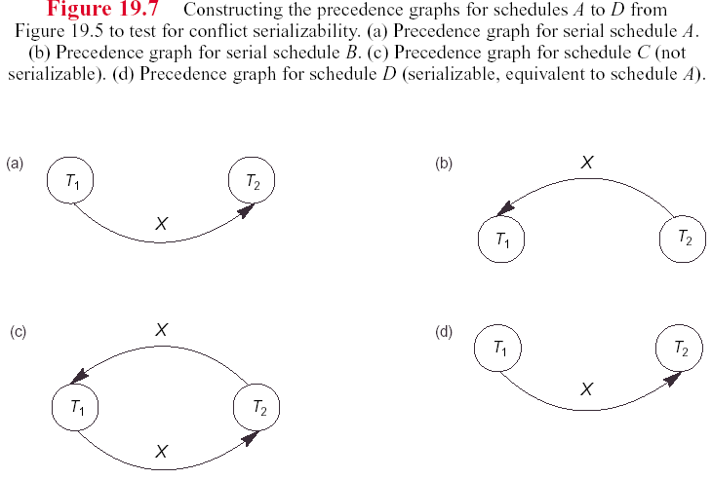

Slide 17
Discussion
  This algorithm is used to test for serializability, but not for schedule equivalence.
  Two schedules having identical precedence graph (even if there is no cycle in the graph) are not necessarily equal. Why?
    since the different sequences r(X)->w(X) and w(x)-> r(X) are mapped to the same precedence graph.
  Why no cycle in a precedence graph indicates serializable schedule?
    since an acyclic graph (tree or lattice) can always find a toplogical sort order of the nodes in the graph. The transaction executed in this order is serial.

Slide 18
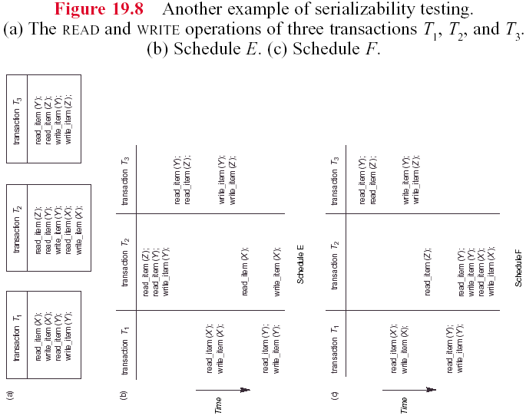

Slide 19

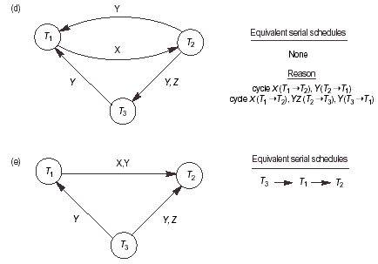
Fig.19.8(b)
的 schedule
Fig.19.8(c)
的 schedule

Slide 20
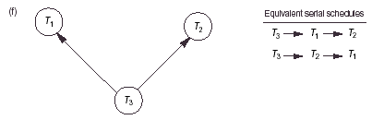
Figure 19.8(d): Since a cycle exists, it is not a serializable schedule.
Figure 19.8(e): Since no cycle exists, it is a serializable schedule.
Also, there happens to exist one equivalent serial
schedule for this example.
But in general a serializable schedule may have more than one
equivalent serial schedule, such as the following one.

Slide 21
Problem of Seriralizability
  In practice, we cannot test a schedule in advance, since the execution is determined by the OS time-sharing scheme, the time instants that transactions are issued to the system, and so on.
  Neither can we let the transactions executed first and then test for serializability, since we must cancel the effect of the schedule if it turns out not to be serializable.
  ➔ Concurrency control protocols are required to resolve this problem.

Slide 22
How to Solve the Problem?
Locking techniques for concurrency control
  binary lock: two modes for each data item X: lock(X) or unlock(X);
  multiple-mode lock: for each data item, we can have
  read_lock(X): shared lock
  write_lock(X): exclusive lock
  unlock(X)
  Using binary locks or multiple-mode locks does not guarantee serializability
  (if a lock releases too early, it still causes lost or temporary update problem).

Slide 23
Two-Phase Locking Protocol
Guaranteeing serializability by two-phase locking
  Growing phase: new locks on items can be acquired but none can be released;
  Shrinking phase:existing locks can be released by no new locks can be acquired.

Slide 24
Discussion of two-phase locking protocol
  If every transaction in a schedule follows the two-phase locking protocol, then the schedule is guaranteed to be serializable.
  Rationale behind two-phase locking protocol:
  conflict transactions: executed serially
  non-conflict transactions: executed concurrently

Slide 25
  Two-phase locking is a sufficient condition for guaranteeing serializability, but not a necessary condition.
  Transaction A Transaction B
  (H = F +1) (F = G + 1)
  read_lock(F)
  copy F to ATEMP
  unlock(F)
  read_lock(G)
  copy G to BTEMP
  write_lock(F)
  F = BTEMP + 1
  write(F)
  COMMIT
  write_lock(H) <== violates 2PL (上面unlock之後，不可再lock data)
  H = ATEMP + 1
  write(H)
  COMMIT
  Discussion: Initially, H=F=G=0. If A-then-B, (F,G,H) = (1,0,1).
  If B-then-A, (F,G,H) = (1,0,2).
  Although this execution does not satisfy 2PL, it is serializable.
  Try: The same execution as the above one, except that F=H+1 is
  replaced by F=H+1.

Slide 26
Deadlock and Livelock
  Two-phase locking protocol may result in deadlock and livelock problem.
    deadlock: detected by wait-for graph or simply time out to avoid deadlock.
      breaking a deadlock: have to choose a victim
      victim candidate:
        the one holding the fewest locks,
        the one having fewest updates,
        the youngest transaction,
        etc.
      aborted transaction will:
        undo all its updates
        release all locks made by that transaction

Slide 27
Deadlock/Livelock Avoidance
    to avoid deadlock:
      wait-die: Ti waits if Ti is older, otherwise Ti dies,
      wound-wait: Ti wounds (kills) Tj if Ti is older (more aggressive), otherwise Ti waits.
    to avoid livelock: can be resolved by using first-come-first-serve method.

Slide 28
Time-stamping protocol
Each transaction is assigned a unique timestamp (can be a transaction start-time)
No locks are used ==> need not to worry about deadlock problem.
Conflicts are resolved by restarting one of the two transactions.
A new timestamp is assigned to the restarted transaction.
Protocol:
  RMAX: timestamp of the youngest transaction that has successfully executed
  a read(X) operation,
  WMAX: timestamp of the youngest transaction that has successfully executed
  a write(X) operation,
  TS(T): timestamp of T
  read(X):
  if TS(T) >= WMAX
    then /* accept the operation */
    RMAX = MAX(TS(T), RMAX)
    else /* conflict */
    restart T;
    write(X):
    if TS(T) >= RMAX and TS(T) >= WMAX
    then /* accept the operation */
    WMAX = TS(T)
    else /* conflict */
    restart T;

Slide 29
Discussion of timestamping protocol
  Transaction A Transaction B
  read(X) t1
  t2 read(X)
  write(X) t3
  t4 write(X)
  Assume: A is younger than B (TS(A) > TS(B))
  at t1: RMAX=TS(A)
  at t2: RMAX=MAX(TS(B),TS(A))=TS(A)
  at t3: WMAX=TS(A)
  at t4: violate TS(B) >= RMAX(=TS(A)), so restart B!
  Test for another case: TS(A) < TS(B)

Slide 30
  Younger transaction has higher priority to read and write a record. Why not giving older transaction a higher priority?
  Livelock still can occur: assume TS(A) < TS(B)
  Cascading rollback:
  Transaction A Transaction B
  read(X) t1
  write(X) t2
  t3 read(X)
  t4 write(X)
  read(X) t5
  write(X) t6
  If the transaction A does not have the second read(X) and write(X), then there is no problem. For this case, however, A will be aborted (run the algorithm), resulting in a cascading rollback for B.

Slide 31
Optimistic concurrency control
  All the previous methods require to check something (e.g., locks or timestamps); checking represents overhead.
  Optimistic concurrency control protocol avoids checking during the execution.
  Protocol:
    read phase: A transaction can read values of data items from DB. But updates are applied only to local copies of the data items kept in the transaction workspace.
    validation phase: checking on serializability.
    write phase: updates are applied to DB if the second step succeeds. Otherwise, discard results and restart all transaction.
  Idea: To do all the checks all together; hence, transaction execution proceeds with a minimum of overhead until the validation phase is reached.
  Advantage: If there is little interference among transaction, most transaction will be validated successfully.
  Disadv: If there is much interference, then many transactions will waste time in execution and rollback.

Slide 32
Locking granularity
File
Page, cylinder, track, segment, ...
Record
attribute

