Slide 1
NOC WHISPERER
Real-time multi-agent alert correlation for distributed infrastructure
H2M Agents | May 30, 2026

Slide 2
The NOC Alert Flood Problem
OpenTelemetry is an open-source observability framework that instruments applications and emits metrics, traces, and logs — the signals this system monitors in real time.
A single infrastructure failure cascades across 7+ services — each generating its own alert
L1 operators manually correlate dozens of noisy alerts
Root cause identification takes 15–30 minutes
Alert fatigue leads to missed signals
Can a multi-agent AI system correlate alerts in real time, identify root cause, and generate actionable advisories — automatically?

Slide 3
System Context
What flows in, what flows out, and who is outside the system boundary
MONITORED INFRASTRUCTURE
NOC WHISPERER
NOC OPERATORS
OTel Demo Stack
applications + services
metrics & threshold alerts
Multi-Agent Alert Correlation System
NOC Team
on-call engineers
NOC Advisory
NormalizerAgent LLM
Incident Board
Prometheus
metrics + thresholds
distributed traces
TriageAgent rule-based
SERVICE RESTORED
Jaeger
distributed traces
host metrics
CorrelationAgent DSPy
Node Exporter
host-level metrics
CommunicationsAgent LLM
ADK LlmAgent Orchestrator — 15s cycle
System ingests observability signals autonomously — operators receive correlated advisories, not raw alerts

Slide 4
System Architecture
DATA SOURCES
MCP TOOL LAYER
AGENT PIPELINE
NOC DASHBOARD
Prometheus
PrometheusMCP
NormalizerAgent
LLM fine-tuned
RAW ALERT STREAM
Jaeger
JaegerMCP
TriageAgent
rule-based
INCIDENT BOARD
Node Exporter
TopologyMCP
CorrelationAgent
LLM DSPy
NOC ADVISORY
OTel Demo Stack
NodeExporterMCP
CommunicationsAgent
LLM fine-tuned
SQLite IncidentStore
Jaeger / NodeExporter MCPs in codebase; not wired into ADK demo loop

Slide 5
Two Layers of Tools
LAYER 1 — ADK FunctionTools
LAYER 2 — MCP Tool Classes
get_active_alerts()
normalize_alert()
PrometheusMCP
→
Prometheus HTTP API
route_alert()
correlate_alert()
JaegerMCP
→
Jaeger trace API
generate_advisory()
check_open_incidents()
calls
check_service_health()
close_incident()
TopologyMCP
→
otel_demo_graph.json
NodeExporterMCP
→
Node Exporter metrics
The agent reasons about tools. The tools handle infrastructure.

Slide 6
From Raw Alert to NOC Advisory — 6 Steps
①
get_active_alerts()
②
normalize_alert()
Pull threshold breaches from Prometheus MCP
Raw metric → canonical CanonicalAlert
③
route_alert()
④
correlate_alert()
Rule-based topology + temporal proximity → new or append
DSPy LLM reasons over alert cluster + topology → root cause + confidence
⑤
generate_advisory()
⑥
check_service_health()
Fine-tuned model writes NOC advisory (preliminary → confirmed → resolution)
Prometheus confirms recovery → close_incident() → SERVICE RESTORED
Cycle time: 15s | CONFIRMED when confidence > 0.85 AND alert_count ≥ 2

Slide 7
Three LLM-Powered Agents
BASE MODEL: Qwen2.5-7B-Instruct | LoRA adapters ~10MB each
Agent | Training | Loss | Accuracy | Notes
NormalizerAgent | SFT 200 ex. | 0.541 | 80.9%
CommunicationsAgent | SFT 80+RLVR | 0.250 | 94.2%
CorrelationAgent | DSPy optimized | — | 96.7%*
* Rule-based baseline 100% same eval. LLM advantage: confidence calibration + advisory generation.
⚠ DISCOVERY: Reward Hacking in Communications RLVR
Symptom: Model repeated boilerplate
Root cause: No repetition penalty
Fix: advisory_reward() unique-line ratio + length tier penalties
Result: Stable output; 94.2% accuracy preserved

Slide 8
CorrelationAgent — DSPy Optimized
The decision engine behind every CONFIRMED advisory
What DSPy does
A compiler for LLM programs — not supervised fine-tuning. DSPy optimizes prompts and few-shot examples automatically against a scoring metric.
96.7%
correlation accuracy
Rule-based baseline: 100% same eval
Program structure
Signature: alerts + topology → root_cause + confidence Module: ChainOfThought Optimizer: BootstrapFewShot Metric: confidence calibration score
Why confidence matters
< 0.85 → PRELIMINARY advisory
≥ 0.85 + count≥2 → CONFIRMED advisory
health True → close_incident()
Optimized against
Labeled alert clusters with known root causes. Metric rewards high confidence on true positives.
Why not fine-tune?
Correlation requires reasoning over dynamic alert clusters. DSPy generalizes better than SFT.

Slide 9
The Agentic Loop
ADK LlmAgent orchestrates 6 steps every 15 seconds
ADK LlmAgent — Orchestrator
Conductor: reads world state, sequences tool calls, decides when to act
① get_active_alerts()
PrometheusMCP
rule-based
② normalize_alert()
NormalizerAgent
LLM fine-tuned
③ route_alert()
TriageAgent
rule-based
④ correlate_alert()
CorrelationAgent
DSPy optimized
⑤ generate_advisory()
CommunicationsAgent
LLM fine-tuned
⑥ health check + close
Prometheus + Comms
rule-based + LLM
15s
STEP 6 fires close_incident() only if check_service_health() returns True — the orchestrator decides, the tool executes
T+2–3 min first alert → T+5–6 min CONFIRMED → T+12–14 min SERVICE RESTORED

Slide 10
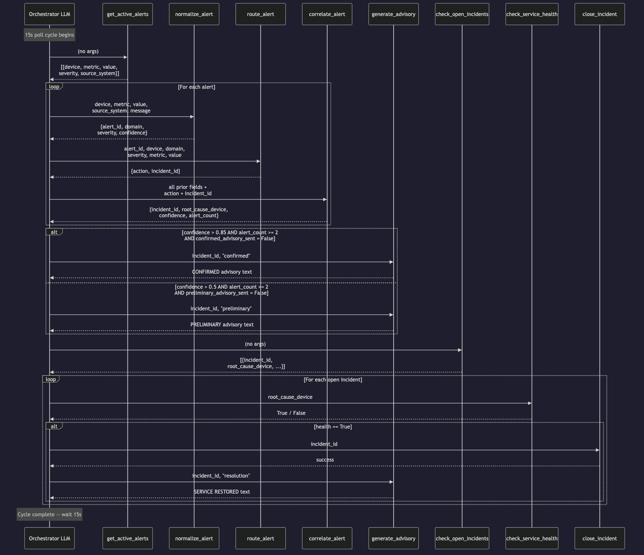
The 6-Step Agentic Protocol
Orchestrator LLM coordinates all tool calls — agents are specialists, LLM is the conductor
15s poll cycle | 8 FunctionTools | 6 steps per tick

Slide 11
Google ADK LlmAgent + 8 FunctionTools
6-step workflow | 15s poll cycle
Which advisory type?
Preliminary or confirmed based on:
• confidence score
• alert count
• flags
When to close?
Only when Prometheus health check confirms recovery — LLM coordinates, close_incident() executes
Same alert, different outcomes — depends on evolving store state: open incidents, flags, history
All 6 steps orchestrated by the LLM.
Routing and health decisions happen inside rule-based tools — not in the LLM itself.

Slide 12
What It Does In Production
Observed in demo runs — May 2026
305
0.90–0.95
T+5–6 min
tests passing
live confidence
to CONFIRMED
end-to-end, ~13s full suite
DSPyCorrelator on real alerts
after fault injection
T+12–14 min
isolated
T+2–3 min
to SERVICE RESTORED
ad noise
detection
after fault injection
separate from valkey-cart cascade
fault to first alert

Slide 13
[ LIVE DEMO ]
Scenario: valkey-cart cache failure cascade OpenTelemetry demo environment Fault pre-injected — live: healing + SERVICE RESTORED (~6 minutes)
1
Baseline — system monitoring, cart cascade already active, CONFIRMED advisory showing
2
Healing — docker start valkey-cart
3
Recovery — Prometheus confirms cart healthy
4
SERVICE RESTORED — advisory fires, incident closed, removed from board
5
Board clears — cart incident resolved, only ad noise remains

Slide 14
What We Learned — And Would Do Differently
Baseline heuristics can beat LLM for structured tasks
Establish a baseline before investing in fine-tuning
Statelessness is a fundamental agentic challenge
Design state management into architecture from day one
Trust code over prompts for invariants
Behavioral guarantees belong in code, not LLM instructions
Noise isolation is as important as detection
Understand operating environment before tuning accuracy
Fine-tuning teaches format, not temporal awareness
Know the boundary of what training can and cannot do
Observability window size is a first-class design decision
PromQL [5m] vs [1m] window affects detection latency, noise stability, and recovery confirmation timing

