Slide 1
Logistic regression
Taehoon Ko (thoon.koh@gmail.com)

Slide 2
Learning logistic regression using ‘gradient descent’
Logistic function, logit
Loss function: negative log-likelihood
Gradient descent method

Slide 3
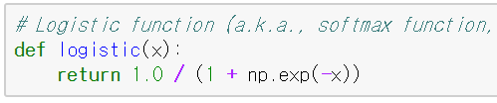
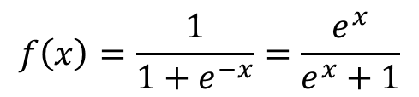



Logistic function
Logistic function
a.k.a. softmax function
For $−∞<x<∞$,
$0<f(x)<1$
$$f\left(x\right)=\frac{1}{1+e^{−x}}=\frac{e^{x}}{e^{x}+1}$$
$$f(x)$$
$$x$$

Slide 4
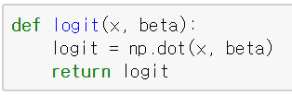



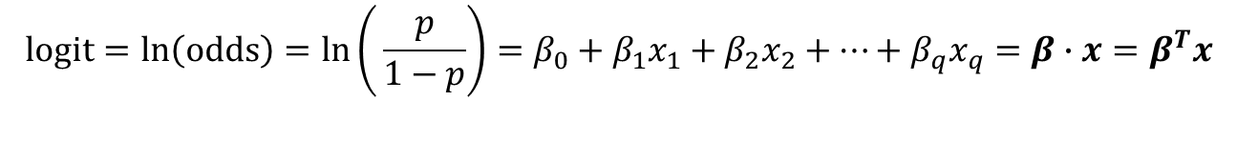
Logit
Logit is a natural logarithm of the odds.
$p$: probability of belonging to class 1 → $P(class=1)$
odds: the ratio between the amounts staked by the parties to a bet, based on the expected probability either way
In logistic regression,
$$y=β_{0}+β_{1}x_{1}+β_{2}x_{2}+…+β_{q}x_{q}$$
$$logit=\ln\left(odds\right)=ln\left(⁡\frac{p}{1−p}\right)=β_{0}+β_{1}x_{1}+β_{2}x_{2}+…+β_{q}x_{q}=β∙x=β^{T}x$$
$$\left(β_{0}{, β}_{1}, …,β_{q}\right)\left(\begin{matrix}1 \\ x_{1} \\ x_{2} \\ … \\ x_{q}\end{matrix}\right)=β^{T}x$$

Slide 5

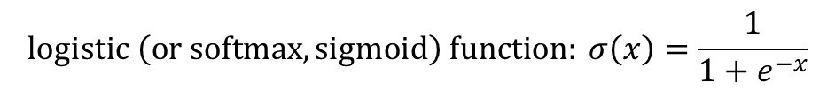
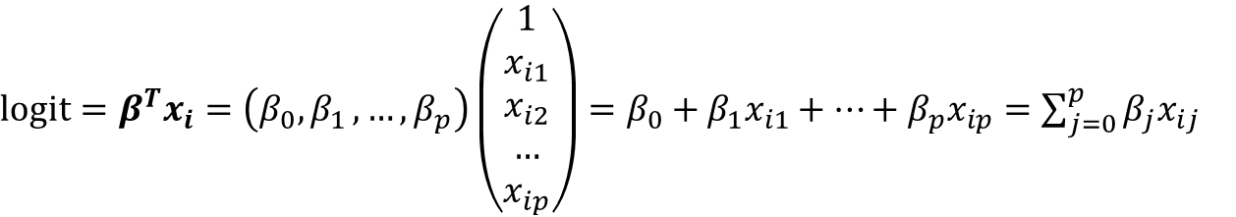
How to learn logistic regression
Maximum likelihood estimation (MLE)
input vector of i-th data point: $x_{i}=(x_{i1}, x_{i2}, …, x_{ip})$
target class of i-th data point: $y_{i}∈\{0, 1\}$
Probability that $y_{i}=1$ given $x_{i}$ and $β$ : $π_{i}$
$$P\left(y_{i}=1 | x_{i}, β\right)=σ\left(logit\right)=σ\left(β^{T}x_{i}\right)=\frac{1}{1+e^{−β^{T}x_{i}}}=π_{i}$$
$$logistic \left(or softmax, sigmoid\right) function: σ\left(x\right)=\frac{1}{1+e^{−x}}$$
$logit=β^{T}x_{i}=\left(β_{0}{, β}_{1}, …,β_{p}\right)\left(\begin{matrix}1 \\ x_{i1} \\ x_{i2} \\ … \\ x_{ip}\end{matrix}\right)=β_{0}+β_{1}x_{i1}+…+β_{p}x_{ip}=\sum_{j=0}^{p}{β_{j}x_{ij}}$

Slide 6
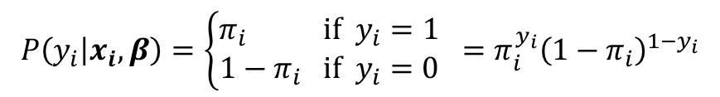


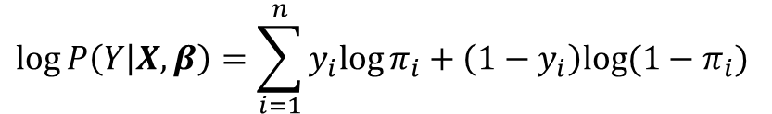
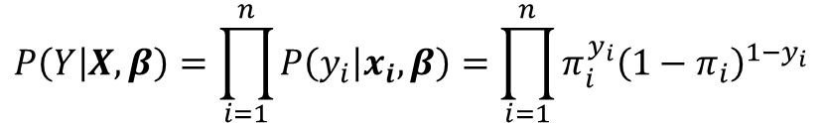
How to learn logistic regression
Maximum likelihood estimation (MLE)
Likelihood for a data point $\left(x_{i}, y_{i}\right)$
Likelihood for all points
Log-likelihood for all points
$$P\left(y_{i} | x_{i}, β\right)=\left\{\begin{aligned}π_{i} if { y}_{i}=1 \\ 1−π_{i} if { y}_{i}=0\end{aligned}\right. =π_{i}^{y_{i}}{\left(1−π_{i}\right)}^{1−y_{i}}$$
$$P\left(Y | X,β\right)=\prod_{i=1}^{n}{P\left(y_{i} | x_{i}, β\right)=\prod_{i=1}^{n}{π_{i}^{y_{i}}{\left(1−π_{i}\right)}^{1−y_{i}}}}$$
$$log⁡P\left(Y | X,β\right)=\sum_{i=1}^{n}{y_{i}{log⁡π}_{i}+\left(1−y_{i}\right)log⁡(1−π_{i}) }$$
We want to maximize the log-likelihood (in terms of $β)$

Slide 7
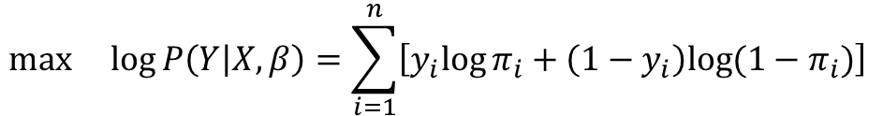
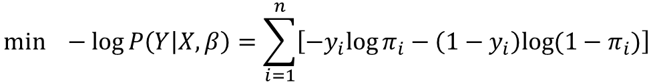
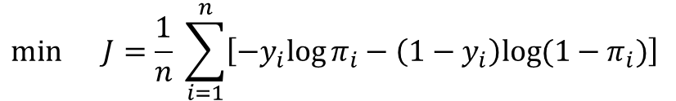
How to learn logistic regression
Maximum likelihood estimation (MLE)
Maximize the log-likelihood = Minimize the negative log-likelihood = Minimize the loss function
$$max log⁡P\left(Y | X,β\right)=\sum_{i=1}^{n}{\left[y_{i}{log⁡π}_{i}+\left(1−y_{i}\right)log⁡(1−π_{i})\right] }$$
[Log-likelihood]
$$min −log⁡P\left(Y | X,β\right)=\sum_{i=1}^{n}{\left[−y_{i}{log⁡π}_{i}−\left(1−y_{i}\right)log⁡(1−π_{i})\right]}$$
[Negative
log-likelihood (NLL)]
$$min J=\frac{1}{n} \sum_{i=1}^{n}{\left[−y_{i}{log⁡π}_{i}−\left(1−y_{i}\right)log⁡(1−π_{i})\right] }$$
[Loss function in logistic regression (and neural network) ]

Slide 8
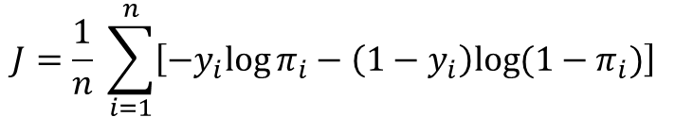
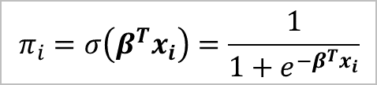




How to learn logistic regression
Gradient descent
Update $β$ to reduce the loss function (or negative log-likelihood).
Gradient descent method
1. Randomly initialize $β=\left(β_{0}, β_{1},β_{2},…,β_{p}\right)$.
2. for step in range(0, num_steps):
2-1. Calculate the derivative of loss function
2-2. Update $β_{j}$s $\left(for j=0, 1, …, p\right)$
See the side note below for further details.
2-2. Update $β$
$$β_{j}←β_{j}−η\frac{∂J}{∂β_{j}}$$
$$β←β−η\frac{∂J}{∂β }$$
scalar version
vector version
$$J=\frac{1}{n} \sum_{i=1}^{n}{\left[−y_{i}{log⁡π}_{i}−\left(1−y_{i}\right)log⁡(1−π_{i})\right] }$$
$$π_{i}=σ\left(β^{T}x_{i}\right)=\frac{1}{1+e^{−β^{T}x_{i}}}$$
[Loss function in logistic regression (and neural network) ]

Slide 9
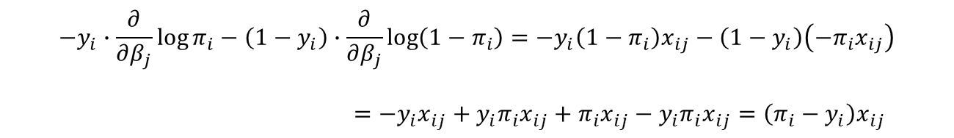
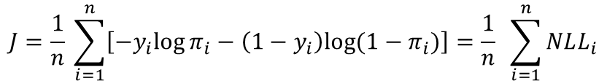
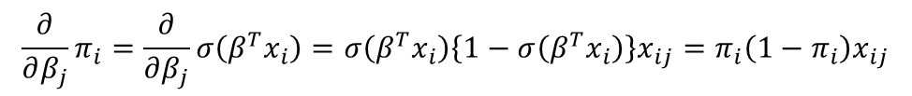



*Side note: Derivate of negative log-likelihood
$$J=\frac{1}{n} \sum_{i=1}^{n}{\left[−y_{i}{log⁡π}_{i}−\left(1−y_{i}\right)log⁡(1−π_{i})\right]}=\frac{1}{n} \sum_{i=1}^{n}{NLL_{i}}$$
$$\frac{∂J}{∂β_{j}}=\frac{1}{n} \sum_{i=1}^{n}{\frac{∂ NLL_{i}}{∂{ β}_{j}}}$$
$$\frac{∂}{∂β_{j}}NLL_{i}=−y_{i}∙\frac{∂}{∂β_{j}}\log{π_{i}}−\left(1−y_{i}\right)∙\frac{∂}{∂β_{j}}\log{(1−π_{i})}=\left(π_{i}−y_{i}\right)x_{ij}$$
$$\frac{∂}{∂β_{j}}\log{π_{i}}=\frac{1}{π_{i}}\frac{∂}{∂β_{j}}π_{i}$$
$$\frac{∂}{∂β_{j}}\log{(1−π_{i})}=\frac{1}{(1−π_{i})}\left(−\frac{∂}{∂β_{j}}π_{i}\right)$$
$$\frac{∂}{∂β_{j}}π_{i}=\frac{∂}{∂β_{j}}σ\left(β^{T}x_{i}\right)=σ\left(β^{T}x_{i}\right)\left\{1−σ\left(β^{T}x_{i}\right)\right\}x_{ij}=π_{i}\left(1−π_{i}\right)x_{ij}$$
See the side note below for further details.
$$−y_{i}∙\frac{∂}{∂β_{j}}\log{π_{i}}−\left(1−y_{i}\right)∙\frac{∂}{∂β_{j}}\log\left(1−π_{i}\right)=−y_{i}\left(1−π_{i}\right)x_{ij}−\left(1−y_{i}\right)\left(−π_{i}x_{ij}\right)$$
$=−y_{i}x_{ij}+y_{i}π_{i}x_{ij}+π_{i}x_{ij}−y_{i}π_{i}x_{ij}=\left(π_{i}−y_{i}\right)x_{ij}$

Slide 10
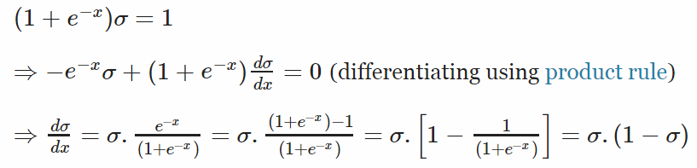
*Side note: Derivate of logistic function
http://math.stackexchange.com/questions/78575/derivative-of-sigmoid-function-sigma-x-frac11e-x

Slide 11
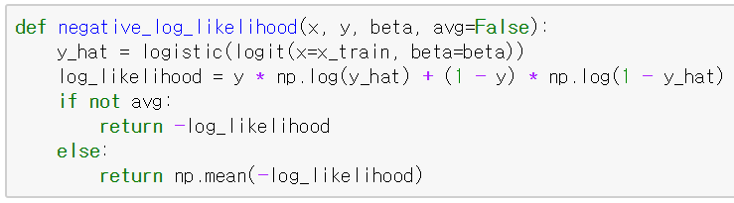
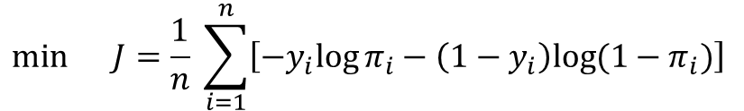
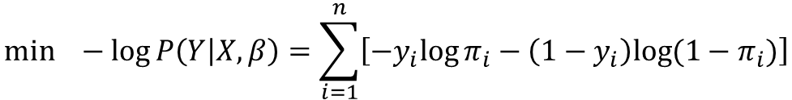
In Python,
$$min −log⁡P\left(Y | X,β\right)=\sum_{i=1}^{n}{\left[−y_{i}{log⁡π}_{i}−\left(1−y_{i}\right)log⁡(1−π_{i})\right]}$$
[Negative
log-likelihood (NLL)]
$$min J=\frac{1}{n} \sum_{i=1}^{n}{\left[−y_{i}{log⁡π}_{i}−\left(1−y_{i}\right)log⁡(1−π_{i})\right] }$$
[Loss function in logistic regression (and neural network) ]

Slide 12
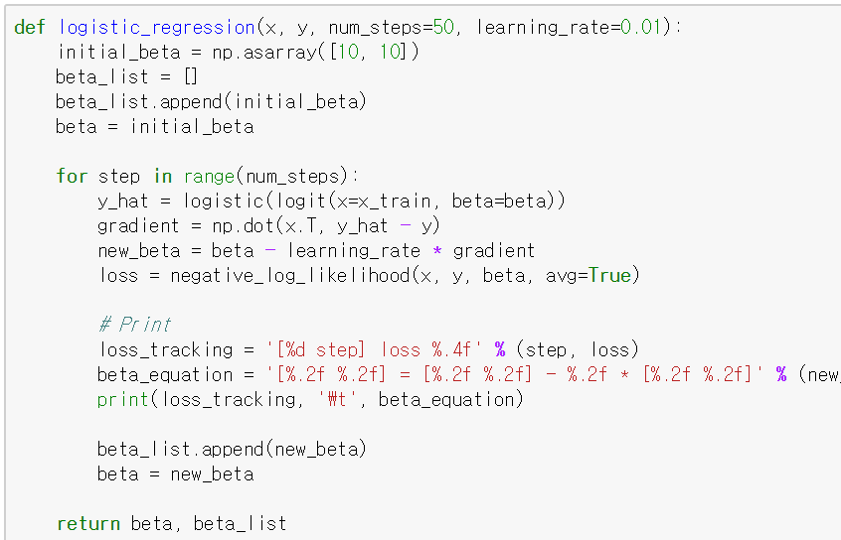

In Python,
Update $β$ by gradient descent

Slide 13
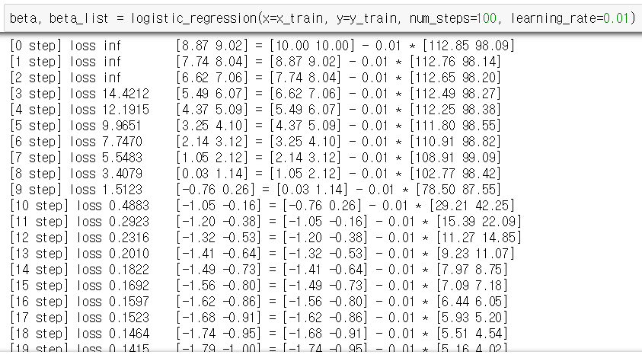
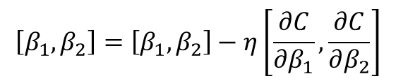
In Python,
As the step progresses, the gradient becomes smaller and the beta values gradually converge.
$$\left[β_{1}, β_{2}\right]=\left[β_{1}, β_{2}\right]−η\left[\frac{∂C}{∂β_{1}},\frac{∂C}{∂β_{2}}\right]$$
* In this scratch code, the intercept $β_{0}$is not considered.

Slide 14
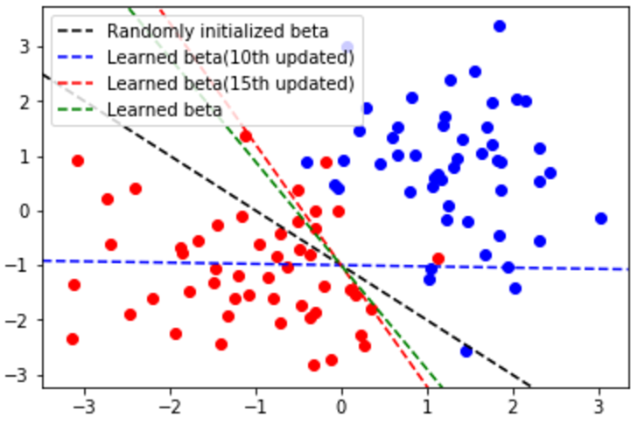
In Python,
As the step progresses, the gradient becomes smaller and the beta values gradually converge.

Slide 15
LogisticRegression in scikit-learn

Slide 16
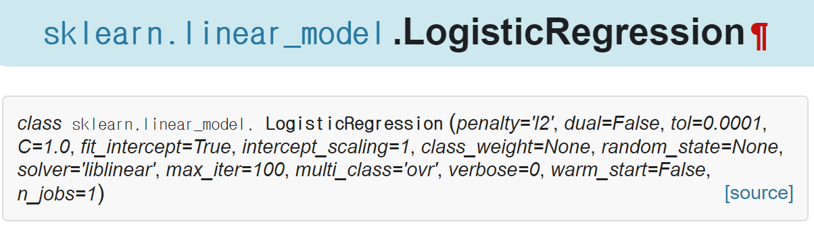
sklearn.linear_model.LogisticRegression
http://scikit-learn.org/stable/modules/generated/sklearn.linear_model.LogisticRegression.html

Slide 17
Parameter: penalty and C
Penalty: ‘l2’ or ‘l1’
‘l2’: Add L2-regularization term.
It has the same effect as the ridge regression.
‘l1’: Add L1-regularization term.
It has the same effect as the lasso regression.

Slide 18
Parameter: penalty and C
C: inverse of the regularization strength
Smaller C values specify stronger regularization.

Slide 19

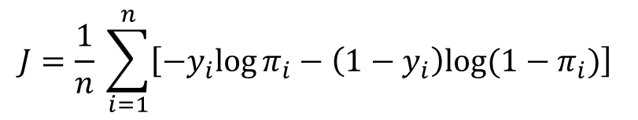



Parameter: penalty and C
Regularized logistic regression
Loss function of logistic regression with no regularization
Cost function of regularized logistic regression
$$J=\frac{1}{n} \sum_{i=1}^{n}{\left[−y_{i}{log⁡π}_{i}−\left(1−y_{i}\right)log⁡(1−π_{i})\right] }$$
$$π_{i}=σ\left(β^{T}x_{i}\right)=\frac{1}{1+e^{−β^{T}x_{i}}}$$
$$Cost=J+α\sum_{j=1}^{p}{\left|β_{j}\right|}$$
[L1 regularization]
$$Cost=J+α\sum_{j=1}^{p}{β_{j}^{2}}$$
[L2 regularization]
$$α=\frac{1}{C}$$

Slide 20
Parameter: class_weight
class_weight
Many scikit-learn estimators have this parameter.
When the number of points in each class is unbalanced (this phenomenon is called class-imbalanced), it can be effective to give different weights to each class.

Slide 21
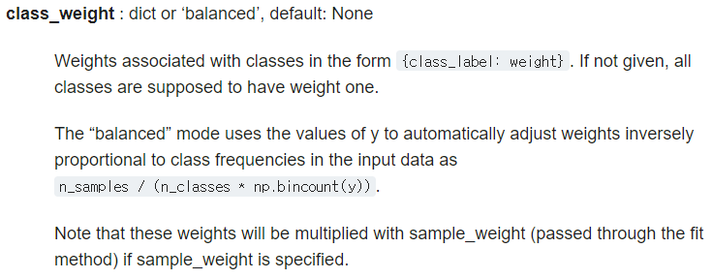
Parameter: class_weight
Count number of occurrences of each value in array of non-negative integers.
(https://docs.scipy.org/doc/numpy/reference/generated/numpy.bincount.html)

Slide 22
Parameter: solver
solver
In fact, there are some algorithms for training logistic regression (or optimizing the cost function of logistic regression).
You can select one of given optimization algorithms.

Slide 23
Parameter: multi-class
multi_class
If your data has several classes, control this parameter.
‘ovr’ (one-versus-rest)
‘multinomial’

Slide 24
Parameter: multi-class
One-versus-rest (OVR)
Train several binary logistic regression models.
Number of binary logistic regression models = Number of classes
Suppose that there are 3 classes; A, B and C.
1st logistic regression model: Classify A and (B, C). ➔ A vs. not A
2nd logistic regression model: Classify B and (A, C). ➔ B vs. not B
3rd logistic regression model: Classify C and (A, B). ➔ C vs. not C
The results of these models are combined to make final prediction.

Slide 25
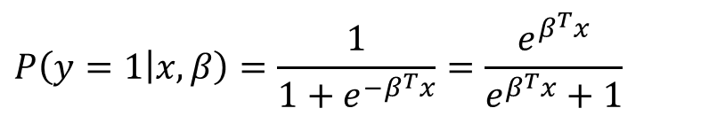
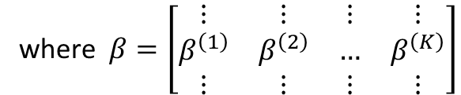
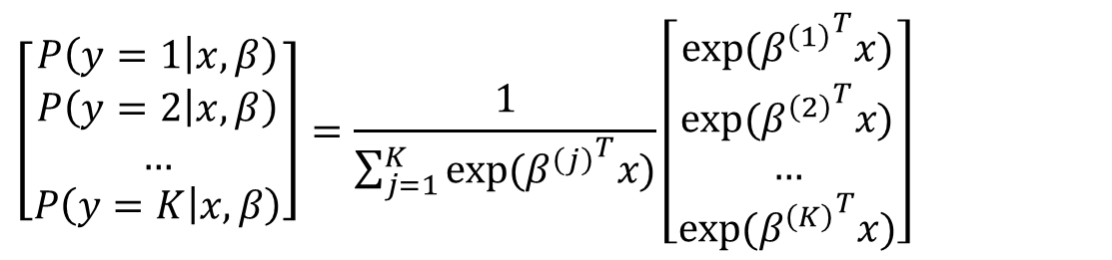
Parameter: multi-class
Multinomial logistic regression (a.k.a. Softmax regression)
Softmax regression is a generalization of logistic regression.
$$P\left(y=1 | x, β\right)=\frac{1}{1+e^{−β^{T}x}}=\frac{e^{β^{T}x}}{e^{β^{T}x}+1}$$
[Binary logistic regression]
$$\left[\begin{matrix}P\left(y=1 | x, β\right) \\ P\left(y=2 | x, β\right) \\ … \\ P\left(y=K | x, β\right)\end{matrix}\right]=\frac{1}{\sum_{j=1}^{K}{exp⁡({β^{\left(j\right)}}^{T}x)}}\left[\begin{matrix}exp⁡({β^{\left(1\right)}}^{T}x) \\ exp⁡({β^{\left(2\right)}}^{T}x) \\ … \\ exp⁡({β^{\left(K\right)}}^{T}x)\end{matrix}\right]$$
[Softmax
regression]
where $β=\left[\begin{matrix}⋮ & ⋮ & ⋮ & ⋮ \\ β^{\left(1\right)} & β^{\left(2\right)} & … & β^{\left(K\right)} \\ ⋮ & ⋮ & ⋮ & ⋮\end{matrix}\right]$
See http://ufldl.stanford.edu/tutorial/supervised/SoftmaxRegression/.

Slide 26
Parameter: n_jobs
n_jobs: Number of CPU cores to assign tasks to
Parallel processing!
It is very useful for heavy work.
Some scikit-learn estimators have this parameter.
If you want to use all CPU cores, set n_jobs to -1.

