Slide 1
IST687 – Applied Data Science
Final Project Team 03
Mateo Arbelaez
Maggie Faiella
Teodor Fatu
Sonny Lizarraga
Daniel Tully

Slide 2
IST687 – Applied Data Science
Introduction
Hyatt company is trying to increase traffic to their chain of hotels. They would like us to see which demographic, age range and locations to target discounts to?
Business Questions
We have selected a wide variety of questions to answer that will help executives and management determine their best strategic plan for targeting.
Data selected
The dataset provided had a significant amount of information that can be useful for this analysis. However, after reviewing the full dataset, we decided to mostly use the following:
Discount, duration of guest, purpose of stay, booking methods, Country, demographic and month of reservation.

Slide 3
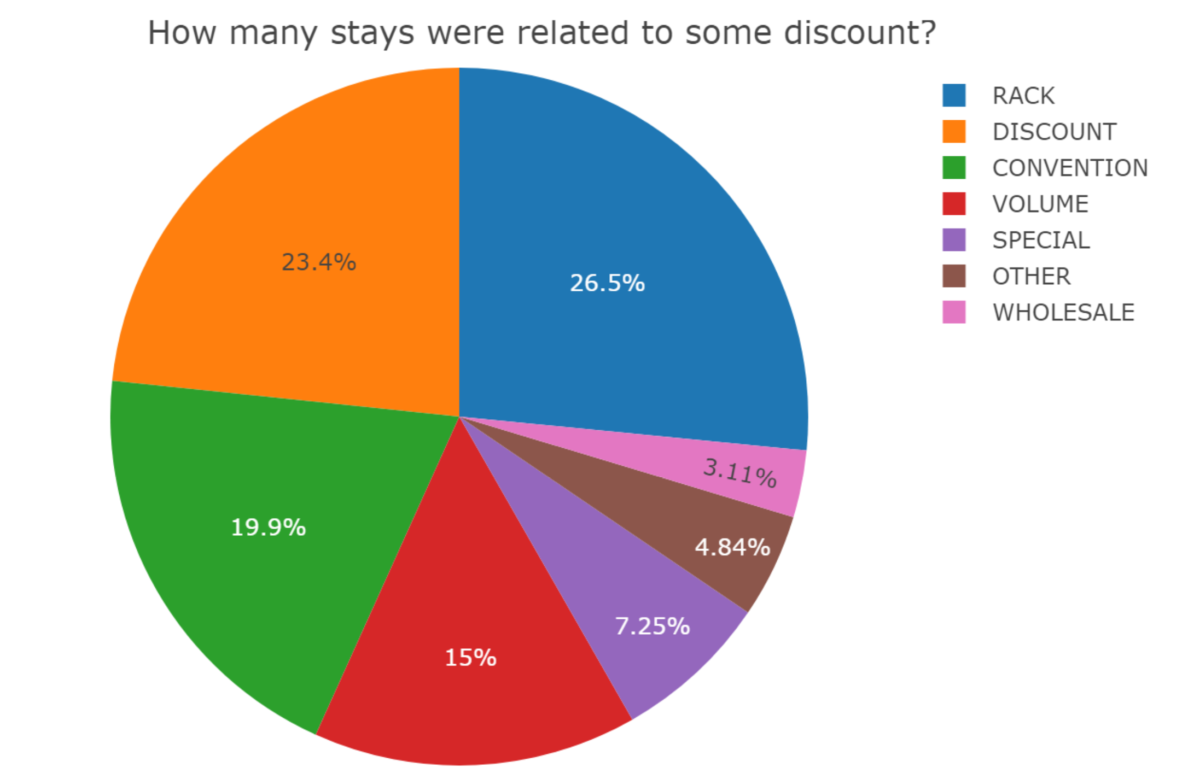
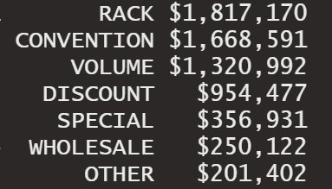
IST687 – Applied Data Science

Slide 4
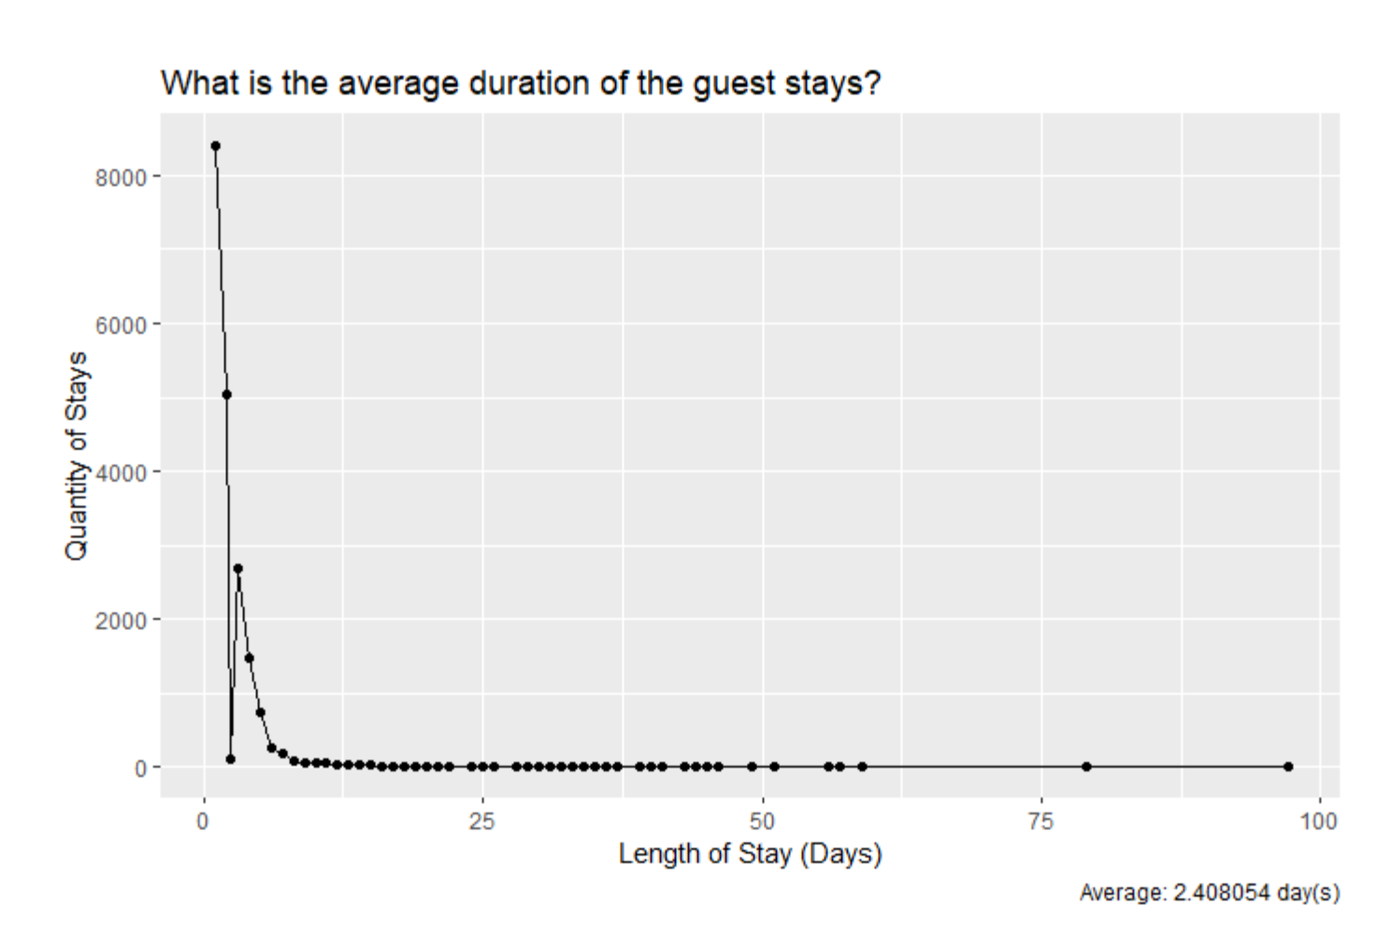
IST687 – Applied Data Science
Short Stays
Avg 2.4 days

Slide 5
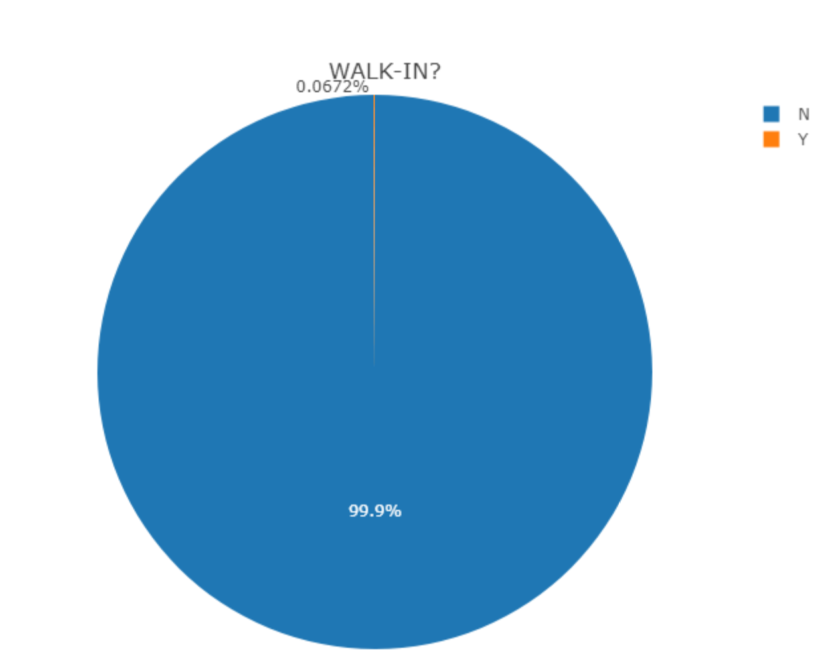
IST687 – Applied Data Science

Slide 6
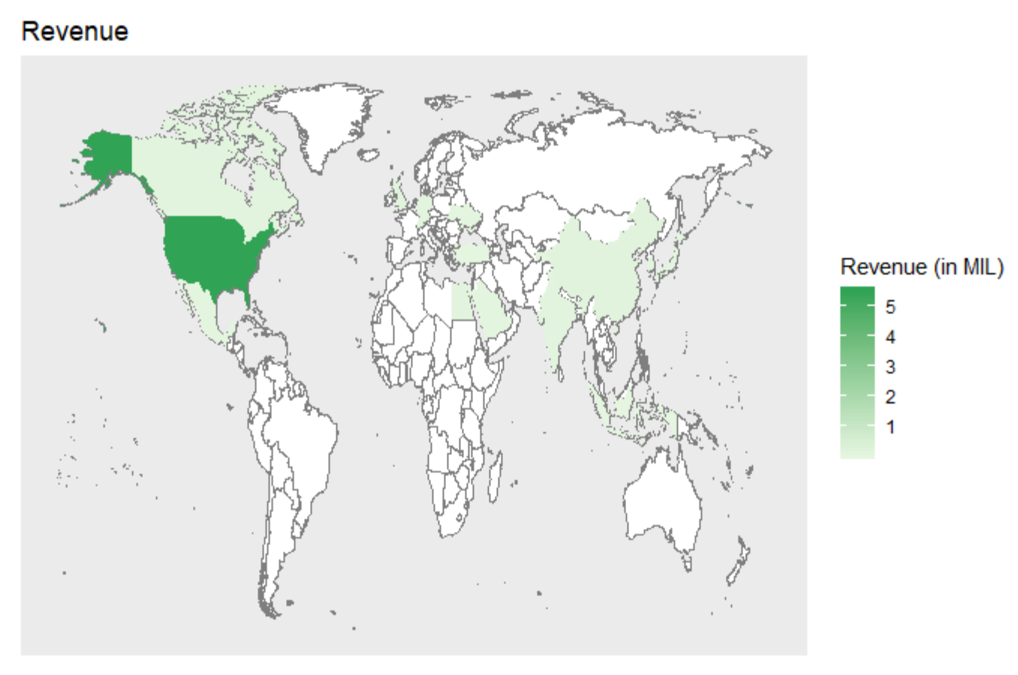
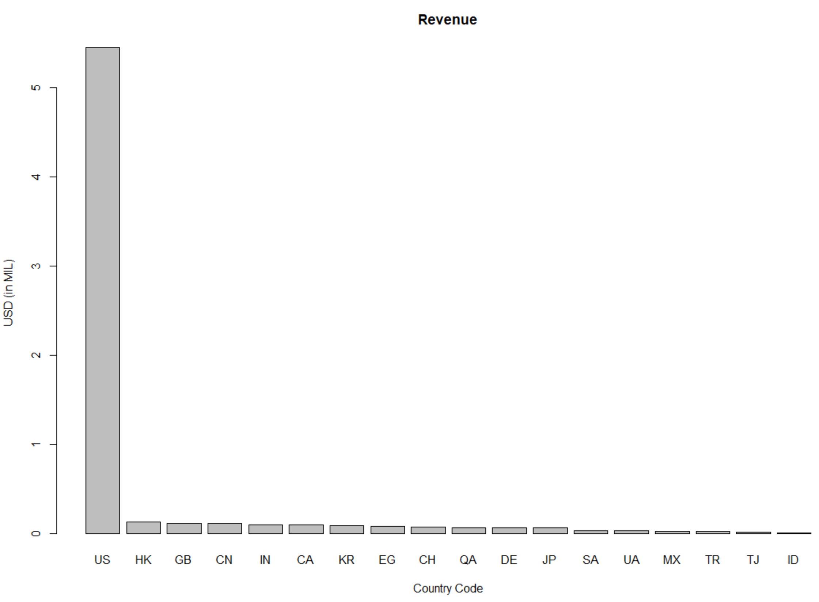
IST687 – Applied Data Science

Slide 7
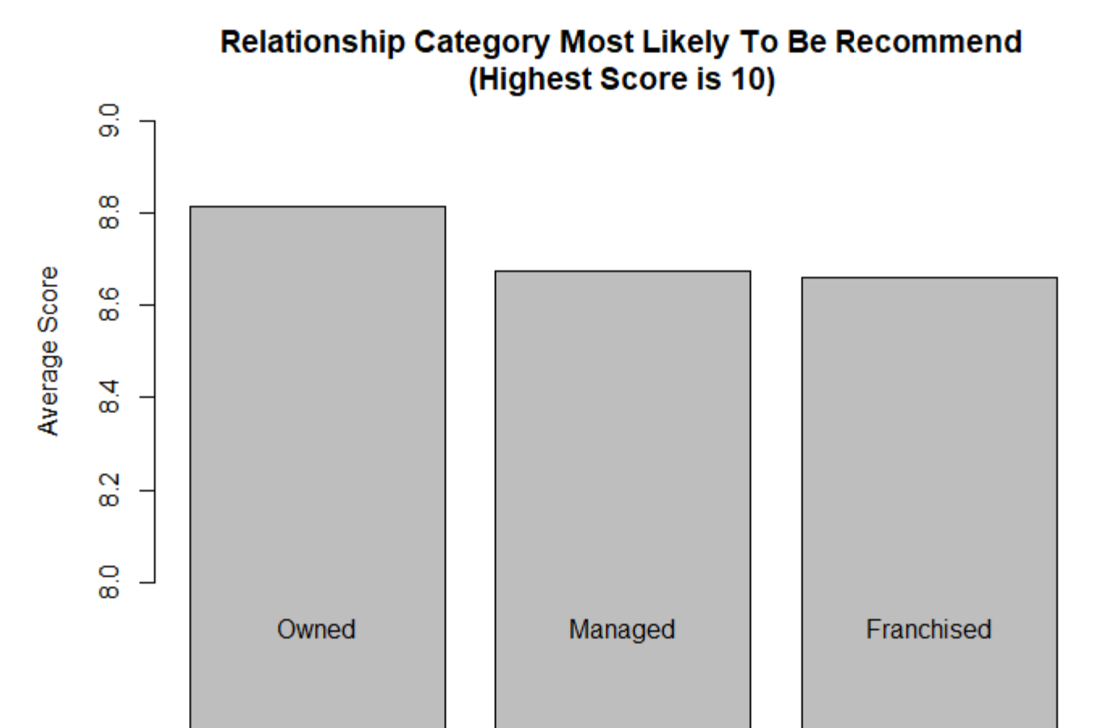
IST687 – Applied Data Science

Slide 8
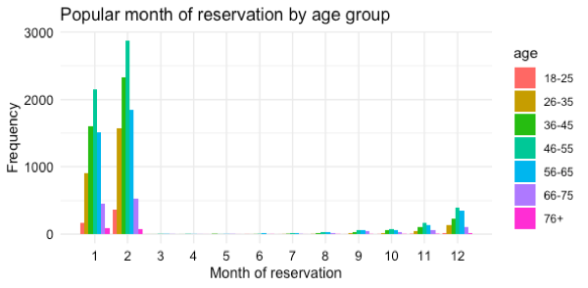
IST687 – Applied Data Science
Which months are more popular among different age group?

Slide 9
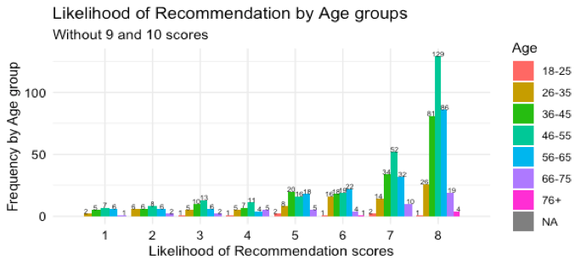
IST 687 – Applied Data Science
•Likelihood of recommendation by Age group. This time excluding Scores of 9&10. To see opportunities for improvement

Slide 10
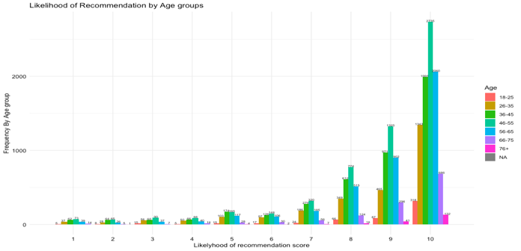
IST687 – Applied Data Science
•Likelihood of recommendation by Age group

Slide 11
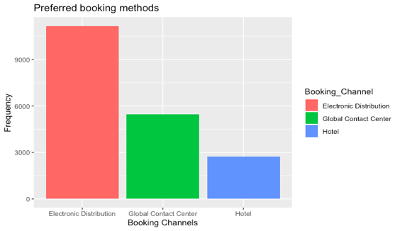
IST 687- Applied Data Science
•Is there a preferred booking method?

Slide 12
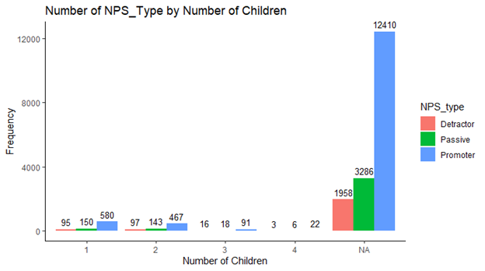
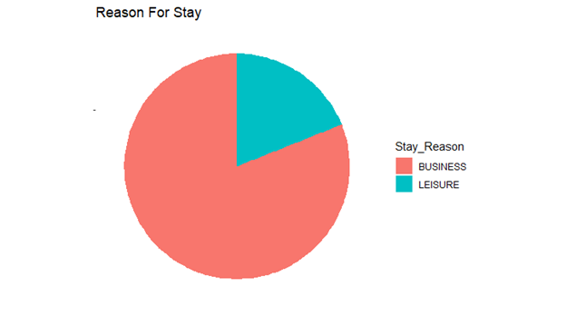
IST 687- Applied Data Science
Possible target groups:
Focus on our promoters
Business/Corporations

Slide 13
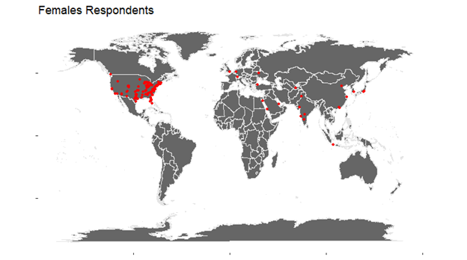
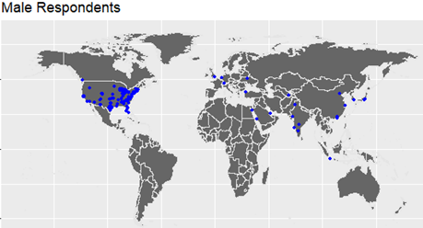
IST 687- Applied Data Science
Respondent Populations

Slide 14
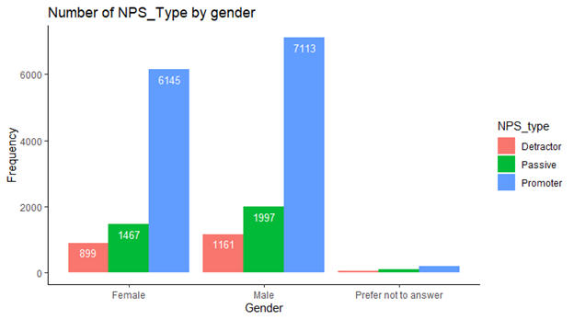
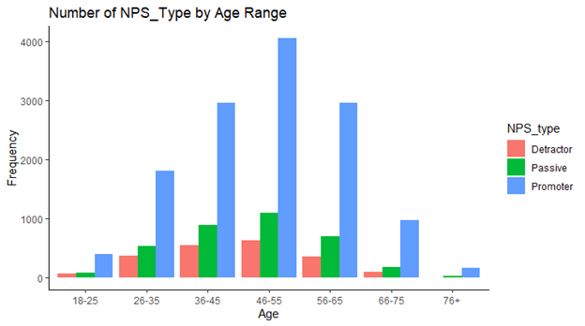
IST 687- Applied Data Science
Pretty even gender population
36 - 65 age group focus
Reward our promoters

Slide 15
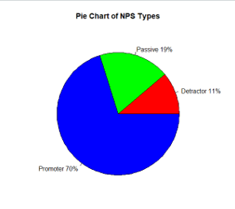
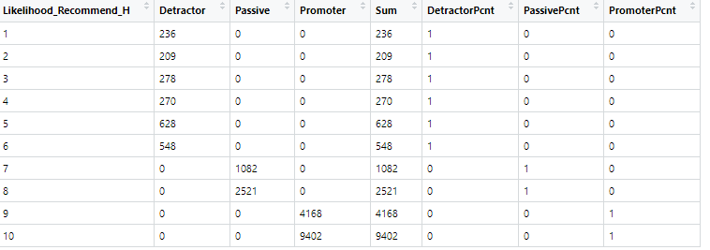
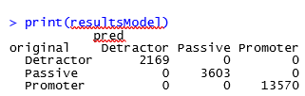
IST687 – Applied Data Science
What are some of the drivers of NPS
Our data is highly shewed towards Promoter NPS types
We were able to create a map from Likelihood to Recommend to NPS which enabled us to predict the NPS with 100% certainty.

Slide 16


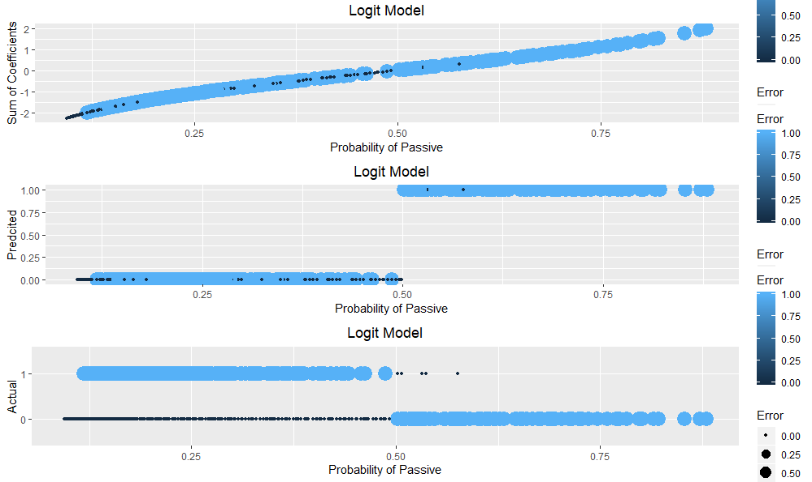
IST687 – Applied Data Science
What are some of the drivers of NPS
We looked at using the same type of map as above but this time from the average across all rating variables to the NPS. We found that we were not very good at predicting Passives and Detractors from the average rating.
We tried a more sophisticated model (Logit) to try and predict the probability of Passive only.
The logit model was not very good at predicting Passive NPS typ

Slide 17
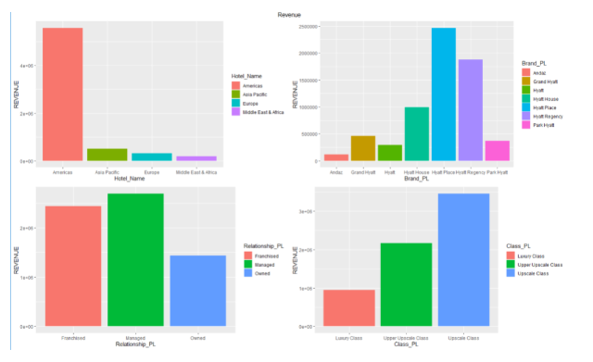
Revenue by Category
We looked at the revenue generated by different brands, regions, class and relationship.

Slide 18
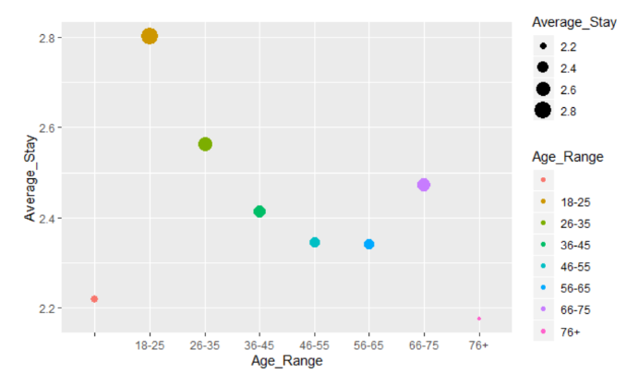
Stay by Age Group
The average stay does not appears to be between 2-3 day among all age groups.

Slide 19
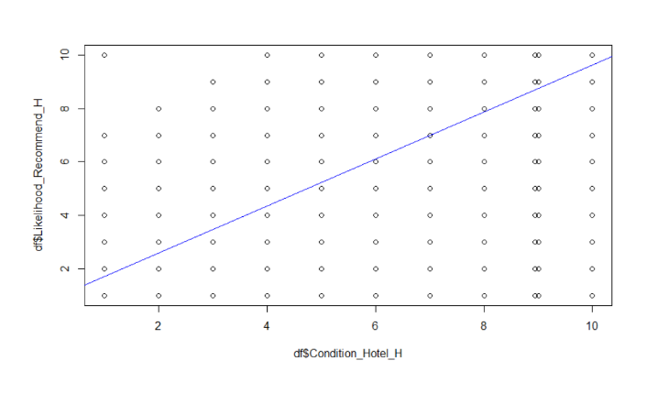
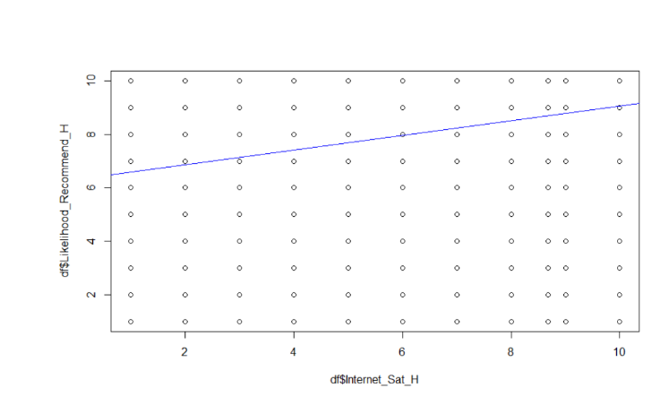
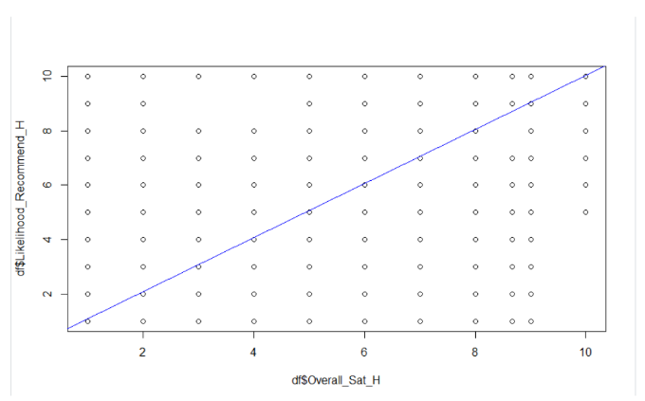
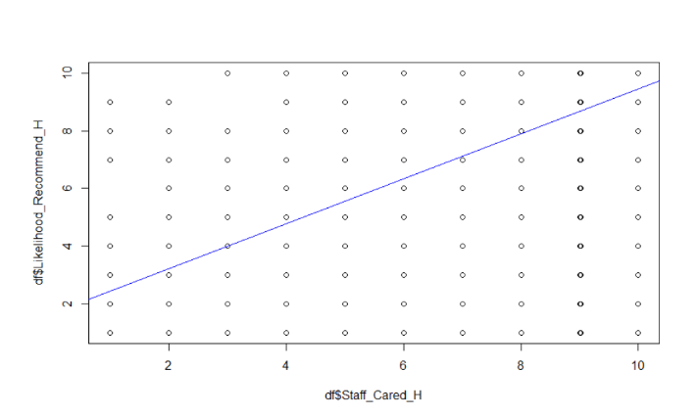
Linear Regression Model
Bivariate plots of score of Likelihood to Recommend versus:
Condition of Hotel
Overall Satisfaction
Internet Satisfaction
Staff cared

Slide 20
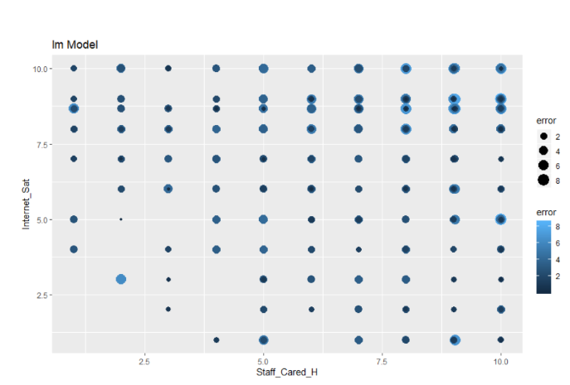
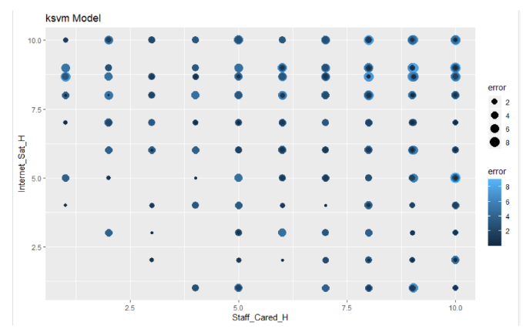
Predictive Models
LM Model
KSVM Model

Slide 21
Thank you!

