Slide 1
CZ2001 Algorithms
Project 1 (SS4)
Aaron Tay Han Yan (U1921247B), Yeong Wei Xian (U1921382J),
Samantha Tan Swee Yun (U1921074B), Goh Ting Qi (U1920306H),
Song Wei Tyan (U1921107H)

Slide 2
DEMO

Slide 3
ANALYSIS

Slide 4
Brute Force Sequential Search

Slide 5
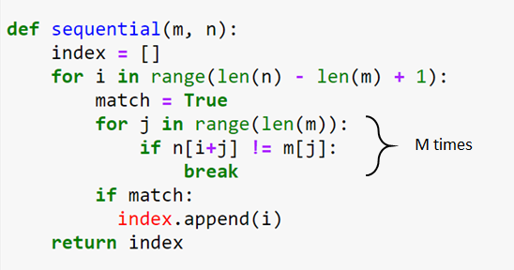

Algorithm
[(N-M) + 1] times

Slide 6
Analysis
Best-Case Scenario:
Occurs when the first element of m is not equal to any indexes of the searched array
Time complexity: O(n).

Slide 7
Analysis
Worst-Case Scenario:
When all characters of the text and pattern are the same, or
The first m-1 elements of the pattern is in the genome sequence, and
The last element of the pattern is not in the genome sequence (e.g. pattern is “AAAAAC”, genome sequence is “AAAAAAAAAAAAAAAAAAAAT”)
Hence, the outer loop executes [(n-m)+1] times while the inner loop executes m times.
Time complexity: O[(n-m+1)m] ≈ O(nm)

Slide 8
2. Knuth-Morris-Pratt Search
Notes:
For our second algorithm, we implemented the KMP Search algorithm which differs from the sequential search algorithm as it studies the pattern before
The search is begin. So the KMP search algorithm, consists of 2 parts, pre-processing of the pattern followed by its search function.

Slide 9
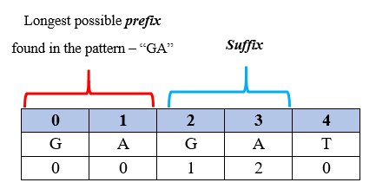
Pre-Processing
Notes:
The Pre-processing section iterates through the pattern to check whether there is a substring that is both a prefix and a suffix that exists in the pattern. Then it assigns a value to each suffixes which as a result, generate what we call a LPS table (longest proper prefix which is also a suffix)
The aim of generating the LPS table is to provide the search function with enough information as to where to start the new search, should a mismatch happens.

Slide 10
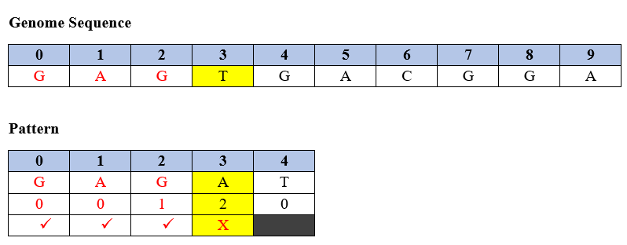
Search Function - First Match
Notes:
With the generated LPS table, the algorithm then begins the search function.
In this figure, assuming that there is a match of character at Genome Index[0].
The algorithm begins to match the rest of the patterns. This happens until a mismatch happens at Pattern Index 3 of Char A.
Char A happens to be part of the suffix. Hence, we note that at this point of mismatch, we have 2 information: Index 3 and the value of index[3-1] which is 1 in the LPS table.

Slide 11
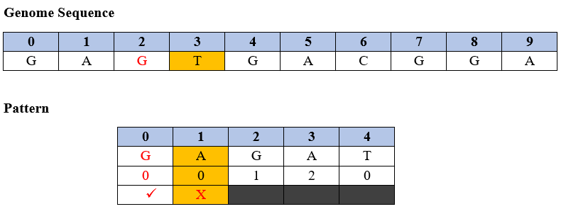
Search Function - Next Match
Notes:
After a mismatch, the algorithm will use the information that noted from the point of mismatch to determine the point of te next match.
We add index number 3 to the initial Genome Index [0] to determine the next search index of genome.
We then take the value 1 from the LPS table to determine the next search index of the pattern.
Hence, this figure shows the next matching point.

Slide 12
Analysis
Overall Time Complexity
Backtracking occurs in the preprocessing pattern (m)
The search pointer of the genome pattern (n) will not backtrack
The next search after a mismatch will not begin at the next index
The time complexity of pre-processing is O(m) to iterate once through the pattern sequence of m.
There is only a need to iterate through the Genome Sequence ONCE: O(n)
Total time complexity: O(m+n)
Notes:
For the pre-processing section, assume m is the length of the pattern and as we have to iterate through the whole pattern to find the longest prefix , the time complexity taken to generate the prefix table is O(m).
Next, to search through a Genome Sequence of length n, there will be no backtracking in the iteration of the Sequence as KMP does not re-examine previously matched characters. Hence, the time complexity of the search function is O(n).
Thus, in total, the time complexity of KMP Search algorithm is computed to be O(m+n) which is better than sequential search as kmp uses a prefix table to skip comparisons. (does not re-examine previously matched characters

Slide 13
2. Rabin-Karp Search

Slide 14
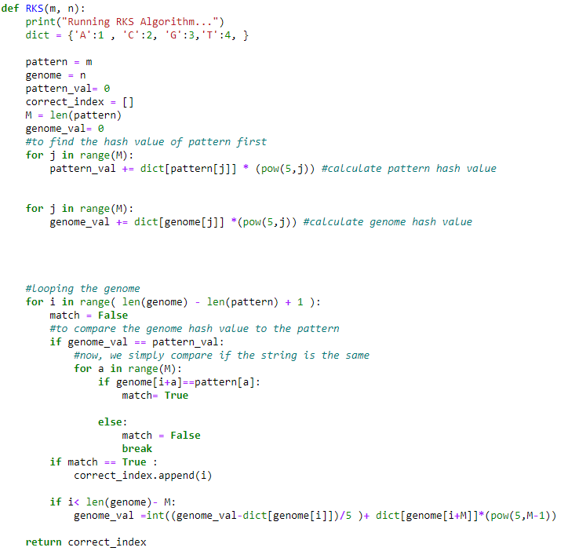
Algorithm

Slide 15
Best-Case & Average-Case Scenario Analysis
Best-Case & Average-Case Scenario:
Each of the indexes of the genome will stop once and then compare its hash value the hash value of the pattern
Rolling hash function: O(m) to create the pattern hash value
If it is a potential match, it will verify each letter to check if the match is true and not just a hashing collision
Total time complexity: O(n+m)

Slide 16
Worst- Case Scenario Analysis
Occurs when hash function value comparison results in false postive at every step of the genome
It is called ‘Spurious Hit’
Hence, the m letters in the pattern will be checked n times
Time complexity: O(mn)
Still, False positives rarely occur
Notes:
Value of genome & search pattern hash value is same but they are not the same
However, this is largely avoided
Largely avoided as our hash function is using base 4,

Slide 17
Space Complexity Issue
We added the power of 5 method for the hash rolling function,
Reduce a space complexity restraint
Search pattern cannot be bigger than 24 letters
int Overflow
Adding a modulus to the rolling hash function helps but:
Reduces the accuracy
Hence more spurious Hit (likely to occur O(mn))
Thus we did not choose to do it

Slide 18
Possible Improvements For RKS
Allow the user to have multiple inputs sequence instead of one
More time efficient than to run the whole genome sequence for each search pattern

Slide 19
Conclusion
KMP is a better solutions than sequential search
Worst Case KMP is O(n+m) compare to Sequential Worst case O(nm)
KMP never backtrack
Rabin Karp is able to take in multiple inputs
Yield better result in term of time complexity
If search pattern is bigger than 24 letters, Rabin Karp Algo will fail

Slide 20
Thank You!!!

