Slide 1

QRB Web-Based Learning Platform
PROJECT MEMBER
QASIM TAWALBEH
RAYA IBRAHIM
BATOOL QAZAN

Slide 2
INTRODUCTION
QRB Is a Browser-based Ethical Hacking Training Platform, Provide Lessons About OWASP Top 10 , Labs To Simulate & Mitigate Real-world Attacks .

Slide 3
Feature of QRB Website
1
Learning Paths
2
Hands-On Labs
Curated curricula for beginner to advanced students
Real-world scenarios for practical experience

Slide 4

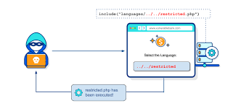
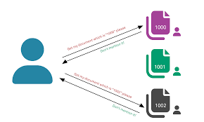
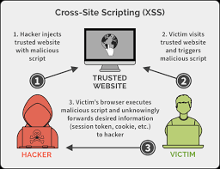
Modules On QRB Platform
SQL Injection
Cross-Site Scripting
File Inclusion
File Uploads
Exploiting vulnerabilities in database-driven
web applications
Injecting malicious scripts into web pages
Accessing unauthorized files and directories on a server
Unchecked
file uploads
exploit it by
disguising
malicious files

Slide 5
SQL Injection(SQLI) Module
SQL Injection Module
1
Fundamentals
user will learn about SQL injection theory and techniques
2
Vulnerable App
So user can Practice on a purposefully insecure web
application

Slide 6
Cross-Site Scripting (XSS) Module
In this modules we provide tutorial about Cross-Site Scripting (XSS)
1
Understanding XSS
The user will Explore different types of XSS vulnerabilities
2
Vulnerable App
We Demonstrate XSS attacks in a controlled environment
1
Mitigating Risks
user will Learn best practices for XSS protection

Slide 7
File Inclusion Module
In this modules we provide tutorial about File Inclusion
1
Local File Inclusion
Accessing local files on the server
2
Mitigations
Implementing safeguards against file inclusion attacks

Slide 8
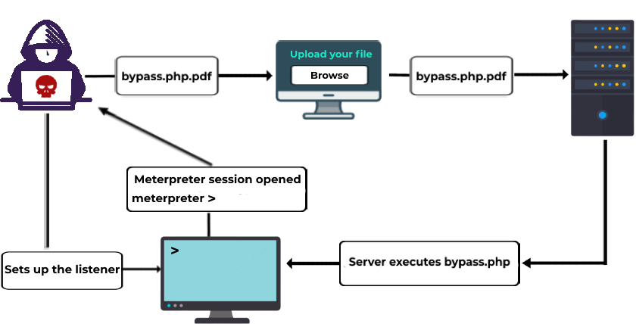
File Upload Module
File Upload Module
1
Unsafe Uploads
Identify and exploit vulnerable file upload functionality
2
Sanitization
Implement proper file type validation and sanitization

Slide 9




Real-World Labs for Hands-On Practice
SQL Injection
Cross-Site Scripting
File Inclusion
File Upload
Practice exploiting and injection Query
Experiment with different XSS attack techniques
Discover a local file inclusion and include files
Identify and address insecure file upload functionality

Slide 10
Thank You
supervised by
Eng.Mohammad Rasool S. Al-Jaafrah

