Slide 1
Policies in place
Transport
Relevant federal policies are listed here.
Here are more details on Australia’s attempt to reduce transport emissions.
Includes Driving the Nation fund to support EV charging and hydrogen refueling.
A baseline (REF) shift to EVs will mostly be driven by income levels (Australia not as well off as US but shouldn’t be too far behind in transition rates).
Consumer choice with some support via policy will drive change but I suspect a large minority of consumers will not be rushing to EVs (it will take additional carrots or sticks to drive required change that may be sought after in TGT)
See example for preference for SUVs, with these vehicles lagging electrification of smaller vehicles
Fuel quality standards continue to underwhelm. For example, see here.
Reference:
Ethanol and biofuels aren’t a big deal.
Additional context from Argus.
Discussion of electrification of transport in the AEMO ESOO
Assumption document talks about three scenarios that sees percent of road transport that is EV in 2040 at 72%, 60% or 32%, depending on the scenario. The lower assumption is likely to be most relevant to REF.
Progressive change in Figure 5-1 of CSIRO EV report likely to be a solid reference for REF. Note the significant revision to sales share from one year to the next.
Appendix Table B1 gives sales share and Table B2 gives fleet share for 4 scenarios
Some freight forecasts from BITRE
Rail freight low growth is likely due to lower coal production.
Target
High speed rail could potentially deliver lower road transport activity.
See High Speed Rail Authority
Subscription driving services could significantly reduce required fleet. Though passenger kilometres may remain unchanged.

Slide 2
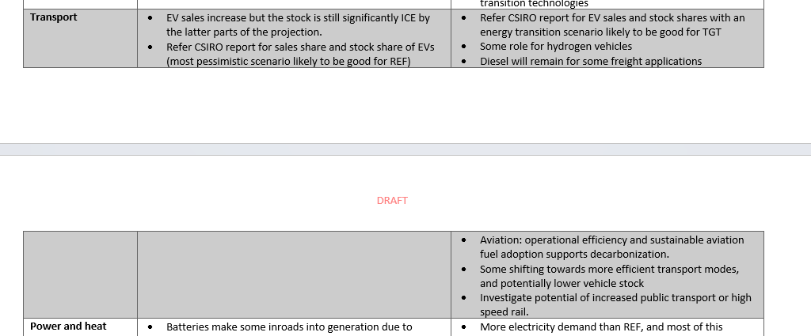

Slide 3
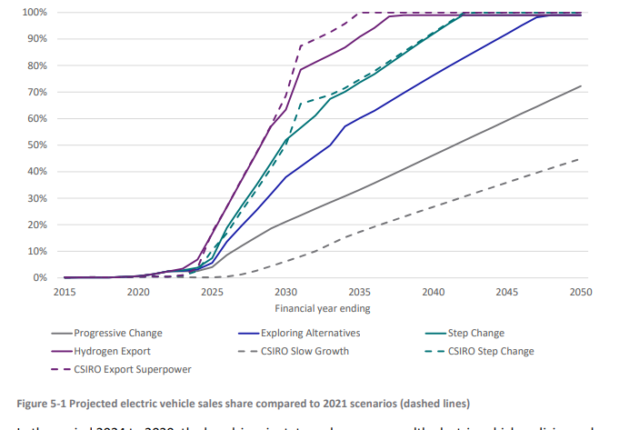
https://aemo.com.au/-/media/files/stakeholder_consultation/consultations/nem-consultations/2022/2023-inputs-assumptions-and-scenarios-consultation/supporting-materials-for-2023/csiro-2022-electric-vehicles-projections-report.pdf
Pg.59

Slide 4
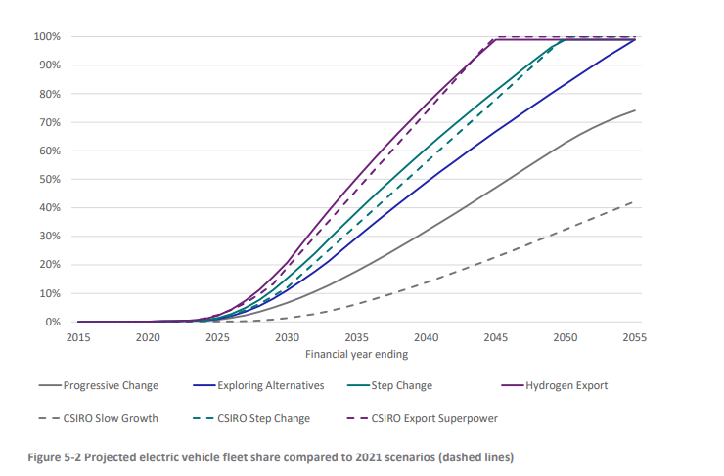
https://aemo.com.au/-/media/files/stakeholder_consultation/consultations/nem-consultations/2022/2023-inputs-assumptions-and-scenarios-consultation/supporting-materials-for-2023/csiro-2022-electric-vehicles-projections-report.pdf
Pg.61

Slide 5
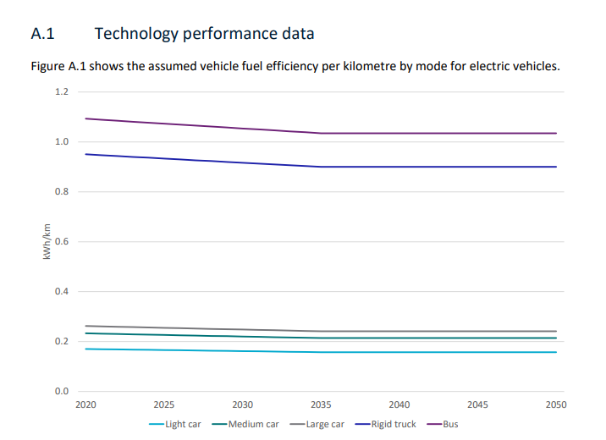
Note that after doing the conversion from kwh to billion km per pj, we found the values to be rather similar in my model:
0.2kwh/km = 1.39billion km / pj
1 kwh / km = 0.278
Find the values in data system/unit
conversions.xlsx

Slide 6
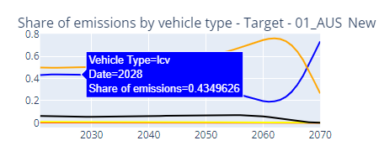
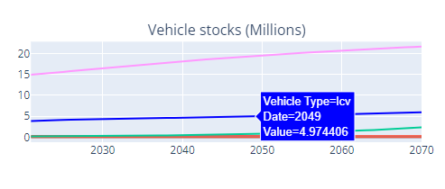
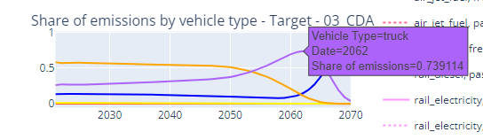
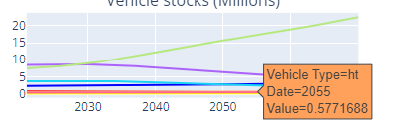
Just a quick note. LCV’s are a bit exaggerated for AUS because ute’s are being define as LCV’s within the AUS census. This makes the share of emissions for LCV’s in my calculations higher than it would otherwise be. Don’t really know how to fix that in a precise way so I will leave it.
However, just a guess, it should really be that emissions by vehicle type are more like the Canada chart below:
5/28/2024 Note I made a change to this in the end. I put half the lcvs into lts within the C:\Users\finbar.maunsell\github\transport_data_system\grooming_code\1_aus_census.py file.

Slide 7
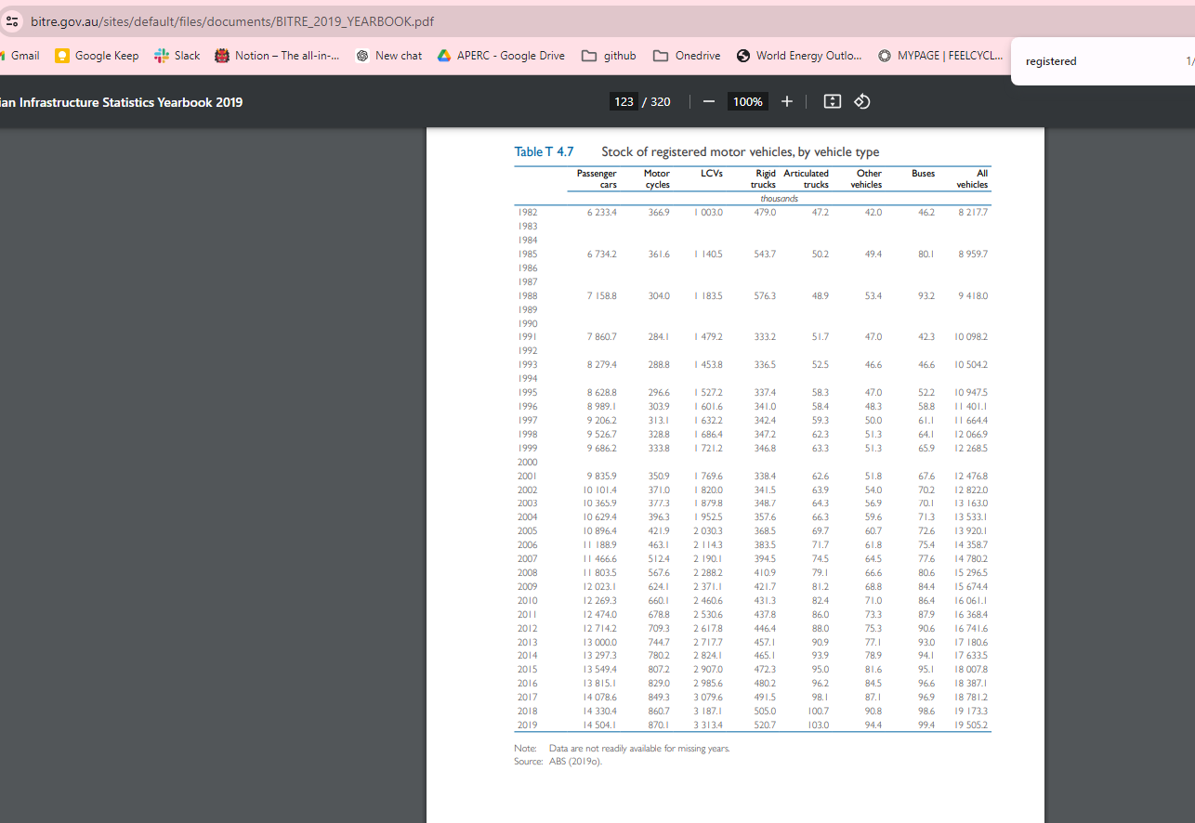
Data that slightly decreases LCV dominance and increases trucks and cars. However not by much!

