Slide 1
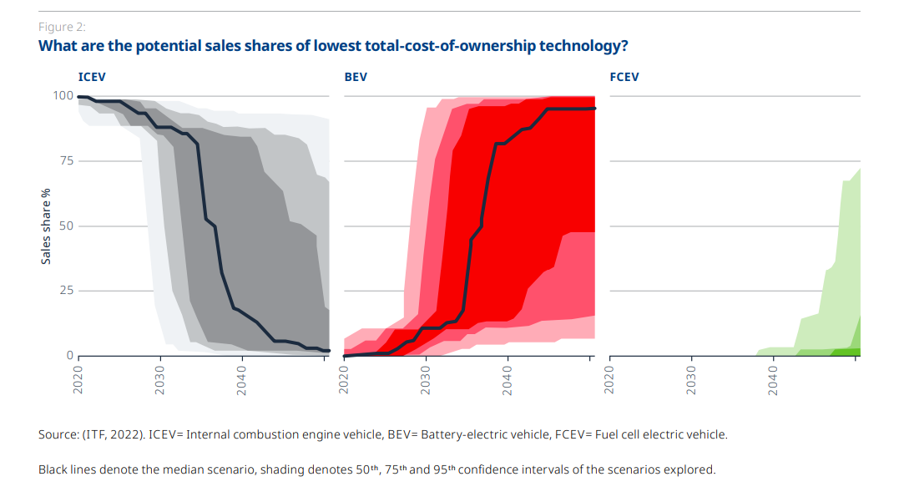
Notes:
https://www.itf-oecd.org/sites/default/files/docs/low-emission-trucks.pdf

