Slide 1
Intro etc.

Slide 2
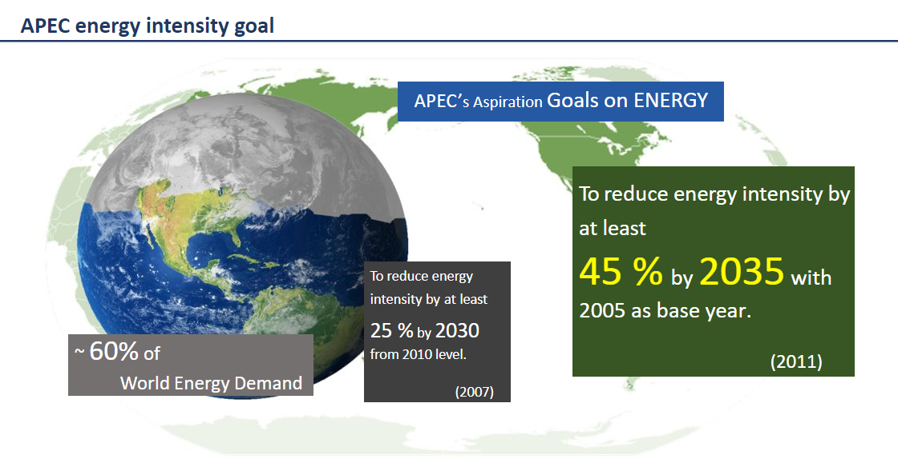
As a reminder:

Slide 3
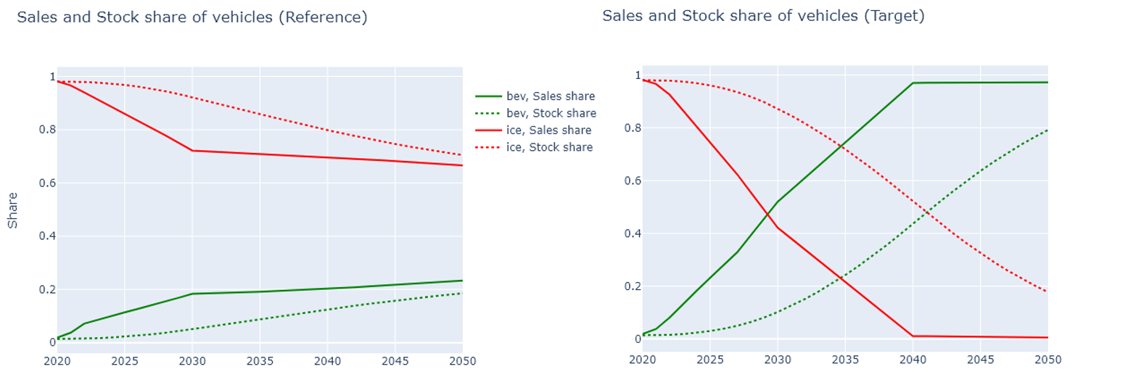
USA – sales share assumptions
Note that the Target scenario is our intended version of the Carbon Neutral scenario from the last Outlook (8th edition).

Slide 4
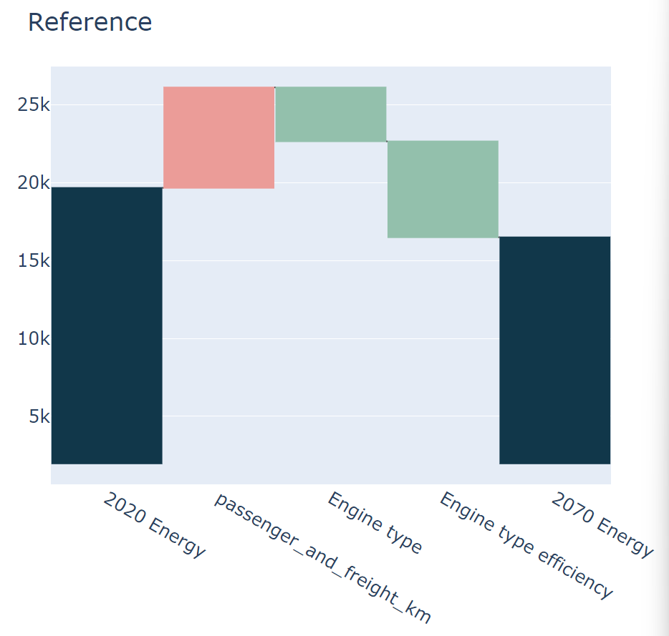
LMDI introduction
Decomposition method. Breaks down changes in energy use into its different drivers.
In the graph to the right, we see the red bar as an effect that causes an increase in energy use, and the green bars as effects that decrease energy use.
Passenger and freight km represents the effect of increases in activity, given the existing vehicle composition.
Engine type is the effect of switching the engine type. For example, moving from ICE to BEV’s.
Engine type efficiency captures all else, however, in this projection that is mostly from improvements to efficiency of pre-existing engine types (ICE’s), as modal switching has very little effect (<1%) and EV efficiency improvement is not assumed.
LMDI stands for log mean divisia index. Please ask me about it!

Slide 5
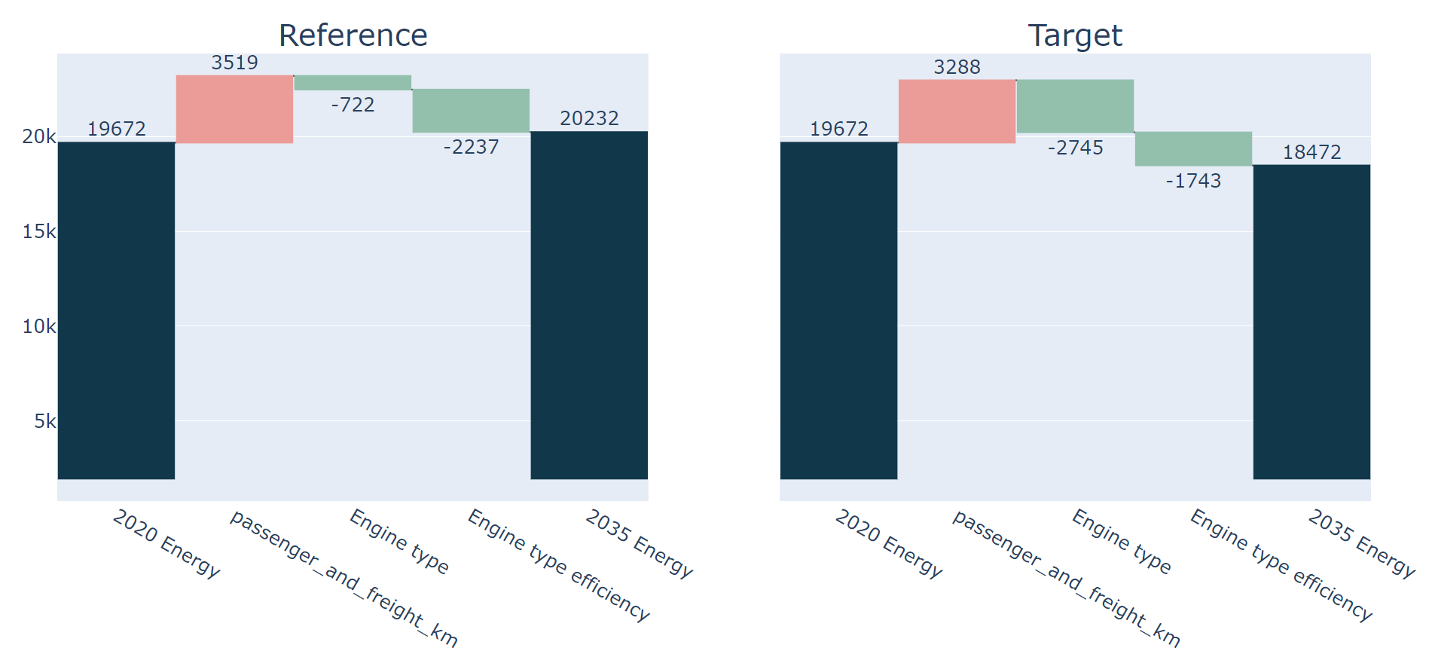
USA - 2035
The effect of switching to EV’s is about 2745PJ in the Target scenario compared to 722PJ in the Reference scenario.
The engine type efficiency effect is a little bit larger in Reference because of efficiency improvements in new ICE vehicles.
Engine type switching would lead to a 5% improvement in USA’s energy use and intensity across its whole economy, compared to the projected energy use in 2035*.
*From the Ref scenario

Slide 6
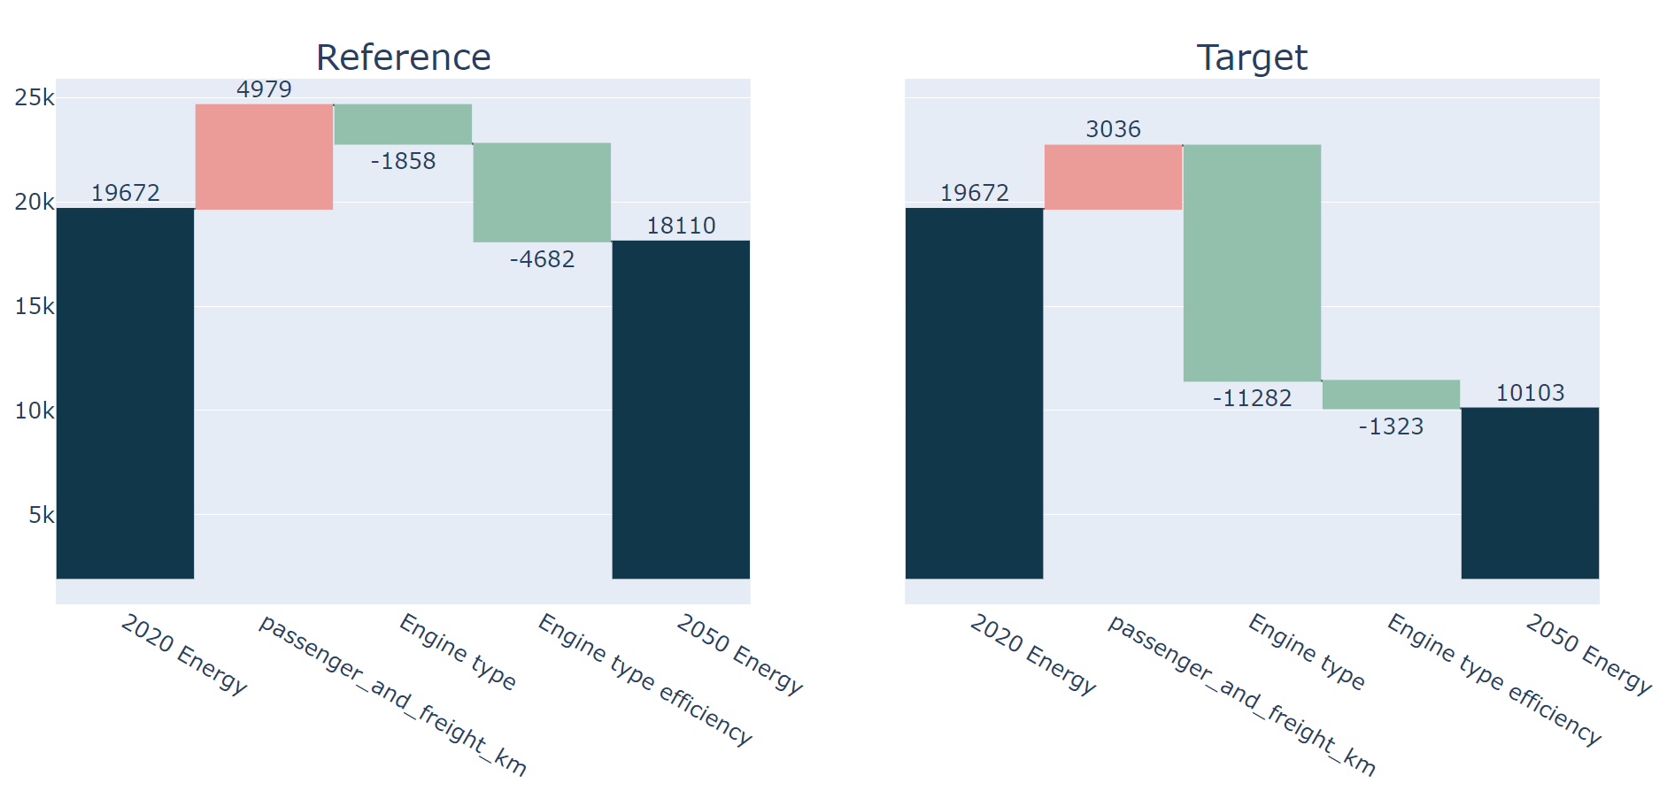
USA - 2050
Total effect of switching is now 11,282Pj, which is about a 50% improvement in intensity compared to if no EV’s were used at all.
For the USA’s whole economy, that would lead to a 16% improvement in energy use and intensity, given the projected energy use in 2050*.
*From the Ref scenario
Notes:
theory: new activity has less of an impact of energy so that’s why the pkm bar is smaller for tgt. It seems non logical but I think when you think about it, it would make sense to therefore show that the effect of pkm growth is lower..but worth considering as a weakness of lmdi

Slide 7
In summary:
By 2035, the impact of EV’s is relatively low. A 3000PJ decrease in energy use only decrease US energy intensity by 5%. But by 2050, it becomes 3 times more significant. This reflects the lag between sales share and stock share.
Since the US energy intensity is projected* to be 2.03 PJ per billion 2018 USD PPP in 2035 compared to 3.73 in 2005 (which is already a 45% drop), a 5% decrease would result in a drop to 1.92, which is an increase from 45 to 48% intensity improvement since 2005.
*In the Ref scenario
Notes:
Focusing on EV’s decreases the effects of improvements to efficiency within ICE engines. However, in the ref, with a constant 1% improvement rate to new vehicle efficiency, this is only expected to generate an effect of around 250PJ.
Could this be improved much more with same amount of money spent on evs?what is the kind of cutoff point where efficiency improvement gains acceptable improvements to replace evs? (probs never)
We are we yet again analysing the USA instead of different economies. Why? This is to help with comparison of the effects to other research.
The findings will be of similar proportions for different economies, changing because of factors such as current vehicle stock efficiency, projected growth and sales shares, and freight/passenger stock compositions.

Slide 8
One alternative: Improving ICE engine efficiency
For sake of finding the highest possible improvement, consider the achievement of these, gradually, until 2050:
Weight Reduction: A 10% reduction in vehicle weight through material improvements can lead to a 6.8% improvement in fuel economy*
Engine Efficiency: Let's assume a 25% improvement in thermal efficiency. Anymore and we would be approaching the efficiency of an f1!
Eco driving systems: for example, stop-start and autopilot. These systems could improve fuel economy by 5%.
Hybrid systems: these allow for regenerative breaking, shutting off the engine when stopped, and some extra power during acceleration. Depending on the design, the efficiency improvement can vary from 25% to 50%. We’ll assume 50%.
*https://www.energy.gov/eere/vehicles/lightweight-materials-cars-and-trucks

Slide 9
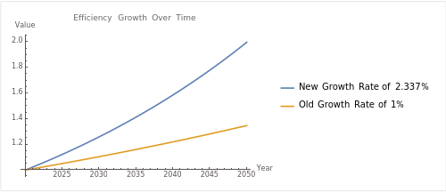
Alternative scenario – vehicle efficiency focus
So, we will consider a future where, in the Reference scenario, fuel economy is doubled between now and 2050.
Note: an improvement to intensity is the same as an improvement to efficiency, they are just inverses of each other.
Notes:
Revious efficiency growth rate was 1% per year till 2050, so =1.01^30 = 1.34 times improvement
The sales share remains the same in both scenarios. This helps to show how switching will cancel out the efficiency improvements

Slide 10
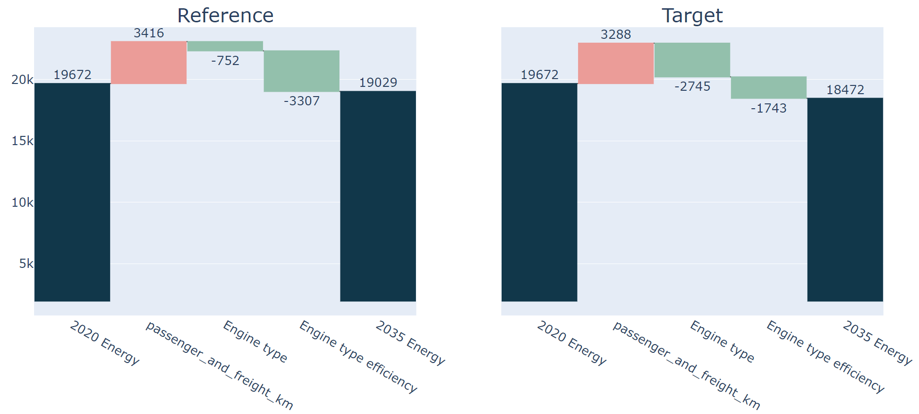
USA high efficiency growth - 2035
A focus on engine efficiency improvement can have a substantial effect. The Engine Type efficiency factor in the reference scenario grows from -2237 in the previous Reference scenario to -3307Pj here.
Still, as you can see in the Target scenario, the effect of engine switching is greater.

Slide 11
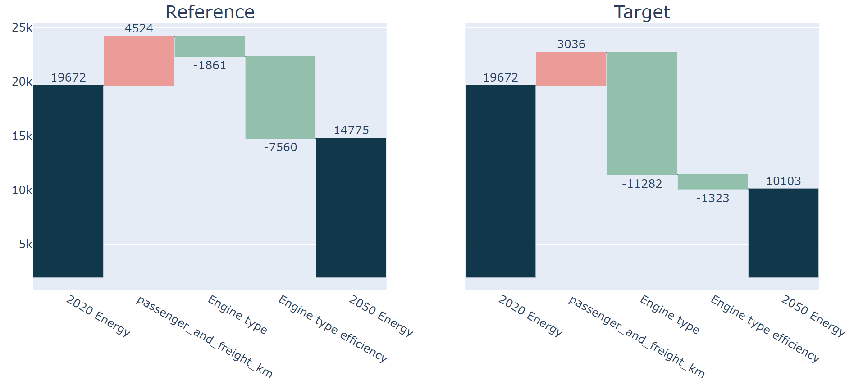
USA high efficiency growth - 2050
Total effect of engine efficiency improvements is 7560PJ in this Reference scenario. This is significant, but still, less than the effect of EV switching shown in the Engine type effect.
Notes:
theory: new activity has less of an impact of energy so that’s why the pkm bar is smaller for tgt. It seems non logical but I think when you think about it, it would make sense to therefore show that the effect of pkm growth is lower..but worth considering as a weakness of lmdi

Slide 12
So what?
In summary, it seems the impact of switching to the inherently more efficient EV is better for energy intensity than slowly switching out current ICE’s for marginally more efficient ICE’s.
But perhaps there are areas we are overlooking, like heavy freight, where a focus on ICE efficiency, including hybridization, may benefit intensity more. This is because the switch to alternative engine types is much slower.

Slide 13
What about other economies?
Thailand and Japan are attached. If you contact me I am happy to do it for your economy too.
Please note that these are just based on our modelling, so they depend on the underlying assumptions we are currently using. I am especially unsure about the underlying assumptions leading to the vehicle type effect for non-US economies.

Slide 14
References:
https://aperc.or.jp/reports/outlook.php - All published Outlook editions are here. A very interesting read from a group of very interesting researchers!
https://github.com/asia-pacific-energy-research-centre/PyLMDI - my code and documentation for producing LMDI analysis. It’s a bit old but I think it will still provide a good starting point for learning about it.
Contact me:
Finbar.maunsell@aperc.or.jp

Slide 15
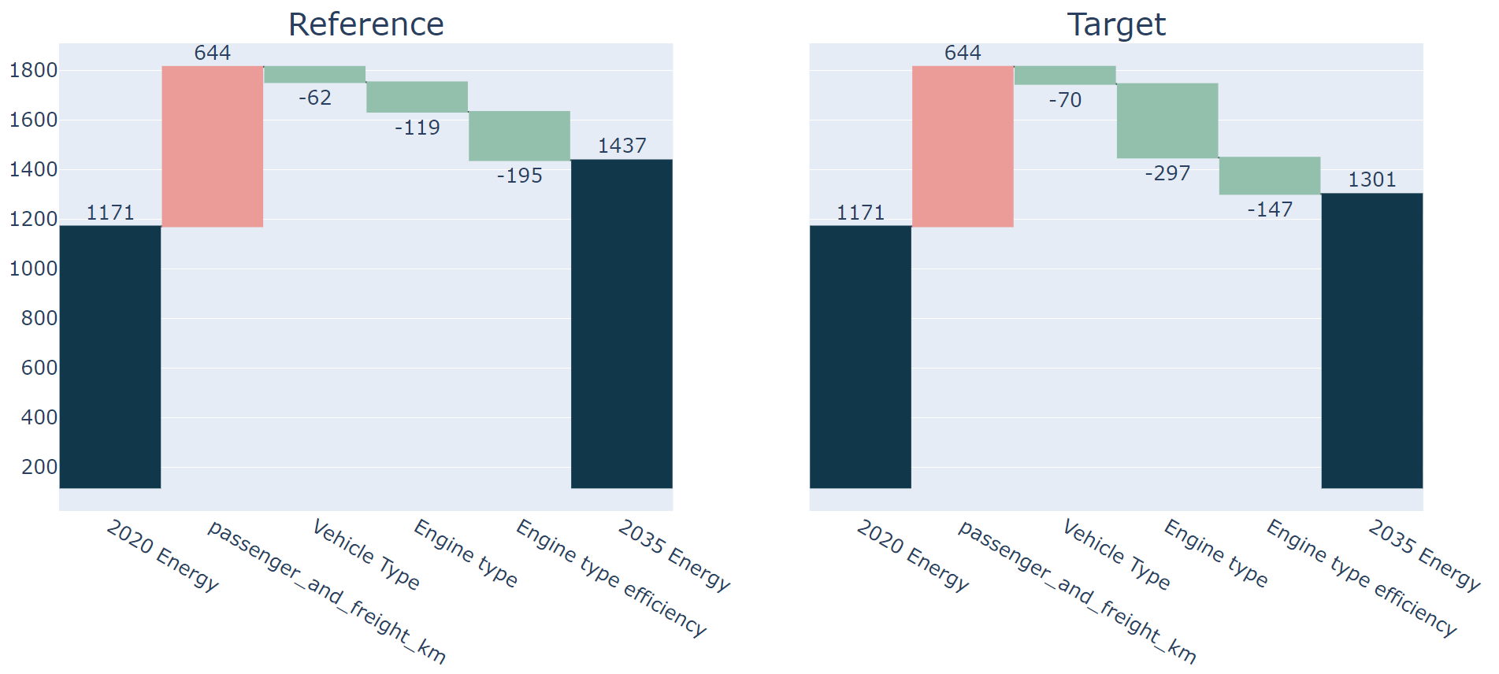
Thailand – 2035 – 1%

Slide 16
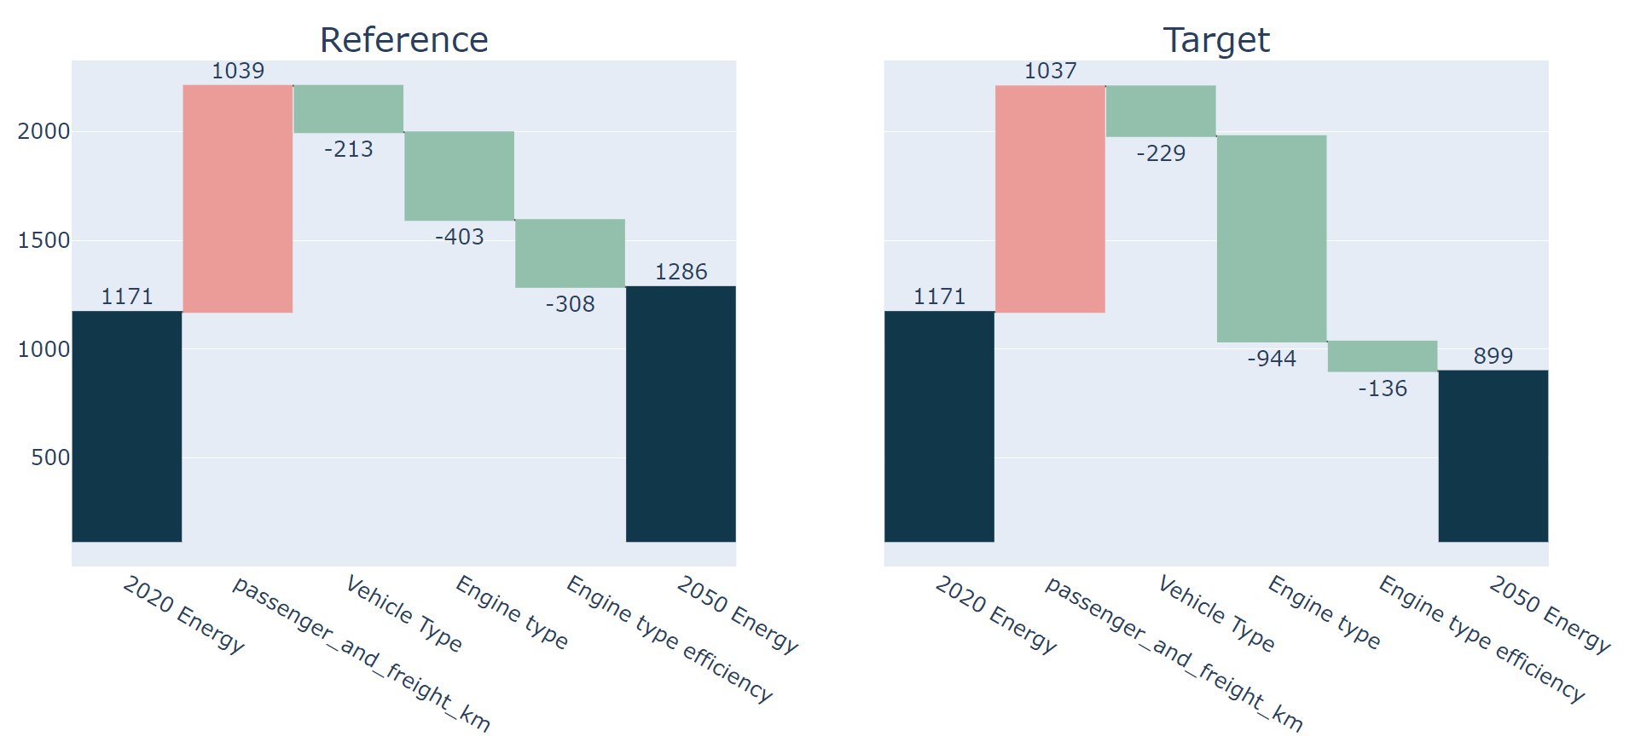
Thailand – 2050 – 1%

Slide 17
Thailand – 2035 – 2.3%

Slide 18
Thailand – 2050 – 2.3%

Slide 19
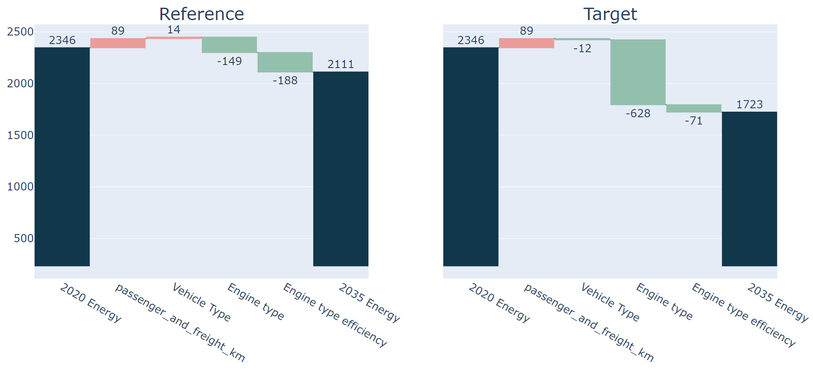
Japan – 2035 – 1%

Slide 20
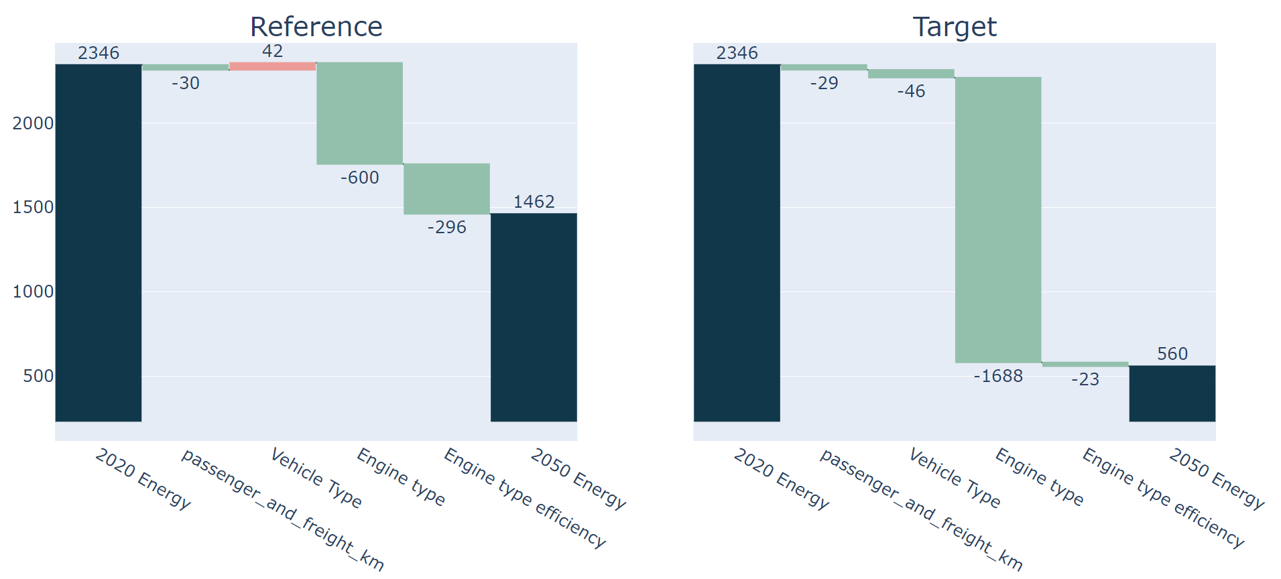
Japan – 2050 – 1%

Slide 21
Japan – 2035 – 2.3%

Slide 22
Japan – 2050 – 2.3%

