Slide 1
Potential for EVs to reduce APEC energy intensity
Finbar Maunsell, Asia Pacific Energy Research Centre (APERC), Researcher
Energy Efficiency Policy (EEP) Workshop
Manila, the Philippines, 16 October 2023

Slide 2
Outline of this presentation
We will look at my current projections for the USA in the transport model for the 9th edition of the Energy Outlook. We will use these projections to help analyse the effects of EVs on energy intensity.
We will utilize the log mean divisia index (LMDI) method to break down changes in energy use into its different drivers and compare the difference in effects between the Target and Reference scenarios in the outlook.
Please note in the Outlook:
The Reference scenario illustrates a pathway where existing policies are retained
The Target scenario illustrates a pathway for each economy towards realizing energy policy targets.

Slide 3

Reminder: APEC energy intensity goal
APEC’s Aspiration Goal on ENERGY Intensity
To reduce energy intensity by
45 % by 2035 with 2005 as base year.
(2011)
To reduce energy intensity by
25 % by 2030 from 2010 level.
(2007)
~ 60% of
World Energy Demand

Slide 4
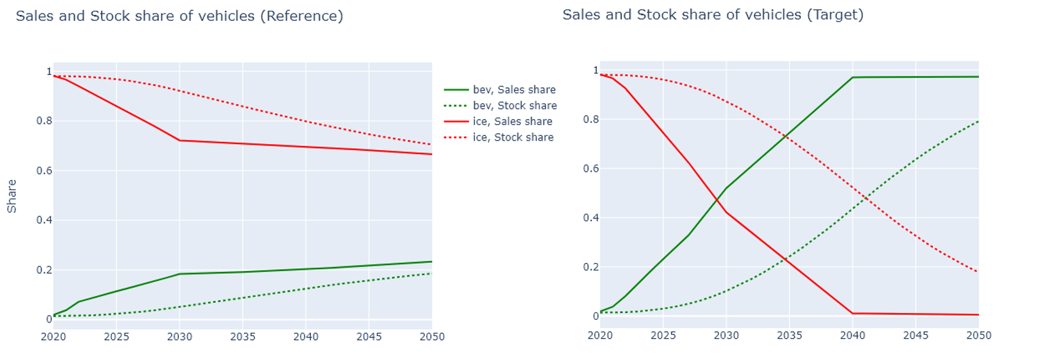
USA – two major assumptions to consider
Passenger and Freight Activity is assumed to remain the same in both the Reference and Target scenarios.
See here the current projections for battery electric vehicle and internal combustion engine sales and stock shares in the USA
Notice how stock share lags the sales share.
Notes:
Verbally:
Chose USA because it’s the economy for which we are the most confident about the data and projections, as well as having more related research to compare to.

Slide 5
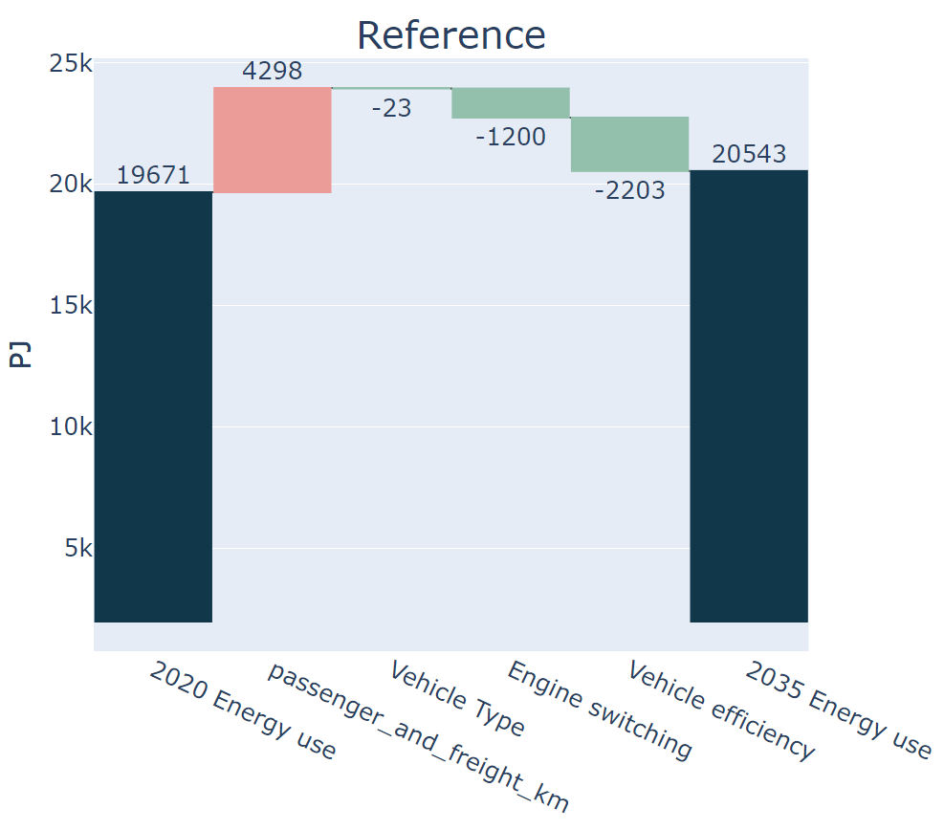
LMDI introduction
Breaks down changes in energy use into its different drivers.
In the graph to the right, we see the red bar as an effect that causes an increase in energy use, and the green bars as effects that decrease energy use.
Passenger and freight km represents the effect of increases in activity, given the existing vehicle composition.
In the graph to the right, increased activity led to an increase in energy use by 4298PJ*
Vehicle Type is the effect of switching to different modes of road transport, such as from car to bus.
A small increase in the share of bus use helped decrease energy use by 23PJ
Engine type is the effect of switching the engine type. For example, moving from ICE to BEV’s.
Increased stock share of EV’s to around 10% led to a decrease in energy use by 1200PJ
Vehicle efficiency captures all else, which, in the case of transport, is mostly from improvements to efficiency of pre-existing engine types (ICE’s).
1% annual improvement to the efficiency of all new vehicles led to a decrease in energy use by 2203PJ
LMDI stands for log mean divisia index. You can find more info at the end of the presentation.
*Activity is assumed to be the same between Reference and Target scenarios

Slide 6
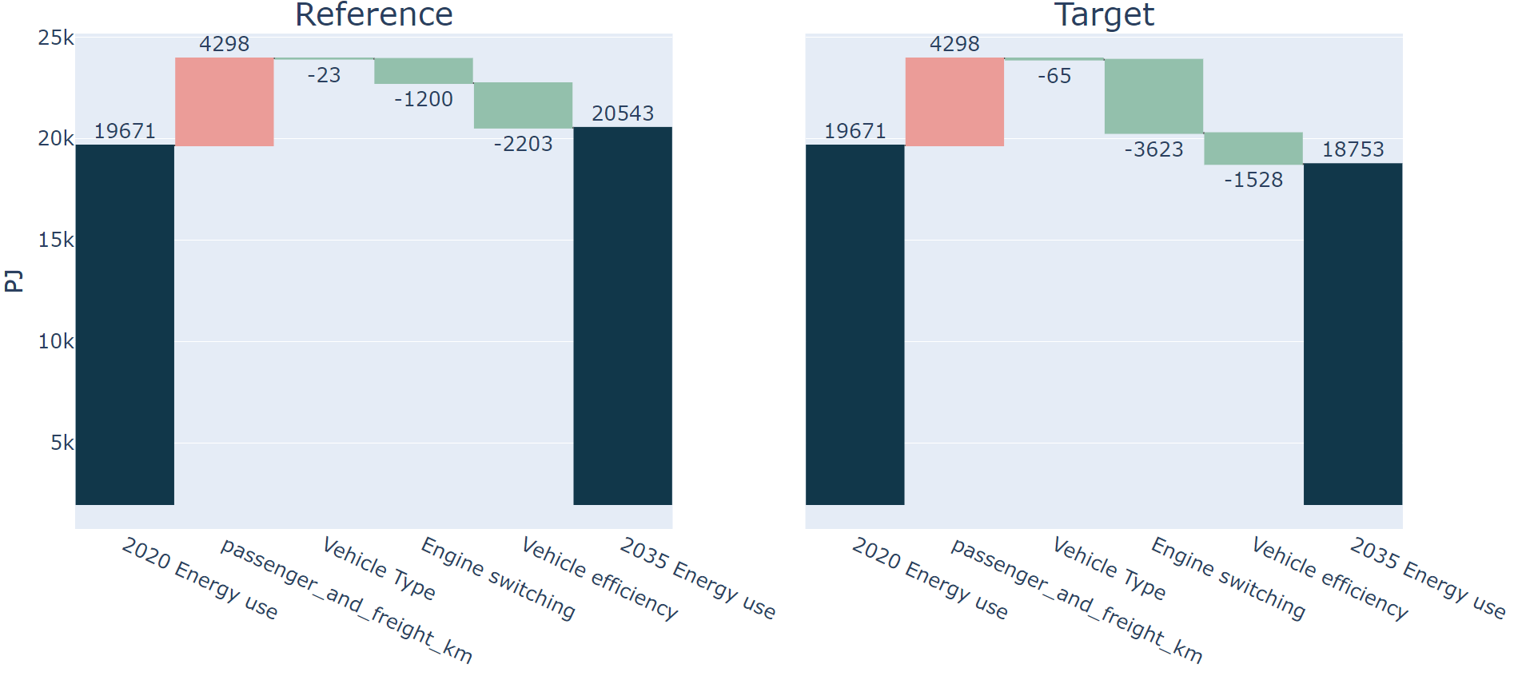
USA in 2035
The effect of a ~20% stock share of EV’s in the Target scenario led to a 3623PJ decrease in energy use, compared to 1200PJ in the Reference scenario.
Engine type switching in the Target scenario would lead to a ~6% improvement in USA’s energy use and intensity, when compared to the projected energy use (58150PJ*) for the whole economy in the Reference scenario, in 2035.
The vehicle efficiency effect is larger in Reference because of efficiency improvements in new ICE vehicles having more of an effect, because they have a higher sales share.
*Excludes non energy use

Slide 7
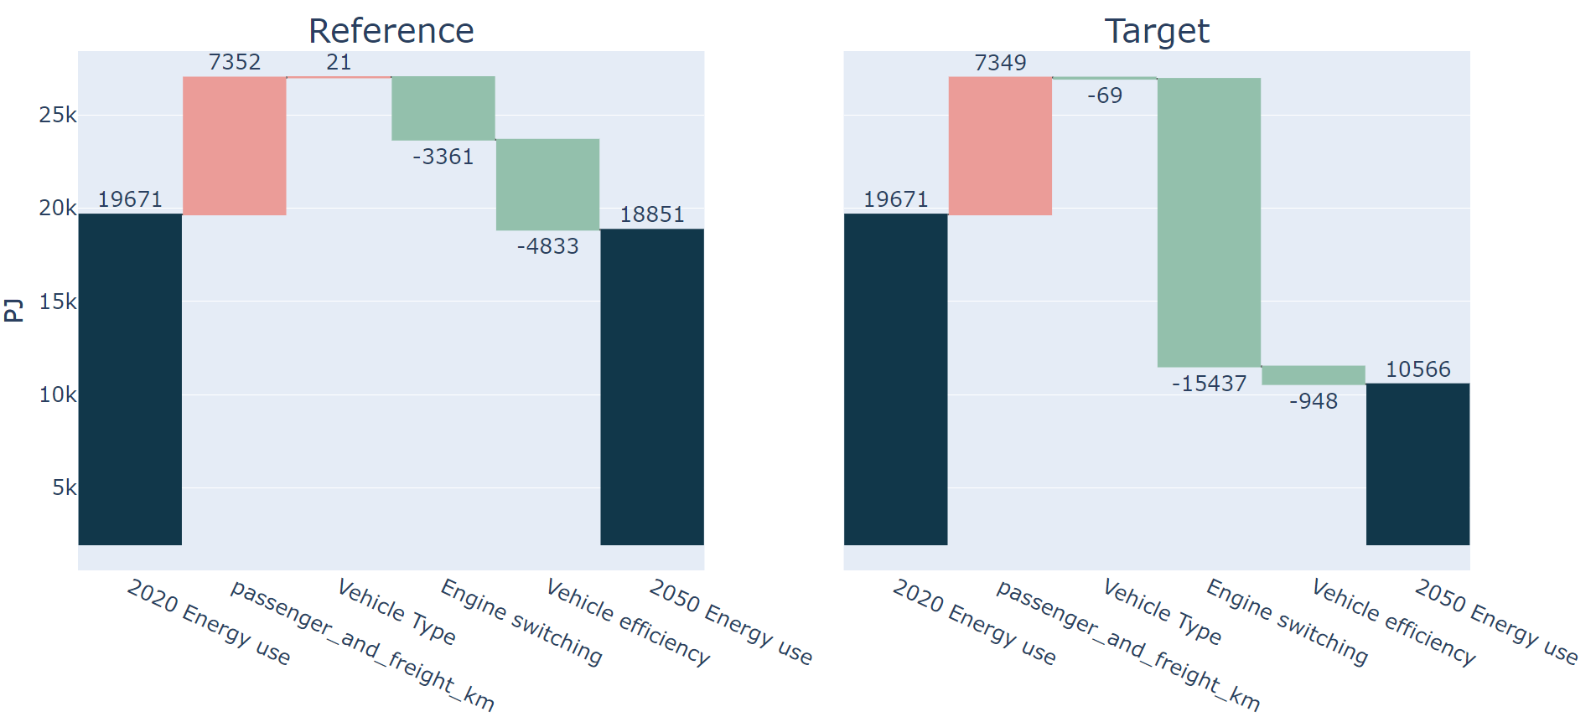
USA in 2050
Total effect of switching is now 15,437Pj, which is a ~60% improvement in transport intensity compared to if no EV’s were used at all.
For the USA’s whole economy, that would lead to a ~26% improvement in energy use and intensity, given the projected energy use in the Reference scenario in 2050.
Notes:
new activity has less of an impact of energy so that’s why the pkm bar is smaller for tgt. It seems non logical but I think when you think about it, it would make sense to therefore show that the effect of pkm growth is lower..but worth considering as a weakness of lmdi

Slide 8
In summary:
According to the Target scenario, in 2035, the impact of EV’s is relatively low. A 3623PJ decrease in energy use only decreases US energy intensity by ~6%. But by 2050, it becomes 4 times larger. This reflects the lag between sales share and stock share.
In the Reference scenario, the US whole-economy energy intensity is projected to be 2.08 PJ per billion 2018 USD PPP in 2035, compared to 3.57 in 2005 (which is already a 42% drop).
A 6% (3623PJ) decrease from increasing the share of EV’s would result in a drop to 1.95, which is an increase from 42 to 45% intensity improvement since 2005.
Notes:
Focusing on EV’s decreases the effects of improvements to efficiency within ICE engines. However, in the ref, with a constant 1% improvement rate to new vehicle efficiency, this is only expected to generate an effect of around 250PJ.
Could this be improved much more with same amount of money spent on evs?what is the kind of cutoff point where efficiency improvement gains acceptable improvements to replace evs? (probs never)
We are we yet again analysing the USA instead of different economies. Why? This is to help with comparison of the effects to other research.
The findings will be of similar proportions for different economies, changing because of factors such as current vehicle stock efficiency, projected growth and sales shares, and freight/passenger stock compositions.
USA GDP 2005 1.64663E+13
USA GDP 2035: 27892491457446.1
USA GDP 2050: 3.72306E+13
USA energy 2005 58803
USA energy 2035 58150
USA energy 2050 59311
USA inten 2005 3.57
USA inten 2035 2.08
USA inten 2050 1.59
Change in intensity 2035: =(58150-3623)/(27892491457446.1/1000000000)

Slide 9
One alternative: Improving ICE engine efficiency
For sake of finding the highest possible improvement, consider the gradual achievement of these until 2050:
Weight Reduction: A 10% reduction in vehicle weight through material improvements can lead to a 6.8% improvement in fuel economy*
Engine Efficiency: Let's assume a 25% improvement in thermal efficiency of engines. This will be expensive but is possible.
Eco driving systems: for example, stop-start and autopilot. I estimated that these systems could improve fuel economy by ~5%.
Hybrid systems: these allow for regenerative breaking, shutting off the engine when stopped, and some extra power during acceleration. Depending on the design, the efficiency improvement can vary from 25% to 50%. We’ll assume 50%.
*https://www.energy.gov/eere/vehicles/lightweight-materials-cars-and-trucks

Slide 10
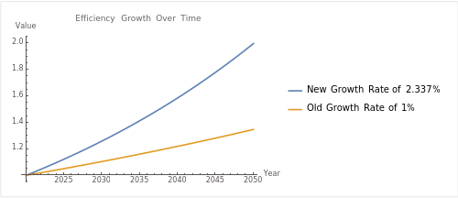
Alternative scenario – vehicle efficiency focus
So, we will consider a future where, in the Reference scenario, fuel economy is doubled between now and 2050.
Note: an improvement to intensity is the same as an improvement to efficiency, they are just inverses of each other.
Notes:
Revious efficiency growth rate was 1% per year till 2050, so =1.01^30 = 1.34 times improvement
The sales share remains the same in both scenarios. This helps to show how switching will cancel out the efficiency improvements

Slide 11
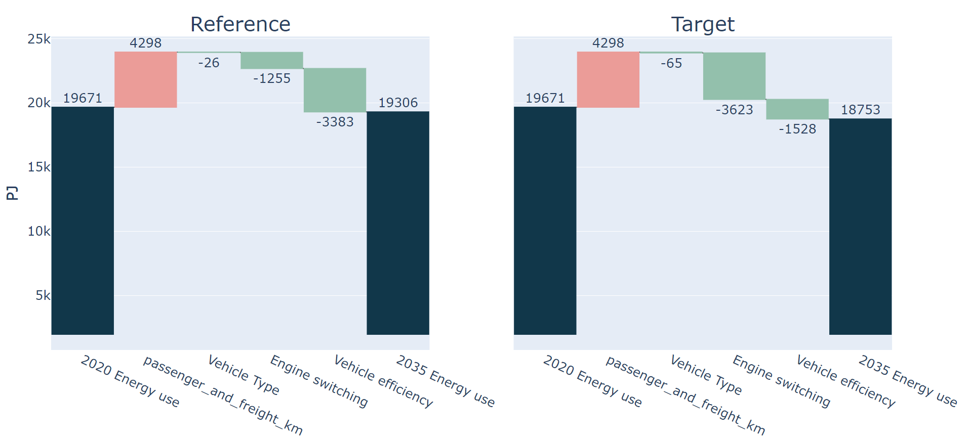
USA high efficiency growth - 2035
An increase in vehicle efficiency by a factor of ~1.4 compared to ~1.2 has led the Vehicle efficiency factor in the reference scenario to grow from -2203 in the previously shown Reference scenario to -3383Pj here.
Still, as you can see in the Target scenario, the effect of engine switching is greater.

Slide 12
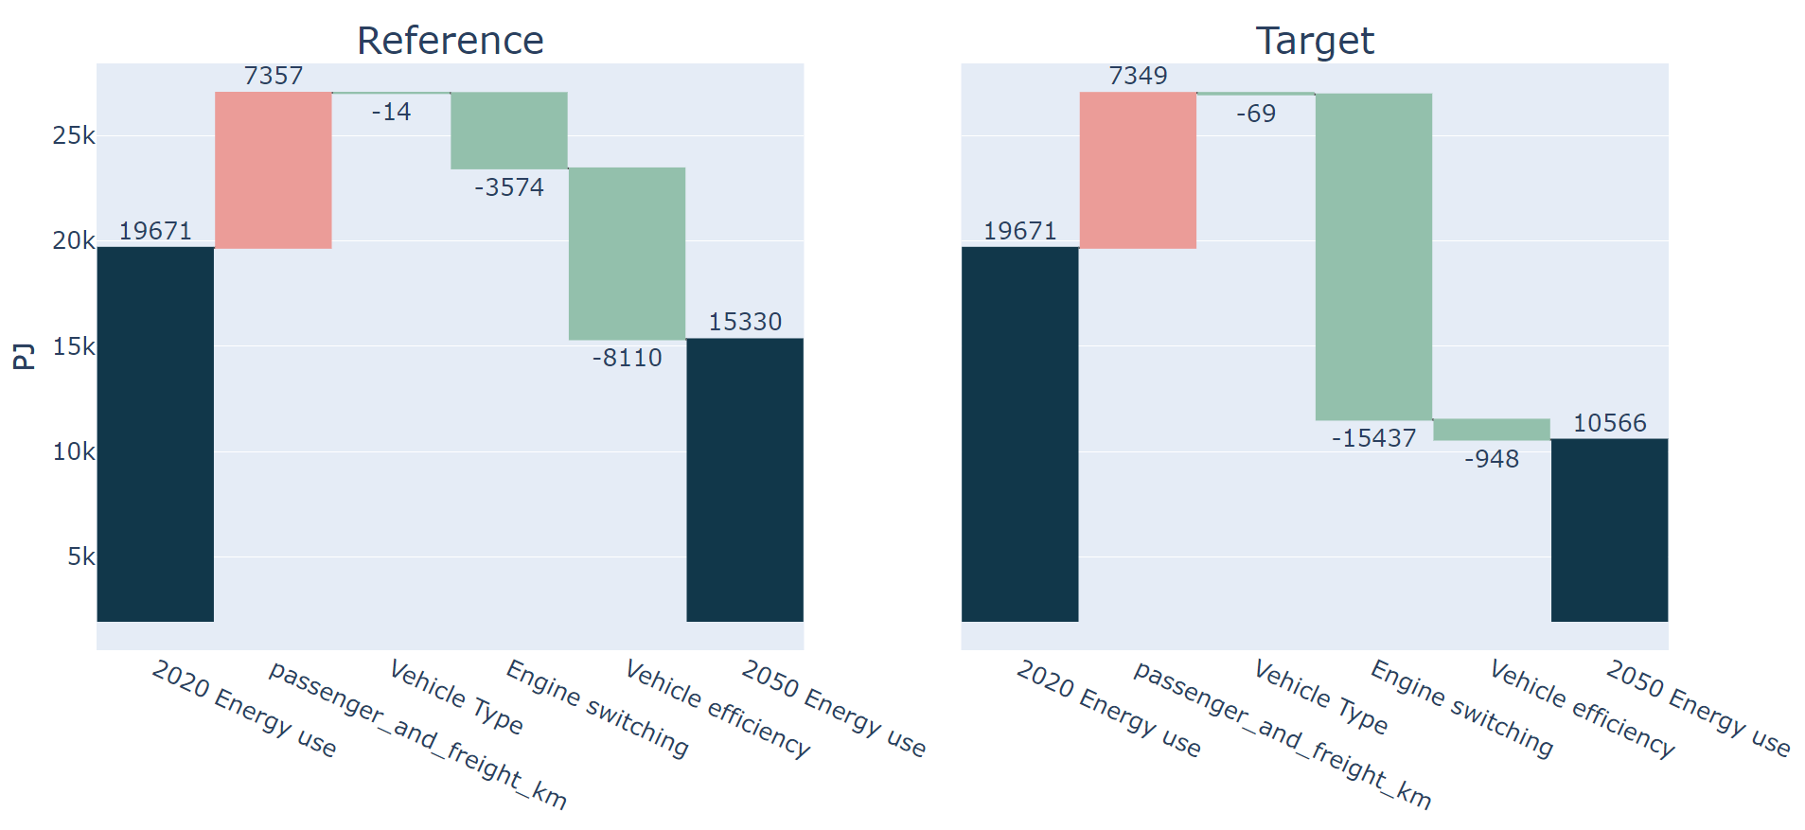
USA high efficiency growth - 2050
Total effect of Vehicle efficiency improvements is 8110PJ in this Reference scenario. This is significant, but still, less than the effect of EV switching shown in the Engine switching effect in the Target scenario.
Notes:
new activity has less of an impact of energy so that’s why the pkm bar is smaller for tgt. It seems non logical but I think when you think about it, it would make sense to therefore show that the effect of pkm growth is lower..but worth considering as a weakness of lmdi

Slide 13
So what?
In summary, it seems the impact of switching to the more efficient EV is better for energy intensity than slowly switching out current ICE’s for marginally more efficient ICE’s.
But perhaps there are areas we are overlooking, like heavy freight, where a focus on ICE efficiency, including hybridization, may benefit intensity more. This is because the switch to alternative engine types is expected to be slower, because of the cost of the batteries or hydrogen for fuel cell vehicles.

Slide 14
What about other economies?
Thailand and Japan are attached. If you contact me, I am happy to show you our results for your economy too.
Please note that these are just based on our modelling, so they depend on the underlying assumptions we are currently using. I am especially unsure about the underlying assumptions leading to the vehicle type effect for non-US economies.

Slide 15
References:
https://aperc.or.jp/reports/outlook.php - All published Outlook editions are here. A very interesting read from a group of very interesting researchers!
https://github.com/asia-pacific-energy-research-centre/PyLMDI - my code and documentation for producing LMDI analysis. It’s a bit old but I think it will still provide a good starting point for learning about it.
Contact me:
Finbar.maunsell@aperc.or.jp

Slide 16
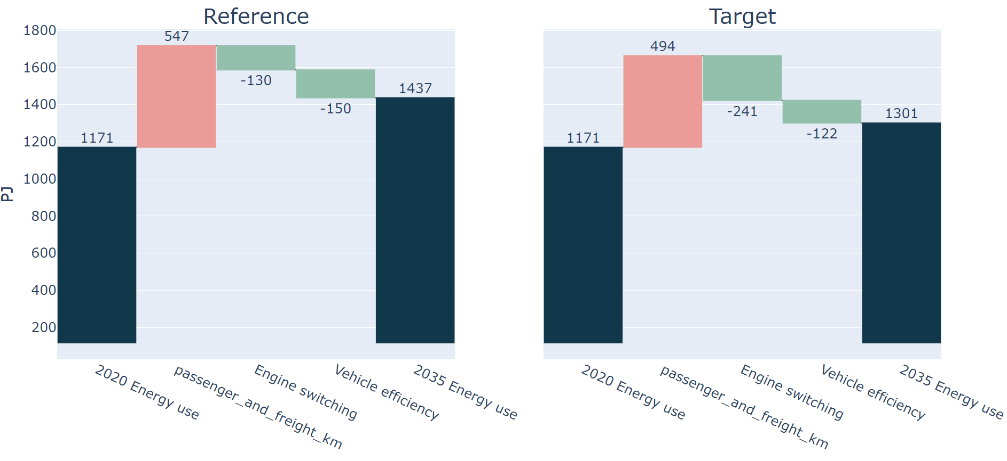
Thailand – 2035 – 1%

Slide 17
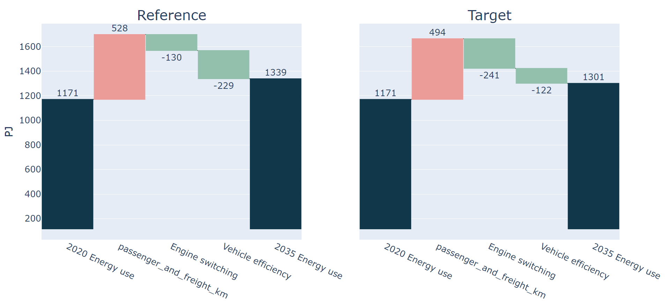
Thailand – 2035 – 2.3%

Slide 18
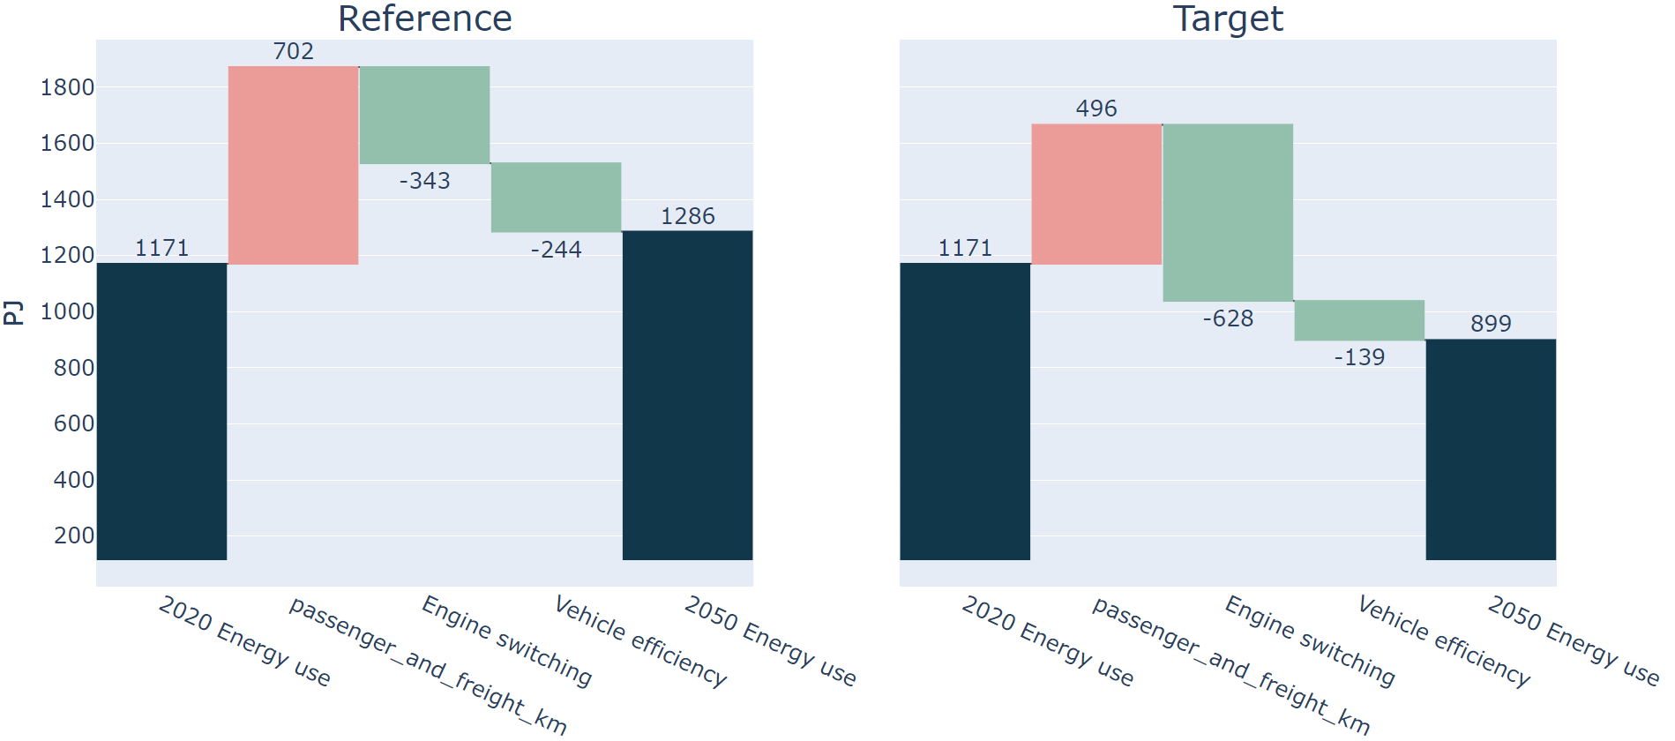
Thailand – 2050 – 1%

Slide 19
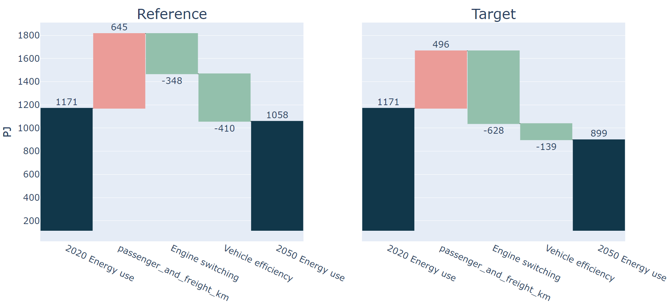
Thailand – 2050 – 2.3%

Slide 20
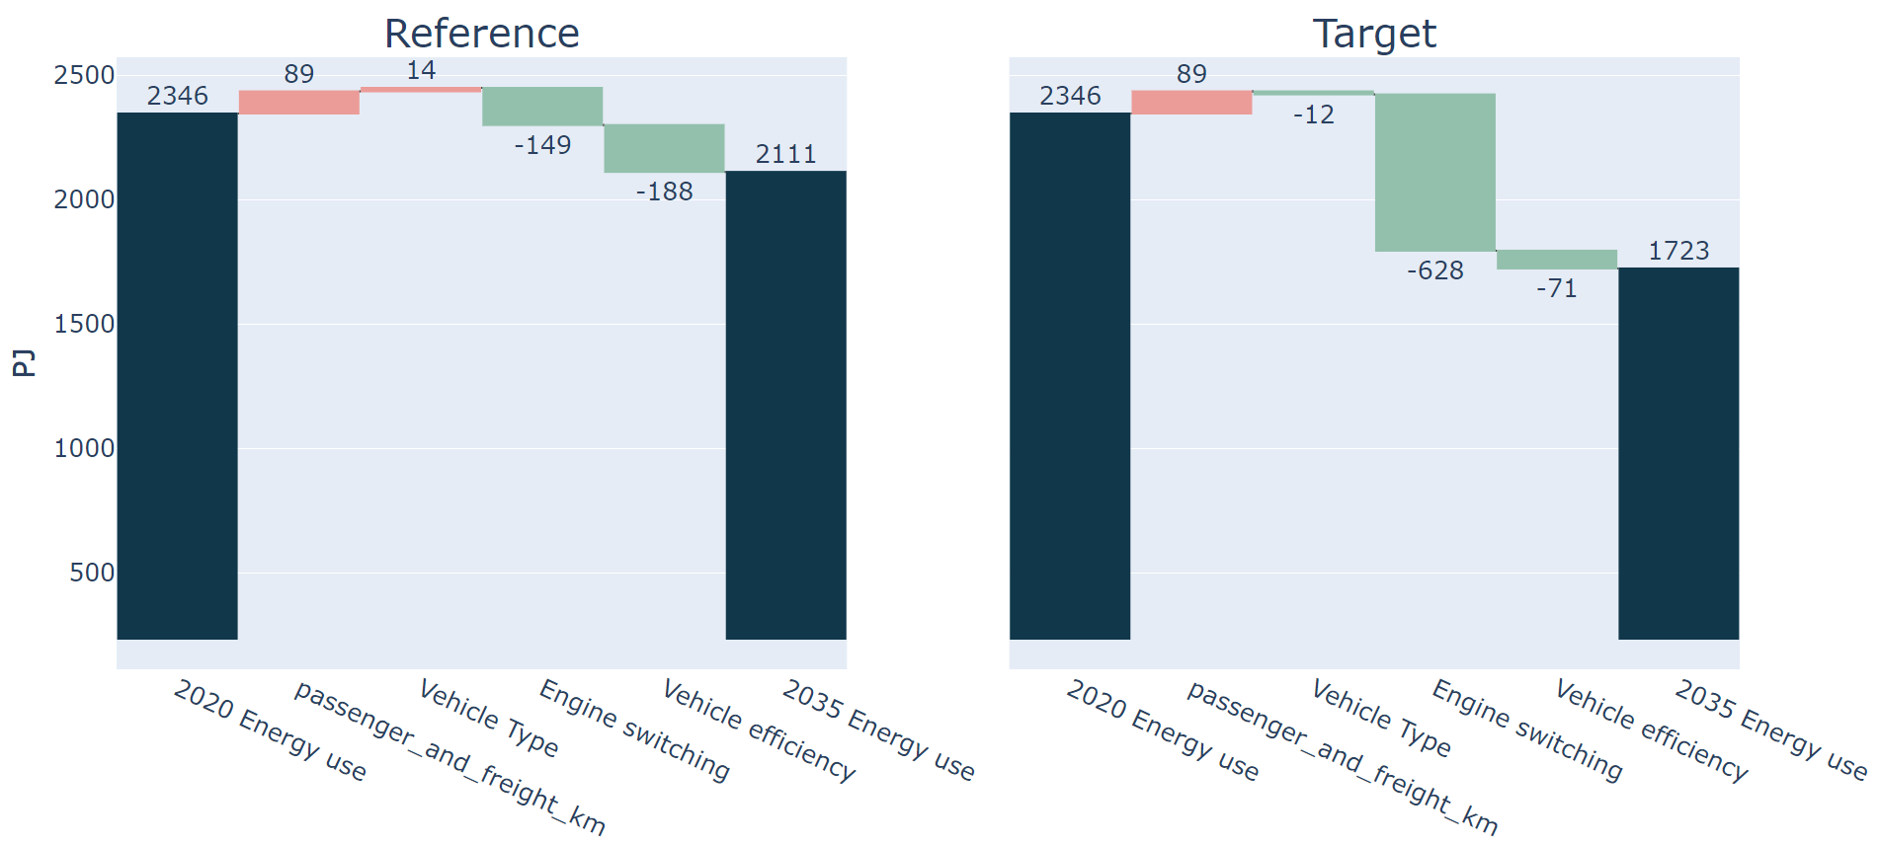
Japan – 2035 – 1%

Slide 21
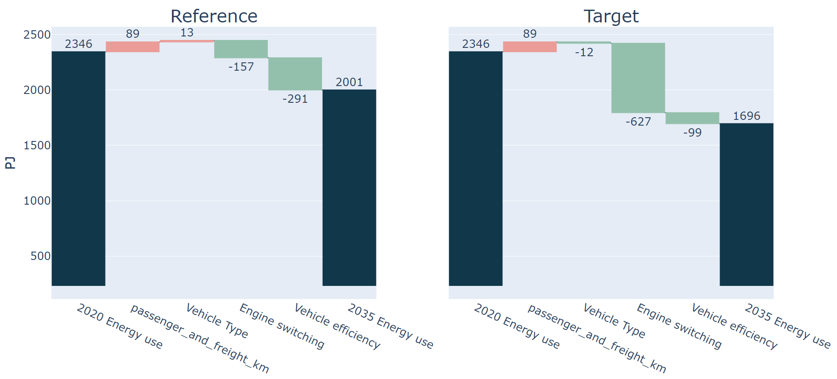
Japan – 2035 – 2.3%

Slide 22
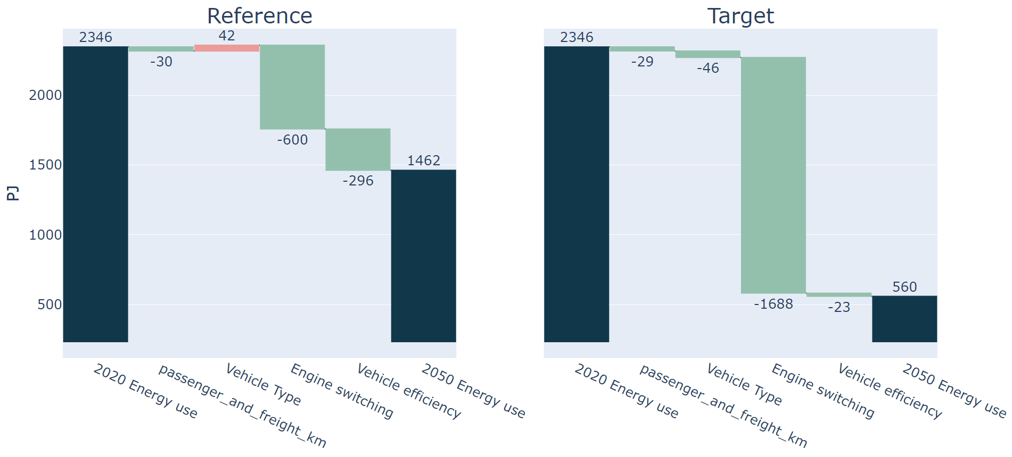
Japan – 2050 – 1%

Slide 23
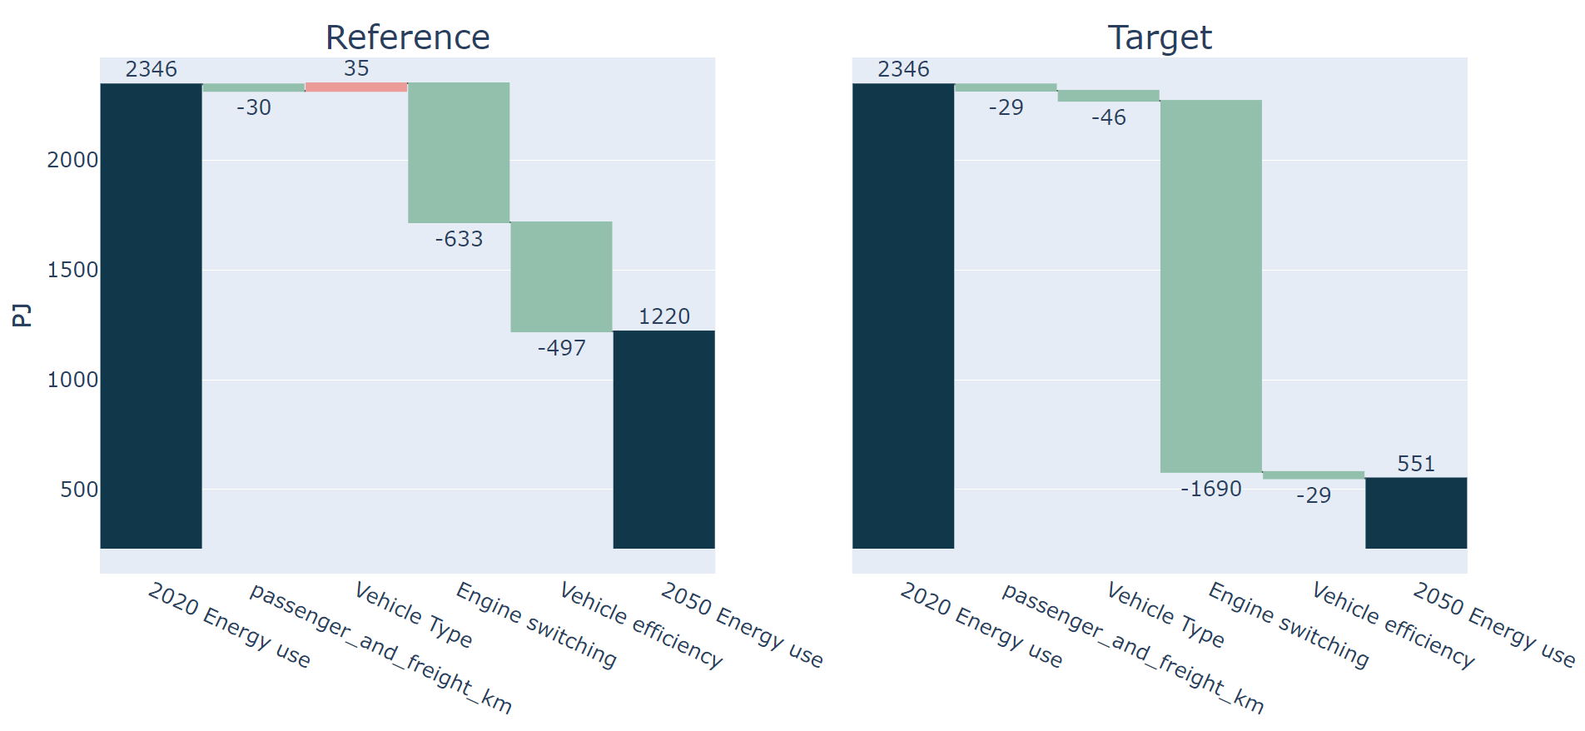
Japan – 2050 – 2.3%

