Slide 1
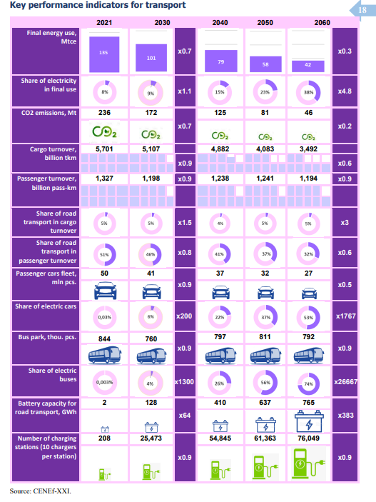
This is target case. Don’t expect electric vehicles to be as successful even at <cost parity because of cold weather decreasing battery capacity.

Slide 2
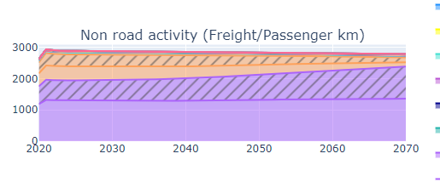
Year | million tons to the East by railroads | Km (Moscow to irkutsk | fkm (billions) | prop change
2022 | 150 | 5000 | 750
2023-2024 | 180 | 5000 | 900 | 0.2
2026-2027 | 197 | 5000 | 985 | 0.313333
2030 | 210 | 5000 | 1050 | 0.4
2032 | 255 | 5000 | 1275 | 0.7
Alex has expectation that Russian freight rail could alsmot double by 2035 because of exports having to be exported via the east (not to Europe anymore). To do this I will have to increase activity growth of rail up to 2035. Can expect it would be like an increase in mileage, for rail. Or a decrease in activity efficiency.
This is what rail looked like previous to this change (orange is diesel, purple is electric) (basically 1000 billion fkm)

