Slide 1

The Traveling Salesman Problem using Combinatorial Optimization

Slide 2

"Given a list of cities and the distances between each pair of cities, what is the shortest possible route that visits each city exactly once and returns to the origin city?"

Slide 3
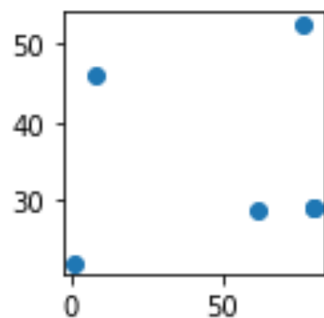
How can we solve it without using any optimization algorithm?
For example, we have 5 cities to find the shortest path, at any first city we have to permutate these cities and sum all distances and find the shortest path in these permutations.
But doing this, the permutation for 5 cities is 5! That doesn't take much time, but what if 10 cities or more?

Slide 4

Combinatorial Optimization can help to decrease the time to do this

Slide 5
These algorithm are used to solve the travelling salesman problem
Genetic Algorithm
Simulated Annealing Algorithm
Hill Climbing Algorithm
Tabu Search Algorithm
Ant Colony Optimization

Slide 6
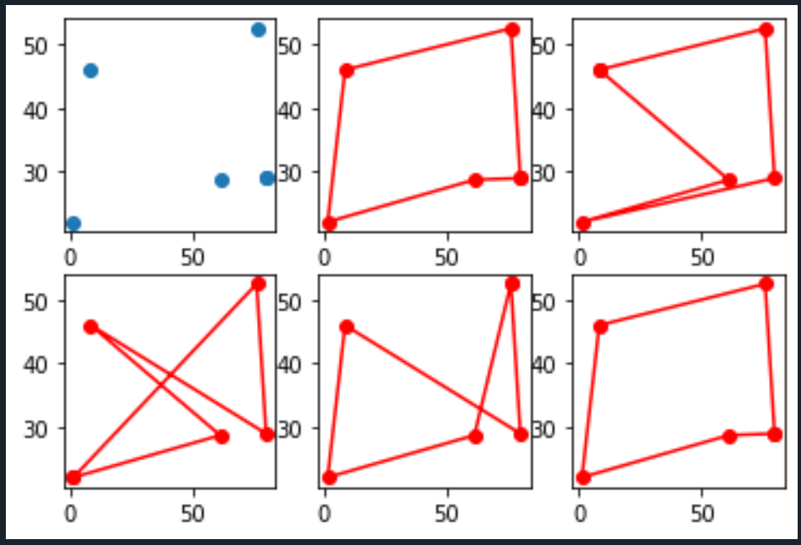
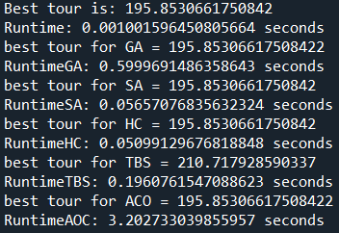
Finding shortest path for 5 cities

Slide 7
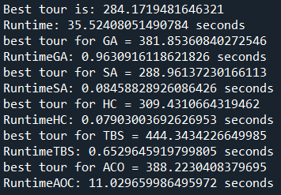
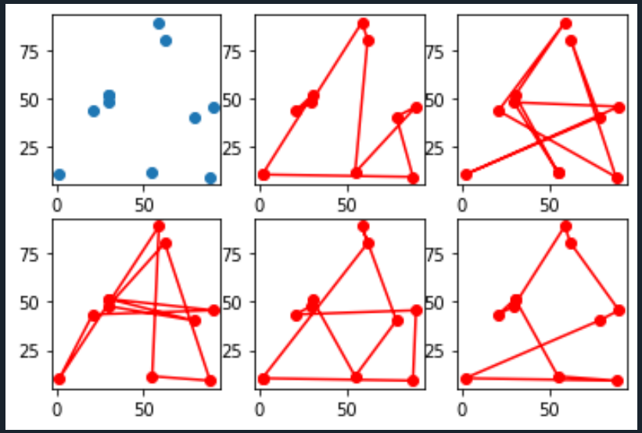
Finding shortest path for 10 cities

Slide 8
Summary

