Slide 1
Arrays

Slide 2
Outline
Array ADT
Matrix
Symmetric Matrix
Triangular Matrix
Symmetric Band Matrix
Sparse Matrix
Representation， Transposing

Slide 3
Arrays
Array:
a set of pairs (index and value)
data structure:
For each index, there is a value associated with that index.
representation (possible):
implemented by using consecutive memory.

Slide 4
The Array ADT
Objects: A set of pairs <index, value> where for each value of index
there is a value from the set item. Index is a finite ordered set of one or
more dimensions, for example, {0, … , n-1} for one dimension,
{(0,0),(0,1),(0,2),(1,0),(1,1),(1,2),(2,0),(2,1),(2,2)} for two dimensions,
etc.
Methods:
for all A ∈ Array, i ∈ index, x ∈ item, j, size ∈ integer
Array Create(j, list)
// return an array of j dimensions where list is a j-tuple whose kth element is the
//size of the kth dimension. Items are undefined.
Item Retrieve(A, i)
// if (i ∈ index) return the item associated with index value i in array A
// else return error
Array Store(A, i, x)
// if (i in index) return an array that is identical to array A except the new pair
//<i, x> has been inserted else return error

Slide 5
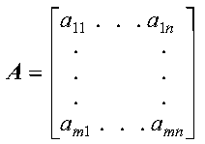
Matrices
Two-dimensional arrays are a particularly common representation for matrices.
A matrix, also referred to as a general matrix, is an m by n ordered collection of numbers. It is represented symbolically as:
where the matrix is named A and has m rows and n columns. And a_{ij} is the element in ith row and jth column of matrix A.

Slide 6
Matrices
A matrix appears as two-dimensional,but physically it is stored in a linear fashion. How to represent this two-dimensional array？
1 2 3
A= 4 5 6
7 8 9

Slide 7
Matrices
Common ways to index into multi-dimensional arrays include:
Row-major order:
The elements of each row are stored in order.
Column-major order:
The elements of each column are stored in order.
1 | 2 | 3 | 4 | 5 | 6 | 7 | 8 | 9
1 | 4 | 7 | 2 | 5 | 8 | 3 | 6 | 9

Slide 8
Matrices
Row-major order:
Col 0
Col 1
Col 2
Col u₂ - 1
Row 0
X
X
X
X
Row 1
X
X
X
X
Row u₁ - 1
X
X
X
X
u₂
elements
u₂
elements
Row 0
Row 1
Row i
Row u₁ - 1
i * u₂ element

Slide 9
Matrices
So,in order to map logical view to physical structure,we need indexing formula.
  Row-major order:Assume that the base address is at M,the address of a_{ij} will be obtained as
Address(a_{ij})=M+(i-1)*n+j-1
  Column-major order:Considering the base address at M,the formula will stand as
Address(a_{ij})=M+(j-1)*n+i-1

Slide 10
Symmetric Matrix
The matrix A is symmetric if it has the property A equal to A^{T}, which means:
  It has the same number of rows as it has columns; that is, it has n rows and n columns.
  The value of every element a_{ij} on one side of the main diagonal equals its mirror image a_{ji} on the other side: a_{ij} equal to a_{ji}.

Slide 11
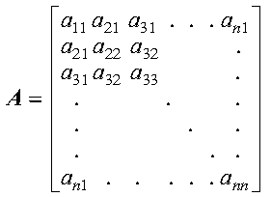
Symmetric Matrix
The following matrix illustrates a symmetric matrix of order n; that is, it has n rows and n columns. The subscripts on each side of the diagonal appear the same to show which elements are equal:

Slide 12
Symmetric Matrix
When a symmetric matrix is stored in lower-packed storage mode, the lower triangular part of the symmetric matrix is stored, including the diagonal, in a one-dimensional array.
The lower triangle can be packed by row or columns. The matrix is packed sequentially row by row (column by column) in n(n+1)/2 elements of a one-dimensional array.
When the matrix is packed sequentially row by row ,to calculate the location k of element a_{ij} of matrix A in an array, use the following formula:
k=i*(i-1)/2+j-1 i>=j, lower triangular part
k=j*(j-1)/2+i-1 i<j , upper triangular part

Slide 13
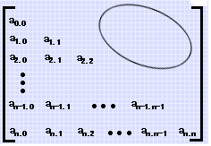
Triangular Matrix
A matrix of the form
is called a triangular matrix.

Slide 14
Triangular Matrix
There are two types of triangular matrices: upper triangular matrix and lower triangular matrix. Triangular matrices have the same number of rows as they have columns; that is, they have n rows and n columns.
A matrix U is an upper triangular matrix if its nonzero elements are found only in the upper triangle of the matrix, including the main diagonal; that is: u_{ij} equal to 0（or constant C） if i greater than j
A matrix L is an lower triangular matrix if its nonzero elements are found only in the lower triangle of the matrix, including the main diagonal; that is: l_{ij} equal to 0 （or constant C） if i less than j

Slide 15
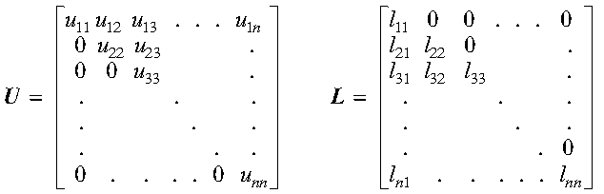
Triangular Matrix
The following matrices, U and L, illustrate upper and lower triangular matrices of order n, respectively:

Slide 16
Triangular Matrix
When a lower-triangular matrix is stored in lower-triangular-packed storage mode, the lower triangle of the matrix is stored, including the diagonal, in a one-dimensional array. The lower triangle is packed by row or by columns. The elements are packed sequentially, row by row (column by column), in n(n+1)/2 elements of a one-dimensional array. To calculate the location of each element of the triangular matrix in the array, use the technique described in Symmetric Matrix.
When an upper-triangular matrix is stored in upper-triangular-packed storage mode, the upper triangle of the matrix is stored, including the diagonal, in a one-dimensional array.

Slide 17
Symmetric Band Matrix
A symmetric band matrix is a symmetric matrix whose nonzero elements are arranged uniformly near the diagonal, such that: a_{ij} equal to 0 if |i-j| greater than k，where k is the half band width.

Slide 18
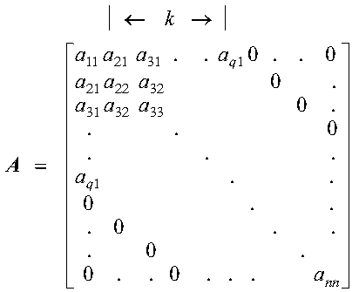
Symmetric Band Matrix
The following matrix illustrates a symmetric band matrix of order n, where the half band width k equal to q-1:
Only the band elements of the symmetric band matrix are stored.

Slide 19
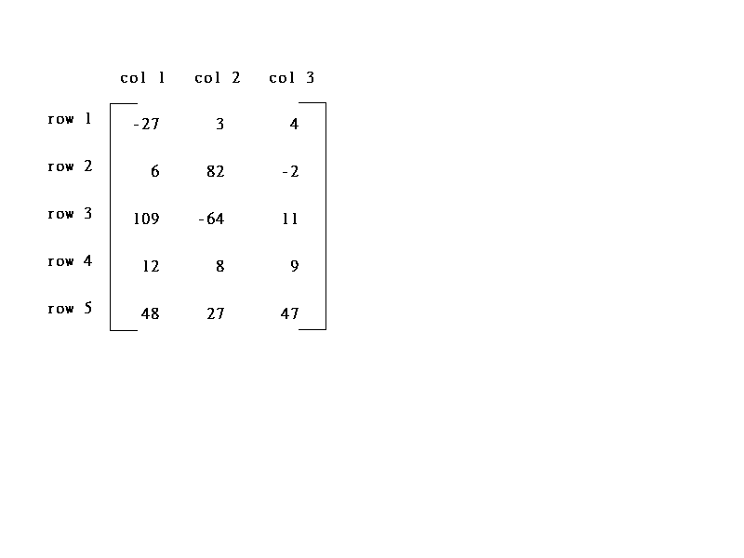
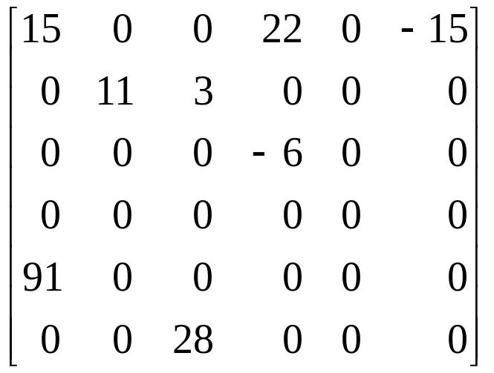
Sparse Matrix
A sparse matrix is a matrix having a relatively small number of nonzero elements.
col1 col2 col3 col4 col5 col6
row0
row1
row2
row3
row4
row5
15/15
8/36
sparse matrix
data structure?

Slide 20
Sparse Matrix Representation
The standard representation of a matrix is a two dimensional array defined as
a[MAX_ROWS][MAX_COLS]
  We can locate quickly any element by writing a[i ][ j ]
Sparse matrix wastes space
  We must consider alternate forms of representation.
  Our representation of sparse matrices should store only nonzero elements.
  Each element is characterized by <row, col, value>.

Slide 21
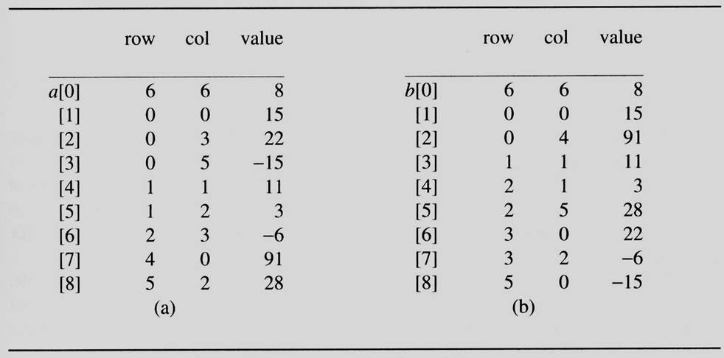
Sparse Matrix Representation
Figure shows how the sparse matrix is represented in the array a.
  Represented by a two-dimensional array.
  Each element is characterized by <row, col, value>.
nonzero terms
rows columns
transpose
col1 col2 col3 col4 col5 col6
row0
row1
row2
row3
row4
row5
row, column in
ascending order

Slide 22
Transposing A Matrix
Transpose a Matrix
  For each row i
    take element <i, j, value> and store it in element <j, i, value> of the transpose.
    difficulty: where to put <j, i, value>
    (0, 0, 15) ====> (0, 0, 15)
    (0, 3, 22) ====> (3, 0, 22)
    (0, 5, -15) ====> (5, 0, -15)
    (1, 1, 11) ====> (1, 1, 11)
    Move elements down very often.
  For all elements in column j,
    place element <i, j, value> in element <j, i, value>

Slide 23
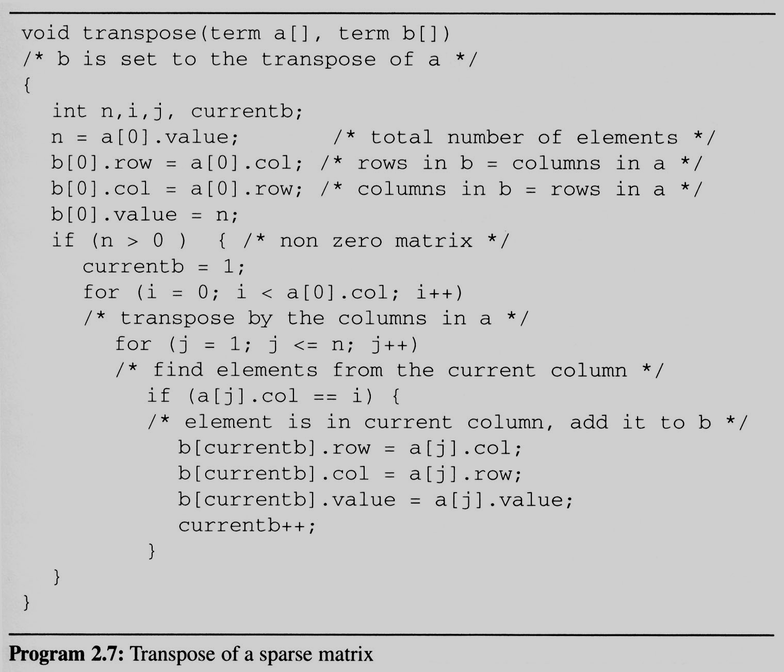

Transposing A Matrix
Assign
A[i][j] to B[j][i]
place element <i, j, value> in element <j, i, value>
For all columns i
For all elements in column j
Scan the array “columns” times.The array has
“elements” elements.
==> O(columns*elements)

Slide 24
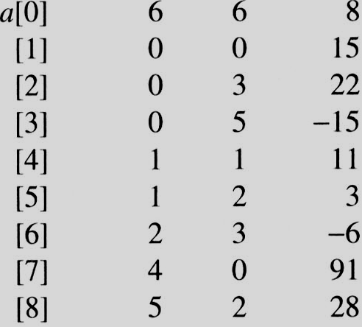
i=0 j=1
i=0 j=1
a[j]= 0 == i
i=0 j=2
i=0 j=2
a[j]=3 != i
i=0 j=3
i=0 j=3
a[j] = 5 != i
i=0 j=4
i=0 j=4
a[j].col = 1 a[j].col != i
i=0 j=5
i=0 j=5
a[j].col = 2 a[j].col != i
i=0 j=6
i=0 j=6
a[j].col = 3 != i
i=0 j=7
i=0 j=7
a[j].col = 0 == i
i=0 j=8
i=0 j=8
a[j].col = 2 != i
i=1 j=1
i=1 j=1
a[j].col = 0 != i
i=1 j=2
i=1 j=2
a[j].col = 3 != i
i=1 j=3
i=1 j=3
a[j].col = 5 != i
i=1 j=4
i=1 j=4
a[j].col = 1 == i
i=1 j=5
i=1 j=5
a[i].col = 2 != i
i=1 j=6
i=1 j=6
a[j].col = 3 != i
i=1 j=7
i=1 j=7
a[j] = 0 != i
i=1 j=8
EX: A[6][6] transpose to B[6][6]
i=1 j=8
a[i].col = 2 != i
Matrix A
Row Col Value
Set Up row & column in B[6][6]
Row Col Value
0 6 6 8
1 0 0 15
2 0 4 91
3 1 1 11
And So on…

Slide 25
Reference
《数据结构（ C 语言版）》，严蔚敏，吴伟民编著，清华大学出版社，1997年第1版,P91-99

