Slide 1
05 Graph (2)

Slide 2
Outline
Simple Path
Connectivity
Graph Traversals
Topological Sorting

Slide 3
Knowledge Points
Chapter 11, pp.390-399

Slide 4
Weighted Graphs
In a weighted graph, each edge has an associated weight or cost.
Clinton
20
Mukilteo
Kingston
30
Edmonds
Bainbridge
35
Seattle
60
Bremerton

Slide 5
Paths
A path is a list of vertices {v₁, v₂, …, v_{n}} such that (v_{i}, v_{i+1}) ∈ E for all 0 ≤ i < n.
Seattle
Chicago
Salt Lake City
San Francisco
Dallas
p = {SEA, SLC, CHI, DAL, SFO, SEA}

Slide 6
Path Length and Cost
Path length: the number of edges in the path
Path cost: the sum of the costs of each edge
3.5
Chicago
Seattle
2
2
2
Salt Lake City
2.5
length(p) = 5
2.5
2.5
cost(p) = 11.5
Dallas
3
San Francisco
p = {SEA, SLC, CHI, DAL, SFO, SEA}

Slide 7
Simple Paths and Cycles
A simple path repeats no vertices (except that the first can be the last):
  p = {Seattle, Salt Lake City, San Francisco, Dallas}
  p = {Seattle, Salt Lake City, Dallas, San Francisco, Seattle}
A cycle is a path that starts and ends at the same node:
  p = {Seattle, Salt Lake City, Dallas, San Francisco, Seattle}
A simple cycle is a cycle that repeats no vertices except that the first vertex is also the last (in undirected graphs, no edge can be repeated)

Slide 8
Connectivity
If there is a path from vertex v_{i} to v_{j}, v_{i} and v_{j} are connected.
An undirected graph are connected-----if, for every pair of distinct vertices v_{i} , v_{j}, there is a path from v_{i} i to v_{j} in G.
Connected component(undirected graph)----a maximal connected subgrap.( a tree is graph that is connected and acycle(无环))
Strongly connected(directed graph)--- if, for every pair of distinct vertices v_{i} , v_{j}, there is a path from v_{i} to v_{j} ,and also from v_{j} to v_{i} in G.

Slide 9

Connectivity
Weakly connected(directed graph)---For a directed graph G, if the undirected graph obtained by suppressing the directions on the edges of G is connected.
Strongly connected Component---a maximal subgraph that is strongly connected.
Degree of v_{i}-----the number of edges incident to that vertex.
In-degree---the number of edges that have v_{i} as the head.
out-degree---the number of edges that have v_{i} as the tail.
the number of edges:
Where d_{i} is the degree of vertex v_{i}

Slide 10
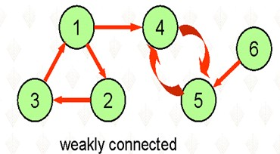
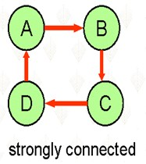
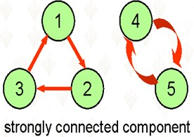

Slide 11
Connectivity
Acycle –a graph without cycles.
directed acycle graph(DAG)--a directed graph without cycles.
free tree—a connected, undirected graph with cycles.
spanning tree—a subgraph of undirected graph G, which is connected and without cycles.

Slide 12
Connectivity
Undirected graphs are connected if there is a path between any two vertices
Directed graphs are strongly connected if there is a path from any one vertex to any other

Slide 13
Connectivity
Di-graphs are weakly connected if there is a path between any two vertices, ignoring direction
A complete graph has an edge between every pair of vertices

Slide 14
Graph Density
A sparse graph has O(|V|) edges
A dense graph has Θ(|V|²) edges
Anything in between is either sparsish or densy depending on the context.

Slide 15
Trees as Graphs
Every tree is a graph with some restrictions:
  the tree is directed
  there are no cycles (directed or undirected)
  there is a directed path from the root to every node
A
B
C
D
E
F
G
H
I
J

Slide 16
Directed Acyclic Graphs (DAGs)
DAGs are directed graphs with no cycles
Trees ⊂ DAGs ⊂ Graphs
main()
mult()
add()
read()
access()

Slide 17
Graph Traversals
A Graph Traversals, which is similar to a tree traversals in concept, is to visit every vertices of a graph exactly once in some specific order.
Graph traversals begin with start vertex, and attempt to visit remaining vertices. There are two problems:
  If the graph is not connected, it may not be possible to reach all vertices.
  The graph may contains cycles, and a vertex may be reached more than one times.

Slide 18
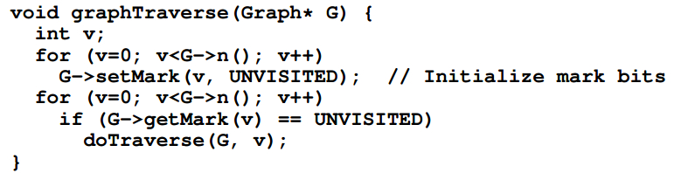
Graph Traversals
The order in which the vertices are visited is important. There are two common traversals:
  Depth-first
  Breadth-first

Slide 19
Depth-First Search (DFS)
Assume a particular node has been designated as the starting point. Let A be the last node visited and suppose A has neighbors N₁,N₂,…,N_{k}.
A depth-first search will:
  visit N₁,then
  Proceed to traverse all the unvisited neighbors of N₁ , then
  proceed to traverse the remaining neighbors of A in similar fashion

Slide 20
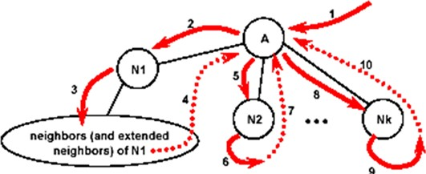
Depth-First Search (DFS)

Slide 21
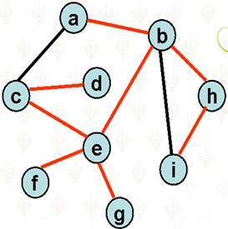
Depth-First Search (DFS)
Assume the node labeled a has been designated as the starting point, a depth-first traversal would visit the graph nodes in the order:
a b e c d f g h i
Note that if the edges taken during the depth-first traversal are marked, they define a tree (not necessarily binary) which includes all the nodes of the graph. Such a tree is a spanning tree for the graph. We call the tree DFS tree.

Slide 22
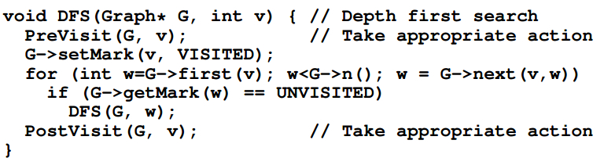
Implementing a DFS

Slide 23
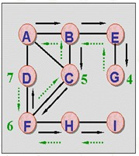
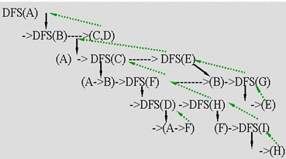
Depth-First Search (DFS)
The cost of DFS traversal is O(|V|+|E|)

Slide 24
Breadth-First Search (BFS)
Assume a particular node has been designated as the starting point. Let A be the last node visited and suppose A has neighbors N₁,N₂,…,N_{k}.
A breadth-first search will:
  visit N₁,then N₂,and so forth through N_{k}, then
  Proceed to traverse all the unvisited immediate neighbors of N₁ , then
  proceed to traverse the immediate neighbors of N₂,…,N_{k} in similar fashion

Slide 25
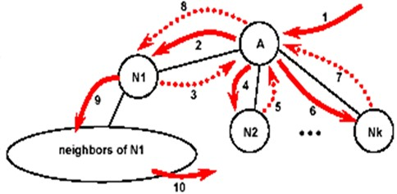
Breadth-First Search (BFS)

Slide 26
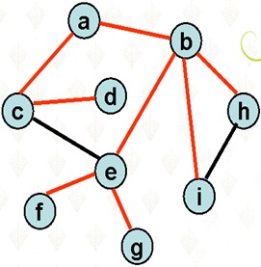
Breadth-First Search (DFS)
Assume the node labeled a has been designated as the starting point, a breadth-first traversal would visit the graph nodes in the order:
a b c h i d f g
Note that if the edges taken during the breadth-first traversal are marked, they define a tree (not necessarily binary) which includes all the nodes of the graph. Such a tree is a spanning tree for the graph. We call the tree BFS tree. This is usually different from the depth-first spanning tree.

Slide 27
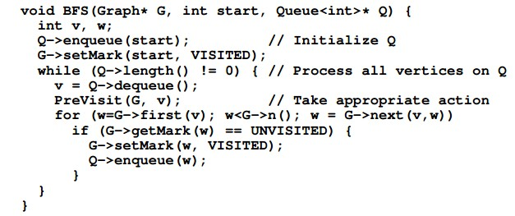
Implementing a BFS
The breadth-first traversal uses a local queue to organize the graph nodes into the proper order:

Slide 28
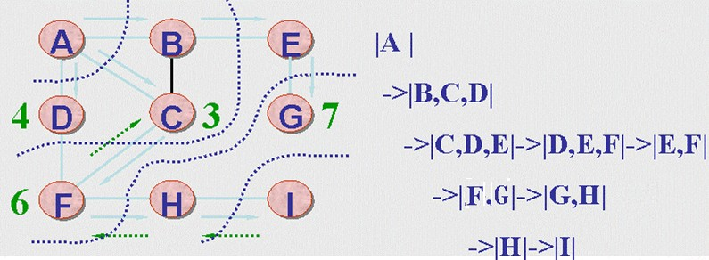
Breadth-First Search (BFS)

Slide 29
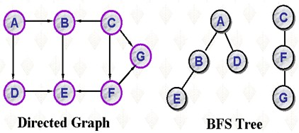
Breadth-First Search (BFS)

Slide 30
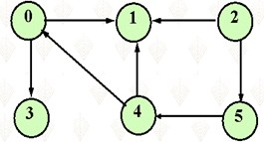
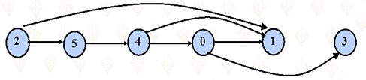
Topological Ordering
Suppose that G is a directed graph which contains no directed cycles. Then a topological ordering of the vertices in G is a sequential listing of the vertices such that for any pair of vertices, v and w in G, if <v,w> is an edge in G then v precedes w in the sequential listing.

Slide 31
Applications of Topological Ordering
Applications of topological ordering are relatively common…
  prerequisite relationships among courses
  glossary of technical terms whose definitions involve dependencies
  Organization of topics in a book or a course.

Slide 32
Total Order
1
A
B
means A must go before B
2
3
4
5
6
7

Slide 33
Partial Order: Planning a Trip
reserve
flight
check in
airport
call
taxi
?
pack
bags
take
flight
locate
gate
taxi to
airport

Slide 34
Topological Sort
Given a graph, G = (V, E), output all the vertices in V such that no vertex is output before any other vertex with an edge to it.
reserve
flight
check in
airport
call
taxi
taxi to
airport
take
flight
locate
gate
pack
bags

Slide 35
Topo-Sort Take One
Label each vertex’s in-degree (# of inbound edges)
While there are vertices remaining
  Pick a vertex with in-degree of zero and output it
  Reduce the in-degree of all vertices adjacent to it
  Remove it from the list of vertices
Runtime?

Slide 36
Topo-Sort Take Two
Label each vertex’s in-degree
Put all in-degree-zero vertices in a queue
While there are vertices remaining in the queue
  Pick a vertex v with in-degree of zero and output it
  Reduce the in-degree of all vertices adjacent to v
  Put any of these with new in-degree zero on the queue
  Remove v from the queue
Runtime?

Slide 37
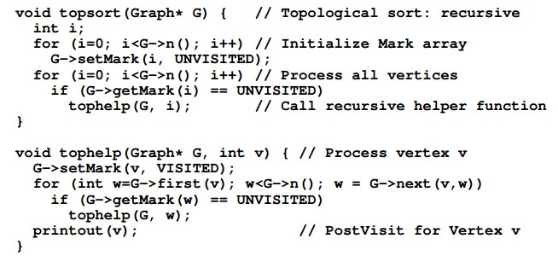

Slide 38
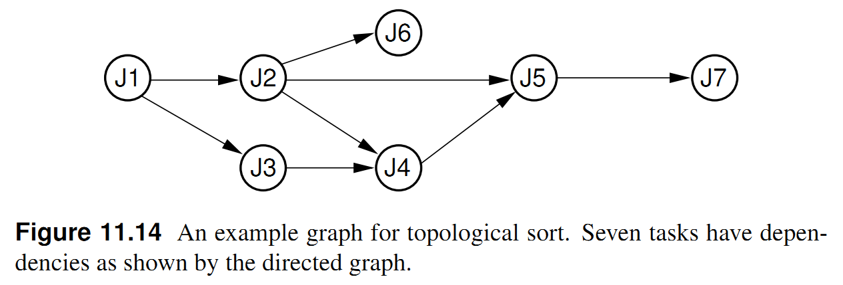
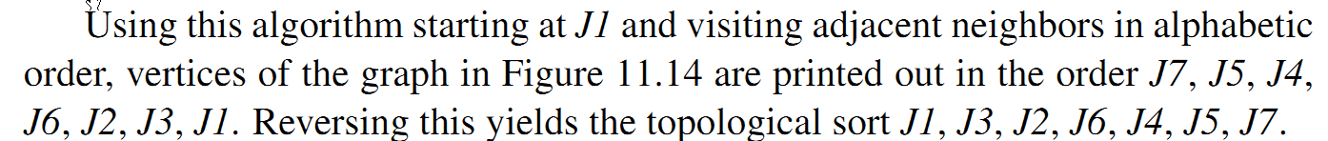

Slide 39
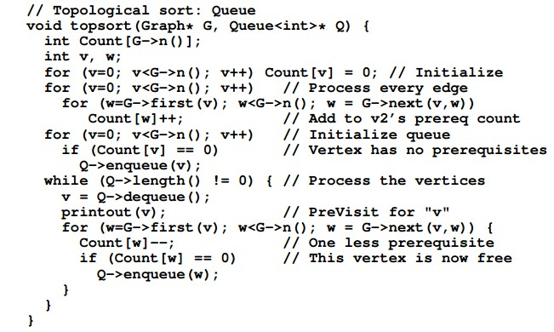

Slide 40
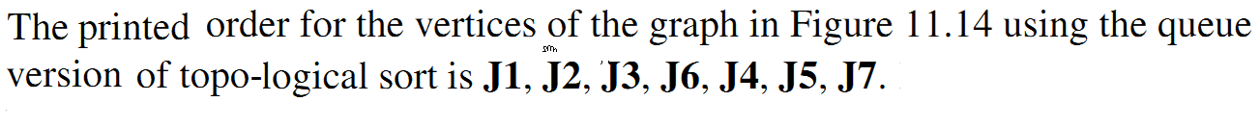

Slide 41
Homework
P410, 11.4-11.8

Slide 42
-End-

