Slide 1
05 Graph (4)
Notes:
课时数：8学时
1st lesson

Slide 2
Outline
Minimum-Cost Spanning Trees
Kruskal’s Algorithm
Prim’s Algorithm

Slide 3
Knowledge Points
Chapter 11, pp.402-409

Slide 4
Spanning Tree
Spanning tree - a subset of the edges from a connected graph that:
  touches all vertices in the graph (spans the graph)
  forms a tree (is connected and contains no cycles)
Minimum spanning tree - spanning tree with lowest total edge cost
4
7
9
2
1
5
Notes:
Interesting note before we move on: it turns out that Dijkstra’s is as good as the best algorithm we have for single-source, single-destination shortest path!
OK, that’s Dijkstra’s.
Now, let’s get a quick definition before we move on to Kruskal’s algorithm.
Which of these three is the minimum spanning tree? (The one in the middle)

Slide 5
Kruskal’s Algorithm (扩边法)
Yet another greedy algorithm
Initialize all vertices to unconnected
While there are still unmarked edges
  Pick the lowest cost edge e = (u, v) and mark it
  If u and v are not already connected, add e to the minimum spanning tree and connect u and v
How is this like maze generation?
How is it different?
Notes:
Here’s how Kruskal’s works.
This should look very familiar. Remember our algorithm for maze creation?
Except that the edge order there was random, this is the same as that algorithm!

Slide 6
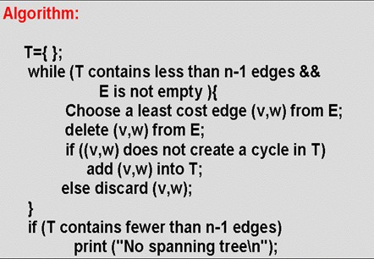
Kruskal’s Algorithm
Notes:
Here’s how Kruskal’s works.
This should look very familiar. Remember our algorithm for maze creation?
Except that the edge order there was random, this is the same as that algorithm!

Slide 7
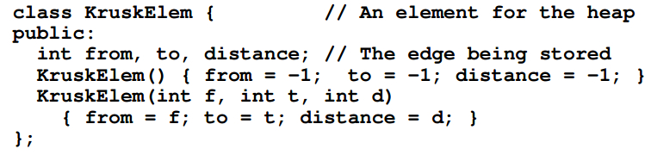
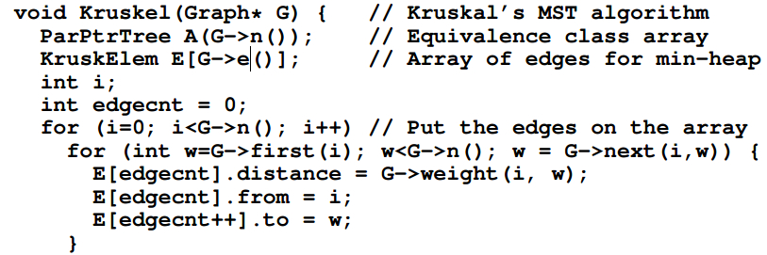

Slide 8
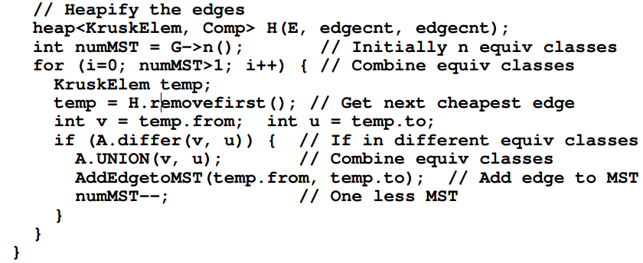

Slide 9
Kruskal’s Algorithm in Action (1/5)
2
2
B
3
A
F
H
1
2
4
10
1
9
G
C
4
2
8
D
E
7
Notes:
Therefore, this example should look a lot like maze creation.
We test the cheapest edge first.
Since B and C are unconnected, we add the edge to the MST and union B and C.

Slide 10
Kruskal’s Algorithm in Action (2/5)
2
2
B
3
A
F
H
1
2
4
10
1
9
G
C
4
2
8
D
E
7
Notes:
I’ll do some uninteresting edges right away (all those edges until the 3 succeed).
Now, we test 3. Are F and H connected?
Yes, so we throw out the 3 edge.

Slide 11
Kruskal’s Algorithm in Action (3/5)
2
2
B
3
A
F
H
1
2
4
10
1
9
G
C
4
2
8
D
E
7
Notes:
What about A and D?
Connected: so throw out the 4 edge.

Slide 12
Kruskal’s Algorithm in Action (4/5)
2
2
B
3
A
F
H
1
2
4
10
1
9
G
C
4
2
8
D
E
7
Notes:
Finally, G and E are unconnected, so we union them.
But, that connects the last unconnected vertices in the graph.
Therefore, we’re done.

Slide 13
Kruskal’s Algorithm Completed (5/5)
2
2
B
3
A
F
H
1
2
4
10
1
9
G
C
4
2
8
D
E
7
Notes:
Here’s the minimum spanning tree.
Notice that just like with mazes:
the tree has no cycles
it touches all the vertices
there’s one unique path between
any two vertices.

Slide 14
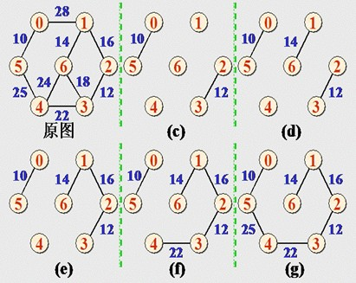
Another Example
Notes:
Here’s the minimum spanning tree.
Notice that just like with mazes:
the tree has no cycles
it touches all the vertices
there’s one unique path between
any two vertices.

Slide 15
Prim’s Algorithm
Prim’s Algorithm (a variation of Dijkstra’s Algorithm) also finds Minimum Spanning Trees:
  Pick an initial node
  Until graph is connected:
    Choose edge (u,v) which is of minimum cost among edges where u is in tree but v is not
    Add (u,v) to the tree
Same “greedy” proof, same asymptotic complexity

Slide 16
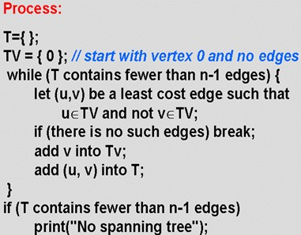
Prim’s Algorithm(扩点法)

Slide 17
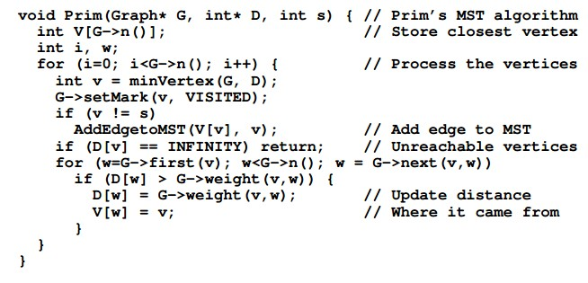
Prim’s Algorithm(扩点法)

Slide 18
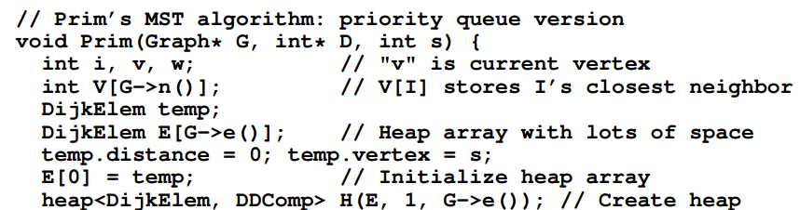
Prim’s Algorithm(扩点法)

Slide 19
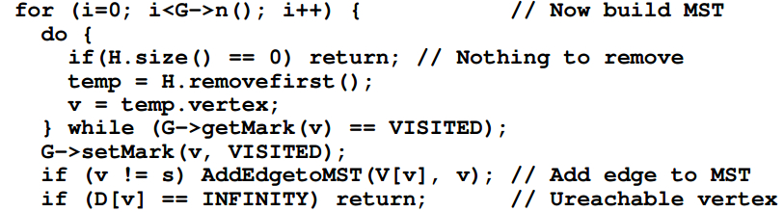
Prim’s Algorithm(扩点法)

Slide 20
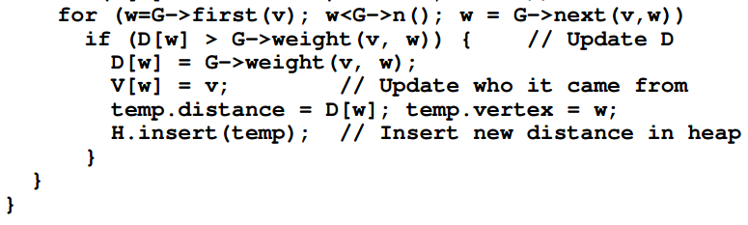
Prim’s Algorithm(扩点法)

Slide 21
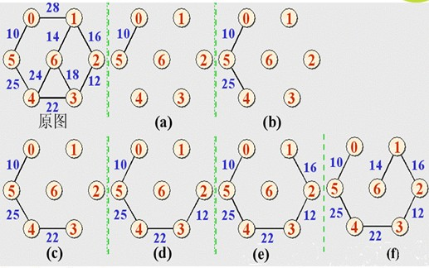
Example of Prim’s Algorithm

Slide 22
Homework
P410, 11.17
P411,11.18-11.22

Slide 23
-End-

