Slide 1
Queues

Slide 2
Outline
Queue ADT
Circular Queue
Linked Queue
Comparison of Array-Based and Linked Queues

Slide 3
Queues
Like the stack, the queue is a list-like structure that provides restricted access to its elements.
Queue elements may only be inserted at the back (called an enqueue operation) and removed from the front (called a dequeue operation).

Slide 4
Queues
FIFO: First in, First Out
Restricted form of list: Insert at one end, remove from the other.
Notation:
Insert: Enqueue
Remove: Dequeue
First element: Front
Last element: Rear

Slide 5
Example: Queue of Char
Enqueue
‘c’
Enqueue
Enqueue
‘b’
‘b’
Dequeue
‘c’
‘a’
‘a’
‘a’
‘b’

Slide 6
Queue ADT
// Abstract queue class
template <typename E> class Queue {
private:
void operator =(const Queue&) {} // Protect assignment
Queue(const Queue&) {} // Protect copy constructor
public:
Queue() {} // Default
virtual ˜Queue() {} // Base destructor

Slide 7
Queue ADT
// Reinitialize the queue. The user is responsible for
// reclaiming the storage used by the queue elements.
virtual void clear() = 0;
// Place an element at the rear of the queue.
// it: The element being enqueued.
virtual void enqueue(const E&) = 0;
// Remove and return element at the front of the queue.
// Return: The element at the front of the queue.
virtual E dequeue() = 0;
// Return: A copy of the front element.
virtual const E& frontValue() const = 0;
// Return: The number of elements in the queue.
virtual int length() const = 0;
};

Slide 8
Array_based Queue
The array-based queue is somewhat tricky to implement effectively. Assume that there are n elements in the queue.
  If we choose the rear element of the queue to be in position 0, enqueue operations will shift the n elements currently in the queue one position in the array.
  If instead we chose the rear element of the queue to be in position n-1, a dequeue operation must shift all of the elements down by one position to retain the property that the remaining n-1 queue elements reside in the first n-1positions of the array.
  A far more efficient implementation can be obtained by relaxing the requirement that all elements of the queue must be in the first n positions of the array.

Slide 9
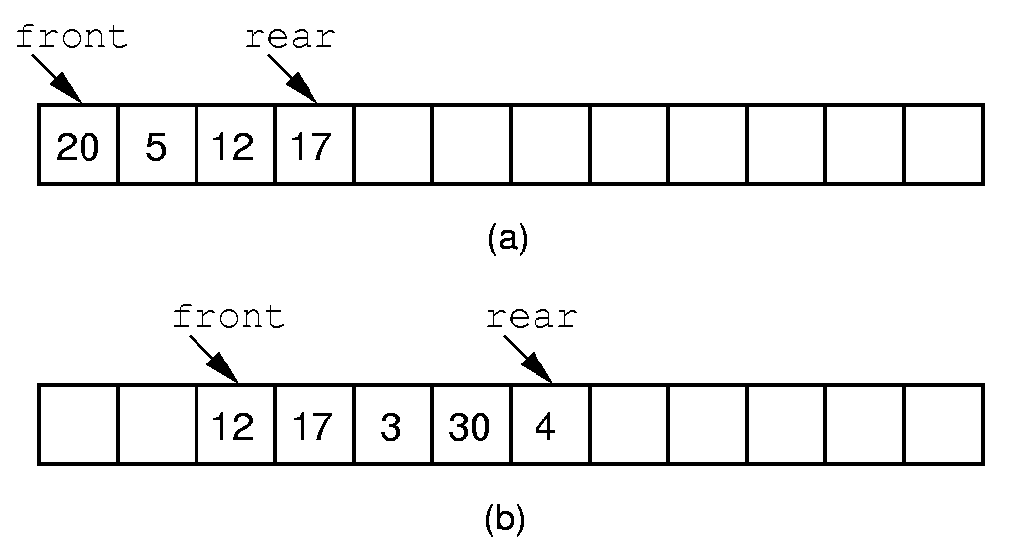
Queue Implementation (1)
Notes:
If we stick to the requirement that the queue elements be at the beginning n elements of the array, then either enqueue or dequeue must be θ(n).
Better is to let the elements “drift” within the array.
Unfortunately, as items are added and removed, the queue “drifts” toward the end. Eventually, there will be no space to the right of the queue, even though there is space in the array.

Slide 10
Queue Implementation (1)
This implementation raises a new problem.
  When elements are removed from the queue, the front index increases. Over time, the entire queue will drift toward the higher-numbered positions in the array. Once an element is inserted into the highest-numbered position in the array, the queue has run out of space. This happens despite the fact that there might be free positions at the low end of the array where elements have previously been removed from the queue.

Slide 11
Queue Implementation (2)
The “drifting queue” problem can be solved by pretending that the array is circular and so allow the queue to continue directly from the highest-numbered position in the array to the lowest-numbered position.

Slide 12
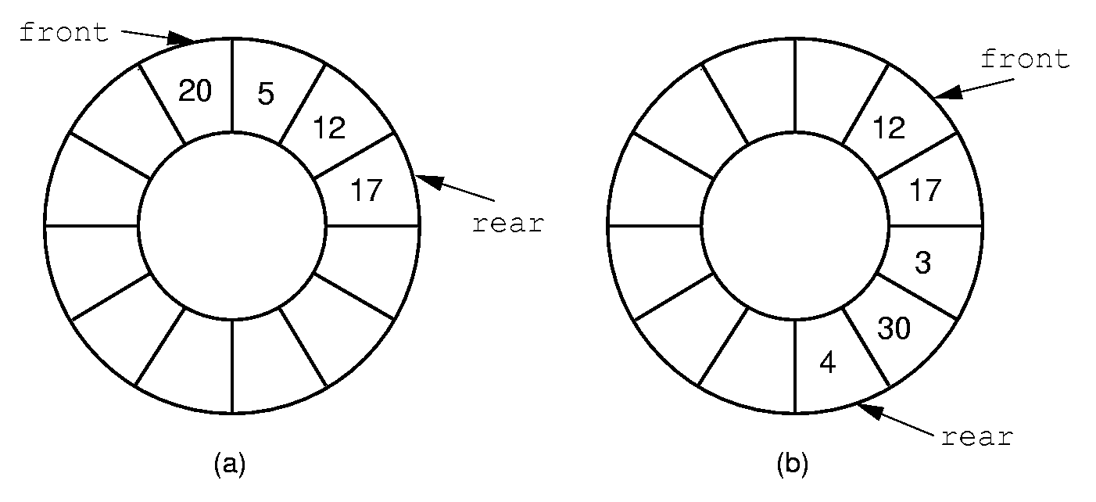
Queue Implementation (2)
Notes:
By using the mod function, we can easily achieve the effect of a “circular” queue.
This leaves one more issue. Where do the front and rear pointers go (point to the item? Or to the space before/after the item)? And, how do we distinguish a full from an empty queue?
Given a fixed position for the front element (and its pointer), there are n-1 possible states for the queue (0 through n elements in the queue for an array of size n), but only n possible positions for rear. To solve this dilemma, we must either leave an empty slot in the queue, or use and external variable to determine if the queue is empty or not.

Slide 13
Queue Implementation (2)
How can we recognize when the circular queue is empty or full?
  For both empty queue and full queues ，the value for rear is one less than the value for front。
  One obvious solution is to keep an explicit count of the number of elements in the queue, or a Boolean variable that indicates whether the queue is empty or not.
  Another solution is to make the array be of size n+ 1, and only allow n elements to be stored.

Slide 14
Circular Queue Demo
A refinement of the lazy approach is the circular queue
2
head = rear = 0;
enQueue (q, ‘a’);
1
3
rear
0
4
head
5

Slide 15
Circular Queue Demo
A refinement of the lazy approach is the circular queue
2
head = rear = 0;
enQueue (q, ‘a’);
enQueue (q, ‘b’);
1
3
rear
‘a’
0
4
head
5

Slide 16
Circular Queue Demo
A refinement of the lazy approach is the circular queue
rear
2
head = rear = 0;
enQueue (q, ‘a’);
enQueue (q, ‘b’);
1
3
‘b’
enQueue (q, ‘c’);
‘a’
0
4
head
5

Slide 17
Circular Queue Demo
A refinement of the lazy approach is the circular queue
2
head = rear = 0;
rear
enQueue (q, ‘a’);
‘c’
enQueue (q, ‘b’);
1
3
‘b’
enQueue (q, ‘c’);
enQueue (q, ‘d’);
‘a’
0
4
head
5

Slide 18
Circular Queue Demo
A refinement of the lazy approach is the circular queue
2
head = rear = 0;
enQueue (q, ‘a’);
‘c’
enQueue (q, ‘b’);
1
3
‘b’
enQueue (q, ‘c’);
‘d’
enQueue (q, ‘d’);
enQueue (q, ‘e’);
‘a’
rear
0
4
head
5

Slide 19
Circular Queue Demo
A refinement of the lazy approach is the circular queue
2
head = rear = 0;
enQueue (q, ‘a’);
‘c’
enQueue (q, ‘b’);
1
3
‘b’
enQueue (q, ‘c’);
‘d’
enQueue (q, ‘d’);
enQueue (q, ‘e’);
‘a’
‘e’
0
enQueue (q, ‘f’); ???
4
head
5
rear

Slide 20
Circular Queue Demo
A refinement of the lazy approach is the circular queue
Empty:
head == rear;
Full:
rear +1 == head ???
General Equations:
head = (head+1)%N;
rear = (rear+1)%N;
2
‘c’
1
3
‘b’
‘d’
‘a’
‘e’
0
4
head
5
rear

Slide 21
Array-based Queue Implementation
template <typename E> class AQueue: public Queue<E> {
private:
int maxSize; // Maximum size of queue
int front; // Index of front element
int rear; // Index of rear element
E *listArray; // Array holding queue elements
public:
AQueue(int size =defaultSize) { // Constructor
// Make list array one position larger for empty slot
maxSize = size+1;
rear = 0; front = 1;
listArray = new E[maxSize];
}
˜AQueue() { delete [] listArray; } // Destructor

Slide 22
Array-based Queue Implementation
void clear() { rear = 0; front = 1; } // Reinitialize
void enqueue(const E& it) { // Put "it" in queue
Assert(((rear+2) % maxSize) != front, "Queue is full")
rear = (rear+1) % maxSize; // Circular increment
listArray[rear] = it;
}
E dequeue() { // Take element out
Assert(length() != 0, "Queue is empty");
E it = listArray[front];
front = (front+1) % maxSize; // Circular increment
return it;
}

Slide 23
Array-based Queue Implementation
const E& frontValue() const { // Get front value
Assert(length() != 0, "Queue is empty");
return listArray[front];
}
virtual int length() const // Return length
{ return ((rear+maxSize) - front + 1) % maxSize; }
};

Slide 24
Linked Queues
Implementation
The linked queue implementation is a straightforward adaptation of the linked list.
On initialization, the front and rear pointers will point to the header node, and front will always point to the header node while rear points to the true last link node in the queue.

Slide 25
Linked Queues
Implementation
template <typename E> class LQueue: public Queue<E> {
private:
Link<E>* front; // Pointer to front queue node
Link<E>* rear; // Pointer to rear queue node
int size; // Number of elements in queue
public:
LQueue(int sz =defaultSize) // Constructor
{ front = rear = new Link<E>(); size = 0; }
˜LQueue() { clear(); delete front; } // Destructor

Slide 26
Linked Queues
Implementation
void clear() { // Clear queue
while(front->next != NULL) { // Delete each link node
rear = front;
front=front->next;
delete rear;
}
rear = front;
size = 0;
}
void enqueue(const E& it) { // Put element on rear
rear->next = new Link<E>(it, NULL);
rear = rear->next;
size++;
}

Slide 27
Linked Queues
Implementation
E dequeue() { // Remove element from front
Assert(size != 0, "Queue is empty");
E it = front->next->element; // Store dequeued value
Link<E>* ltemp = front->next; // Hold dequeued link
Front->next = ltemp->next; // Advance front
if (rear == ltemp) rear = front; // Dequeue last element
delete ltemp; // Delete link
size --;
return it; // Return element value
}

Slide 28
Linked Queues
Implementation
const E& frontValue() const { // Get front element
Assert(size != 0, "Queue is empty");
return front->next->element;
}
virtual int length() const { return size; }
};

Slide 29
Comparison of Array-Based and Linked Queues
All member functions for both the array-based and linked queue implementations require constant time.
The space comparison issues are the same as for the equivalent stack implementations.

Slide 30
Problem：
Let Q be a non-empty queue, and let S be an empty stack. Using only the stack and queue ADT functions and a single element variable X, write an algorithm to reverse the order of the elements in Q.
Notes:
该练习可课堂讨论或课堂练习

Slide 31
Solution
void reverse(Queue& Q, Stack& S) {
ELEM X;
while (!Q.isEmpty()) {
X = Q.dequeue();
S.push(X);
}
while (!S.isEmpty()) {
X = S.pop();
Q.enqueue(X);
}
}

Slide 32
Homework
Modify the array-based queue definition of Figure 4.26 to use a separate Boolean member to keep track of whether the queue is empty, rather than require that one array position remain empty.

Slide 33
Reference
Data Structures and Algorithm Analysis in C++ .Third Edition.Clifford A. Shaffer(P.129-134)

Slide 34
Project1
You are to create programs that keep track of inventory and shipping at a store or business of your choosing. Suppose there are five different categories of items, and there are five linked lists correspondingly. When items are made, they are put into certain linked list inventory according to its category. When you ship something, it comes out of inventory and goes into a shipping queue. When an item is delivered, it is taken out of the shipping queue. You should keep a list of all delivered items. Users of your system should be able to do the following:
1. Input an item (some category, some name) and an amount. The item and amount should be inserted into a linked list of inventory items.
2. Push a button to get a list displayed of all the items and their quantities in the inventory.
3. Push a button to take the next (top) item from inventory and put it in a shipping queue.
4. Push a button to get a list displayed of all the items that are currently shipping.
5. Push a button to indicate that a shipped item has been delivered and should be taken out of the shipping queue. Shipped items are put in and taken out FIFO.
6. Push a button to display all the things that have been delivered.

Slide 35
Project 1
You are to create classes for the different data structures and nodes. You also need a driver program that takes user input and manipulates a node object and prints output. The driver should be written as a C++ application with buttons and text input and output.
One way to do the application is to have two text fields for input, a text area for output, and buttons that say “add to inventory,” “display inventory,” etc. Think about your design and draw it out before you write the code. Also, draw your data structures before you write any code. Draw out the operations of taking things from one data structure and putting them into another. Think about what goes in your application and your class before you write any code.

