Slide 1
Sorting(2)

Slide 2
outline
Shellsort
Mergesort
Quicksort

Slide 3
Shellsort (diminishing increment sort)
Shellsort makes comparisons and swaps between non-adjacent elements
Shellsort’s strategy is to make the list “mostly sorted” so that a final Insertion Sort can finish the job.

Slide 4
Shellsort: Idea
  Shellsort breaks the array of elements into “virtual” sublists.
  Each sublist is sorted using an Insertion Sort.
  Another group of sublists is then chosen and sorted,
  and so on.

Slide 5
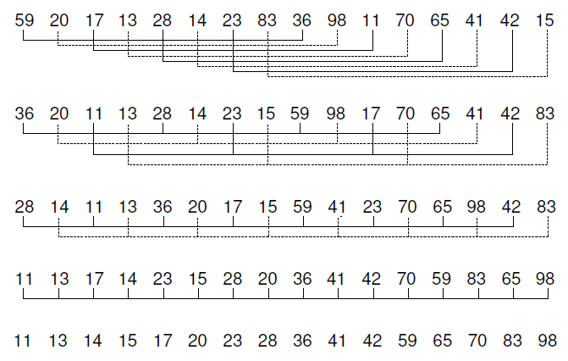
Shellsort: Example

Slide 6
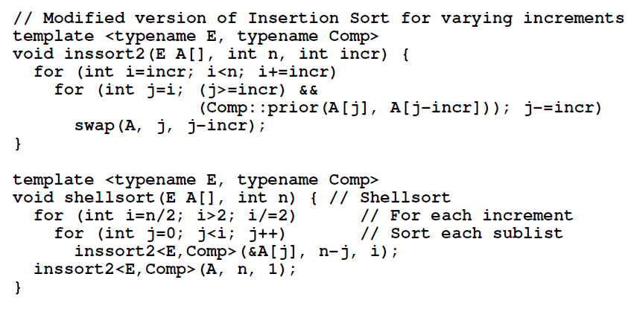
Shellsort: Implementation

Slide 7

Shellsort: Complexity
The average-case performance of Shellsort (for “divisions by three” increments) is O(n^{1.5}).
Shellsort is substantially better than Insertion Sort, or any of exchange sorts .

Slide 8
Mergesort
Mergesort is one of the simplest sorting algorithms conceptually, and has good performance both in the asymptotic sense and in empirical running time.

Slide 9
Mergesort: Idea
Idea: divide and conquer
  Divide: If S has at least two elements (nothing needs to be done if S has zero or one elements), remove all the elements from S and put them into two sequences, S₁ and S₂, each containing about half of the elements of S. (i.e. S₁ contains the first ⎡n/2⎤ elements and S₂ contains the remaining ⎣n/2⎦ elements.
  Recur: Recursive sort sequences S₁ and S₂.
  Conquer: Put back the elements into S by merging the sorted sequences S₁ and S₂ into a unique sorted sequence.

Slide 10
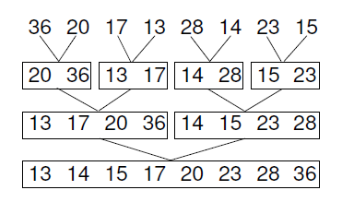
Mergesort: Example

Slide 11
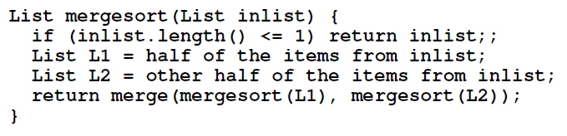
Mergesort: Pseudocode Sketch

Slide 12
Implementing Mergesort
how to represent the lists?
linked list :
  Implementing merge for linked lists is straightforward, because we need only remove items from the front of the input lists and append items to the output list.
  Breaking the input list into two equal halves presents some difficulty.
array:
  splitting input into two subarrays is easy if we know the array bounds.
  Merging is also easy if we merge the subarrays into a second array.
  a serious disadvantage: requires twice the amount of space as any of the sorting methods presented so far.

Slide 13
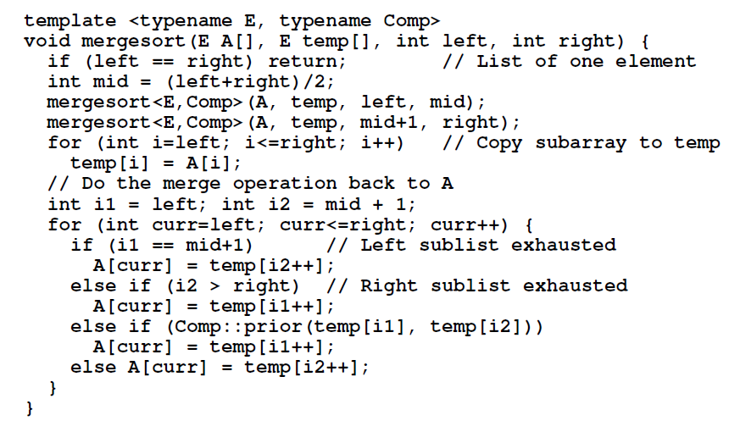
Mergesort: Standard Implementation

Slide 14


Merge (standard)
left
mid
mid+1
right
temp[ ]
Compare,
Copy back
copy
i1
i2
left
right
A[ ]
curr

Slide 15
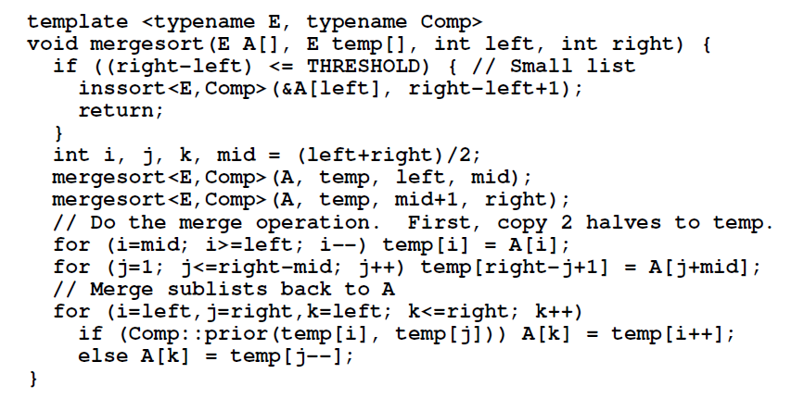
Mergesort: Optimized Implementation

Slide 16




Merge(optimized)
left
mid
right
mid+1
temp[ ]
Compare,
Copy back
copy
i
j
left
mid
right
A[ ]
k

Slide 17

Mergesort: Complexity
mergesort ‘s time complexity is
it is the conceptually simplest algorithm we will see.
Space Requirements for Mergesort
  two sorted linked lists without using any extra space.
  However, to merge two sorted arrays (or portions of an array), we must use a third array to store the result of the merge.

Slide 18
Quicksort
Quicksort when properly implemented, is the fastest known general-purpose in-memory sorting algorithm in the average case.
It does not require the extra array needed by Mergesort, so it is space efficient as well.
Quicksort is widely used while hampered by exceedingly poor worst-case performance, thus making it inappropriate for certain applications.

Slide 19
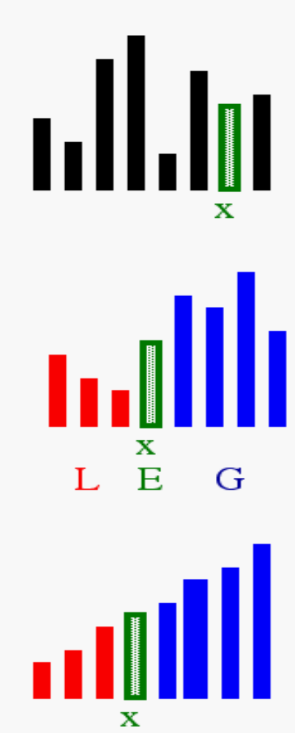
Quicksort: Idea
1) Select: pick an element
2) Divide: rearrange elements so that x goes to its final position E
3) Recurse and Conquer: recursively sort

Slide 20
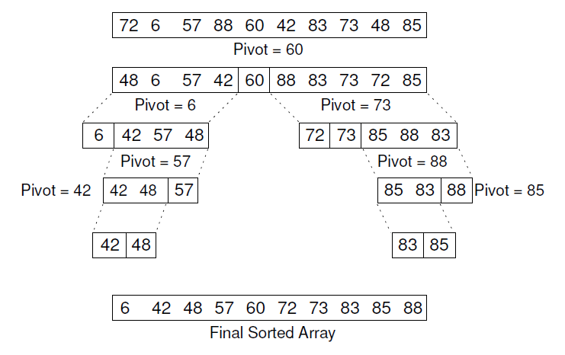
Quicksort: Example

Slide 21
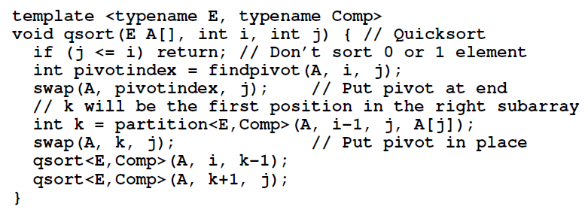
Quicksort Implementation

Slide 22
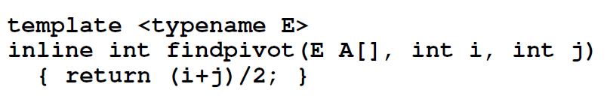
Findpivot()

Slide 23
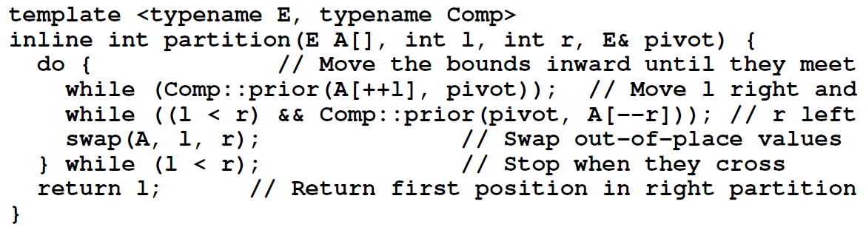
Partition()

Slide 24
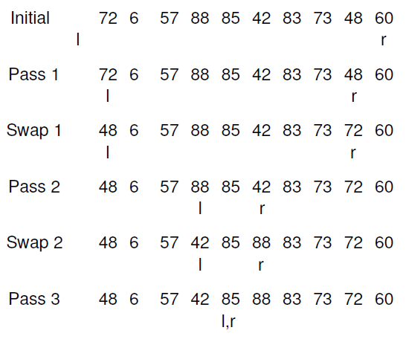
Partition: example

Slide 25
Quicksort: Complexity
Worst case: when each pivot yields a bad partitioning of the array
  Cost:
Best case: when findpivot always breaks the array into two equal halves
  Cost:
Average case:

Slide 26
References
Data Structures and Algorithm Analysis Edition 3.2 (C++ Version)
  P.239-248

