Slide 1
01 Course Overview
Notes:
课时数：2学时
1st lesson

Slide 2
Outline
About teacher
Textbook & Reference materials
Grading policy
Course introduction

Slide 3
Welcome to the course
Dongsheng Zou(邹东升)
Email: dszou@cqu.edu.cn
Phone: 13883922399

Slide 4
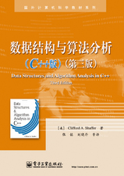

The Book
Data Structures and Algorithm Analysis (C++ Version)
Clifford A. Shaffer

Slide 5
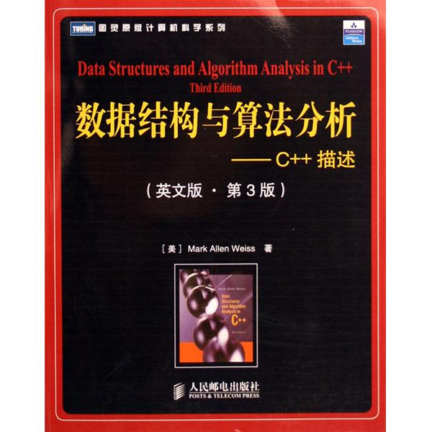
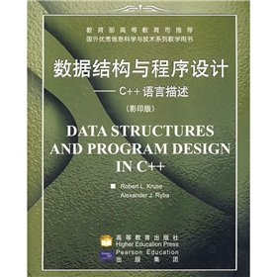
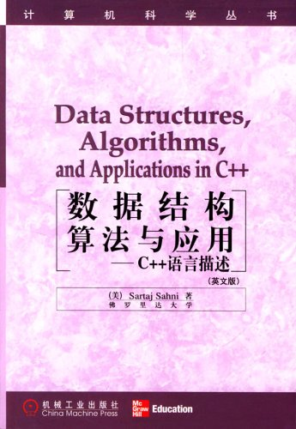
Reference Books
  Data Structure and Algorithm Analysis in C++ (Third Edition)，Mark Allen Weiss， Pearson Education, 2006.
  Data Structures, Algorithms, and Applications in C++，Sartaj Sahni， McGraw-Hill, 1998.
  《数据结构（ C 语言版）》，严蔚敏，吴伟民编著，清华大学出版社，2007年第1版

Slide 6
Grading policy
Final Examination 50%
3 Projects 25%
Homework 10%
Quiz 15%

Slide 7
Course Contents
Algorithm, Time Complexity(算法与时间复杂度)
Linear List(线性表)
Stack and Queue(栈与队列)
Tree (树)
Graph(图)
Sort (排序)
Search（查找）

Slide 8
Unit 1 Introduction
1.1 Course Description
1.2 Terminology
1.3 Research Topics of Data Structure
1.4 Problem ,Algorithm and Program
1.5 Conclusions

Slide 9
1.1Course Description
This course is emphasis on how to design, implementation and run-time analysis of important data structures and algorithms.
The main data structures considered include lists, stacks, queues, trees and graphics.

Slide 10
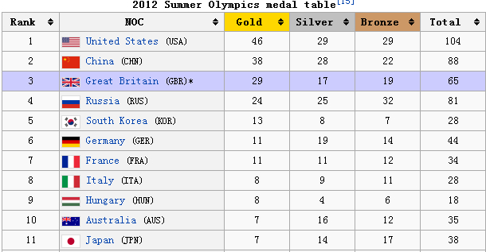
Application Example

Slide 11
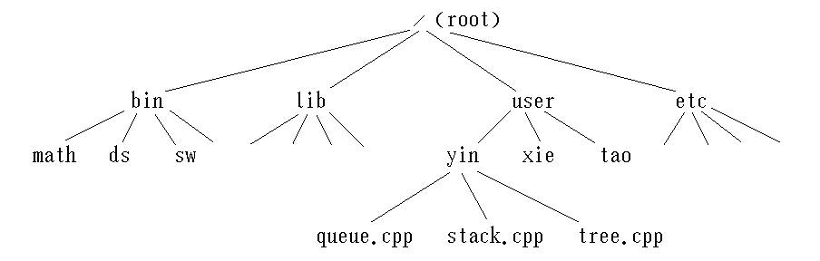
Application Example

Slide 12
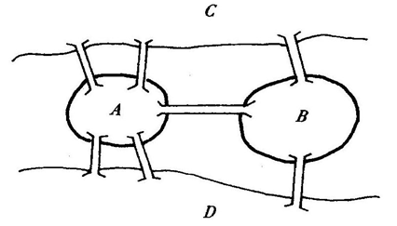
Seven Bridges Problem
Application Example
C
B
A
D

Slide 13
Goals
To present the commonly used data structures.
  These form a programmer’s basic data structure “toolkit.” For many problems, some data structure in the toolkit provides a good solution.
To introduce the idea of tradeoffs and reinforce the concept that there are costs and benefits associated with every data structure.
  This is done by describing the amount of space and time required for typical operations.
To teach how to measure the effectiveness of a data structure or algorithm.
  Only through such measurement can you determine which data structure in your toolkit is most appropriate for a new problem.

Slide 14
The Need for Data Structures
More complex problems demand more computation, making the need for efficient programs even greater.
A data structure is any data representation and its associated operations.
Using the proper data structure can make the difference between a program running in a few seconds and one requiring many days.
A solution is said to be efficient if it solves the problem within the required resource constraints(space and time).

Slide 15
Picking the best Data Structure
1. Analyze your problem to determine the basic operations that must be supported. Examples of basic operations include inserting, deleting and finding.
2. Quantify the resource constraints for each operation.
3. Select the data structure that best meets these requirements.

Slide 16
Costs and Benefits
A data structure requires a certain amount of space for each data item it stores, a certain amount of time to perform a single basic operation, and a certain amount of programming effort. Each problem has constraints on available space and time.
Each solution to a problem makes use of the basic operations in some relative proportion, and the data structure selection process must account for this.
Only after a careful analysis of your problem’s characteristics can you determine the best data structure for the task.

Slide 17
1.2 Terminology
A type is a collection of values .
  Divided into Simple Type and Aggregate Type or Composite Type.
A Data Type is a type together with a collection of operations to manipulate the type.
Data item is a piece of information or a record whose value is drawn from a type. A data item is said to be a member of a type.
A distinction should be made between the logical concept of a data type and its physical implementation in a computer program.

Slide 18
Terminology
An abstract data type(ADT) is the realization of a data type as a software component. An ADT does not specify how the data type is implemented.
A data structure is the implementation for an ADT.
A given ADT might be supported by more than one implementation.

Slide 19
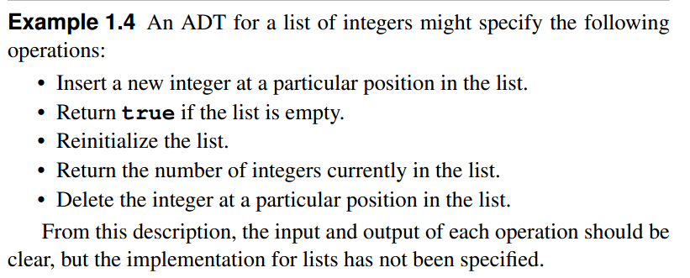
ADT Example

Slide 20
Other ADT Examples
Data structures
  Lists, Stacks, Queues
  Heaps
  Binary Search Trees
  AVL Trees
  Hash Tables
  Graphs
  Disjoint Sets

Slide 21
Logical vs. Physical Form
Data types have both a logical and a physical form.
The definition of the data type in terms of an ADT is its logical form.
The implementation of the data type as a data structure is its physical form.

Slide 22
Data Type
ADT:
  Type
  Operations
Data Items:
Logical Form
Data Structure:
  Storage Space
  Subroutines
Data Items:
Physical Form

Slide 23
1.3 Topics of Data Structure
Logical structure
  The logical relationship between data.
Storage structure
  Storage mapping of logical structure in storage.
How to implement operations based on above logical and storage structure

Slide 24
Basic Logical Structures
  Set structure
  Linear structure
  Tree structure
  Graph structure

Slide 25
1.4 Problem ,Algorithm and Program
Problems: a problem is a task to be performed.
  A problem definition should include constraints on the resources that may be consumed by any acceptable solution.
Algorithms: An algorithm is a method or a process followed to solve a problem.
  If the problem is viewed as a function, then an algorithm is an implementation for the function that transforms an input to the corresponding output.
Programs: A computer program is thought as an instance, or concrete representation, of an algorithm in some programming language.

Slide 26
properties of Algorithm
1. It must be correct.
2. It is composed of a series of concrete steps.
3. There can be no ambiguity as to which step will be performed next.
4. It must be composed of a finite number of steps.
5. It must terminate.
Notes:
1. It must be correct. It must compute the desired function, converting each input to the correct output.
2. It is composed of a series of concrete steps. Concrete means that the action described by that step is completely understood — and do able by the person or machine that must perform the algorithm. Each step must also be doable in a finite amount of time.
3. There can be no ambiguity as to which step will be performed next. Often it is the next step of the algorithm description.
4. It must be composed of a finite number of steps. of steps actu-ally performed controlled by the input.
5. It must terminate. In other words, it may not go into an infinite loop.

Slide 27
Knowledge Points
Chapter1,pp.3-12,16-18

Slide 28
-End-

