Slide 1
Tree & Binary Trees

Slide 2
Outline
Tree Definitions and Terminology
Tree ADT
Binary Tree Definitions
Binary Tree Properties

Slide 3
Tree Example
Representing File Structures:
  Consider the Unix file system
  Hierarchically arranged so that each file (including directories) belongs to some directory (except the / file which is the root)
  Each directory must be able to tell what files are in it

Slide 4
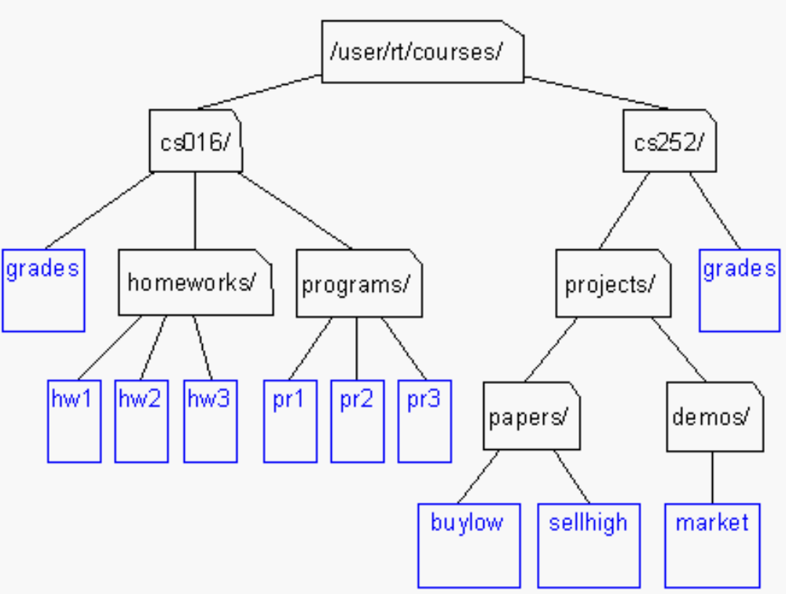
Tree Example
Unix / Windows file structure

Slide 5
Other Trees
Family Trees
Organization Structure Charts
Program Design
Structure of a chapter in a book
……

Slide 6
Definition of Tree
A tree T is a finite set of one or more elements called nodes such that:
  There is one designated node R, called the root of T.
  If the set (T- {R}) is not empty, these nodes are partitioned into n > 0 disjoint subsets T₀, T₁, ..., T_{n-1}, each of which is a tree, and whose roots R₁, R₂, ..., R_{n}, respectively, are children of R
  The subsets T_{i} (0 i < n) are said to be subtrees of T.
root: no predecessor
leaf: no successor
others: only one predecessor and one or more successor
Definition is recursive

Slide 7
A
B
C
B
C
D
E
F
G
D
E
F
G
H
I
H
I
T2
T
T1
E
D
F
H
I
T11
T12
T13

Slide 8
Tree: Level feature
Root of subtree only have a direct previous, but can have 0 or more direct successor.
A
Level 0
B
C
D
Level 1
height= 4
E
F
G
H
I
J
Level 2
K
L
M
Level 3

Slide 9
Terminology
There is an edge from a node to each of its children, and a node is said to be the parent of its children.
If n₁, n₂, ..., n_{k} is a sequence of nodes in the tree such that n_{i} is the parent of n_{i+1} for 1 ≤ i < k, then this sequence is called a path from n₁ to n_{k}. The length of the path is k -1.
The depth of a node M in the tree is the length of the path from the root of the tree to M.
All nodes of depth d are at level d in the tree.
The height of a tree is one more than the depth of the deepest node in the tree.

Slide 10
Terminology
The degree of a node is the number of subtrees of the node
  The degree of A is 3; the degree of C is 1.
The degree of a tree is the maximum degree of the nodes in the tree.
The node with degree 0 is a leaf or terminal node.
A node that has subtrees is the parent of the roots of the subtrees.
The roots of these subtrees are the children of the node.
Children of the same parent are siblings.
The ancestors of a node are all the nodes along the path from the root to the node.
A forest is a collection of one or more trees.

Slide 11
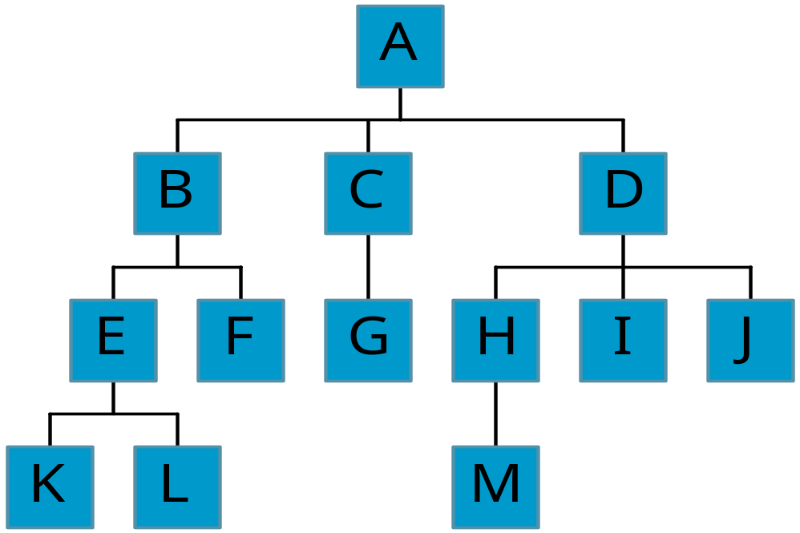
Terminology
node (13)
degree of a node
root
leaf (terminal)
internal node
parent
children
sibling
degree of a tree (3)
ancestor
descendant
level of a node
height of a tree (4)
forest
Level
0
1
2
3
3
0
2
1
1
1
3
1
2
2
0
2
0
2
1
2
0
2
0
2
0
3
0
3
0
3

Slide 12
ADT for Tree Nodes
// General tree node ADT
template <typename E> class GTNode {
public:
E value(); // Return node’s value
bool isLeaf(); // True if node is a leaf
GTNode* parent(); // Return parent
GTNode* leftmostChild(); // Return first child
GTNode* rightSibling(); // Return right sibling
void setValue(E&); // Set node’s value
void insertFirst(GTNode<E>*); // Insert first child
void insertNext(GTNode<E>*); // Insert next sibling
void removeFirst(); // Remove first child
void removeNext(); // Remove right sibling
};

Slide 13
General Tree ADT
// General tree ADT
template <typename E> class GenTree {
public:
void clear(); // Send all nodes to free store
GTNode<E>* root(); // Return the root of the tree
// Combine two subtrees
void newroot(E&, GTNode<E>*, GTNode<E>*);
void print(); // Print a tree
};

Slide 14
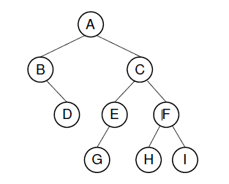
Definition of Binary Tree
A binary tree is made up of a finite set of nodes. This set either is empty or consists of a node called the root together with two binary trees, called the left subtree and right subtree, which are disjoint from each other.
A binary tree example

Slide 15

Shapes of Binary Tree
Binary Tree has five different shapes
L
R
L
R
left and right are important for binary trees
The following three trees are the same or not?

Slide 16
Full Binary Tree
Each node in a full binary tree is either (1) an internal node with exactly two non-empty children or (2) a leaf.

Slide 17
Complete Binary Tree
A complete binary tree has a restricted shape obtained by starting at the root and filling the tree by levels from left to right. In the complete binary tree of height d, all levels except possibly level d-1 are completely full. The bottom level has its nodes filled in from the left side.

Slide 18
Properties of Binary Tree
⑴ The maximum number of nodes on i^{th} level of a binary tree is 2^{i-1}, i≥1.
Proof: The proof is by induction on i.
  Induction base: The root is the only node on first level. The maximum number of nodes on 1th level is 2^{i-1} = 2⁰ = 1.
  Induction hypothesis: For all j, 1 ≤ j<i, the maximum number of nodes on j^{th} level is 2^{j-1}.
  Induction step: Since each node has a maximum degree of 2, the maximum number of nodes on ith level is two times the maximum number of nodes on
  (i–1)th level or 2 * 2^{(i-1)-1} = 2^{i-1}

Slide 19
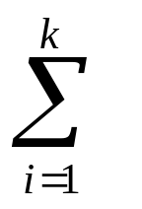
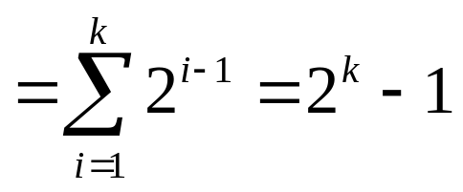
Properties of Binary Tree
⑵The maximum number of nodes in a binary tree
of height k is 2^{k}-1, k≥1.
Proof: The maximum number of nodes in a binary tree of height k is:
(max number of nodes on ith level)

Slide 20
Relations between Number of
Leaf Nodes and Nodes of Degree 2
⑶ For any nonempty binary tree, T, if n₀ is the number of leaf nodes and n₂ is the number of nodes of degree 2, then n₀=n₂+1(叶子数比度为2的数加1)
proof:
  Let n and B denote the total number of nodes & branches in T.
  Let n₀, n₁, n₂ represent the nodes with no children, single child, and two children respectively.
  n= n₀+n₁+n₂, B+1=n, B=n₁+2n₂ ==> n₁+2n₂+1= n,
n₁+2n₂+1= n₀+n₁+n₂ ==> n₀=n₂+1

Slide 21
Complete Binary Tree
⑷The height k of the complete binary tree with n nodes is:
k= ⎣log₂n⎦ +1(下取整)
Proof:
By (2) and definition of complete BT, there is:
2^{k-1}-1 ＜n ≤2^{k}-1
2^{k-1} ≤ n ＜ 2^{k}
k-1≤log₂n ＜k
k is integer, so k = ⎣log₂n⎦ +1

Slide 22
Binary Tree Representations
⑸ If a complete binary tree with n nodes (height =log₂ n + 1) is represented sequentially, then for any node with index i, 1≤ i ≤ n, we have:
  parent(i) is at i/2 if i!=1. If i=1, i is at the root and
  has no parent.
  leftChild(i) is at 2i if 2i ≤ n. If 2i>n, then i has no
  left child.
  rightChild(i) is at 2i+1 if 2i +1 ≤ n. If 2i +1 >n,
  then i has no right child.
Proof

Slide 23
Full Binary Tree Theorem
Theorem 5.1 Full Binary Tree Theorem: The number of leaves in a non-empty full binary tree is one more than the number of internal nodes.
Proof:
By definition, all internal nodes of full binary tree are nodes of degree 2.
And n₀=n₂+1

Slide 24
Full Binary Tree Theorem
Theorem 5.2 The number of empty subtrees in a non-empty binary tree is one more than the number of nodes in the tree.
Proof :
  Let n denotes the number of nodes in binary tree T.
  By definition, every node in binary tree T has two children. So, there are 2n children in T.
  Every node except the root node has one parent, for a total of n-1 nodes with parents. In other words, there are n-1 non-empty children.
  The number of empty children is :2n-(n-1)=n+1

Slide 25
Reference
Chapter 5
  5.1: P151--P155
Chapter 6
  6.1: P203—P204
《数据结构（ C 语言版）》，严蔚敏，吴伟民编著，清华大学出版社，1997年第1版，P118-125

Slide 26
-End-

