Slide 1
Tree & Binary Trees (6)

Slide 2
Outline
Heap
Heapsort

Slide 3
Heaps
A heap is a data structure that defined by two properties:
it is a complete binary tree
  its height is guaranteed to be the minimum possible. In particular, a heap containing n nodes will have a height of
the values stored in a heap are partially ordered. This means that there is a relationship between the value stored at any node and the values of its children.
There are two variants of the heap, depending on the definition of this relationship:
  MinHeap: key(parent) ≤ key(child)
  MaxHeap: key(parent) >= key(child)]
Note : there is no necessary relationship between the value of a node and that of its sibling in either the min-heap or the max-heap.

Slide 4
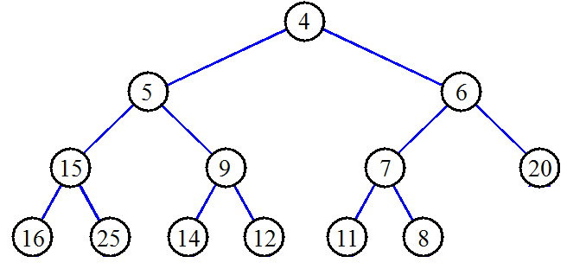
Heap : Example
Minheap

Slide 5
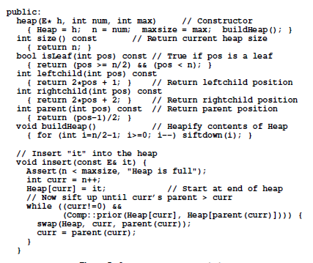
Building a heap (call insert())
insert the elements one at a time.
Each call to insert takes time in the worst case, because the value being inserted can move at most the distance from the bottom of the tree to the top of the tree.
Thus, to insert n values into the heap, if we insert them one at a time, will take time in the worst case.

Slide 6
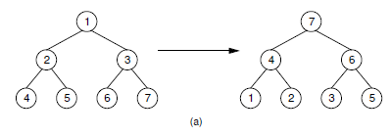
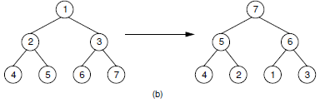
Building a heap (a faster way)
all n values are available at the beginning of the building process.
(a) This heap is built by a series of nine exchanges in the order (4-2), (4-1), (2-1), (5-2), (5-4), (6-3), (6-5), (7-5), (7-6).
(b) This heap is built by a series of four exchanges in the order(5-2), (7-3), (7-1), (6-1).
different arrangement
Same input
different heaps
How do we pick the best rearrangement?

Slide 7

A good arrangement algorithm(call siftdown())
Suppose that the left and right subtrees of the root are already heaps, and R is the name of the element at the root.
In this case there are two possibilities.
(1) Value(R) ≥Value(children) :construction is complete.
(2) Value(R) <one or both of Value( children): R should be exchanged with the child that has greater value.
  The result will be a heap, except that R might still be less than one or both of its (new) children.
  In this case, we simply continue the process of “pushing down” R until it reaches a level where it is greater than its children, or is a leaf node. This process is implemented by the private method siftdown(next slide).

Slide 8
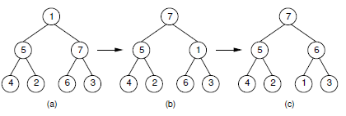
Siftdown operation
The subtrees of the root are assumed to be heaps.
The partially completed heap.
(b) Values 1 and 7 are swapped.
(c) Values 1 and 6 are swapped to form the final heap.

Slide 9
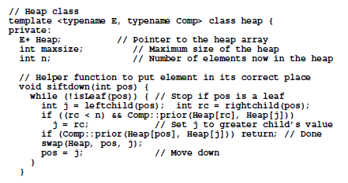
siftdown ()

Slide 10
The cost of buildHeap
Cost(buildheap)=is the sum of all cost(siftdown)
Each siftdown operation can cost at most the number of levels it takes for the node being sifted to reach the bottom of the tree.
So, this algorithm takes time in the worst case.

Slide 11
Heap removal
Removing the maximum (root) value from a heap containing n elements requires
  maintain the complete binary tree shape,
    by moving the element in the last position in the heap (the current last element in the array) to the root position.
  the remaining n-1 node values conform to the heap property.
    If the new root value is not the maximum value in the new heap, use siftdown to reorder the heap.
the cost of deleting the maximum element is in the average and worst cases, since the heap is log n levels deep,

Slide 12
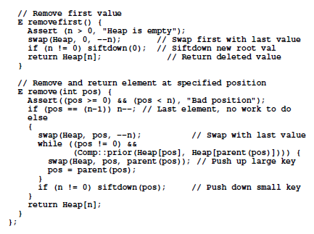
removefirst()& remove()

Slide 13
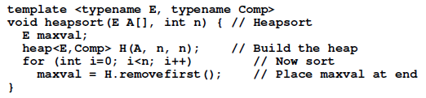

Heapsort
Cost of heapsort:
in the worst, average, and best cases.
  building the heap takes O(n) time
  n deletions of the maximum element each take (log n) time

Slide 14
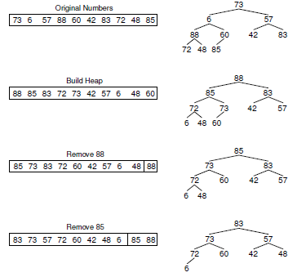
Heapsort:example
…

