Slide 1
Tree & Binary Trees (3)

Slide 2
Outline
Binary Tree ADT
Array-Based Implementation
Pointer-Based Implementation
1

Slide 3
Binary Tree ADT
// Binary tree node abstract class
template <typename E> class BinNode {
public:
virtual ˜BinNode() {} // Base destructor
// Return the node’s value
virtual E& element() = 0;
// Set the node’s value
virtual void setElement(const E&) = 0;
// Return the node’s left child
virtual BinNode* left() const = 0;

Slide 4
Binary Tree ADT
// Set the node’s left child
virtual void setLeft(BinNode*) = 0;
// Return the node’s right child
virtual BinNode* right() const = 0;
// Set the node’s right child
virtual void setRight(BinNode*) = 0;
// Return true if the node is a leaf, false otherwise
virtual bool isLeaf() = 0;
};

Slide 5
Binary Tree Implementations
There are two implementations:
  array-based implementation
  pointer-based implementation

Slide 6
Array-Based Implementation
How to use an array representation for binary trees?
[1]
[2]
[3]
[4]
[5]
[6]
[7]
[8]
[9]
.
[16]
A
B
--
C
--
--
--
D
--
.
E
A
A
[1]
[2]
[3]
[4]
[5]
[6]
[7]
[8]
[9]
A
B
C
D
E
F
G
H
I
B
B
C
C
D
E
F
G
D
E
H
I
waste space

Slide 7
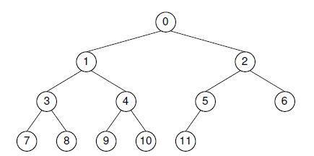
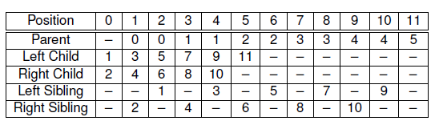
Array-Based Implementation for Complete Binary Trees

Slide 8
Array-Based Implementation for Complete Binary Trees
The formulae for calculating the array indices of the various relatives of a node are as follows. The total number of nodes in the tree is n. The index of the node in question is r, which must fall in the range 0 to n-1.
  Parent(r) = ⎣(r -1)/2 ⎦ if r ≠ 0.
  Left child(r) = 2r + 1 if 2r + 1 < n.
  Right child(r) = 2r + 2 if 2r + 2 < n.
  Left sibling(r) = r - 1 if r is even.
  Right sibling(r) = r + 1 if r is odd and r + 1 < n.

Slide 9
Pointer-Based Implementation
All binary tree nodes have two children.
The most common node implementation includes a value field and pointers to the two children
lChild data rChild
data
lChild
rChild

Slide 10
Pointer-Based Implementation
All binary tree nodes have two children and one parent, except root.
An alternate node implementation includes a value field and pointers to the two children and one parent.
lChild data parent rChild
parent
data
lChild
rChild

Slide 11

Example
root
root
root
A
A
∧
A
∧
∧
B
B
B
C
D
∧
C
∧
D
∧
C
∧
D
E
F
∧
E
∧
∧
F
∧
∧
E
∧
∧
F
∧

Slide 12
Pointer-Based Node Implementation
// Simple binary tree node implementation
template <typename Key, typename E>
class BSTNode : public BinNode<E> {
private:
Key k; // The node’s key
E it; // The node’s value
BSTNode* lc; // Pointer to left child
BSTNode* rc; // Pointer to right child
public:
// Two constructors -- with and without initial values
BSTNode() { lc = rc = NULL; }
BSTNode(Key K, E e, BSTNode* l =NULL, BSTNode* r =NULL)
{ k = K; it = e; lc = l; rc = r; }
˜BSTNode() {} // Destructor

Slide 13
Pointer-Based Node Implementation
// Functions to set and return the value and key
E& element() { return it; }
void setElement(const E& e) { it = e; }
Key& key() { return k; }
void setKey(const Key& K) { k = K; }
// Functions to set and return the children
inline BSTNode* left() const { return lc; }
void setLeft(BinNode<E>* b) { lc = (BSTNode*)b; }
inline BSTNode* right() const { return rc; }
void setRight(BinNode<E>* b) { rc = (BSTNode*)b; }
// Return true if it is a leaf, false otherwise
bool isLeaf() { return (lc == NULL) && (rc == NULL); }
};

Slide 14
Distinguish leaf and internal nodes
Why?
  Some applications require data values only for the leaves.
  Other applications require one type of value for the leaves and another for the internal nodes.
By definition, only internal nodes have non-empty children. It can save space to have separate implementations for internal and leaf nodes.

Slide 15
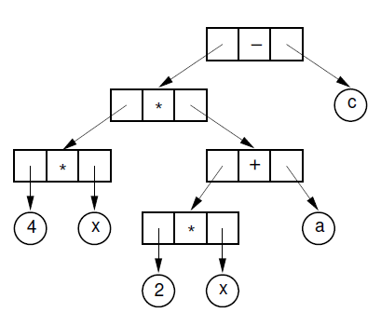
Example: Expression Tree
Expression : 4x(2x + a) - c
Internal nodes store operators, while the leaves store operands.

Slide 16
Approach
Approach 1: to use class inheritance
  A base class can be declared for binary tree nodes in general, with subclasses defined for the internal and leaf nodes.
Approach 2: to use the composite design pattern
  using a virtual base class and separate node classes for the two types.

Slide 17
Approach1
--leaf node representation
// Node implementation with simple inheritance
class VarBinNode { // Node abstract base class
public:
virtual ˜VarBinNode() {}
virtual bool isLeaf() = 0; // Subclasses must implement
};
class LeafNode : public VarBinNode { // Leaf node
private:
Operand var; // Operand value
public:
LeafNode(const Operand& val) { var = val; } // Constructor
bool isLeaf() { return true; } // Version for LeafNode
Operand value() { return var; } // Return node value
};

Slide 18
Approach1
--internal node representation
class IntlNode : public VarBinNode { // Internal node
private:
VarBinNode* left; // Left child
VarBinNode* right; // Right child
Operator opx; // Operator value
public:
IntlNode(const Operator& op, VarBinNode* l, VarBinNode* r)
{ opx = op; left = l; right = r; } // Constructor
bool isLeaf() { return false; } // Version for IntlNode
VarBinNode* leftchild() { return left; } // Left child
VarBinNode* rightchild() { return right; } // Right child
Operator value() { return opx; } // Value
};

Slide 19
Approach1--Function traverse
void traverse(VarBinNode *root) { // Preorder traversal
if (root == NULL) return; // Nothing to visit
if (root->isLeaf()) // Do leaf node
cout << "Leaf: " << ((LeafNode *)root)->value() << endl;
else { // Do internal node
cout << "Internal: "
<< ((IntlNode *)root)->value() << endl;
traverse(((IntlNode *)root)->leftchild());
traverse(((IntlNode *)root)->rightchild());
}
}

Slide 20
Approach2
--leaf node implementation
// Node implementation with the composite design pattern
class VarBinNode { // Node abstract base class
public:
virtual ˜VarBinNode() {} // Generic destructor
virtual bool isLeaf() = 0;
virtual void traverse() = 0;
};
class LeafNode : public VarBinNode { // Leaf node
private:
Operand var; // Operand value
public:
LeafNode(const Operand& val) { var = val; } // Constructor
bool isLeaf() { return true; } // isLeaf for Leafnode
Operand value() { return var; } // Return node value
void traverse() { cout << "Leaf: " << value() << endl; }
};

Slide 21
Approach2
--internal node implementation
class IntlNode : public VarBinNode { // Internal node
private:
VarBinNode* lc; // Left child
VarBinNode* rc; // Right child
Operator opx; // Operator value
public:
IntlNode(const Operator& op, VarBinNode* l, VarBinNode* r)
{ opx = op; lc = l; rc = r; } // Constructor
bool isLeaf() { return false; } // isLeaf for IntlNode
VarBinNode* left() { return lc; } // Left child
VarBinNode* right() { return rc; } // Right child
Operator value() { return opx; } // Value
void traverse() { // Traversal behavior for internal nodes
cout << "Internal: " << value() << endl;
if (left() != NULL) left()->traverse();
if (right() != NULL) right()->traverse();
}
};

Slide 22
-End-

