Slide 1
Tree & Binary Trees (5)

Slide 2
Outline
General Tree Traversals
General Tree Implementations
Converting forest to binary tree

Slide 3
General Tree Traversals
For general trees, preorder and postorder traversals are defined with meanings similar to binary tree counterparts.
Preorder traversal of a general tree first visits the root of the tree, then performs a preorder traversal of each subtree from left to right.
A postorder traversal of a general tree performs a postorder traversal of the root’s subtrees from left to right, then visits the root.
Inorder traversals are generally not useful with general trees.

Slide 4
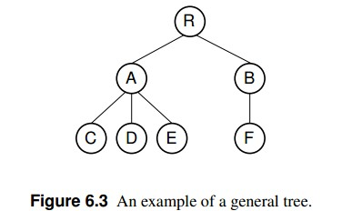
General Tree Traversals
preorder traversal : RACDEBF
postorder : CDEAFBR

Slide 5
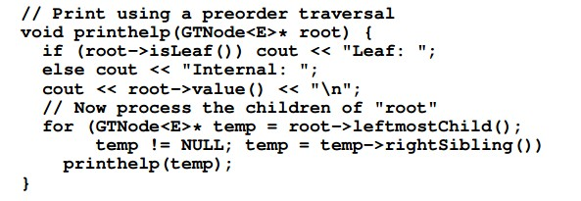
General Tree Traversals

Slide 6
General Tree Implementation
The simplest general tree implementation is to store for each node only a pointer to that node’s parent. We will call this the parent pointer（父指针） implementation.
The parent pointer implementation stores precisely the information required to answer the following useful question: “Given two nodes, are they in the same tree?”
  To answer the question, we need only follow the series of parent pointers from each node to its respective root. If both nodes reach the same root, then they must be in the same tree. If the roots are different, then the two nodes are not in the same tree.

Slide 7
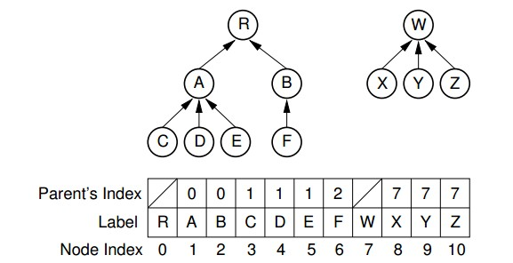
Parent Pointer Implementations
This implementation is not general purpose, because it is inadequate(不足) for such important operations as finding the left most child or the right sibling for a node.

Slide 8
List of Children Implementations
It simply stores with each internal node a linked list of its children.
Each node contains a value, a pointer (or index) to its parent, and a pointer to a linked list of the node’s children, stored in order from left to right.
Each linked list element contains a pointer to one child.
Thus, the leftmost child of a node can be found directly because it is the first element in the linked list.
However, to find the right sibling for a node is more difficult.

Slide 9
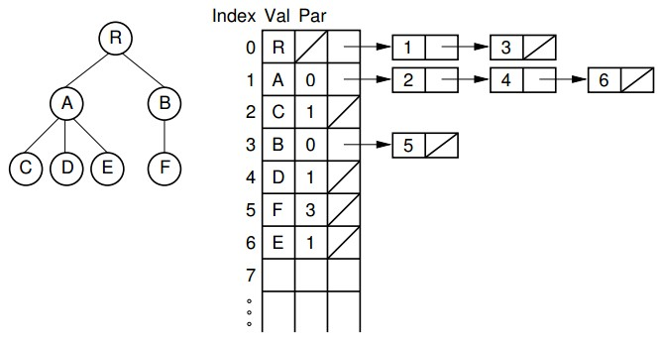
List of Children Implementations

Slide 10
Left-Child/Right-Sibling
Implementation
Each node stores its value and pointers to its parent, leftmost child, and right sibling.
Thus, each of the basic ADT operations can be implemented by reading a value directly from the node.
This implementation is more space efficient than the “list of children” implementation, and each node requires a fixed amount of space in the node array

Slide 11
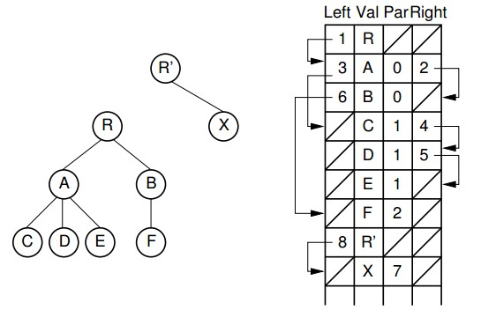
Left-Child/Right-Sibling
Implementation

Slide 12
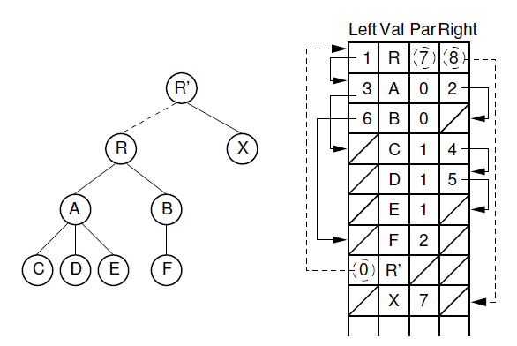
Left-Child/Right-Sibling
Implementation

Slide 13
Dynamic Node Implementations
The general tree implementations just described use an array to store the collection of nodes. In contrast, our standard implementation for binary trees stores each node as a separate dynamic object containing its value and pointers to its two children.
Unfortunately, nodes of a general tree can have any number of children, and this number may change during the life of the node.
A general tree node implementation must support these properties.

Slide 14
Dynamic Node Implementations
One solution is simply to limit the number of children permitted for any node and allocate pointers for exactly that number of children.
There are two major objections to this.
  First, it places an undesirable limit on the number of children, which makes certain trees un-representable by this implementation.
  Second, this might be extremely wasteful of space.

Slide 15
Dynamic Node Implementations
The alternative is to allocate variable space for each node. There are two basic approaches.
  One is to allocate an array of child pointers as part of the node. In essence, each node stores an array-based list of child pointers.

Slide 16
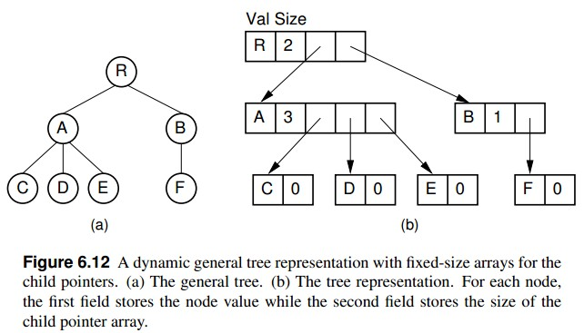
Dynamic Node Implementations

Slide 17
Dynamic Node Implementations
This approach assumes that the number of children is known when the node is created, which is true for some applications but not for others.
It also works best if the number of children does not change. If the number of children does change (especially if it increases), then some special recovery mechanism must be provided to support a change in the size of the child pointer array.
One possibility is to allocate a new node of the correct size from free store and return the old copy of the node to free store for later reuse. This works especially well in a language with built-in garbage collection(内置垃圾收集) such as Java.

Slide 18
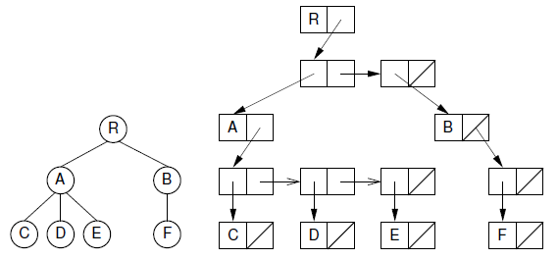
Dynamic Node Implementations
Another approach is to store a linked list of child pointers with each node.

Slide 19
Dynamic Left-Child/Right-Sibling Implementation
The “left-child/right-sibling” implementation stores a fixed number of pointers with each node. This can be readily adapted to a dynamic implementation. In essence, we substitute a binary tree for a general tree. Each node of the “left-child/right-sibling” implementation points to two “children” in a new binary tree structure.
The left child of this new structure is the node’s first child in the general tree. The right child is the node’s right sibling. We can easily extend this conversion to a forest of general trees, because the roots of the trees can be considered siblings.

Slide 20
Dynamic Left-Child/Right-Sibling Implementation
data
firstChild
nextSibling
A
A
B
B
C
D
E
C
E
F
G
F
D
G

Slide 21
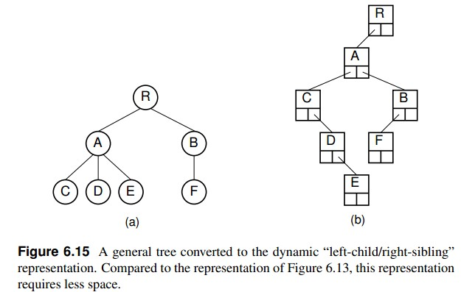
Dynamic Left-Child/Right-Sibling Implementation

Slide 22
Converting forest to binary tree
Here we simply include links from each node to its right sibling and remove links to all children except the leftmost child.
shows how this might look in an implementation with two pointers at each node. The implementation only requires two pointers per node.
The representation is likely to be easier to implement, space efficient, and more flexible than the other implementations presented in this section.

Slide 23
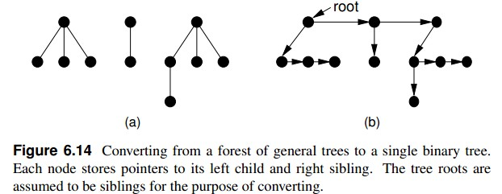
Converting forest to binary tree

Slide 24
Sequential Tree Implementations
Sequential tree implementation stores a series of node values with the minimum information needed to reconstruct the tree structure.
This approach has the advantage of saving space because no pointers are stored. It has the disadvantage that accessing any node in the tree requires sequentially processing all nodes that appear before it in the node list. In other words, node access must start at the beginning of the node list, processing nodes sequentially in whatever order they are stored until the desired node is reached.
Thus, one primary virtue of the other implementations discussed in this section is lost: efficient access to arbitrary nodes in the tree.

Slide 25
Sequential Tree Implementations
Sequential tree implementations are ideal for archiving trees on disk for later use because they save space, and the tree structure can be reconstructed as needed for later processing.
Sequential tree implementations can be used to serialize a tree structure.
Serialization is the process of storing an object as a series of bytes, typically so that the data structure can be transmitted between computers.
This capability is important when using data structures in a distributed processing environment.

Slide 26
-End-

