Slide 1
05 Graph (1)
Notes:
课时数：8学时
1st lesson

Slide 2
Outline
Basic Concept
Graph ADT
Graph Representation
Adjacency Matrix
Adjacency List

Slide 3
Knowledge Points
Chapter 11, pp.381-392

Slide 4
Basic Concept
Graphs are a formalism useful for representing relationships between things
A graph G consists of a set of vertices and a set of connections linking pairs of vertices. These pairs of vertices are called edges.
A graph G is represented as G = (V, E)
  V is a set of vertices: {v₁, …, v_{n}}
  E is a set of edges: {e₁, …, e_{m}} where
  each e_{i} connects two vertices (v_{i1}, v_{i2})
Operations include:
  iterating over vertices
  iterating over edges
  iterating over vertices adjacent to a specific vertex
  asking whether an edge exists connects two vertices

Slide 5
Basic Concept
If each <v_{i},v_{j}> in the E is undirected, that is <v_{i},v_{j}> is same as <v_{j},v_{i}>, G is called an undirected graph. In undirected graph, the edge <v_{i},v_{j}> can be written as is (v_{i},v_{j}) .
If each <v_{i},v_{j}> in the E is directed, G is called a directed graph. In directed graph, the edge <v_{i},v_{j}> is also called arcs.
Complete graph: a graph that has the maximum number of edges
  Undirected graph (n vertices)----n(n-1)/2
  Directed graph (n vertices)-------n(n-1)

Slide 6
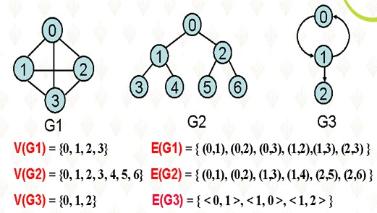
Example
G1 and G2 are undirected graphs, and G3 is a directed graph.
G2 is a tree -→tree is a special case of graphs

Slide 7
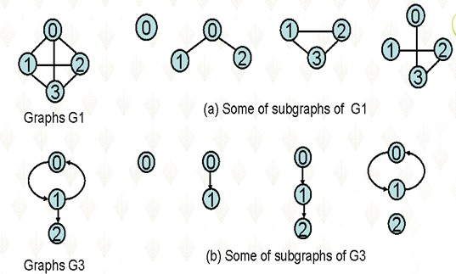
Example

Slide 8
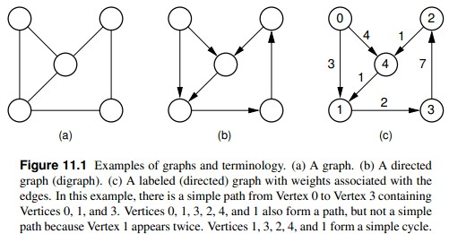

Slide 9
Basic Concept
(v_{i},v_{j}) : vertices v_{i} and v_{j} are adjacent (相邻的)
edge (v_{i},v_{j}) is incident on e_{i} and e_{j} (相关联)
<v_{i},v_{j}> vertex e_{i} is adjacent to vertex e_{j} , vertex v_{j} is adjacent from vertex v_{i} . edge <v_{i},v_{j>} is incident on v_{i} and v_{j} (相关联)
Weighted graph: graphs whose each edge has a weight.
Subgraph: Assume there are two graphs G=(V,E) and G’=(V’,E’). If V’≤V,and E’ ≤E, G’ is called subgraph of G.

Slide 10
Graph Applications
Modeling connectivity in computer and communications networks.
Representing a map as a set of locations with distances between locations; used to compute shortest routes between locations.
Modeling flow capacities in transportation networks.
Finding a path from a starting condition to a goal condition; for example, in artificial intelligence problem solving.
Modeling computer algorithms, showing transitions from one program state to another.
6Finding an acceptable order for finishing subtasks in a complex activity, such as constructing large buildings.

Slide 11
Graph ADT
// Graph abstract class. This ADT assumes that the number
// of vertices is fixed when the graph is created.
class Graph {
private:
  void operator =(const Graph&) {} // Protect assignment
  Graph(const Graph&) {} // Protect copy constructor
public:
  Graph() {} // Default constructor
  virtual ˜Graph() {} // Base destructor
  // Initialize a graph of n vertices
  virtual void Init(int n) =0;
  // Return: the number of vertices and edges
  virtual int n() =0;
  virtual int e() =0;

Slide 12
Graph ADT
// Return v’s first neighbor
virtual int first(int v) =0;
// Return v’s next neighbor
virtual int next(int v, int w) =0;
// Set the weight for an edge
// i, j: The vertices
// wgt: Edge weight
virtual void setEdge(int v1, int v2, int wght) =0;
// Delete an edge
// i, j: The vertices
virtual void delEdge(int v1, int v2) =0;

Slide 13
Graph ADT
// Determine if an edge is in the graph
// i, j: The vertices
// Return: true if edge i,j has non-zero weight
virtual bool isEdge(int i, int j) =0;
// Return an edge’s weight
// i, j: The vertices
// Return: The weight of edge i,j, or zero
virtual int weight(int v1, int v2) =0;
// Get and Set the mark value for a vertex
// v: The vertex
// val: The value to set
virtual int getMark(int v) =0;
virtual void setMark(int v, int val) =0;
};

Slide 14
Graph Representations
List of vertices + list of edges
2-D matrix of vertices (marking edges in the cells)
  “adjacency matrix”
List of vertices each with a list of adjacent vertices
  “adjacency list”

Slide 15
Adjacency Matrix
A |V| x |V| array in which an element (u, v) is true if and only if there is an edge from u to v
Han
Luke
Leia
Han
Han
Luke
Luke
Leia
Leia
runtime:
space requirements:

Slide 16
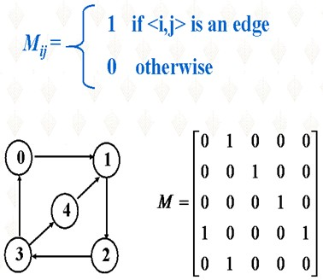
Adjacency Matrix
A graph may be represented with a two-dimensional array. If G has n=|v| vertices, let M be an n×n matrix whose entries are defined by:

Slide 17
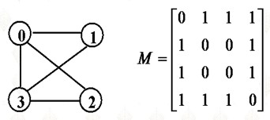
Adjacency Matrix
Worst case:
O(1): to determine existence of a specific edge
O(|V|²) : storage cost
O(|V|) : for finding all vertices accessible from a specific vertex
O(1): to add or delete an edge
Not easy to add or delete a vertex; better for static graph structure
Symmetric (对称)：matrix for undirected graph; so half if redundant then.

Slide 18
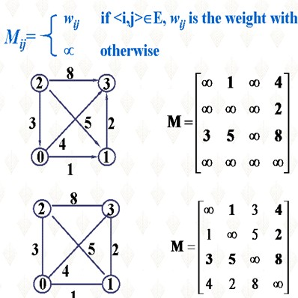
Adjacency Matrix

Slide 19
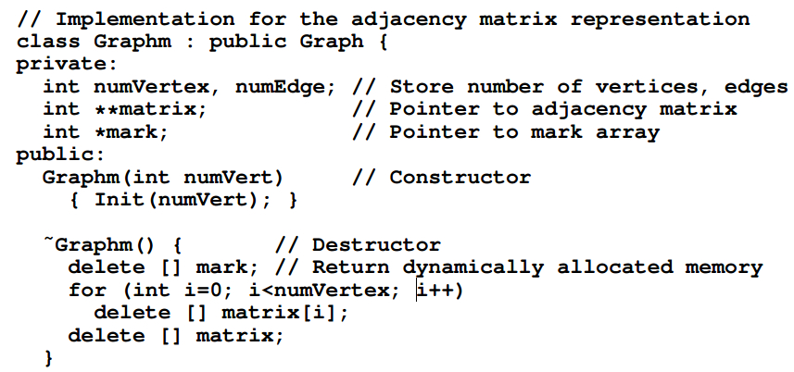
Adjacency Matrix Implementation

Slide 20
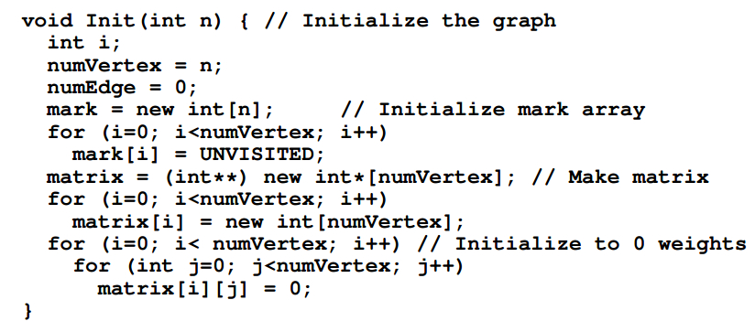
Adjacency Matrix Implementation

Slide 21
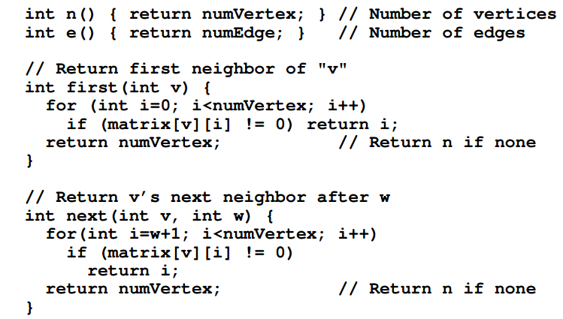
Adjacency Matrix Implementation

Slide 22
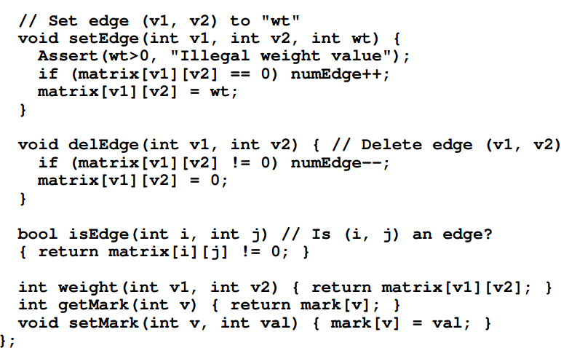
Adjacency Matrix Implementation

Slide 23
Adjacency List
A |V|-ary list (array) in which each entry stores a list (linked list) of all adjacent vertices (or edges)
Han
Han
Luke
Luke
Leia
Leia
runtime:
space requirements:

Slide 24
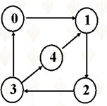
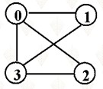
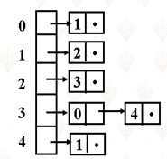
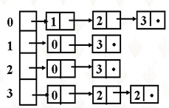
Adjacency List

Slide 25
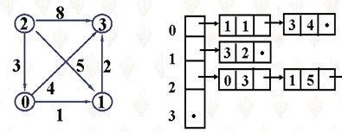
Adjacency List
Worst case:
O(|V|): to determine existence of a specific edge
O(|V|+|E|) : storage cost
O(|V|) : for finding all neighbors of a specific vertex
O(|V|): to add or delete an edge
Still not easy to add or delete a vertex; however, we can use a linked list in place of the arrya

Slide 26
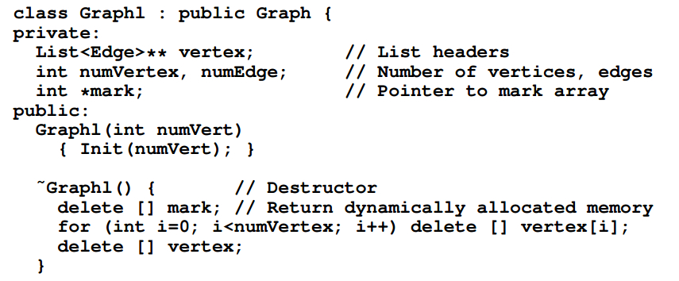
Adjacency List Implementation

Slide 27
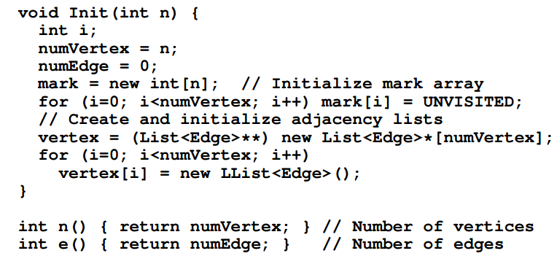
Adjacency List Implementation

Slide 28
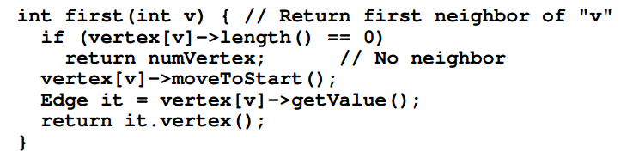
Adjacency List Implementation

Slide 29
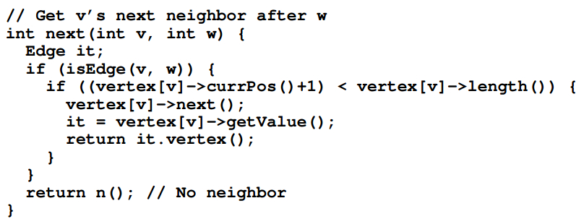
Adjacency List Implementation

Slide 30
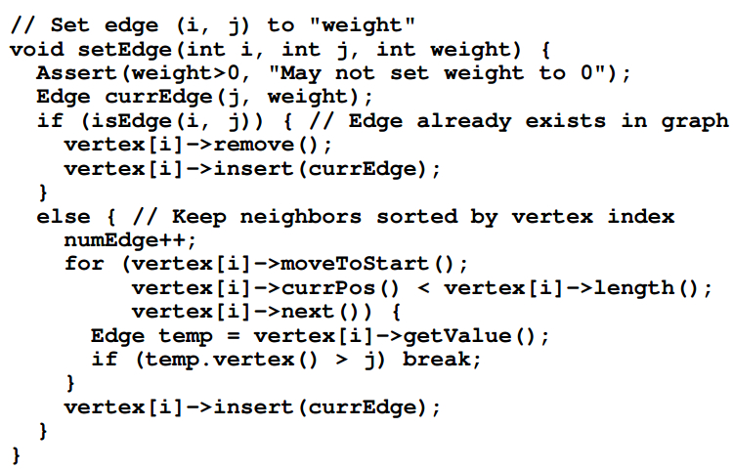
Adjacency List Implementation

Slide 31
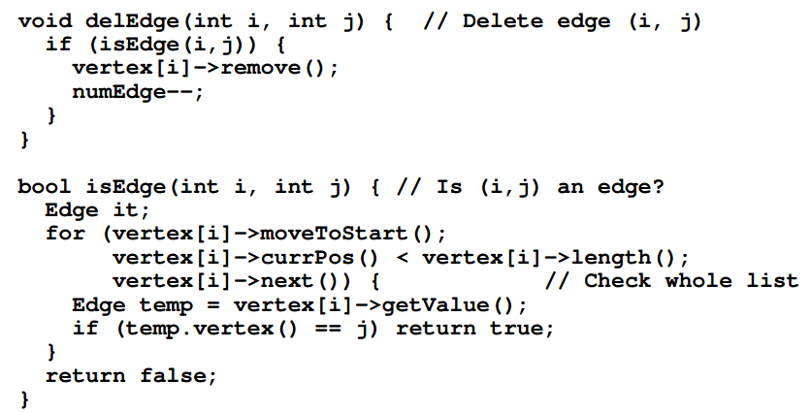
Adjacency List Implementation

Slide 32
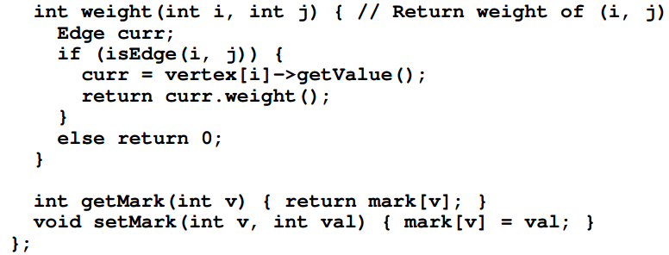
Adjacency List Implementation

Slide 33
Homework
P410, 11.3

Slide 34
-End-

