Slide 1
Stacks（1）

Slide 2
Outline
Stack ADT
Array-Based Stack
Linked Stack
Comparison of Array-Based and Linked Stacks
Applications

Slide 3
Stacks
The stack is a list-like structure in which elements may be inserted or removed from only one end, called the top of the stack.
All access is restricted to the most recently inserted elements
Basic operations are push, pop

Slide 4
Stacks
LIFO: Last In, First Out.
Restricted form of list: Insert and remove only at front of list.
Notation:
Insert: PUSH
Remove: POP
The accessible element is called top element.

Slide 5
Example: Stack of Char
push
push
push
pop
‘c’
‘b’
‘b’
‘b’
‘a’
‘a’
‘a’
‘a’

Slide 6
Stack ADT
// Stack abtract class
template <typename E> class Stack {
private:
void operator =(const Stack&) {} // Protect assignment
Stack(const Stack&) {} // Protect copy constructor
public:
Stack() {} // Default constructor
virtual ˜Stack() {} // Base destructor
// Reinitialize the stack. The user is responsible for
// reclaiming the storage used by the stack elements.
virtual void clear() = 0;

Slide 7
Stack ADT
// Push an element onto the top of the stack.
// it: The element being pushed onto the stack.
virtual void push(const E& it) = 0;
// Remove the element at the top of the stack.
// Return: The element at the top of the stack.
virtual E pop() = 0;
// Return: A copy of the top element.
virtual const E& topValue() const = 0;
// Return: The number of elements in the stack.
virtual int length() const = 0;
}

Slide 8
Array-Based Stack
The array-based stack implementation is essentially a simplified version of the array-based list.
The only important design decision to be made is which end of the array should represent the top of the stack.
  One choice is to make the top be at position 0 in the array. This implementation is inefficient.（Why？）
  The other choice is have the top element be at position n-1 when there are n elements in the stack.
For the implementation of Figure 4.18, top is defined to be the array index of the first free position in the stack. Thus, an empty stack has top set to 0, the first available free position in the array.

Slide 9
Array-Based Stack
// Array-based stack implementation
private:
int size; // Maximum size of stack
int top; // Index for top element
Elem *listArray; // Array holding elements
public:
AStack(int size =defaultSize) // Constructor
{ maxSize = size; top = 0; listArray = new E[size]; }
˜AStack() { delete [] listArray; } // Destructor
void clear() { top = 0; } // Reinitialize
void push(const E& it) { // Put "it" on stack
Assert(top != maxSize, "Stack is full");
listArray[top++] = it;
}

Slide 10
Array-Based Stack
E pop() { // Pop top element
Assert(top != 0, "Stack is empty");
return listArray[--top];
}
const E& topValue() const { // Return top element
Assert(top != 0, "Stack is empty");
return listArray[top-1];
}
int length() const { return top; } // Return length
};
Issues:
Which end is the top?
What is the cost of the operations?

Slide 11
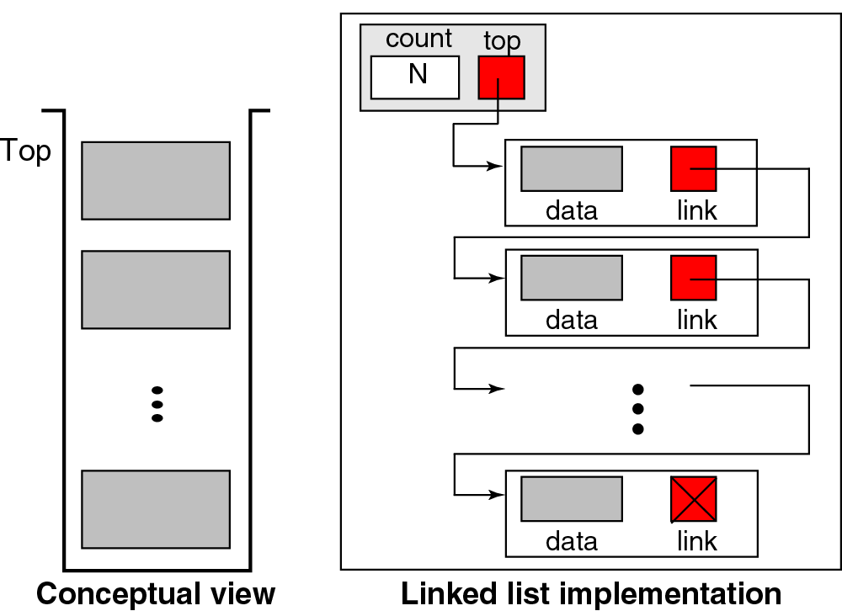
Linked Stack

Slide 12
Linked Stack
The linked stack implementation is quite simple. The freelist of Section 4.1.2 is an example of a linked stack.
Elements are inserted and removed only from the head of the list. A header node is not used because no special-case code is required for lists of zero or one elements.
The only data member is top, a pointer to the first (top) link node of the stack.

Slide 13
Linked Stack
// Linked stack implementation
private:
Link<Elem>* top; // Pointer to first elem
int size; // Count number of elems
public:
LStack(int sz =defaultSize) // Constructor
{ top = NULL; size = 0; }
˜LStack() { clear(); } // Destructor

Slide 14
Linked Stack
void clear() { // Reinitialize
while (top != NULL) { // Delete link nodes
Link<E>* temp = top;
top = top->next;
delete temp;
}
size = 0;
}
void push(const E& it) { // Put "it" on stack
top = new Link<E>(it, top);
size++;
}

Slide 15
Linked Stack
E pop() { // Remove "it" from stack
Assert(top != NULL, "Stack is empty");
E it = top->element;
Link<E>* ltemp = top->next;
delete top;
top = ltemp;
size--;
return it;
}

Slide 16
Linked Stack
const E& topValue() const { // Return top value
Assert(top != 0, "Stack is empty");
return top->element;
}
int length() const { return size; } // Return length
};
What is the cost of the operations?
How do space requirements compare to the array-based stack implementation?

Slide 17
Comparison of Array-Based and Linked Stacks
All operations for the array-based and linked stack implementations take constant time
Total space required：the analysis is similar to that done for list implementations
When multiple stacks are to be implemented, it is possible to take advantage of the one-way growth of the array-based stack. This can be done by using a single array to store two stacks，as illustrated by Figure 4.20

Slide 18
Implementing Recursion
Perhaps the most common computer application that uses stacks is the implementation of subroutine calls in most programming language runtime environments.
A subroutine call is normally implemented by placing necessary information about the subroutine (including the return address, parameters, and local variables) onto a stack.
Further subroutine calls add to the stack
Each return from a subroutine pops the top activation record off the stack

Slide 19
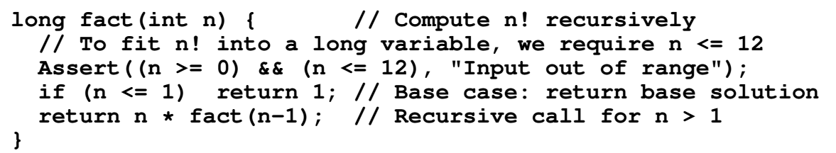
Implementing Recursion
An algorithm is recursive if it calls itself to do part of its work.
In general, a recursive algorithm must have two parts：
  The base case, which handles a simple input that can be solved without resorting to a recursive call
  The recursive part which contains one or more recursive calls to the algorithm where the parameters are in some sense “closer” to the base case than those of the original call.

Slide 20
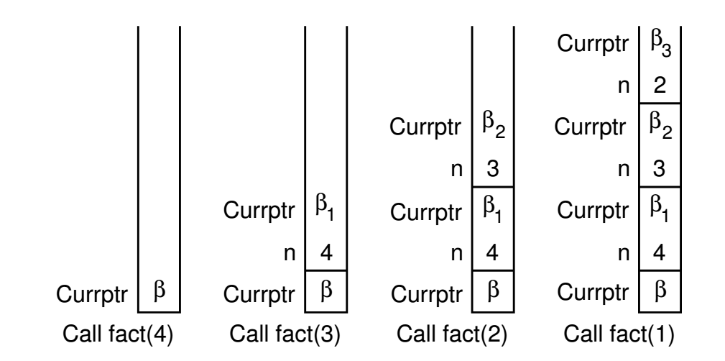
Implementing Recursion
Consider what happens when we call fact with the value 4：

Slide 21
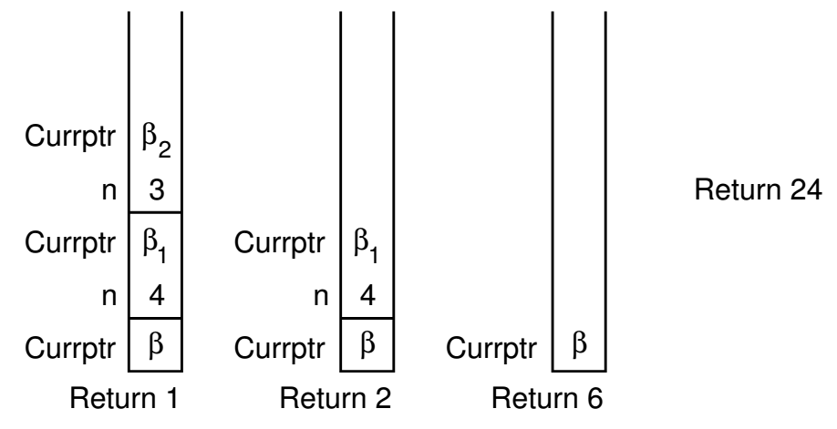
Implementing Recursion

Slide 22
Stack Applications
Notes:
以下应用，给出了思路，可选择一个或几个，安排学生分组完成代码，下次课堂讨论

Slide 23
Application 1
Data conversion
A simple algorithm uses the following law:
N=( N/ d) × d+ N% d
eg: Convert decimal to binary
(100)10 = (1100100)2
  divide decimal number by 2 continuously
  record the remainders until the quotient becomes 0
  print the remainders in backward order.
Stack is an ideal structure to implement this process.
How to implement it？
2
100
2
50
0
2
25
0
2
12
1
2
6
0
2
3
0
2
1
1
0
1
Notes:
Application1和application2的实现部分可选择作为学生的随堂练习，或课堂讨论

Slide 24
Applications 2
Balancing Symbols
How do we know the following parentheses are nested correctly ?
7-((X*((X+Y)/(J-3))+Y)/(4-2.5))
1. There are an equal number of right and left parentheses.
2. Every right parenthesis is preceded by a matching left
parenthesis.
((A+B) or A+B( violate 1
)A+B(-C or (A+B))-(C+D violate 2

Slide 25
Applications 2
Balancing Symbols
Stack can be used to check a program for balanced symbols (such as {}, (), []).
Example: {()} is legal, {(}) is not (so simply counting symbols does not work).
When a closing symbol is seen, it matches the most recently seen unclosed opening symbol. Therefore, a stack will be appropriate.

Slide 26
Applications 2
Balancing Symbols
Make an empty stack. Read characters until end of file.
If the character is an opening symbol, push it onto stack.
If it is a closing symbol, then if the stack is empty, report an error. Otherwise, pop the stack.
If the symbol popped is not the corresponding opening symbol, then report an error.
At the end of file, if the stack is not empty, report an error.

Slide 27
Problem
Modify the code of Figure 4.18 to implement two stacks sharing the same array, as shown in Figure 4.20.
top1
top2

Slide 28
Solution
template <class Elem> class AStack2 {
private:
int size; // Maximum size of stack
int top1, top2; // Index for top element (two)
Elem *listArray; // Array holding stack elements
public:
AStack2(int sz =DefaultListSize) // Constructor
{ size = sz; top1 = 0;top2 = size - 1; listArray = new Elem[sz]; }
˜AStack2() { delete [] listArray; } // Destructor

Slide 29
Solution
void clear(int st) {
if (st == 1) top1 = 0;
else top2 = size - 1;
}
bool push(int st, const Elem& item) {
if (top1+1 >= top2) return false; // Stack is full
if (st == 1) listarray[top1++] = item;
else listarraay[top2--] = item;
return true;
}

Slide 30
Solution
bool pop(int st, Elem& it) { // Pop top element
if ((st == 1) && (top1 == 0)) return false;
if ((st == 2) && (top2 == (size-1))) return false;
if (st == 1) it = listArray[--top1];
else it = listArray[++top2];
return true;
}

Slide 31
Solution
bool topValue(int st, Elem& it) const { // Return top
if ((st == 1) && (top1 == 0)) return false;
if ((st == 2) && (top2 == (size-1))) return false;
if (st == 1) it = listArray[top1-1];
else it = listArray[top2+1];
return true;
}
int length(int st) const {
if (st == 1) return top1;
else return size - top2 - 1;
}
};

Slide 32
Reference
Data Structures and Algorithm Analysis in C++ .Third Edition.Clifford A. Shaffer(P.120-127)
《数据结构（ C 语言版）》，严蔚敏，吴伟民编著，清华大学出版社，1997年第1版,P48-49

Slide 33
-END-

