Slide 1
Stacks（2）
Stack Applications

Slide 2
Application 4
Evaluating RPN Expressions
RPN?
A notation for arithmetic expressions:
operators are written after the operands.
Infix notation: operators written between the operands
Postfix notation (RPN): operators written after the operands
Prefix notation : operators written before the operands
Examples:
INFIX RPN (POSTFIX) PREFIX
A + B A B + + A B
A * B + C A B * C + + * A B C
A * (B + C) A B C + * * A + B C
A–(B –(C – D)) A B C D - - - - A - B - C D
A – B – C – D A B - C - D - - - - A B C D

Slide 3
Application 3
Evaluating RPN Expressions
"By hand": Underlining technique:
1. Scan the expression from left to right to find an operator.
2. Locate ("underline") the last two preceding operands and combine them using this operator.
3. Repeat until the end of the expression is reached.
Example:
2 3 4 + 5 6 - - *
→ 2 3 4 + 5 6 - - *
→ 2 7 5 6 - - *
→ 2 7 5 6 - - *
→ 2 7 -1 - *
→ 2 7 -1 - *
→ 2 8 * → 2 8 * → 16

Slide 4
Application 3
Evaluating RPN Expressions
STACK ALGORITHM
Receive:An RPN expression.
Return: A stack whose top element is the value of RPN
expression(unless an error occurred).
1. Initialize an empty stack.
2. Repeat the following until the end of the expression is encountered:
a. Get next token (constant, variable, arithmetic operator) in the RPN expression.
b. If token is an operand, push it onto the stack.
If it is an operator, then
(i) Pop top two values from the stack.
If stack does not contain two items, error due to a malformed RPN Evaluation terminated
(ii) Apply the operator to these two values.
(iii) Push the resulting value back onto the stack.
3. When the end of expression encountered, its value is on top of the stack
(and, in fact, must be the only value in the stack).

Slide 5
Application 3
Evaluating RPN Expressions
Unary minus causes problems
Example:
5 3 - -
→ 5 3 - -
→ 5 -3 - → 8
5 3 - -
→ 5 3 - -
→ 2 - → -2
Use a different symbol:
5 3 ~ -
5 3 - ~

Slide 6
Application 3
Evaluating RPN Expressions
Example: 2 3 4 + 5 6 - - *
Push 2
Push 3
Push 4
Read +
Pop 4, Pop 3, 3 + 4 = 7
Push 7
Push 5
Push 6
Read –
Pop 6, Pop 5, 5 - 6 = -1
Push -1
Read –
Pop -1, Pop 7, 7 - -1 = 8
Push 8
Read *
Pop 8, Pop 2, 2 * 8 = 16

Slide 7
Application 4
Converting Infix to RPN
1. Initialize an empty stack of operators.
2. While no error has occurred and end of infix expression not reached
a. Get next Token in the infix expression.
b. If Token is
(i) a left parenthesis: Push it onto the stack.
(ii) a right parenthesis:Pop and display stack elements until a left parenthesis is encountered,but do not display it. (Error if stack empty with no left parenthesis found.)
(iii) an operator:If stack empty or Token has higher priority than top stack element, push Token on stack.( Left parenthesis in stack has lower priority than operators)
Otherwise, pop and display the top stack element; then repeat the comparison of Token with new top stack item.
(iv) an operand: Display it.
3. When end of infix expression reached,pop and display stack items until stack is empty.

Slide 8
Application 4
Converting Infix to RPN
Example: ((A+B)*C)/(D-E)
Push (
Push (
Display A A
Push +
Display B AB
Read )
Pop +, Display +, Pop ( AB+
Push *
Display C AB+C
Read )
Pop *, Display *, Pop ( AB+C* // stack now empty
Push /
Push (
Display D AB+C*D
Push –
Display E AB+C*DE
Read )
Pop -, Display -, Pop ( AB+C*DE-
Pop /, Display / AB+C*DE-/

Slide 9
Application 5
Maze
A maze is a rectangular area with an entrance and an exit.
The interior of a maze contains walls or obstacles that one cannot walk through.
We view the maze as broken up into equal size squares, some of which are part of the walls and the others are part of the hallways. Thus they are “open”.
One of the open squares is designated as the Start position and another as the Exit position.
S
E
Maze M

Slide 10
Application 5
Maze
So we will use an enumerated type which will include constants OPEN and WALL.
To reflect our search method for finding an exit path, we will also have a
third state: VISITED.
In traversing the maze, we can only move forward into an OPEN position .
Thus a given position has 4 possible neighboring positions in the directions east, south, west and north.

Slide 11
Searching the Example Maze
S
E
Visited and pending
(on current path)
Visited and Done
(not on current path)
Current position

Slide 12
Searching the Example Maze
S
↓
Arrows indicate the
current path
E
Visited and pending
(on current path)
Visited and Done
(not on current path)
Current position

Slide 13
Searching the Example Maze
S
↓
↓
Arrows indicate the
current path
E
Visited and pending
(on current path)
Visited and Done
(not on current path)
Current position

Slide 14
Searching the Example Maze
S
↓
↓
Arrows indicate the
current path
↓
E
Visited and pending
(on current path)
Visited and Done
(not on current path)
Current position

Slide 15
Searching the Example Maze
S
↓
↓
Arrows indicate the
current path
↓
↓
E
Visited and pending
(on current path)
Visited and Done
(not on current path)
Current position

Slide 16
Searching the Example Maze
S
↓
↓
Arrows indicate the
current path
↓
↓
↓
E
Visited and pending
(on current path)
Visited and Done
(not on current path)
Current position

Slide 17
Searching the Example Maze
S
↓
↓
Arrows indicate the
current path
↓
↓
E
Visited and pending
(on current path)
Visited and Done
(not on current path)
Current position

Slide 18
Searching the Example Maze
S
↓
↓
Arrows indicate the
current path
↓
E
Visited and pending
(on current path)
Visited and Done
(not on current path)
Current position

Slide 19
Searching the Example Maze
S
↓
↓
Arrows indicate the
current path
E
Visited and pending
(on current path)
Visited and Done
(not on current path)
Current position

Slide 20
Searching the Example Maze
S
↓
Arrows indicate the
current path
E
Visited and pending
(on current path)
Visited and Done
(not on current path)
Current position

Slide 21
Searching the Example Maze
S
Arrows indicate the
current path
E
Visited and pending
(on current path)
Visited and Done
(not on current path)
Current position

Slide 22
Searching the Example Maze
↑
S
Arrows indicate the
current path
E
Visited and pending
(on current path)
Visited and Done
(not on current path)
Current position

Slide 23
Searching the Example Maze
↑
↑
S
Arrows indicate the
current path
E
Visited and pending
(on current path)
Visited and Done
(not on current path)
Current position

Slide 24
Searching the Example Maze
↑
S
Arrows indicate the
current path
E
Visited and pending
(on current path)
Visited and Done
(not on current path)
Current position

Slide 25
Searching the Example Maze
→
↑
S
Arrows indicate the
current path
E
Visited and pending
(on current path)
Visited and Done
(not on current path)
Current position

Slide 26
Searching the Example Maze
→
↑
↓
S
Arrows indicate the
current path
E
Visited and pending
(on current path)
Visited and Done
(not on current path)
Current position

Slide 27
Searching the Example Maze
→
↑
↓
S
→
Arrows indicate the
current path
E
Visited and pending
(on current path)
Visited and Done
(not on current path)
Current position

Slide 28
Searching the Example Maze
→
↑
↓
S
→
↓
Arrows indicate the
current path
E
Visited and pending
(on current path)
Visited and Done
(not on current path)
Current position

Slide 29
Searching the Example Maze
→
↑
↓
S
→
↓
↓
Arrows indicate the
current path
E
Visited and pending
(on current path)
Visited and Done
(not on current path)
Current position

Slide 30
Searching the Example Maze
→
Three steps combined
↑
↓
↑
S
→
Arrows indicate the
current path
E
Visited and pending
(on current path)
Visited and Done
(not on current path)
Current position

Slide 31
Searching the Example Maze
→
→
→
Several steps combined
↑
↓
↑
↓
S
→
↓
↓
Arrows indicate the
current path
↓
↓
←
←
↓
↓
E
Visited and pending
(on current path)
Visited and Done
(not on current path)
Current position

Slide 32
Searching the Example Maze
→
→
→
Several steps combined
↑
↓
↑
↓
S
→
↓
↓
Arrows indicate the
current path
↓
↓
←
←
↓
↓
↓
E
Visited and pending
(on current path)
Visited and Done
(not on current path)
Current position

Slide 33
Searching the Example Maze
→
→
↑
↓
→
→
→
Several steps combined
↑
↓
↑
↓
↑
↓
S
→
↓
↑
↓
↑
Arrows indicate the
current path
↓
↑
↓
↑
←
←
↓
↑
↓
↑
→
→
→
↓
↑
→
E
Visited and pending
(on current path)
Visited and Done
(not on current path)
Current position

Slide 34
Searching the Example Maze
→
→
↑
↓
→
→
→
Several steps combined
↑
↓
↑
↓
↑
↓
S
→
→
↓
↑
↓
↑
↓
Arrows indicate the
current path
←
↓
↑
↓
↓
↑
↓
←
←
↓
↑
↓
↓
↑
↓
→
→
→
↓
↑
↓
→
→
E
Visited and pending
(on current path)
Visited and Done
(not on current path)
Current position

Slide 35
Application 5
Maze ：Search Method
First we mark the Start position as VISITED and make it the current position.
When exploring from a current position P, we look for an open neighbor in a fixed pattern: east, south, west and north.
When an OPEN neighbor Q is found, we mark it as visited.
In this case we say that Q was entered from P and that P is “pending”: we have not finished exploring from P.
We first check to see if Q is the Exit position.
If so, the search concludes successfully. In this case, we print out the path from the Start to the Exit.
If not, we continue exploring from position Q.

Slide 36
Application 5
Maze ：Search Method
If all four neighbors of Q are either WALL or VISITED, we return to the position P from which Q was first visited and continue exploring from P.
That is, we “back out” from Q to P. This is the only way we can move to a previously visited position.
Once we back out from Q, we will never return. Also, Q will not be on the path.
If we return to the Start position and find no OPEN neighbors, the search concludes unsuccessfully: there is no path from the Start to the Exit.

Slide 37
Application 5
Maze
We now consider how to carry out the algorithm described previously.
In particular, how do we keep track of the position from which the current position was entered?
Consider this: Suppose we go from S to P, then P to Q, then Q to R and R to T, then at position T find no OPEN neighbors.
Then we back out to R. Suppose R has no OPEN neighbors. Then we should back out to Q.
If Q has no OPEN neighbors, we back out to P and then to S.
So the Path progresses like this:
S
S→P
S →P →Q
S →P→Q →R
S →P→Q →R →T
S →P→Q →R
S →P→Q
S →P
S
So we will maintain a stack of Positions.
When we first visit a Position, we push it on the stack.
To back out from a Position, we pop the top of the stack
and continue exploring from there.

Slide 38
Application 6
Towers of Hanoi
A Legend ：The Towers of Hanoi
In the great temple of Brahma in Benares, on a brass plate under the dome that marks the center of the world, there are 64 disks of pure gold that the priests carry one at a time between these diamond needles according to Brahma's immutable law: No disk may be placed on a smaller disk. In the begging of the world all 64 disks formed the Tower of Brahma on one needle. Now, however, the process of transfer of the tower from one needle to another is in mid course. When the last disk is finally in place, once again forming the Tower of Brahma but on a different needle, then will come the end of the world and all will turn to dust.

Slide 39

Application 6
The Towers of Hanoi
  GIVEN: three poles
  a set of discs on the first pole, discs of different sizes, the smallest discs at the top
  GOAL: move all the discs from the left pole to the right one.
  CONDITIONS: only one disc may be moved at a time.
  A disc can be placed either on an empty pole or on top of a larger disc.

Slide 40

Application 6
The Towers of Hanoi

Slide 41
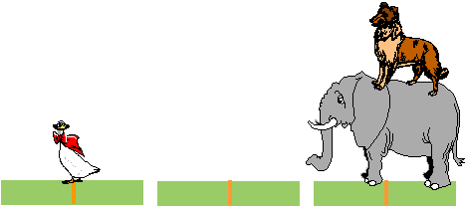
Application 6
The Towers of Hanoi

Slide 42
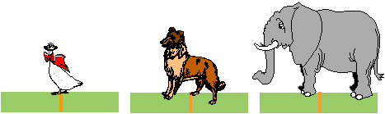
Application 6
The Towers of Hanoi

Slide 43

Application 6
The Towers of Hanoi

Slide 44

Application 6
The Towers of Hanoi

Slide 45

Application 6
The Towers of Hanoi

Slide 46
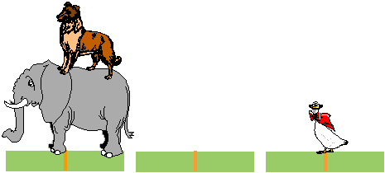
Application 6
The Towers of Hanoi

Slide 47
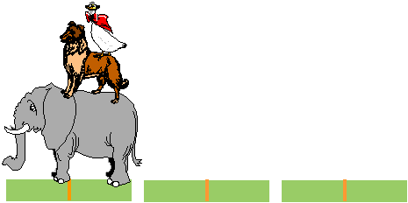
Application 6
The Towers of Hanoi

Slide 48
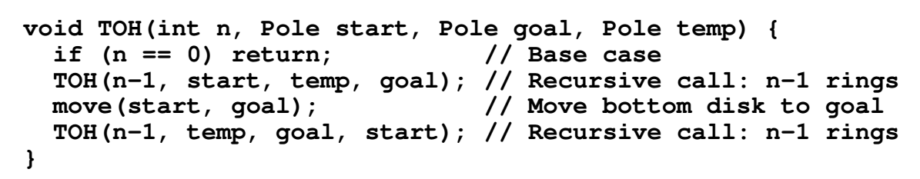
Application 6
Towers of Hanoi – Recursive Solution
Notes:
教材上的递归算法（没有用栈），而算法4.22是一个用栈实现的非递归算法。

Slide 49
Application 6
Towers of Hanoi – Recursive Solution
void hanoi (int discs,Stack fromPole, Stack toPole, Stack aux) {
Discs d;
if( discs >= 1) {
hanoi(discs-1, fromPole, aux, toPole);
d = fromPole.pop();
toPole.push(d);
hanoi(discs-1,aux, toPole, fromPole);
}
Notes:
用栈实现的递归算法

Slide 50
Is the End of the World Approaching?
Problem complexity 2^{n}
64 gold discs
Given 1 move a second
→ 600,000,000,000 years until the end of the world ☺

Slide 51
Summary
ADT stack operations have a last-in, first-out (LIFO) behavior
Stack applications
A strong relationship exists between recursion and stacks

Slide 52
Reading Materials
  《数据结构（ C 语言版）》，严蔚敏，吴伟民编著，清华大学出版社，1997年第1版,P50-58

