Slide 1
Sorting(1)

Slide 2
outline
Sorting
Insertion Sort
Bubble Sort
Selection Sort

Slide 3
Sorting
Sorting is, without doubt, the most fundamental algorithmic problem
Supposedly, 25% of all CPU cycles are spent sorting
Sorting is fundamental to most other algorithmic problems, for example binary search.
Many different approaches lead to useful sorting algorithms, and these ideas can be used to solve many other problems.

Slide 4
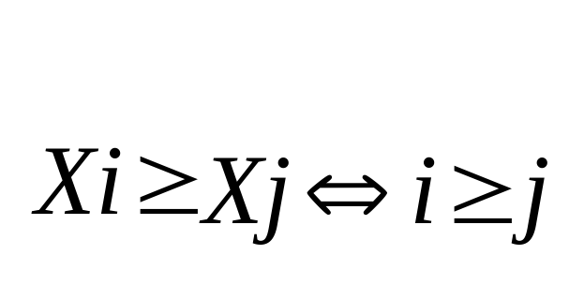
What is sorting?
It is the problem of taking an arbitrary permutation of n items and rearranging them into the total order,

Slide 5
Issues in Sorting
Increasing or Decreasing Order?
  The same algorithm can be used by both all we need do is change to in the comparison function as we desire.
What about equal keys?
  Does the order matter or not? Maybe we need to sort on secondary keys, or leave in the same order as the original permutations.
What about non-numerical data?
  Alphabetizing is sorting text strings, and libraries have very complicated rules concerning punctuation, etc. Is Brown-Williams before or after Brown America before or after Brown, John?
We can ignore all three of these issues by assuming a comparison function which depends on the application. Compare (a, b) should return ``<'', ``>'', or ''=''.

Slide 6
Applications of Sorting
One reason why sorting is so important is that once a set of items is sorted, many other problems become easy.
Searching Binary search lets you test whether an item is in a dictionary in time.
Speeding up searching is perhaps the most important application of sorting.

Slide 7
Applications of Sorting
Closest pair
  Given n numbers, find the pair which are closest to each other.
  Once the numbers are sorted, the closest pair will be next to each other in sorted order, so an O(n) linear scan completes the job.
Element uniqueness
  Given a set of n items, are they all unique or are there any duplicates?
  Sort them and do a linear scan to check all adjacent pairs.
  This is a special case of closest pair above.
Frequency distribution – Mode
  Given a set of n items, which element occurs the largest number of times?
  Sort them and do a linear scan to measure the length of all adjacent runs.
Median and Selection
  What is the kth largest item in the set?
  Once the keys are placed in sorted order in an array, the kth largest can be found in constant time by simply looking in the kth position of the array.

Slide 8
How do you sort?
There are several different ideas which lead to sorting algorithms:
Insertion - putting an element in the appropriate place in a sorted list yields a larger sorted list.
Exchange - rearrange pairs of elements which are out of order, until no such pairs remain.
Selection - extract the largest element form the list, remove it, and repeat.
Distribution - separate into piles based on the first letter, then sort each pile.
Merging - Two sorted lists can be easily combined to form a sorted list.

Slide 9
Analyzing sorting algorithms
Traditional measure: the number of comparisons made between keys.
  This measure is usually closely related to the running time for the algorithm and has the advantage of being machine and datatype independent.
Another measure :the number of swap operations performed by the algorithm.
  In some cases records might be so large that their physical movement might take a significant fraction of the total running time.
In most applications we can assume that all records and keys are of fixed length, and that a single comparison or a single swap operation requires a constant amount of time regardless of which keys are involved.

Slide 10
Insertion Sort
Intuitive sorting process:
  Organizing a stack of phone bills;
  Organizing cards when play cards
Basic Idea:
  Insertion sort iterates through a list of records. Each record is inserted in turn at the correct position within a sorted list composed of those records already processed

Slide 11
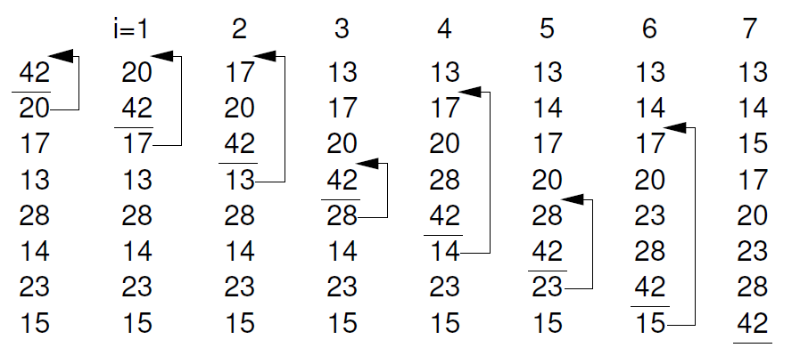
Insertion sort: Example

Slide 12

Insertion Sort
In inserting the element in the sorted section, we might have to move many elements to make room for it.
If the elements are in an array, we scan from bottom to top until we find the j such that
then move from j+1 to the end down one to make room.
If the elements are in a linked list, we do the sequential search until we find where the element goes, then insert the element there. No other elements need move!

Slide 13
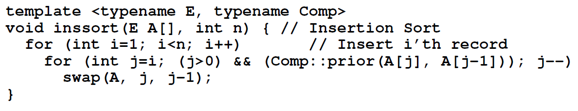
Insertion Sort: Implementation

Slide 14

Insertion Sort : Complexity
Since we do not necessarily have to scan the entire sorted section of the array, the best, worst, and average cases for insertion sort all differ!
Best case: when the array or list is already sorted
  The element always gets inserted at the end,
  don't have to move anything,
  only compare against the last sorted element.
  have (n-1) insertions, each with exactly one comparison and no data moves per insertion!
  Cost:

Slide 15
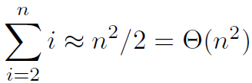

Worst Case Complexity
Worst case: the array is sorted in reverse order.
  the element always gets inserted at the front,
  all the sorted elements must be moved at each insertion.
  The ith insertion requires (i-1) comparisons and moves so:
cost:

Slide 16


Average Case Complexity
Average Case: If we were given a random permutation, the chances of the ith insertion requiring 0,1,2,…,(i-1) comparisons are equal, and hence 1/i.
The expected number of comparisons is for the ith insertion is:
Summing up over all n keys,
So we do half as many comparisons/moves on average!
Cost:

Slide 17
Bubble Sort
Bubble Sort consists of a simple double for loop.
The first iteration of the inner for loop moves through the record array from bottom to top, comparing adjacent keys. If the lower-indexed key’s value is greater than its higher-indexed neighbor, then the two values are swapped. Once the smallest value is encountered,this process will cause it to “bubble” up to the top of the array.
The second pass through the array repeats this process. However, because we know that the smallest value reached the top of the array on the first pass, there is no need to compare the top two elements on the second pass.

Slide 18
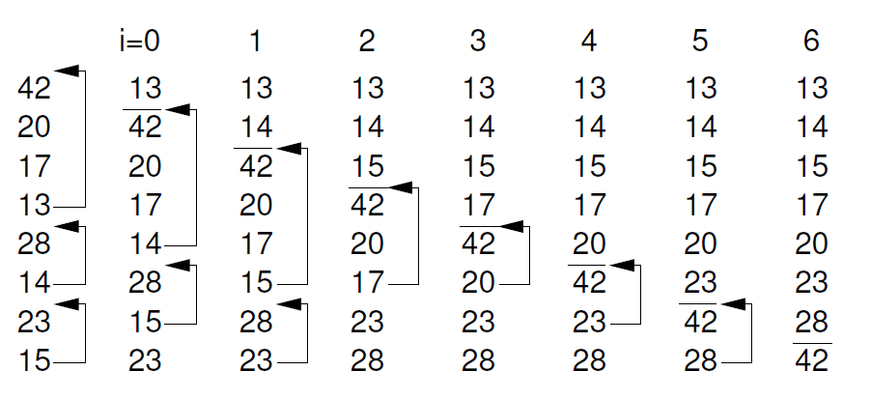
Bubble Sort: Example

Slide 19
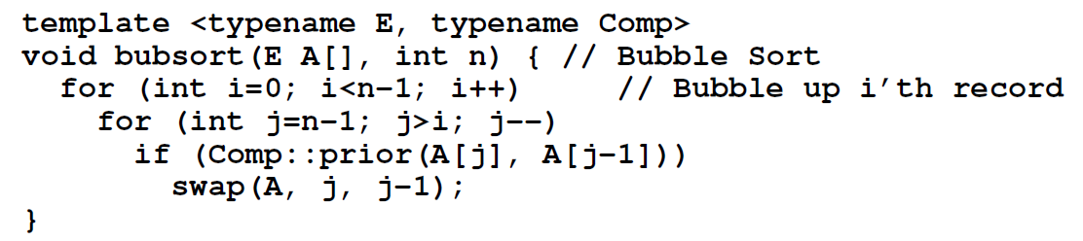
Bubble Sort: Implementation

Slide 20
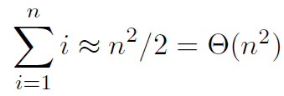
Bubble Sort: Complexity
One traversal = move the minimum element at the start
Traversal #i : n – i + 1 operations
Cost:
Bubble Sort’s running time is roughly the same in the best, average, and worst cases.

Slide 21
Bubble Sort
Alternative algorithm for Bubble sort
Idea:
  1. Set flag = false
  2. Traverse the array and compare pairs of two elements
    2.1 If E1 ≤ E2 - OK
    2.2 If E1 > E2 then
    Switch(E1, E2) and set flag = true
  3. If flag = true goto 1.
Complexity:
  Best case: O(n) when the array is sorted by ascending order, the number of comparisons.

Slide 22
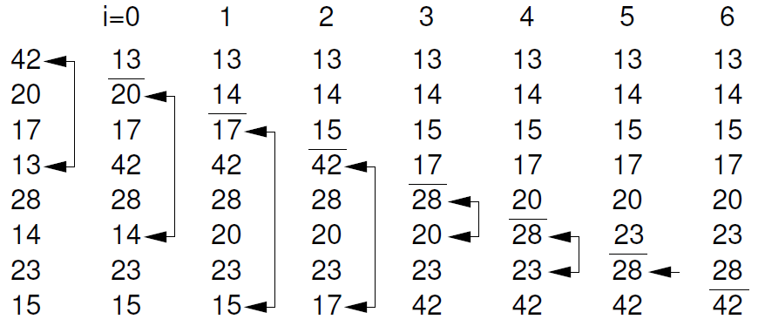
Selection Sort
In my opinion, the most natural and easiest sorting algorithm is selection sort, where we repeatedly find the smallest element, move it to the front, then repeat...

Slide 23
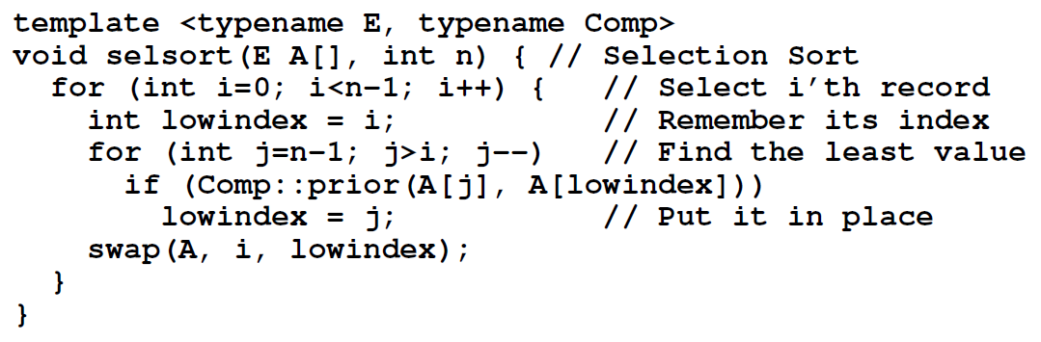
Selection Sort : Implementation
If elements are in an array, swap the first with the smallest element- thus only one array is necessary.
If elements are in a linked list, we must keep two lists, one sorted and one unsorted, and always add the new element to the back of the sorted list.

Slide 24

Selection Sort : Complexity
best case, worst case, and average cases are all the same!
Intuitively, we make n iterations, each of which “on average'' compares n/2, so we should make about comparisons to sort n items.
To do this more precisely, we can count the number of comparisons we make.
To find the largest takes (n-1) steps, to find the second largest takes (n-2) steps ... to find the last largest takes 0 steps.
The number of comparisons is still , but the number of swaps is much less than that required by bubble sort.

Slide 25
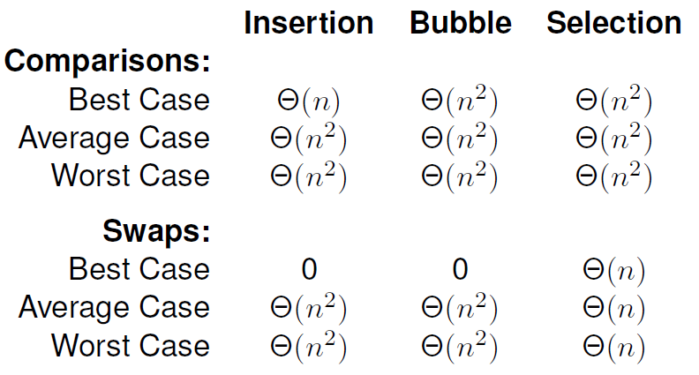
Summary
Swapping adjacent records is called an exchange.
Thus, these sorts are sometimes referred to as exchange sorts.

Slide 26
Why exchange sorts are slow?
The cost of any exchange sort can be at best the total number of steps that the records in the array must move to reach their “correct” location (i.e., the number of inversions 倒置 for each record).
Inversion: a pair (i, j) such that i<j but Array[i] > Array[j]
Array of size N can have Θ(N²) inversions
  average number of inversions in a random set of elements is N(N-1)/4
Exchange Sort only swaps adjacent elements
  only removes 1 inversion!

Slide 27
References
Data Structures and Algorithm Analysis Edition 3.2 (C++ Version)
  P.231-239

