Slide 1
02 Algorithm Analysis

Slide 2
Outline
Introduction
Best, Worst and Average Cases
Asymptotic Analysis
Space Bounds

Slide 3
Introduction
  How do you compare two algorithms for solving some problem in terms of efficiency?
  Solution 1:implement both algorithms as computer programs and then run them on a suitable range of inputs.
  Result: unsatisfactory
Notes:
Result: unsatisfactory for four reasons
programming and testing two algorithms when at best you want to keep only one
Perhaps one of the programs was “better written” than the other
choice of empirical test cases might unfairly favor one algorithm
even the better of the two algorithms does not fall within your resource budget

Slide 4
Asymptotic analysis
  Solution 2:using asymptotic analysis(渐进分析)
  Asymptotic analysis measures the efficiency of an algorithm as the input size becomes large.
  It is actually an estimating technique.
  However, asymptotic analysis has been proved useful.

Slide 5
Critical resource
  The critical resource for a program is most often its
    running time.
    space required to run the program.
  We have no way to calculate the running time reliably other than to run an implementation of the algorithm on some computer.
  The only alternative is to use some other measure as a surrogate for running time.

Slide 6
Estimating an algorithm’s performance
  One primary consideration when estimating an algorithm’s performance is the number of basic operations required by the algorithm to process an input of a certain size.
  Size is often the number of inputs processed.
  A basic operation must have the property that its time to complete does not depend on the particular values of its operands.
Notes:
One primary consideration when estimating an algorithm’s performance is the number of basic operations required by the algorithm to process an input of a certain size.
Size is often the number of inputs processed. For example, when comparing sorting algorithms, the size of the problem is typically measured by the number of records to be sorted.
A basic operation must have the property that its time to complete does not depend on the particular values of its operands. Adding or comparing two integer variables are examples of basic operations in most programming languages. Summing the contents of an array containing n integers is not, because the cost depends on the value of n(i.e.,the size of the input).

Slide 7
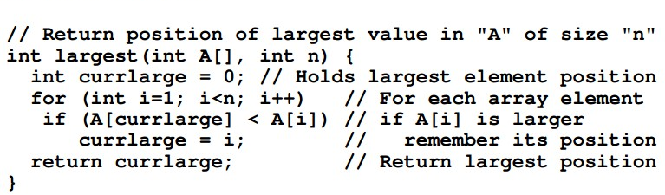
Example
  basic operations: to compare an integer’s value to that of the largest value seen so far
  size: A.length

Slide 8
Growth rate
  The most important factor affecting running time is normally size of the input.
  For a given input size n we often express the time T to run the algorithm as a function of n, written as T(n).
  Let us call c the amount of time required to compare two integers in function largest.
  T(n) =c n
  This equation describes the growth rate for the running time of the largest-value sequential search algorithm

Slide 9
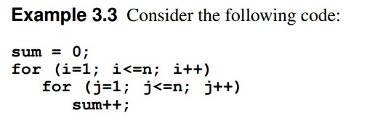
Growth rate
  The basic operation in this example is the increment operation for variable sum. We can assume that incrementing takes constant time; call this time c₂.
  The total number of increment operations is n².
  Thus, we say that the running time is T(n) = c₂ n²

Slide 10
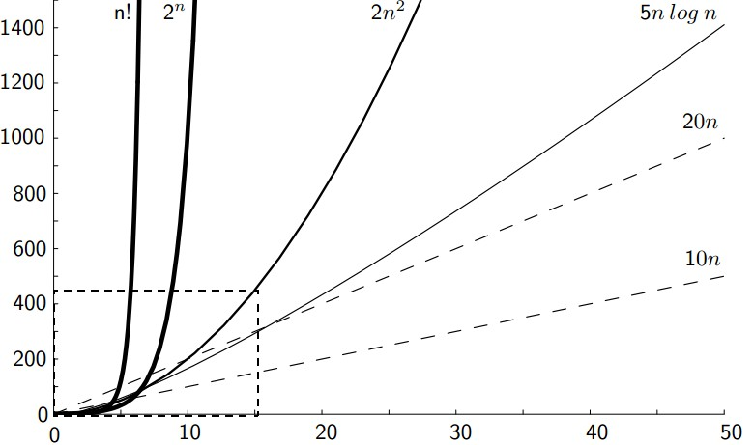
Growth rate
  The growth rate for an algorithm is the rate at which the cost of the algorithm grows as the size of its input grows.

Slide 11
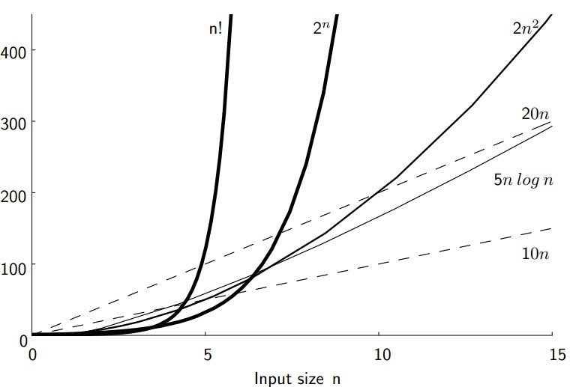
Growth rate
Notes:
Figure 3.1 Two views of a graph illustrating the growth rates for six equation. The bottom view shows in detail the lower-left portion of the top view. The horizontal axis represents input size. The vertical axis can represent time, space, or any other measure of cost.

Slide 12
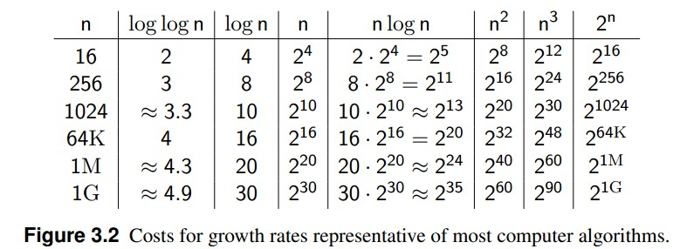
Growth rate
Notes:
We can get some further insight into relative growth rates for various algorithms from Figure 3.2. Most of the growth rates that appear in typical algorithms are shown, along with some representative input sizes. Once again, we see that the growth rate has a tremendous effect on the resources consumed by an algorithm.

Slide 13

Best, Worst, and Average Cases
  For some algorithms, different inputs of a given size require different amounts of time.
  Best case : Find “35”.Compare 1 value
  Worst case : Find “46”. Compare n values.
  Average case : Compare n/2 values.

Slide 14
Best, Worst, and Average Cases
  When analyzing an algorithm, should we study the best, worst, or average case?
  Normally the best case is too optimistic.
  For realtime applications we are likely to prefer a worst case analysis of an algorithm.
  Otherwise, we often desire an average-case analysis.
Notes:
Normally we are not interested in the best case, because this might happen only rarely and generally is too optimistic for a fair characterization of the algorithm’s running time.
For real-time applications we are likely to prefer a worst-case analysis of an algorithm. The advantage to analyzing the worst case is that you know for certain that the algorithm must perform at least that well.
Otherwise, we often desire an average-case analysis if we know enough about the distribution of our input to compute the average case.
If not, then we must resort to worst-case analysis.

Slide 15
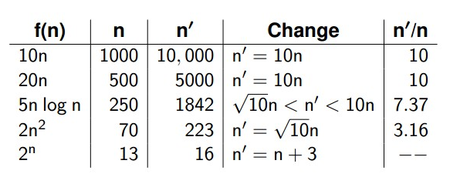
Faster Computer or Algorithm
  Assume that the new machine is ten times faster than the old.
  It would be much better off changing algorithms instead of buying a computer
Notes:
How much larger a problem can be solved in a given amount of time by a faster computer?
Assume that the new machine is ten times faster than the old. Say that the old machine could solve a problem of size n in an hour. What is the largest problem that the new machine can solve in one hour? Figure 3.3 shows how large a problem can be solved on the two machines for five of the running-time functions from Figure 3.1.

Slide 16
Asymptotic Analysis
Asymptotic algorithm analysis(渐进算法分析).
  Focus on growth rate
  Ignore the constants
  Refer to the study of an algorithm as the input size “gets big” or reaches a limit
Asymptotic analysis provides a simplified model of the running time or other resource needs of an algorithm.
Notes:
To be precise, asymptotic analysis refers to the study of an algorithm as the input size “gets big” or reaches a limit (in the calculus sense).
However, it has been proved to be so useful to ignore all constant factors that asymptotic analysis is used for most algorithm comparisons.
It is not always reasonable to ignore the constants. When comparing algorithms meant to run on small values of n, the constant can have a large effect.
Asymptotic analysis provides a simplified model of the running time or other resource needs of an algorithm. This simplification usually helps you understand the behavior of your algorithms. Just be aware of the limitations to asymptotic analysis in the rare situation where the constant is important.

Slide 17
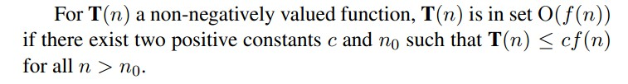

Upper Bounds
The upper bound for the growth of algorithm’s running time indicates the upper or highest growth rate that the algorithm can have.
The upper bound is defined by “Big-Oh”.
Notes:
Because the phrase “has an upper bound to its growth rate of f(n)” is long and often used when discussing algorithms, we adopt a special notation, called big-Oh notation. If the upper bound for an algorithm’s growth rate (for, say, the worst case) is f(n), then we would write that this algorithm is “in the set O(f(n))in the worst case” (or just ” in O(f(n)) in the worst case”).
For example, if n² grows as fast as T(n)(the running time of our algorithm) for the worst-case input, we would say the algorithm is “in O(n²)in the worst case “.

Slide 18
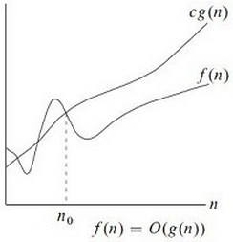

Slide 19
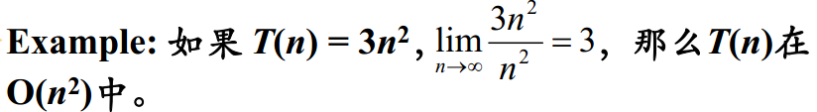
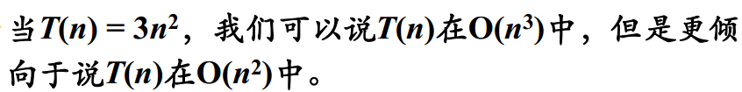
Upper Bounds
意义:对于问题的所有输入,只要输入规模足够大(即n>n0),该算法总能在cf(n)步以内完成。
分别考虑最好、最坏、平均情况下的上限。
大O表示法给出了算法运行时间的上限，表明该算法可能有的最高增长率。-〉顶多坏到某种程度。
希望找找到最紧的上限。

Slide 20
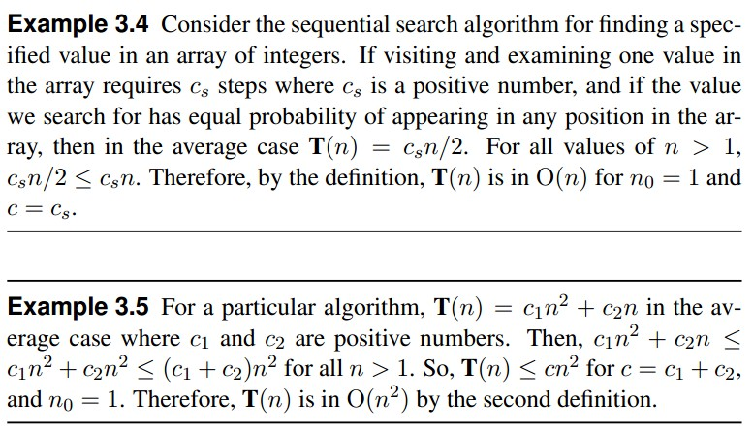
Upper Bounds

Slide 21
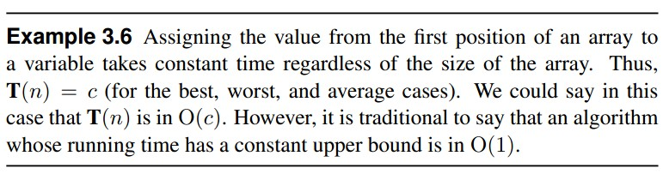
Upper Bounds
上限与最坏情况的区别：
  上限是用来确定运行时间的增长率，体现随着输入规模变化算法的代价变化
  最差情况是指：在一个给定的规模中，所有可能的输入中最糟糕的情况。

Slide 22
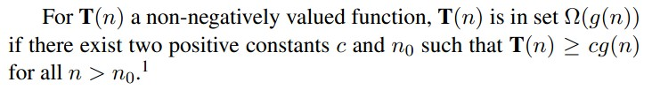

Lower Bounds
The lower bound for the growth of algorithm’s running time indicates the lower or lowest growth rate that the algorithm can have.
The lower bound is defined by “Big-Omega”.
Notes:
Big-Oh notation describes an upper bound. Similar notation is used to describe the least amount of a resource that an algorithm needs for some class of input.
Like big-Oh notation, this is a measure of the algorithm’s growth rate.
Like big-Oh notation, it works for any resource, but we most often measure the least amount of time required.
Like big-Oh notation, we are measuring the resource required for some particular class of inputs: the worst-, average-, or best-case input of size n.

Slide 23
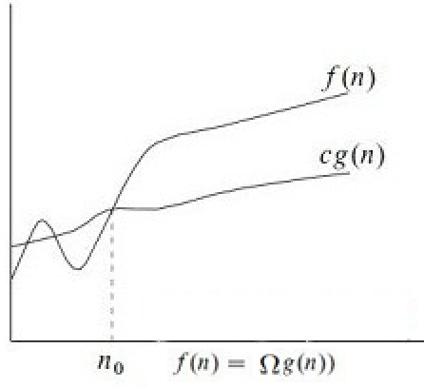

Slide 24
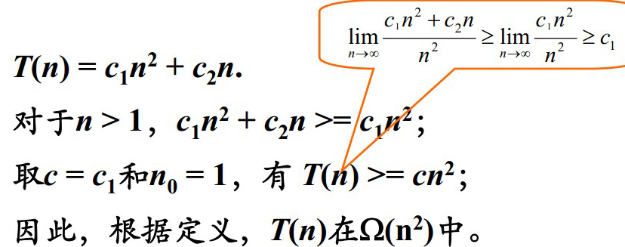
Lower Bounds
意义:对于问题的所有输入,只要输入规模足够大(即n>n0),该算法至少需要cg(n)步以上才能 完成。
分别考虑最好、最坏、平均情况下的下限。
大Ω表示法给出了算法运行时间的下限，表明该算法可能有的最低增长率。
希望找找到最紧的下限。

Slide 25
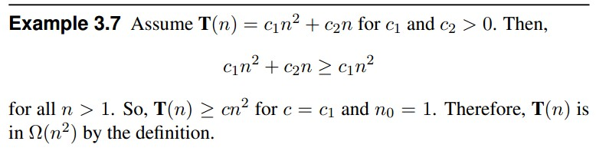
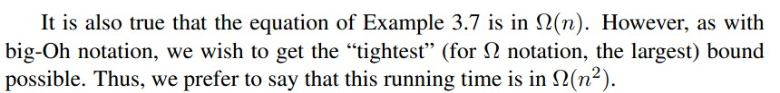
Lower Bounds

Slide 26
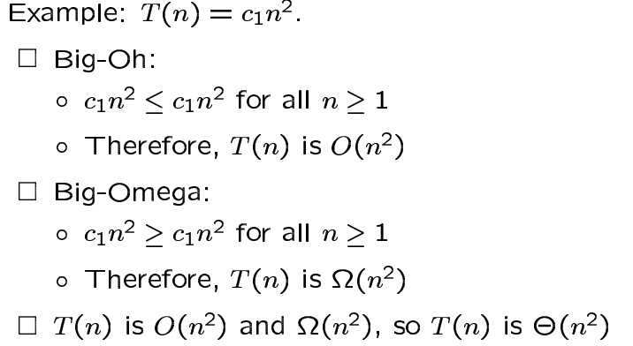
Θ Notation
When the upper and lower bounds are the same within a constant factor, we indicate this by using Θ(big-Theta) notation.
An algorithm is said to be Θ(h(n)) if it is in O(h(n))and it is in Ω(h(n)).
For an algorithm, the upper and lower bounds always meet.
Notes:
Note that we drop the word “in” for Θ notation, because there is a strict equality for two equations with the same Θ. In other words, if f(n)is Θ(g(n)), then g(n)is Θ(f(n)).
Because the sequential search algorithm is both in O(n)and in Ω(n) in the average case, we say it is Θ(n)in the average case.
Given an algebraic equation describing the time requirement for an algorithm, the upper and lower bounds always meet.
Most algorithms presented are well understood and we can almost always give a Θ analysis for them. However, Chapter 17 discusses a whole class of algorithms for which we have no Θ analysis, just some unsatisfying big-Oh and Ω analyses.

Slide 27
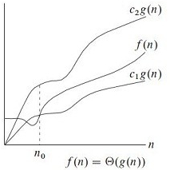

Slide 28




Simplifying Rules

Slide 29
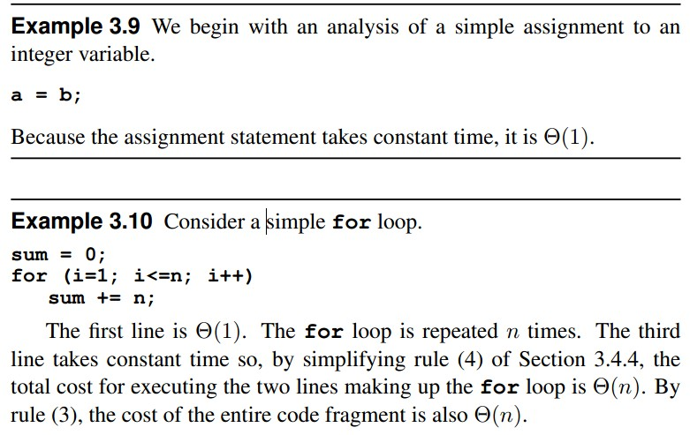
Calculating the Running Time for a Program

Slide 30
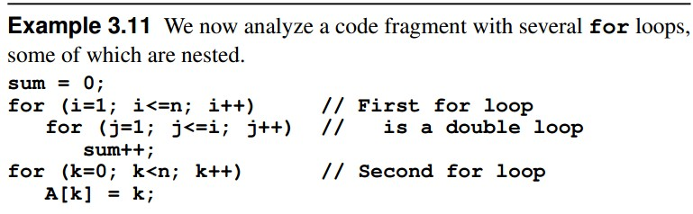

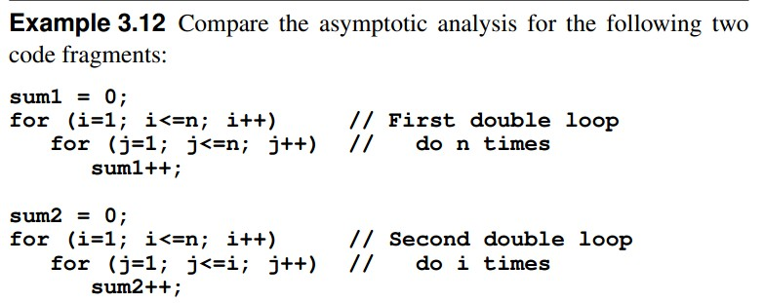
Calculating the Running Time for a Program

Slide 31
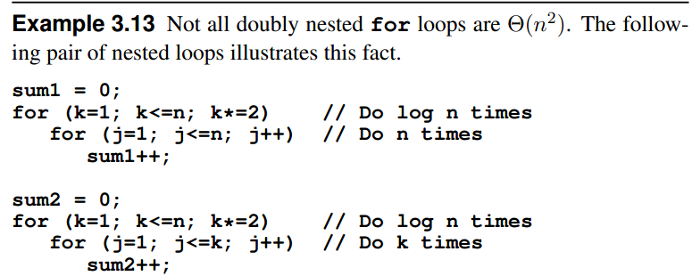
Calculating the Running Time for a Program

Slide 32
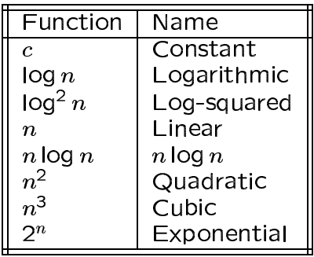
Typical Growth Rate
There is a terminology for certain growth rate functions.

Slide 33
Space Bounds
Besides time, space is the other computing resource that is commonly of concern to programmers.
The analysis techniques used to measure space requirements are similar to those used to measure time requirements.
However, while time requirements are normally measured for an algorithm that manipulates a particular data structure, space requirements are normally determined for the data structure itself.
The concepts of asymptotic analysis for growth rates on input size apply completely to measuring space requirements.

Slide 34
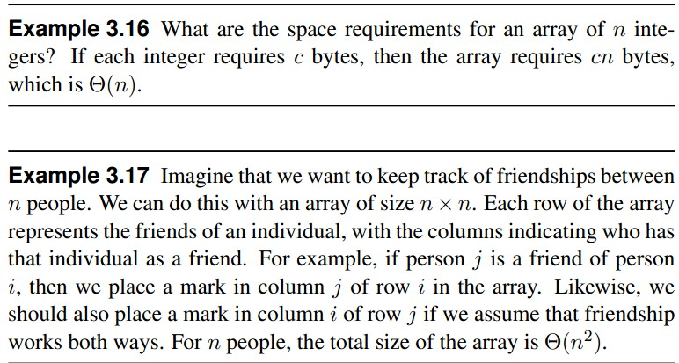
Space Bounds

Slide 35
Space Bounds
One important aspect of algorithm design is referred to as the space/time tradeoff principle(空间时间权衡原理), which says that one can often achieve a reduction in time if one is willing to sacrifice space or vice versa.
Many programs can be modified to reduce storage requirements by “packing” or encoding information. The resulting program uses less space but runs slower.
Conversely, many programs can be modified to pre-store results or reorganize information to allow faster running time at the expense of greater storage requirements.

Slide 36
Homework
P87, 3.8
P88,3.12

Slide 37
Knowledge Points
Chapter 3, pp.55-86

