Slide 1
05 Graph (3)

Slide 2
Outline
Shortest Path Problems
Single Source Shortest Path
Dijkstra’s Algorithm
All-Pairs Shortest Paths
Floyd’s Algorithm

Slide 3
Knowledge Points
Chapter 11, pp.399-402

Slide 4
Shortest Paths Problems
In many applications, each edge of a graph has an associated numerical value, called a weight. The weight of an edge is often referred to as the “cost” of the edge.
In applications, the weight may be a measure of the length of a route, the capacity of a line, the energy required to move between locations along a route, etc.
Usually, the edge weights are nonnegative integers.
Weighted graphs may be either directed or undirected.

Slide 5
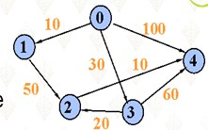
Shortest Paths
The cost of a path: in weighted graphs, the cost of a path is the sum of the weights of its edges.
Shortest path: Given two vertices A and B, there are more than one paths from A to B. The path with minimum cost is called shortest path from A to B.

Slide 6
Single Source, Shortest Path
Given a graph G = (V, E) and a vertex s ∈ V, find the shortest path from s to every vertex in V
  (Strangely, this is also typically the best way to find the shortest path from s to any vertex in V)
Many variations:
  weighted vs. unweighted
  cyclic vs. acyclic
  positive weights only vs. negative weights allowed
  multiple weight types to optimize
Many applications!

Slide 7
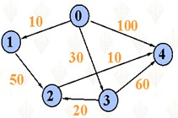
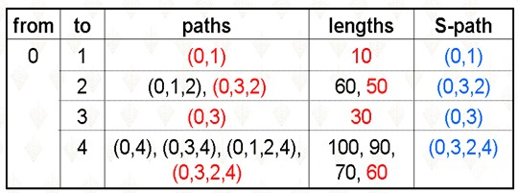
Example

Slide 8
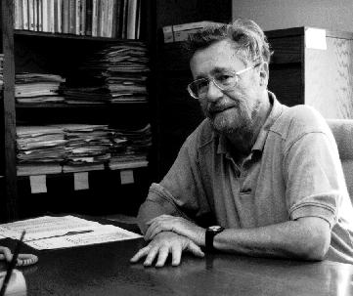
Dijkstra, Edsger Wybe
Legendary figure in computer science;
1930.5.11~2002.8.6
Supports teaching introductory computer courses without computers (pencil and paper programming)
Supposedly wouldn’t (until recently) read his e-mail; so, his staff had to print out messages and put them in his box.

Slide 9
Dijkstra’s Algorithm for Single Source, Shortest Path
We assume that there is a path from the source vertex v₀ to every other vertex in the graph.
Let S be the set of vertices whose minimum distance from the source vertex has been found. Initially S contains only the source vertex.
The algorithm is iterative, adding one vertex to S on each pass.
We maintain an array D such that for each vertex v, D[v] is the minimum distance from the source vertex to v via vertices that are already in S.

Slide 10
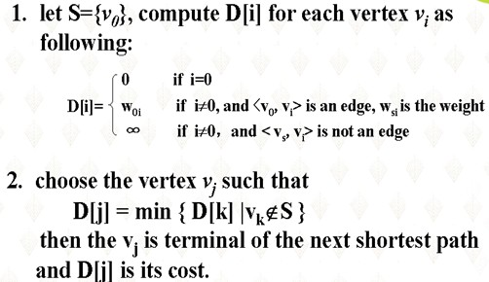

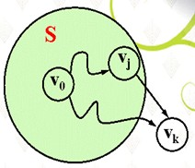

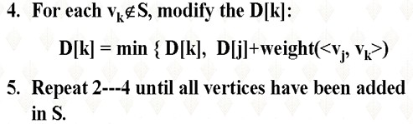
Steps

Slide 11
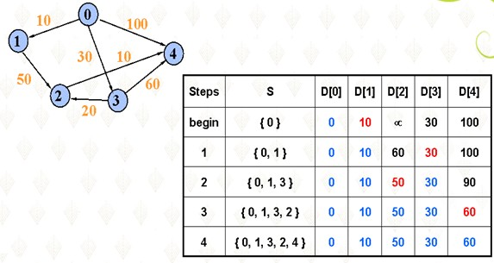
Dijkstra’s Algorithm Trace

Slide 12
Record the Shortest paths
The algorithm described above does not record the shortest paths. It can not output the shortest paths.
The algorithm can be modified to record the paths by building an array pre[]. If pre[i]=k, this represents that the shortest path from v₀ to v_{i} is (v₀,..,v_{k},v_{i}). It is easy to prove that if (v₀,..,v_{k},v_{i}) is the shortest path from v₀ to v_{i} , the path (v₀,..,v_{k}) is the shortest path from v₀ to v_{k} . We can output the shortest path from v₀ to v_{i} by outputting the shortest path from v₀ to v_{k} recursively and vertex to v_{i}
The pre[i] is initiated by v₀. It is updated while the minimum distance is modified.

Slide 13
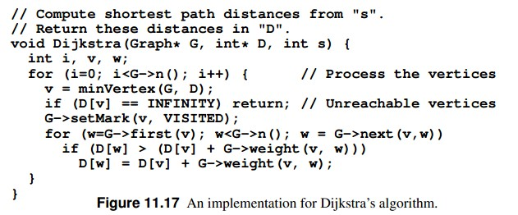
Dijkstra’s Algorithm

Slide 14
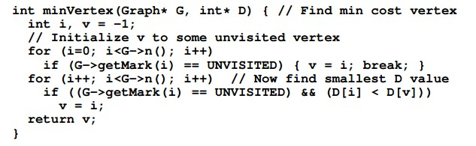
Dijkstra’s Algorithm

Slide 15
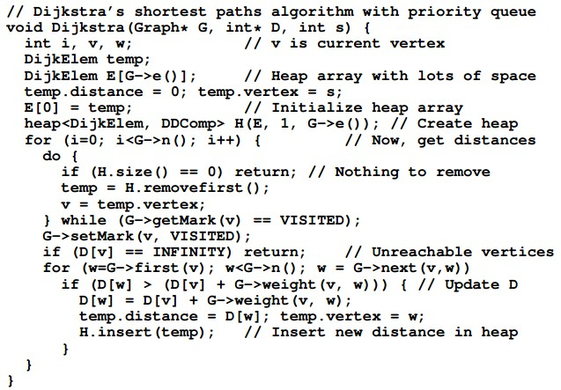
Dijkstra’s Algorithm

Slide 16
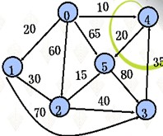
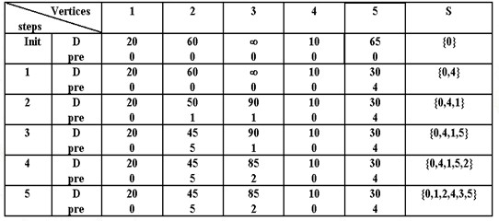
Example

Slide 17
All-Pairs Shortest Paths
The problem of finding the shortest distance between all pairs of vertices in the graph called all-pairs shortest paths.
Using the above shortest path algorithm, we can find the shortest path between all pairs of vertices, v_{i} and v_{j}, i≠j.
Another method is Floyd’s algorithm. It is simple and easy to implement.

Slide 18
Floyd’s Algorithm
Define a K-path from vertex v to vertex u to be any path whose intermediate vertices all indices less than k.
Define D_{k}(v,u) to be the length of shortest k-path from vertex v to vertext u.
D₀(v,u)---the weight of <u,v>
D_{n}(v,u)---the length of shortest path from u to v
D_{k}(v,u) can be calculated from D_{k-1}(v,u) :

Slide 19
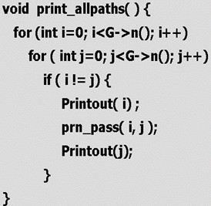
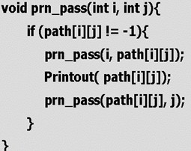
Floyd’s Algorithm
Define a two-dimension array path[][] to record all shortest paths.
If path[i][j]=k, the shortest path from vertex i to vertex j go through vertex k. that is, the shortest path from vertex i to vertex j is (i,..,k,..j). It is evident that (i,…,k) and (k,…,j) are the shortest path from i to k and k to j.
We can output all shortest paths using path[][]

Slide 20
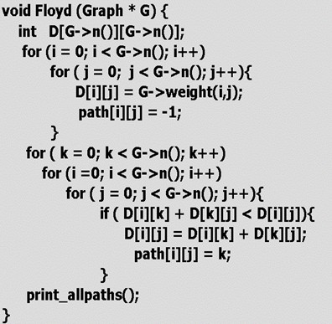
Floyd’s Algorithm

Slide 21
D⁻¹
 | 0 | 1 | 2
0 | 0 | 4 | 11
1 | 6 | 0 | 2
2 | 3 | ∞ | 0
 | 0 | 1 | 2
0 | 0 | 4 | 11
1 | 6 | 0 | 2
2 | 3 | 7 | 0
D⁰
6
 | 0 | 1 | 2
0 | 0 | 4 | 6
1 | 6 | 0 | 2
2 | 3 | 7 | 0
D¹
V0
V1
4
3
2
 | 0 | 1 | 2
0 | 0 | 4 | 6
1 | 5 | 0 | 2
2 | 3 | 7 | 0
11
V2
D²

Slide 22
Homework
P410, 11.9-11.11,11.16

Slide 23
-End-

