Slide 1

Unit 3 Lists
Array-Based lists
Notes:
课时数：2学时
1st lesson

Slide 2
outline
Definition of ADT
Array-based List (Sequential List)
Singly Linked List
Circular Linked List
Doubly Linked List
Applications

Slide 3
1 Definition
list
Length of list
Empty list
Order

Slide 4
 Lists
A list is a finite, ordered sequence of data elements.
Important concept: List elements have a position.
Notation:
<a₀, a₁, …, a_{n-1}>
< >
Sorted list
<1,3,5,6,8,9,21,24,56,77>
<98,65,43,23,11,10,9,6,5,4,2>
Unsorted list
<1,6,3,9,34,30,19,8,12,44>
a_{i} denotes a list element
n >= 0 is finite
list size is n
Empty List
head
tail
Data 1
Data 2
Data 3
Data n
Notes:
Students should already be familiar with lists.
Chapter objective: Use algorithm analysis in a familiar context to compare implementations.

Slide 5
Terminology
Length of list
The number of elements currently stored is called the length of the list.
Empty list
A list is said to be empty when it contains no elements. the empty list would appear as <>.
Order
Order of a element is it’s position in the list.

Slide 6
List Implementation Concepts
Our list implementation will support the concept of a current position.
Operations will act relative to the current position.
Example: <20, 23 | 12, 15> to indicate the list of four elements, with the current position being to the right of the bar at element 12.
What operations should we implement?
Notes:
Here, 12 is the “current” node. We use a bar to its left to indicate this in the notation.

Slide 7
List ADT
template <typename E> class List { // List ADT
private:
void operator =(const List&) {} // Protect assignment
List(const List&) {} // Protect copy constructor
public:
List() {} // Default constructor
virtual ~List() {} // Base destructor
// Clear contents from the list, to make it empty.
virtual void clear() = 0;
// Insert an element at the current location.
// item: The element to be inserted
virtual void insert(const E& item) = 0;

Slide 8
List ADT
// Append an element at the end of the list.
// item: The element to be appended.
virtual void append(const E& item) = 0;
// Remove and return the current element.
// Return: the element that was removed.
virtual E remove() = 0;
// Set the current position to the start of the list
virtual void moveToStart() = 0;
// Set the current position to the end of the list
virtual void moveToEnd() = 0;

Slide 9
List ADT
// Move the current position one step left. No change if already at beginning.
virtual void prev() = 0;
// Move the current position one step right. No change if already at end.
virtual void next() = 0;
// Return: The number of elements in the list.
virtual int length() const = 0;
// Return: The position of the current element.
virtual int currPos() const = 0;
// Set current position. pos: The position to make current.
virtual void moveToPos(int pos) = 0;
// Return: The current element.
virtual const E& getValue() const = 0;
};

Slide 10
List ADT Examples
List: <12 | 32, 15>
L.insert(99);
Result: <12 | 99, 32, 15>
Iterate through the whole list:
for (L.moveToStart(); L.currPos()<L.length(); L.next())
{ it = L.getValue();
doSomething(it);
}

Slide 11
List Find Function
//return True if k is in list L,
//false otherwise
bool find(List<int>& L, int k) {
int it;
for (L.moveToStart(); L.currPos()<L.length(); L.next())
{it=L.getValue();
if (k == it) return true;}
return false; // k not found
}

Slide 12
 Array-Based List
list physical implementation
array-based list linked list

Slide 13
Array-Based List (cont)
address
value
element
A₀
L_{o}
A₁
Lo+m
A₀ A₁ … …… … A_{n-2} A_{n-1}
……..
Loc(a)=L_{o}+i*m
A_{i-1}
Lo+(i-1)*m
……..
Given some position in the list
A_{n-1}
Lo+（n-1)*m

Slide 14
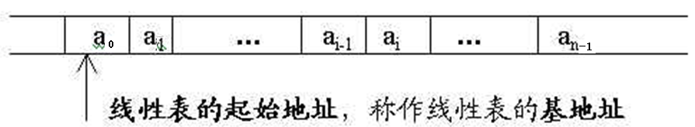
Array-Based List Implementation
Array_Based List : The elements are stored in a consecutive storage area one by one

Slide 15
Notes ：
With ordered pair <a_{i-1} ，a_{i}> to express “Storage is adjacent to” ， loc（a_{i}）=loc（a_{i-1}）+c
Unnecessary to store logic relationship
First data component location can decide all data elements locations

Slide 16
Array-Based List Class (1)
#include "list.h“
template <typename E> // Array-based list implementation
class AList : public List<E> {
private:
int maxSize; // Maximum size of list
int listSize; // Number of list items now
int curr; // Position of current element
E* listArray; // Array holding list elements

Slide 17
Array-Based List Class (2)
public:
AList(int size=defaultSize)
{ // Constructor
maxSize = size;
listSize = curr = 0;
listArray = new E[maxSize];
}
~AList() { delete [] listArray; } // Destructor

Slide 18
Array-Based List Class (3)
void clear() { // Reinitialize the list
delete [] listArray; // Remove the array
listSize = curr = 0; // Reset the size
listArray = new E[maxSize]; // Recreate array
}
void moveToStart() { curr = 0; }
void moveToEnd() { curr = listSize; }
void prev() { if (curr != 0) curr--; }
void next() { if (curr < listSize) curr++; }

Slide 19
Array-Based List Class (4)
// Return list size
int length() const { return listSize; }
// Return current position
int currPos() const { return curr; }
// Set current list position to "pos"
void moveToPos(int pos) {
Assert ((pos>=0)&&(pos<=listSize), "Pos out of range");
curr = pos; }

Slide 20
Array-Based List Class (5)
// Return current element
const E& getValue() const
{ Assert((curr>=0)&&(curr<listSize),"No current element");
return listArray[curr];
}

Slide 21
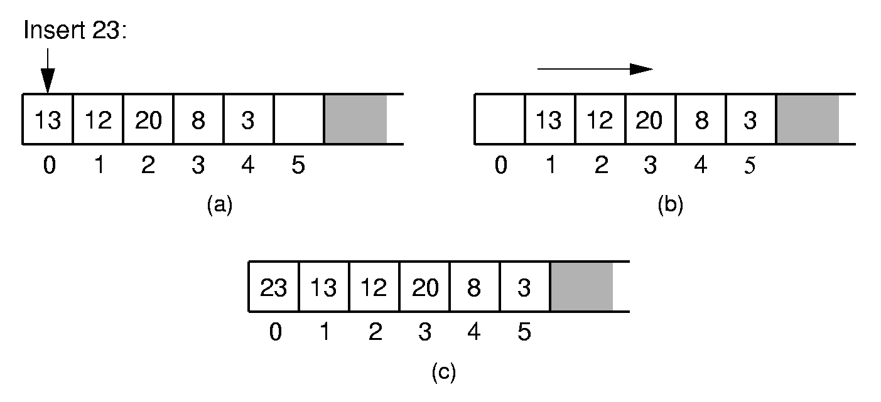
Array-Based List Insert
Notes:
Push items up/down. Cost: Θ(n).

Slide 22
Insert
// Insert "it" at current position
void insert(const E& it) {
Assert(listSize < maxSize, "List capacity exceeded");
for(int i=listSize; i>curr; i--) // Shift elements up
listArray[i] = listArray[i-1]; // to make room
listArray[curr] = it;
listSize++; // Increment list size
}

Slide 23
Append
void append(const E& it) { // Append "it"
Assert(listSize < maxSize, "List capacity exceeded");
listArray[listSize++] = it;
}

Slide 24
    Remove
<a₁, …, a_{i-1}, a_{i}, a_{i+1}, …, a_{n}> change to
<a₁, …, a_{i-1}, a_{i+1}, …, a_{n}>
<a_{i-1}, a_{i}>, <a_{i}, a_{i+1}>
<a_{i-1}, a_{i+1}>
a₁ a₂ … a_{i-1} a_{i} a_{i+1} … a_{n}
a₁ a₂ … a_{i-1}
a_{i+1}
…
a_{n}
Listsize--

Slide 25
Remove
// Remove and return the current element.
E remove() {
Assert((curr>=0) && (curr < listSize), "No element");
E it = listArray[curr]; // Copy the element
for(int i=curr; i<listSize-1; i++) // Shift them down
listArray[i] = listArray[i+1];
listSize--; // Decrement size
return it;
}

Slide 26
Exercise ：
1.To give an example to illustrate data structure idea and describe it in abstract data type form .
2.Analyses the time complexity of the following algorithms 。
1. i=1; 2. i=n; 3. x=y=1;
while (s<n) do { while(x++ * y++<n);
{ i++;s+=i;} i++;
} while (i<n)
3.Design an Improve LocateElem's algorithm to look for all the elements matching the relationship 。
4.Design an algorithm to reverse an sequential list (a₁a₂..a_{n})->(a_{n}a_{n-1}…a₁)

Slide 27
Summing Up
Advantages ：
  Stores a collection of items contiguously.
    Stores no relations
    Access randomly
Disadvantages ：
  Need to shift many elements in the array whenever there is an insertion or deletion.
  Need to allocate a fix amount of memory in advance.

Slide 28
Reference
P95----P103

Slide 29
-End-

