Slide 1
Unit 5 Circularly Linked Lists
& Doubly Linked List
Notes:
课时数：2学时
1st lesson

Slide 2
Circularly Linked Lists
Singly Linked Lists
the last node contain a NULL pointer
Circularly Linked Lists
  the last node contains a pointer to the first node
Advantage
start from any node, can access the others.

Slide 3
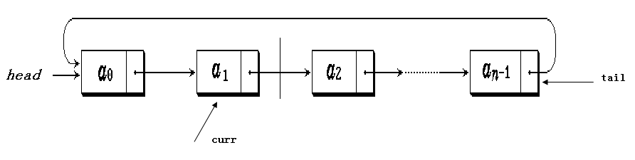
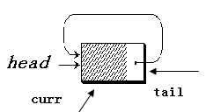
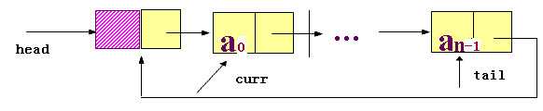
Example of circular linked list
Nonempty list & Empty list

Slide 4
Example:Josehus problem
A description of the problem are: number 1,2, ..., n of n individuals sitting around a circle clockwise, each holding a password (positive integer). Choose a positive integer beginning as a limit on the number of reported m, starting from the first person to start a clockwise direction from a report number, report the number of reported m stop. Who reported m out of line, his password as the new m value, in a clockwise direction from the next person he began to re-reported from a number, it goes on until all the people all of the columns so far. Design a program, according to the column order prints each number.

Slide 5
Example:Josehus problem
Use circular link list to acomplish.
Josehusproblem.cpp

Slide 6
Example:Josehus problem
Main function
bool LList<Elem>::remove(Elem& it)
void LList<Elem>::getOut(int &it,int& sum)
bool LList<Elem>::append(const people& T)

Slide 7
Doubly Linked Lists
Singly Linked Lists
The singly linked list allows for direct access from a list node only to the next node in the list.
Doubly Linked Lists
  A doubly linked list allows convenient access from a list node to the next node and also to the preceding node on the list.
How to accomplish?
The doubly linked list node accomplishes this in the obvious way by storing two pointers: one to the node following it (as in the singly linked list), and a second pointer to the node preceding it.

Slide 8
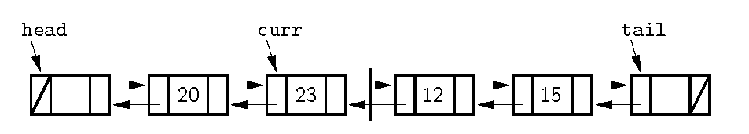
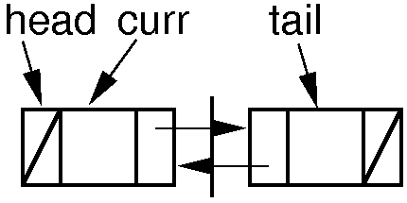
Doubly Linked Lists

Slide 9
Doubly Linked Lists
// Doubly linked list link node with freelist support
template <typename E> class Link {
private:
static Link<E>* freelist; // Reference to freelist head
public:
E element; // Value for this node
Link* next; // Pointer to next node in list
Link* prev; // Pointer to previous node

Slide 10
Doubly Linked Lists
// Constructors
Link(const E& it, Link* prevp, Link* nextp) {
element = it;
prev = prevp;
next = nextp;
}
Link(Link* prevp =NULL, Link* nextp =NULL) {
prev = prevp;
next = nextp;
}

Slide 11
Doubly Linked Lists
void* operator new(size_t) { // Overloaded new operator
if (freelist == NULL) return ::new Link; // Create space
Link<E>* temp = freelist; // Can take from freelist
freelist = freelist->next;
return temp; // Return the link
}

Slide 12
Doubly Linked Lists
// Overloaded delete operator
void operator delete(void* ptr) {
((Link<E>*)ptr)->next = freelist; // Put on freelist
freelist = (Link<E>*)ptr;
}
};
// The freelist head pointer is actually created here
template <typename E>
Link<E>* Link<E>::freelist = NULL;

Slide 13
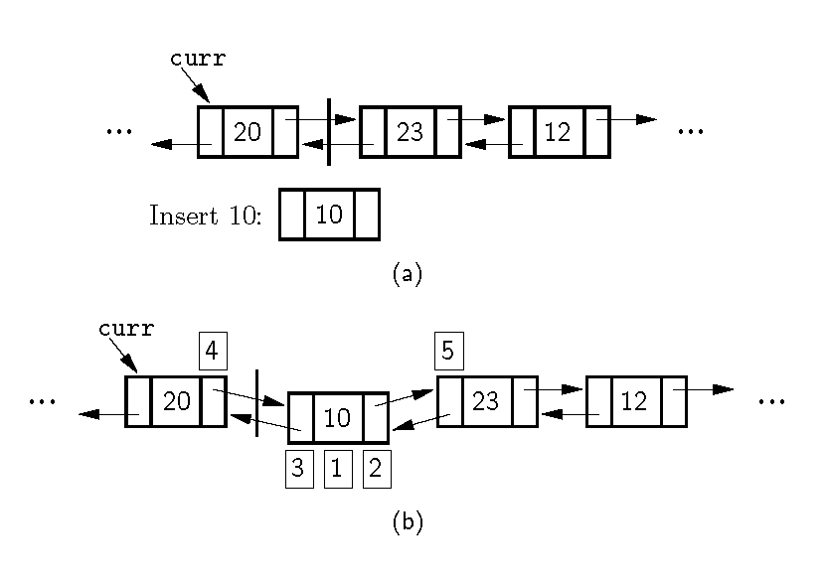
Doubly Linked Insert

Slide 14
Doubly Linked Insert
// Insert "it" at current position
void insert(const E& it) {
curr->next = curr->next->prev =
new Link<E>(it, curr, curr->next);
cnt++;
}

Slide 15
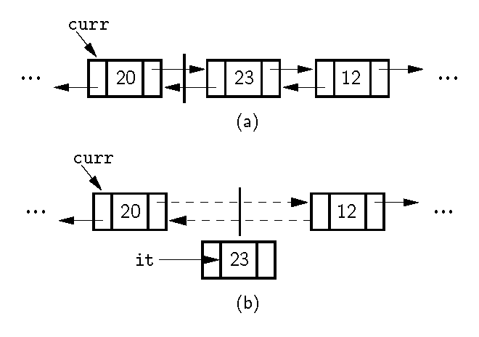
Doubly Linked Remove

Slide 16
Doubly Linked Remove
// Remove and return current element
E remove() {
if (curr->next == tail) // Nothing to remove
return NULL;
E it = curr->next->element; // Remember value
Link<E>* ltemp = curr->next; // Remember link node
curr->next->next->prev = curr;
curr->next = curr->next->next; // Remove from list
delete ltemp; // Reclaim space
cnt--; // Decrement cnt
return it;
}

Slide 17
Doubly Linked Append
// Append "it" to the end of the list.
void append(const E& it) {
tail->prev = tail->prev->next =
new Link<E>(it, tail->prev, tail);
cnt++;
}

Slide 18
Doubly Linked Prev
// Move fence one step left; no change if left is empty
void prev() {
if (curr != head) // Can't back up from list head
curr = curr->prev;
}

Slide 19
Doubly Linked List disadvantage
The only disadvantage of the doubly linked list as compared to the singly linked list is the additional space used.

Slide 20
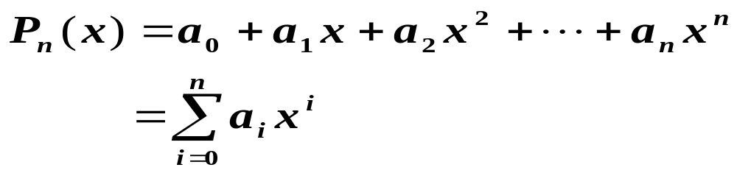
Application: polynomial

Slide 21
Expressing the polynomial
Express the linear list :
P = (p0, p1, …，pn)
It is also unsuitable to express the form like S ( X ) = 1 + 3x¹⁰⁰⁰⁰
Writing factor and index number
（（p1, e1）, (p2, e2), ┄, (pm,em) ）
How about the defects

Slide 22

The link expressing
Every one node addd data member Nexts during the polynomial chained list being living is expressed ，As the link pointer 。
Strong point is ：
  The number of item of polynomial may rise dynamicly 。
  It is convenient to insert,delete the element 。

Slide 23
Polynomial type definition
ADT Polynomial {
Data object ：D＝{ a_{i} | a_{i} ∈TermSet, i=1,2,...,m, m≥0 }
Data relationship ：R1＝{ <a_{i-1} ,a_{i} >|a_{i-1} ,a_{i}∈The index number value of A_{i-1} ＜The index number value of A_{i} ，i=2,...,n }
Basic opertions ：
  CreatPolyn ( &P )
  DestroyPolyn ( &P )
  PrintPolyn ( &P )
  AddPolyn (…)
  SubtractPolyn (…)
  MultiplyPolyn ( … )
  PolynLength ( P )
} ADT Polynomial

Slide 24
Polynomial node definition
Class term{
private
int coef;
int exp;
term * link;
}

Slide 25
Polynomial node definition
Class Term{
public
int coef;
int exp;
Term(const int c_t=1, const int e_t=0)
{
coef = c_t;
exp = e_t;
}
Term(const Term& t)
{
coef = t.coef;
exp = t.exp;
}
}

Slide 26
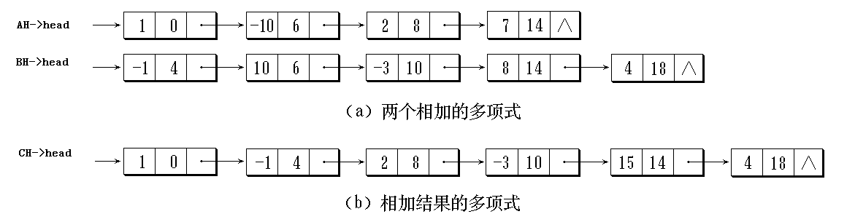
Polynomial adding to of chained list
AH = 1 - 10x⁶ + 2x⁸ +7x¹⁴
BH = - x⁴ + 10x⁶ - 3x¹⁰ + 8x¹⁴ +4x¹⁸

Slide 27
Polynomial
Polymial.cpp

Slide 28
Reference
P115----P120

Slide 29
-End-

