Slide 1
Searching(1)

Slide 2
outline
Searching
Searching on unsorted arrays
Searching on sorted arrays
Binary search

Slide 3
Searching
Search can be viewed abstractly as a process to determine if an element with a particular value is a member of a particular set.
The more common view of searching is an attempt to find the record within a collection of records that has a particular key value, or those records in a collection whose key values meet some criterion such as falling within a range of values.

Slide 4
Searching: formal definition
Suppose that we have a collection L of n records of the form
(k₁; I₁); (k₂; I₂); :::; (k_{n}; I_{n})
where I_{j} is information associated with key k_{j} from record j for 1≤ j ≤ n. Given a particular key value K, the search problem is to locate a record (k_{j} ; I_{j}) in L such that k_{j} = K (if one exists). Searching is a systematic method for locating the record (or records) with key value k_{j} = K.

Slide 5
Searching
A successful search is one in which a record with key k_{j} = K is found.
An unsuccessful search is one in which no record with k_{j} = K is found (and no such record exists).
An exact-match query is a search for the record whose key value matches a specified key value.
A range query is a search for all records whose key value falls within a specified range of key values.

Slide 6
Searching Algorithms
We can categorize search algorithms into three general approaches:
  1. Sequential and list methods.
  2. Direct access by key value (hashing).
  3. Tree indexing methods.

Slide 7
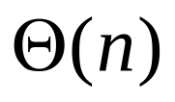
Searching on Unsorted Arrays
Sequential search algorithm
  the simplest form of search
  Sequential search on an unsorted list requires time in the worst case.
Basic algorithm:
  Get the search criterion (key)
  Get the first record from the file
  While ( (record != key) and (still more records) )
  Get the next record
  End_while
When do we know that there wasn’t a record in the file that matched the key?

Slide 8
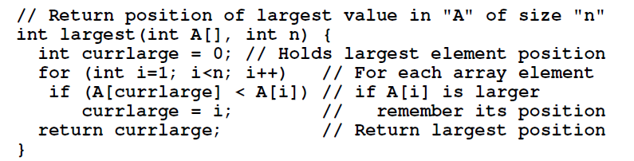
Sequential Search on unsorted arrays: implementation

Slide 9
Searching on sorted Arrays
Basic algorithm:
  Get the search criterion (key)
  Get the first record from the file
  While ( (record < key) and (still more records) )
  Get the next record
  End_while
  If ( record = key )
  Then success
  Else there is no match in the file
  End_else
When do we know that there wasn’t a record in the file that matched the key?

Slide 10
Unsorted vs. Sorted
Observation: the search is faster on an sorted list only when the item being searched for is not in the list.
Also, keep in mind that the list has to first be placed in order for the ordered search.
Conclusion: the efficiency of these algorithms is roughly the same.
So, if we need a faster search, we need a completely different algorithm.
How else could we search an ordered file?

Slide 11
Binary search
If we have an ordered list and we know how many things are in the list (i.e., number of records in a file), we can use a different strategy.
The binary search gets its name because the algorithm continually divides the list into two parts.

Slide 12
How a Binary Search Works
Always look at the center value. Each time you get to discard half of the remaining list.
Is this fast ?

Slide 13
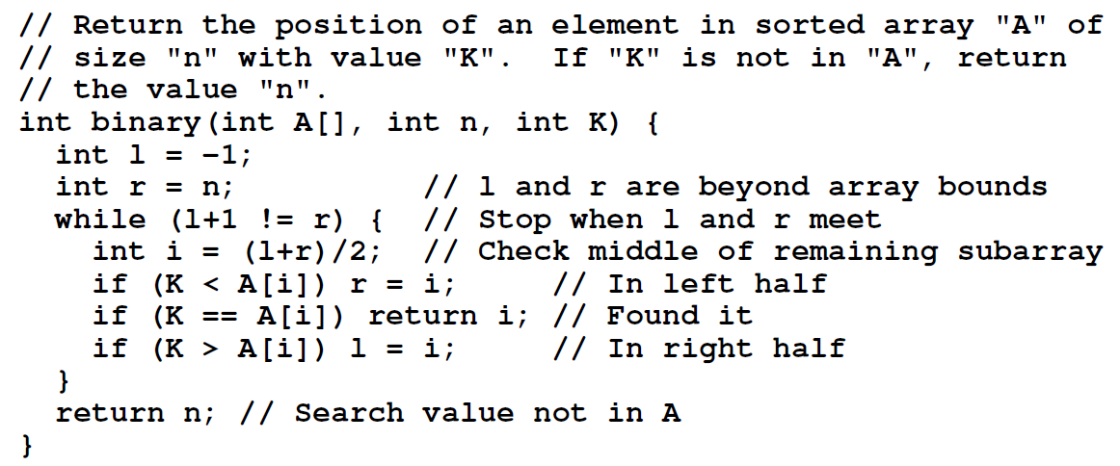
Binary search: Implementation

Slide 14
How Fast is a Binary Search?
Worst case: 11 items in the list took 4 tries
How about the worst case for a list with 32 items ?
  1st try - list has 16 items
  2nd try - list has 8 items
  3rd try - list has 4 items
  4th try - list has 2 items
  5th try - list has 1 item

Slide 15
How Fast is a Binary Search? (con’t)
List has 250 items
1st try - 125 items
2nd try - 63 items
3rd try - 32 items
4th try - 16 items
5th try - 8 items
6th try - 4 items
7th try - 2 items
8th try - 1 item
List has 512 items
1st try - 256 items
2nd try - 128 items
3rd try - 64 items
4th try - 32 items
5th try - 16 items
6th try - 8 items
7th try - 4 items
8th try - 2 items
9th try - 1 item

Slide 16
What’s the Pattern?
List of 11 took 4 tries
List of 32 took 5 tries
List of 250 took 8 tries
List of 512 took 9 tries
32 = 2⁵ and 512 = 2⁹
8 < 11 < 16 2³ < 11 < 2⁴
128 < 250 < 256 2⁷ < 250 < 2⁸

Slide 17

A Very Fast Algorithm!
How long (worst case) will it take to find an item in a list 30,000 items long?
  2¹⁰ = 1024 2¹³ = 8192
  2¹¹ = 2048 2¹⁴ = 16384
  2¹² = 4096 2¹⁵ = 32768
So, it will take only 15 tries!
Time complexity:

Slide 18
References
Data Structures and Algorithm Analysis Edition 3.2 (C++ Version)
  P.57 Example 3.1
  P.74-75

Slide 19
End

