Slide 1
Searching(3)

Slide 2
outline
Hashing
Hash functions
Open hashing
Closed hashing

Slide 3
Hashing
The process of finding a record using some computation to map its key value to a position in the array is called hashing.
Hash function: the function that maps key values to positions , denoted by h
Hash table: the array that holds the records , denoted by HT.
Slot: A position in the hash table.

Slide 4
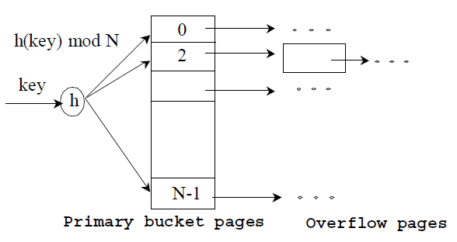
Hashing
slot
Hashing function
Hash table

Slide 5
Basic Idea
Use hash function to map keys into positions in a hash table
Ideally
If element e has key k and h is hash function, then e is stored in position h(k) of table
To search for e, compute h(k) to locate position. If no element, array does not contain e.

Slide 6
Example
Dictionary Student Records
  Keys are ID numbers (951000 - 952000), no more than 100 students
  Hash function: h(k) = k-951000 maps ID into distinct table positions 0-1000
  array table[1001]
hash table
...
0
1
2
3
1000
buckets

Slide 7
Analysis (Ideal Case)
O(b) time to initialize hash table (b number of positions or buckets in hash table)
O(1) time to perform insert, remove, search

Slide 8
Ideal Case is Unrealistic
Works for implementing dictionaries, but many applications have key ranges that are too large to have 1-1 mapping between buckets and keys!
Example:
Suppose key can take on values from 0 .. 65,535 (2 byte unsigned int)
Expect ≈ 1,000 records at any given time
Impractical to use hash table with 65,536 slots!

Slide 9
Hash Functions
If key range too large, use hash table with fewer buckets and a hash function which maps multiple keys to same bucket:
  h(k₁) = β = h(k₂): k₁ and k₂ have collision at slot β
Popular hash functions: hashing by division
  h(k) = k%D, where D number of buckets in hash table
Example: hash table with 11 buckets
  h(k) = k%11
  80 → 3 (80%11= 3), 40 → 7, 65 → 10
  58 → 3 collision!

Slide 10
Hash Functions - Numerical Values
Consider: h(x) = x%16
  poor distribution, not very random
  depends solely on least significant four bits of key
Better, mid-square method
  if keys are integers in range 0,1,…,K , pick integer C such that DC² about equal to K², then
  h(x) = ⎣x²/C⎦ % D
  extracts middle r bits of x², where 2^{r}=D (a base-D digit)
  better, because most or all of bits of key contribute to result

Slide 11
Hash Function –
Strings of Characters
Folding Method:
    int h(String x, int D) {
    int i, sum;
    for (sum=0, i=0; i<x.length(); i++)
      sum+= (int)x.charAt(i);
    return (sum%D);
    }
  sums the ASCII values of the letters in the string
    ASCII value for “A” =65; sum will be in range 650-900 for 10 upper-case letters; good when D around 100, for example
  order of chars in string has no effect

Slide 12
Hash Function –
Strings of Characters
Much better: Cyclic Shift
    static long hashCode(String key, int D) {
    int h=0;
    for (int i=0, i<key.length(); i++){
      h = (h << 4) | ( h >> 27);
      h += (int) key.charAt(i);
      }
    return h%D;
    }

Slide 13
Collision Resolution Policies
Two classes:
  (1) Open hashing, a.k.a. separate chaining
  (2) Closed hashing, a.k.a. open addressing
Difference has to do with whether collisions are stored outside the table (open hashing) or whether collisions result in storing one of the records at another slot in the table (closed hashing)

Slide 14
Open Hashing
Each bucket in the hash table is the head of a linked list
All elements that hash to a particular bucket are placed on that bucket’s linked list
Records within a bucket can be ordered in several ways
  by order of insertion, by key value order, or by frequency of access order

Slide 15
Open Hashing Data Organization
0
...
1
...
2
3
4
D-1
...

Slide 16
Analysis
Open hashing is the most appropriate when the hash table is kept in main memory, implemented with a standard in-memory linked list
We hope that number of elements per bucket roughly equal in size, so that the lists will be short
If there are n elements in set, then each bucket will have roughly n/D
If we can estimate n and choose D to be roughly as large, then the average bucket will have only one or two members

Slide 17
Analysis Cont’d
Average time per dictionary operation:
D buckets, n elements in dictionary ⇒ average n/D elements per bucket
insert, search, remove operation take O(1+n/D) time each
If we can choose D to be about n, constant time
Assuming each element is likely to be hashed to any bucket, running time constant, independent of n

Slide 18
Closed hashing
Closed hashing stores all records directly in the hash table.
Each record R with key value k_{R} has a home position that is h(k_{R}), the slot computed by the hash function.
If R is to be inserted and another record already occupies R’s home position, then R will be stored at some other slot in the table. It is the business of the collision resolution policy to determine which slot that will be.
Naturally, the same policy must be followed during search as during insertion, so that any record not found in its home position can be recovered by repeating the collision resolution process.

Slide 19
Bucket hashing
The M slots of the hash table are divided into B buckets, with each bucket consisting of M/B slots.
The hash function assigns each record to the first slot within one of the buckets.
If this slot is already occupied, then the bucket slots are searched sequentially until an open slot is found. If a bucket is entirely full, then the record is stored in an overflow bucket of infinite capacity at the end of the table.
ALL buckets share the same overflow bucket.
A good implementation will use a hash function that distributes the records evenly among the buckets so that as few records as possible go into the overflow bucket.

Slide 20
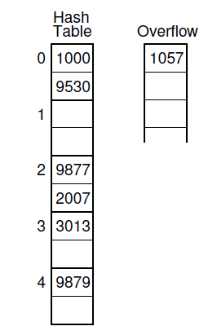
Bucket hashing: example
seven numbers are stored in a five bucket hash table
hash function h(K) = K mod 5.
Each bucket contains two slots.
three values hash to bucket 2.
Because bucket 2 cannot hold three values, the third one ends up in the overflow bucket.

Slide 21
Search using bucket hashing
to hash the key to determine which bucket should contain the record. The records in this bucket are then searched.
If the desired key value is not found and the bucket still has free slots, then the search is complete.
If the bucket is full, then it is possible that the desired record is stored in the overflow bucket. In this case, the overflow bucket must be searched until the record is found or all records in the overflow bucket have been checked. If many records are in the overflow bucket, this will be an expensive process.

Slide 22
A simple variation on bucket hashing
Hash a key value to some slot in the hash table as though bucketing were not being used.
If the home position is full, then the collision resolution process is to move down through the table toward the end of the bucket whil searching for a free slot in which to store the record.
If the bottom of the bucket is reached, then the collision resolution routine wraps around to the top of the bucket to continue the search for an open slot.
If all slots in this bucket are full, then the record is assigned to the overflow bucket.
advantage : initial collisions are reduced
  Because any slot can be a home position rather than just the first slot in the bucket.

Slide 23
Bucket hashing: summary
Bucket methods are good for implementing hash tables stored on disk, because the bucket size can be set to the size of a disk block.
Whenever search or insertion occurs, the entire bucket is read into memory. Because the entire bucket is then in memory, processing an insert or search operation requires only one disk access, unless the bucket is full.
If the bucket is full, then the overflow bucket must be retrieved from disk as well.
Naturally, overflow should be kept small to minimize unnecessary disk accesses.

Slide 24
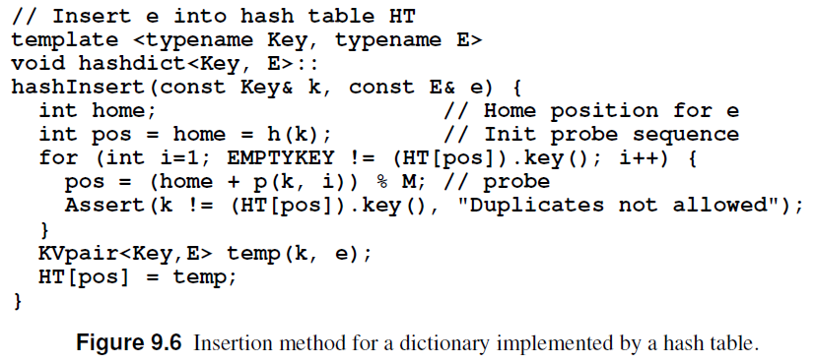
Linear probing
In general, linear probing is to generate a sequence of hash table slots (probe sequence) that can hold the record using some probe function ; test each slot until find empty one (probing).
The simplest probe function : p(K, i) = i

Slide 25
Linear probing: Example
D=8, keys a,b,c,d have hash values h(a)=3, h(b)=0, h(c)=4, h(d)=3
Where do we insert d? 3 already filled
Probe sequence using linear hashing:
  h₁(d) = (h(d)+1)%8 = 4%8 = 4
  h₂(d) = (h(d)+2)%8 = 5%8 = 5*
  h₃(d) = (h(d)+3)%8 = 6%8 = 6
  etc.
  7, 0, 1, 2
Wraps around the beginning of the table!
0
b
1
2
3
a
4
c
5
d
6
7

Slide 26
Problem of linear probing
primary clustering:
  by linear probing, the items has tendency to be clustered together.
Small clusters tend to merge into big clusters, making the problem worse.
primary clustering leads to long probe sequences.

Slide 27
Improved Collision Resolution
Linear probing: h_{i}(x) = (h(x) + i) % M
  all buckets in table will be candidates for inserting a new record before the probe sequence returns to home position
  clustering of records, leads to long probing sequences
Linear probing with skipping: h_{i}(x) = (h(x) + ic) % M
  c constant other than 1
  records with adjacent home buckets will not follow same probe sequence
(Pseudo)Random probing: h_{i}(x) = (h(x) + r_{i}) % M
  r_{i} is the i^{th} value in a random permutation of numbers from 1 to M-1
  insertions and searches use the same sequence of “random” numbers

Slide 28
References
Data Structures and Algorithm Analysis Edition 3.2 (C++ Version)
  P.324-339

