Slide 1
Algorithm Analysis & Design Introduction to Algorithm
T&R Team of Algorithm Design
College of Computer Science and Engineering, CQU
Notes:
本人是国际视觉电生理学会(ISCEV)的会员。

Slide 2
String Matching
32

Slide 3
Introduction
Naïve Algorithm
Rabin-Karp Algorithm
String Matching using Finite Automata
Knuth-Morris-Pratt (KMP) Algorithm
Literature
Cormen, Leiserson, Rivest, “Introduction to Algorithms”, chapter 32, string matching, The MIT Press, 2001, 906-932.

Slide 4
Introduction
What is string matching?
Finding all occurrences of a pattern in a given text (or body of text)
Many applications
While using editor/word processor/browser
Login name & password checking
Virus detection
Header analysis in data communications
DNA sequence analysis

Slide 5
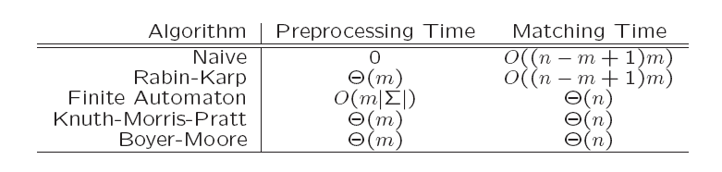
History of String Search
The brute force algorithm:
invented in the dawn of computer history
re-invented many times, still common
Knuth & Pratt invented a better one in 1970
published 1976 as “Knuth-Morris-Pratt”
Boyer & Moore found a better one before 1976
Published 1977
Karp & Rabin found a “better” one in 1980
Published 1987
Notes:
19

Slide 6
String-Matching Problem
The text is in an array T [1..n] of length n
The pattern is in an array P [1..m] of length m
Elements of T and P are characters from a finite alphabet ∑
E.g., ∑ = {0,1} or ∑ = {a, b, …, z}
Usually T and P are called strings of characters

Slide 7
String-Matching Problem …contd
We say that pattern P occurs with shift s in text T if:
0 ≤ s ≤ n-m and
T [(s+1)..(s+m)] = P [1..m]
If P occurs with shift s in T, then s is a valid shift, otherwise s is an invalid shift
String-matching problem: finding all valid shifts for a given T and P

Slide 8
Example 1
1
2
3
4
5
6
7
8
9
10
11
12
13
text T
a | b | c | a | b | a | a | b | c | a | b | a | c
s = 3
pattern P
a | b | a | a
1
2
3
4
shift s = 3 is a valid shift
(n=13, m=4 and 0 ≤ s ≤ n-m holds)

Slide 9
Example 2
1
2
3
4
pattern P
a
b
a
a
1
2
3
4
5
6
7
8
9
10
11
12
13
text T
a | b | c | a | b | a | a | b | c | a | b | a | a
s = 3
a | b | a | a
s = 9
a
b
a
a

Slide 10
Naïve String-Matching Algorithm
Input: Text strings T [1..n] and P[1..m]
Result: All valid shifts displayed
NAÏVE-STRING-MATCHER (T, P)
n ← length[T]
m ← length[P]
for s ← 0 to n-m
if P[1..m] = T [(s+1)..(s+m)]
print “pattern occurs with shift” s

Slide 11
Example
P=“abxyabxz” and T=“xabxyabxyabxz”
T
x
a
b
x
y
a
b
x
y
a
b
x
z
a
b
a
x
b
a
y
x
b
a
a
y
x
b
a
b
a
y
x
b
x
b
a
y
x
z
x
b
a
y
z
x
b
a
z
x
b
z
P
a
b
x
a
x
z
y
b
a
x
b
y
x
a
z
b
x
z

Slide 12
Worst-case Analysis
There are m comparisons for each shift in the worst case
There are n-m+1 shifts
So, the worst-case running time is Θ((n-m+1)m)
Naïve method is inefficient because information from a shift is not used again

Slide 13
Reflection Question
Suppose that all characters in the pattern P are
different. Show how to accelerate
NAIVE-STRING-MATCHER to run in time O(n)
on an n-character text T .

Slide 14
Excercise
Ch. 32.1-4

Slide 15
Rabin-Karp Algorithm
Has a worst-case running time of O((n-m+1)m) but average-case is O(n+m)
Also works well in practice
Based on number-theoretic notion of modulo模量 equivalence
We assume that ∑ = {0,1, 2, …, 9}, i.e., each character is a decimal digit
In general, use radix-d where d = |∑|

Slide 16
Modulo Equivalence
If (a mod n) = (b mod n), then we say
“a is equivalent to b, modulo n”
Denoted by a ≡ b (mod n)
That is, a ≡ b (mod n) if a and b have the same remainder when divided by n
E.g., 23 ≡ 37 ≡ -19 (mod 7)

Slide 17
Rabin-Karp Approach
We can view a string of k characters (digits) as a length-k decimal number
E.g., the string “31425” corresponds to the decimal number 31,425
Given a pattern P [1..m], let p denote the corresponding decimal value
Given a text T [1..n], let t_{s} denote the decimal value of the length-m substring T [(s+1)..(s+m)] for s=0,1,…,(n-m)

Slide 18
Rabin-Karp Approach …contd
t_{s} = p iff T [(s+1)..(s+m)] = P [1..m]
s is a valid shift iff t_{s} = p
p can be computed in O(m) time
p = P[m] + 10 (P[m-1] + 10 (P[m-2]+…))
t₀ can similarly be computed in O(m) time
Other t₁, t₂,…, t_{n-m} can be computed in O(n-m) time since t_{s+1} can be computed from t_{s} in constant time避免重复计算

Slide 19
Rabin-Karp Approach …contd
t_{s+1} = 10(t_{s} - 10^{m-1} ·T [s+1]) + T [s+m+1]
E.g., if T={…,3,1,4,1,5,2,…}, m=5 and t_{s}= 31,415, then t_{s+1} = 10(31415 – 10000·3) + 2
We can compute p, t₀, t₁, t₂,…, t_{n-m} in O(n+m) time
But…a problem: this is assuming p and t_{s} are small numbers
They may be too large to work with easily

Slide 20
Rabin-Karp Approach …contd
Solution: we can use modulus arithmetic with a suitable modulus, q
E.g., t_{s+1} ≡ 10(t_{s} - …)+ T [s+m+1] (mod q)
q is chosen as a small prime number ; e.g., 13 for radix 10
Generally, if the radix根 is d, then dq should fit within one computer word

Slide 21
How values modulo 13 are computed
3
1
4
1
5
2
old high-order digit
new low-order digit
7
8
14152 ≡ (31415 – 3 · 10000) · 10 + 2 (mod 13)
≡ (731415对13的余数 – 3 · 310000对13的余数) · 10 + 2 (mod 13)
≡ 8 (mod 13)以8匹配P的13除余数

Slide 22
Problem of Spurious Hits
t_{s} ≡ p (mod q) does not imply that t_{s}=p
Modular equivalence does not necessarily mean that two integers are equal
A case in which t_{s} ≡ p (mod q) when t_{s} ≠ p is called a spurious伪 hit
On the other hand, if two integers are not modulo equivalent, then they cannot be equal

Slide 23
Example
3
1
4
1
5
pattern
mod 13
text
7
1
2
3
4
5
6
7
8
9
10
11
12
13
14
2
3
1
4
1
5
2
6
7
3
9
9
2
1
mod 13
1
7
8
4
5
10
11
7
9
11
valid match
spurious hit

Slide 24
Rabin-Karp Algorithm
Basic structure like the naïve algorithm, but uses modular arithmetic as described
For each hit, i.e., for each s where t_{s} ≡ p (mod q), verify character by character whether s is a valid shift or a spurious hit
In the worst case, every shift is verified
Running time can be shown as O((n-m+1)m)
Average-case running time is O(n+m)

Slide 25
Excercise
Ch. 32.2-3
Show how to extend the Rabin-Karp method to handle the problem of looking for a given mxm pattern in an nxn array of characters.
(The pattern may be shifted vertically and horizontally, but it may not be rotated.)

Slide 26
Deterministic Finite State Automata (DFA)
……..
One-way, infinite tape, broken into cells
One-way, read-only tape head.
Finite control, I.e., a program, containing the position of the read head, current symbol being scanned, and the current “state.”
A string is placed on the tape, read head is positioned at the left end, and the DFA will read the string one symbol at a time until all symbols have been read. The DFA will then either accept or reject.
0 | 1 | 1 | 0 | 0
Finite
Control

Slide 27
The finite control can be described by a transition diagram:
Example #1:
1 0 0 1 1
q₀ q₀ q₁ q₀ q₀ q₀
One state is final/accepting, all others are rejecting.
The above DFA accepts those strings that contain an even number of 0’s
1
0
q₀
q₁
1
0

Slide 28
Example #2:
a c c c b accepted
q₀ q₀ q₁ q₂ q₂ q₂
a a c rejected
q₀ q₀ q₀ q₁
Accepts those strings that contain at least two c’s
a
a
a/b/c
q₀
c
c
q₂
q₁
b
b

Slide 29
Finite Automata
A finite automaton M is a 5-tuple (Q, q₀, A, ∑, δ), where
Q is a finite set of states
q₀ ε Q is the start state
A ⊆ Q is a set of accepting states
∑ is a finite input alphabet
δ is the transition function that gives the next state for a given current state and input

Slide 30
How a Finite Automaton Works
The finite automaton M begins in state q₀
Reads characters from ∑ one at a time
If M is in state q and reads input character a, M moves to state δ(q,a)
If its current state q is in A, M is said to have accepted the string read so far
An input string that is not accepted is said to be rejected

Slide 31
For example #1:
Q = {q₀, q₁}
Σ = {0, 1}
Start state is q₀
F = {q₀}
δ:
0 1
q₀ q₁ q₀
q₁ q₀ q₁
1
0
q₀
q₁
1
0
接受偶数个0

Slide 32
For example #2:
Q = {q₀, q₁, q₂}
Σ = {a, b, c}
Start state is q₀
F = {q₂}
δ: a b c
q₀ q₀ q₀ q₁
q₁ q₁ q₁ q₂
q₂ q₂ q₂ q₂
Since δ is a function, at each step M has exactly one option.
a
a
a/b/c
q₀
c
q₁
c
q₂
b
b
接受至少2个c

Slide 33
Example 3
Q = {0,1}, q₀ = 0, A={1}, ∑ = {a, b}
δ(q,a) shown in the transition table/diagram
This accepts strings that end in an odd number of a’s; e.g., abbaaa is accepted, aa is rejected
input
a
state
a
b
0
1
0
0
1
b
1
0
0
a
transition table
transition diagram
b

Slide 34
Example 4
Give a DFA M to accept all strings of a’s, b’s and c’s which contain the substring abac
b/c
a
a
a
a
q₀
q₁
b
q₂
q₃
c
b
c
b/c
a/b/c
q₄

Slide 35
String-Matching Automata
Given the pattern P [1..m], build a finite automaton M
The state set is Q={0, 1, 2, …, m}
The start state is 0
The only accepting state is m
Time to build M can be large if 字母表∑ is large

Slide 36
String-Matching Automata …contd
Scan the text string T [1..n] to find all occurrences of the pattern P [1..m]
String matching is efficient: Θ(n)
Each character is examined exactly once
Constant time for each character
But …time to compute δ转换关系 is O(m |∑|)
δ Has O(m |∑| ) entries

Slide 37
Algorithm
Input: Text string T [1..n], δ and m
Result: All valid shifts displayed
FINITE-AUTOMATON-MATCHER (T, m, δ)
n ← length[T]
q ← 0
for i ← 1 to n shift偏移长度
q ← δ (q, T [i])状态转换过程
if q = m终态恰好是自动机接受态
print “pattern occurs with shift” i-m

Slide 38
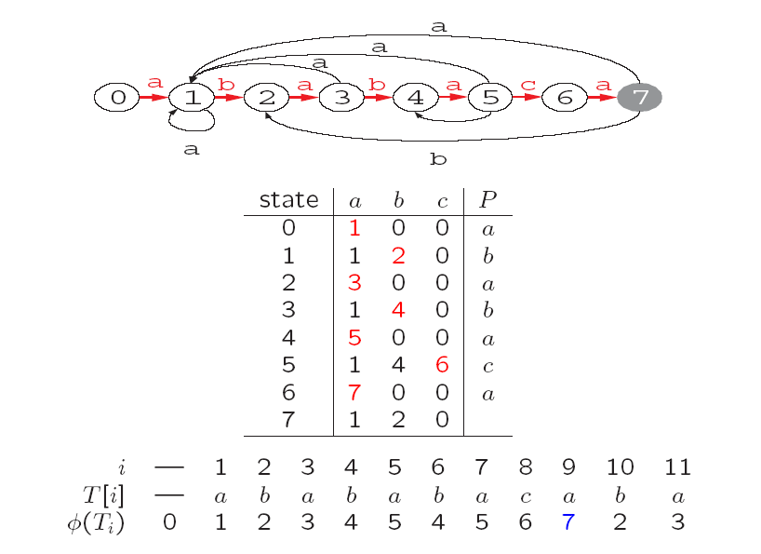
Example

Slide 39
Knuth-Morris-Pratt (KMP) Method
Avoids computing δ (transition function)
Instead computes a prefix function π in O(m) time
π has only m entries
Prefix function stores info about how the pattern matches against shifts of itself
Can avoid testing useless shifts

Slide 40
Terminology/Notations
String w is a prefix of string x, if x=wy for some string y (e.g., “srilan” of “srilanka”)
String w is a suffix后缀 of string x, if x=yw for some string y (e.g., “anka” of “srilanka”)
The k-character prefix of the pattern P [1..m] denoted by P_{k}
E.g., P₀= ε, P_{m} = P =P [1..m]

Slide 41
Prefix Function for a Pattern
Given that pattern prefix P [1..q] matches text characters T [(s+1)..(s+q)], what is the least shift s’ > s such that
P [1..k] = T [(s’+1)..(s’+k)] where s’+k=s+q?
At the new shift s’, no need to compare the first k characters of P with corresponding characters of T
Since we know that they match

Slide 42
Prefix Function: Example 1
b
a
c
b
a
b
a
b
a
a
b
c
b
a
T
s
a
b
a
b
a
c
a
P
q已匹配前缀长度
P直接后移2位因为知道不足2位移动肯定无法匹配
b
a
c
b
a
b
a
b
a
a
b
c
b
a
T
s’
a
b
a
b
a
c
a
P
k
往后移动保证黄色部分对其，黄色最长长度
a
b
a
b
a
P_{q}
Compare pattern against itself; longest prefix of P that is also a suffix of P₅ is P₃; so π[5]= 3
后位对其（从前数3从后数3一样）
a
b
a
P_{k}

Slide 43
Prefix Function: Example 2
i | 1 | 2 | 3 | 4 | 5 | 6 | 7 | 8 | 9 | 10
P [i] | a | b | a | b | a | b | a | b | c | a
π[i] | 0 | 0 | 1 | 2 | 3 | 4 | 5 | 6 | 0 | 1
π[q] = max { k | k<q and P_{k} is a suffix of P_{q}}

Slide 44
Illustration: given a String ‘S’ and pattern ‘p’ as follows:
S
b | a | c | b | a | b | a | b | a | b | a | c | a | c | a
p
a | b | a | b | a | c | a
Let us execute the KMP algorithm to find whether ‘p’ occurs in ‘S’.
For ‘p’ the prefix function, Π was computed previously and is as follows:
q | 1 | 2 | 3 | 4 | 5 | 6 | 7
p | a | b | a | b | a | c | a
Π | 0 | 0 | 1 | 2 | 3 | 0 | 1

Slide 45
Initially: n = size of S = 15;
m = size of p = 7
Step 1: i = 1, q = 0
comparing p[1] with S[1]
S
b | a | c | b | a | b | a | b | a | b | a | c | a | a | b
p
a | b | a | b | a | c | a
P[1] does not match with S[1]. ‘p’ will be shifted one position to the right.
Step 2: i = 2, q = 0
comparing p[1] with S[2]
S
b | a | c | b | a | b | a | b | a | b | a | c | a | a | b
p
a | b | a | b | a | c | a
P[1] matches S[2]. Since there is a match, p is not shifted.

Slide 46
Step 3: i = 3, q = 1
Comparing p[2] with S[3]
p[2] does not match with S[3]
S
b | a | c | b | a | b | a | b | a | b | a | c | a | a | b
p
a | b | a | b | a | c | a
Backtracking on p, q = Π[q] =Π[1] = 0后位对其 ，comparing p[1] and S[3]，not match
Step 4: i = 4, q = 0
comparing p[1] with S[4]
p[1] does not match with S[4]
S
b | a | c | b | a | b | a | b | a | b | a | c | a | a | b
p
a | b | a | b | a | c | a
Step 5: i = 5, q = 0
comparing p[1] with S[5]
p[1] matches with S[5]
S
b | a | c | b | a | b | a | b | a | b | a | c | a | a | b
p
a | b | a | b | a | c | a

Slide 47
Step 6: i = 6, q = 1
Comparing p[2] with S[6]
p[2] matches with S[6]
S
b | a | c | b | a | b | a | b | a | b | a | c | a | a | b
p
a | b | a | b | a | c | a
Step 7: i = 7, q = 2
Comparing p[3] with S[7]
p[3] matches with S[7]
S
b | a | c | b | a | b | a | b | a | b | a | c | a | a | b
p
a | b | a | b | a | c | a
Step 8: i = 8, q = 3
Comparing p[4] with S[8]
p[4] matches with S[8]
S
b | a | c | b | a | b | a | b | a | b | a | c | a | a | b
p
a | b | a | b | a | c | a

Slide 48
Step 9: i = 9, q = 4
Comparing p[5] with S[9]
p[5] matches with S[9]
S
b | a | c | b | a | b | a | b | a | b | a | c | a | a | b
p
a | b | a | b | a | c | a
Step 10: i = 10, q = 5
Comparing p[6] with S[10]
p[6] doesn’t match with S[10]
S
b | a | c | b | a | b | a | b | a | b | a | c | a | a | b
p
a | b | a | b | a | c | a
Backtracking on p, comparing p[4] with S[10] because after mismatch q = Π[q] =Π[5] = 3后位对齐
Step 11: i = 11, q = 4
Comparing p[5] with S[11]
p[5] matches with S[11]
b | a | c | b | a | b | a | b | a | b | a | c | a | a | b
S
p
a | b | a | b | a | c | a

Slide 49
Step 12: i = 12, q = 5
Comparing p[6] with S[12]
p[6] matches with S[12]
S
b | a | c | b | a | b | a | b | a | b | a | c | a | a | b
p
a | b | a | b | a | c | a
Step 13: i = 13, q = 6
Comparing p[7] with S[13]
p[7] matches with S[13]
S
b | a | c | b | a | b | a | b | a | b | a | c | a | a | b
p
a | b | a | b | a | c | a
Pattern ‘p’ has been found to completely occur in string ‘S’. The total number of shifts
that took place for the match to be found are: i – m = 13 – 7 = 6 shifts.
其实还有一部，算Π[7] =1后位对其，但长度受限根本不行了

Slide 50
Knuth-Morris-Pratt (KMP) Algorithm
Information stored in prefix function
Can speed up both the naïve algorithm and the finite-automaton matcher
KMP Algorithm
2 parts: KMP-MATCHER, PREFIX
Running time
PREFIX takes O(m)
KMP-MATCHER takes O(m+n)

Slide 51
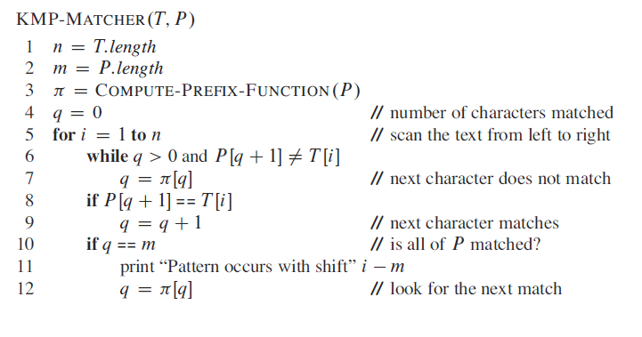
Knuth-Morris-Pratt (KMP) Algorithm
已匹配子串长度
计算跳跃后的下个shift位置
计算跳跃后的下个shift位置

Slide 52
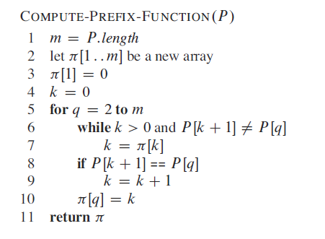
Knuth-Morris-Pratt (KMP) Algorithm
长度为一的子串无合格的匹配后缀

Slide 53
Exercises
Ch. 32 3-1
Ch. 32 4-1

Slide 54
Boyer-Moore Algorithm
Published in 1977
The longer the pattern is, the faster it works
Starts from the end of pattern, while KMP starts from the beginning
Works best for character string, while KMP works best for binary string
KMP and Boyer-Moore
- Preprocessing existing patterns
- Searching patterns in input strings

