Slide 1
Tree & Binary Trees (3)

Slide 2
Outline
Binary Tree Implementations
  Array-Based Implementation
  Pointer-Based Implementation
General Tree Traversals
General Tree Implementations
Converting forest to binary tree

Slide 3
Binary Tree Implementations
There are two implementations:
  array-based implementation
  pointer-based implementation

Slide 4
Array-Based Implementation
How to use an array representation for binary trees?
[1]
[2]
[3]
[4]
[5]
[6]
[7]
[8]
[9]
.
[16]
A
B
--
C
--
--
--
D
--
.
E
A
A
[1]
[2]
[3]
[4]
[5]
[6]
[7]
[8]
[9]
A
B
C
D
E
F
G
H
I
B
B
C
C
D
E
F
G
D
E
H
I
waste space

Slide 5
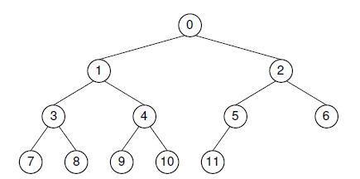
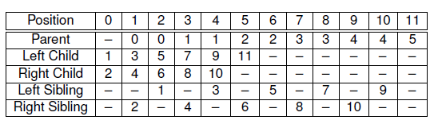
Array-Based Implementation for Complete Binary Trees

Slide 6
Array-Based Implementation for Complete Binary Trees
The formulae for calculating the array indices of the various relatives of a node are as follows. The total number of nodes in the tree is n. The index of the node in question is r, which must fall in the range 0 to n-1.
  Parent(r) = ⎣(r -1) /2⎦ if r ≠ 0.
  Left child(r) = 2r + 1 if 2r + 1 < n.
  Right child(r) = 2r + 2 if 2r + 2 < n.
  Left sibling(r) = r - 1 if r is even.
  Right sibling(r) = r + 1 if r is odd and r + 1 < n.

Slide 7
Pointer-Based Implementation
All binary tree nodes have two children.
The most common node implementation includes a value field and pointers to the two children
lChild data rChild
data
lChild
rChild

Slide 8
Pointer-Based Implementation
All binary tree nodes have two children and one parent, except root.
An alternate node implementation includes a value field and pointers to the two children and one parent.
lChild data parent rChild
parent
data
lChild
rChild

Slide 9

Example
root
root
root
A
A
∧
A
∧
∧
B
B
B
C
D
∧
C
∧
D
∧
C
∧
D
E
F
∧
E
∧
∧
F
∧
∧
E
∧
∧
F
∧

Slide 10
Pointer-Based Node Implementation
// Simple binary tree node implementation
template <typename Key, typename E>
class BSTNode : public BinNode<E> {
private:
Key k; // The node’s key
E it; // The node’s value
BSTNode* lc; // Pointer to left child
BSTNode* rc; // Pointer to right child
public:
// Two constructors -- with and without initial values
BSTNode() { lc = rc = NULL; }
BSTNode(Key K, E e, BSTNode* l =NULL, BSTNode* r =NULL)
{ k = K; it = e; lc = l; rc = r; }
˜BSTNode() {} // Destructor

Slide 11
Pointer-Based Node Implementation
// Functions to set and return the value and key
E& element() { return it; }
void setElement(const E& e) { it = e; }
Key& key() { return k; }
void setKey(const Key& K) { k = K; }
// Functions to set and return the children
inline BSTNode* left() const { return lc; }
void setLeft(BinNode<E>* b) { lc = (BSTNode*)b; }
inline BSTNode* right() const { return rc; }
void setRight(BinNode<E>* b) { rc = (BSTNode*)b; }
// Return true if it is a leaf, false otherwise
bool isLeaf() { return (lc == NULL) && (rc == NULL); }
};

Slide 12
Distinguish leaf and internal nodes
Why?
  Some applications require data values only for the leaves.
  Other applications require one type of value for the leaves and another for the internal nodes.
By definition, only internal nodes have non-empty children. It can save space to have separate implementations for internal and leaf nodes.

Slide 13
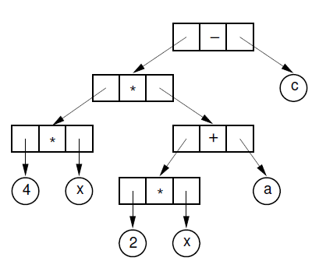
Example: Expression Tree
Expression : 4x(2x + a) - c
Internal nodes store operators, while the leaves store operands.

Slide 14
Approach
Approach 1: to use class inheritance
  A base class can be declared for binary tree nodes in general, with subclasses defined for the internal and leaf nodes.
Approach 2: to use the composite design pattern
  using a virtual base class and separate node classes for the two types.

Slide 15
Approach1
--leaf node representation
// Node implementation with simple inheritance
class VarBinNode { // Node abstract base class
public:
virtual ˜VarBinNode() {}
virtual bool isLeaf() = 0; // Subclasses must implement
};
class LeafNode : public VarBinNode { // Leaf node
private:
Operand var; // Operand value
public:
LeafNode(const Operand& val) { var = val; } // Constructor
bool isLeaf() { return true; } // Version for LeafNode
Operand value() { return var; } // Return node value
};

Slide 16
Approach1
--internal node representation
class IntlNode : public VarBinNode { // Internal node
private:
VarBinNode* left; // Left child
VarBinNode* right; // Right child
Operator opx; // Operator value
public:
IntlNode(const Operator& op, VarBinNode* l, VarBinNode* r)
{ opx = op; left = l; right = r; } // Constructor
bool isLeaf() { return false; } // Version for IntlNode
VarBinNode* leftchild() { return left; } // Left child
VarBinNode* rightchild() { return right; } // Right child
Operator value() { return opx; } // Value
};

Slide 17
Approach1--Function traverse
void traverse(VarBinNode *root) { // Preorder traversal
if (root == NULL) return; // Nothing to visit
if (root->isLeaf()) // Do leaf node
cout << "Leaf: " << ((LeafNode *)root)->value() << endl;
else { // Do internal node
cout << "Internal: "
<< ((IntlNode *)root)->value() << endl;
traverse(((IntlNode *)root)->leftchild());
traverse(((IntlNode *)root)->rightchild());
}
}

Slide 18
Approach2
--leaf node implementation
// Node implementation with the composite design pattern
class VarBinNode { // Node abstract base class
public:
virtual ˜VarBinNode() {} // Generic destructor
virtual bool isLeaf() = 0;
virtual void traverse() = 0;
};
class LeafNode : public VarBinNode { // Leaf node
private:
Operand var; // Operand value
public:
LeafNode(const Operand& val) { var = val; } // Constructor
bool isLeaf() { return true; } // isLeaf for Leafnode
Operand value() { return var; } // Return node value
void traverse() { cout << "Leaf: " << value() << endl; }
};

Slide 19
Approach2
--internal node implementation
class IntlNode : public VarBinNode { // Internal node
private:
VarBinNode* lc; // Left child
VarBinNode* rc; // Right child
Operator opx; // Operator value
public:
IntlNode(const Operator& op, VarBinNode* l, VarBinNode* r)
{ opx = op; lc = l; rc = r; } // Constructor
bool isLeaf() { return false; } // isLeaf for IntlNode
VarBinNode* left() { return lc; } // Left child
VarBinNode* right() { return rc; } // Right child
Operator value() { return opx; } // Value
void traverse() { // Traversal behavior for internal nodes
cout << "Internal: " << value() << endl;
if (left() != NULL) left()->traverse();
if (right() != NULL) right()->traverse();
}
};

Slide 20
General Tree Traversals
For general trees, preorder and postorder traversals are defined with meanings similar to their binary tree counterparts.
Preorder traversal of a gen-eral tree first visits the root of the tree, then performs a preorder traversal of each subtree from left to right.
A postorder traversal of a general tree performs a postorder traversal of the root’s subtrees from left to right, then visits the root.
Inorder traversals are generally not useful with general trees.

Slide 21
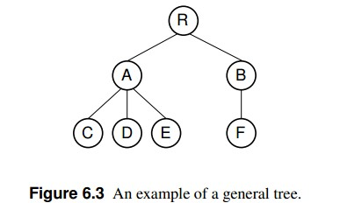
General Tree Traversals
preorder traversal : RACDEBF.
postorder : CDEAFBR.

Slide 22
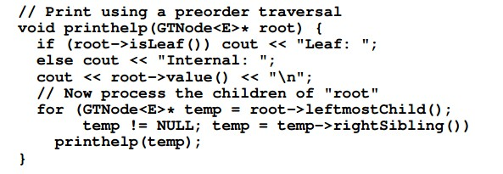
General Tree Traversals

Slide 23
General Tree Implementations
The simplest general tree implementation is to store for each node only a pointer to that node’s parent. We will call this the parent pointer implementation.
The parent pointer implementation stores precisely the information
required to answer the following, useful question: “Given two nodes, are they in the same tree?”
To answer the question, we need only follow the series of parent pointers from each node to its respective root. If both nodes reach the same root, then they must be in the same tree. If the roots are different, then the two nodes are not in the same tree.

Slide 24
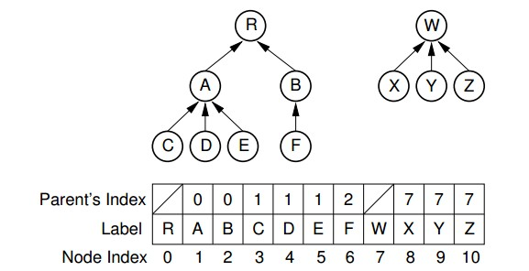
Parent Pointer Implementations
This implementation is not general purpose, because it is inadequate for such important operations as finding the leftmost child or the right sibling for a node.

Slide 25
List of Children Implementations
It simply stores with each internal node a linked list of its children.
Each node contains a value, a pointer (or index) to its parent, and a pointer to a linked list of the node’s children, stored in order from left to right.
Each linked list element contains a pointer to one child.
Thus, the leftmost child of a node can be found directly because it is the first element in the linked list.
However, to find the right sibling for a node is more difficult.

Slide 26
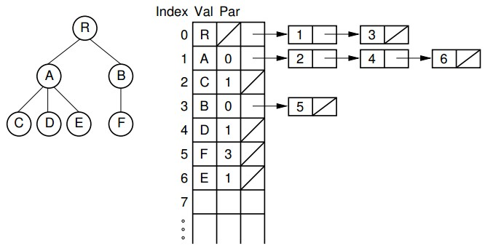
List of Children Implementations

Slide 27
Left-Child/Right-Sibling
Implementation
Each node stores its value and pointers to its parent, leftmost child, and right sibling.
Thus, each of the basic ADT operations can be implemented by reading a value directly from the node.
If two trees are stored within the same node array, then adding one as the subtree of the other simply requires setting three pointers
This implementation is more space efficient than the “list of children” implementation, and each node requires a fixed amount of space in the node array

Slide 28
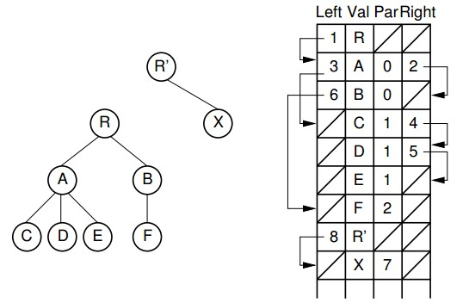
Left-Child/Right-Sibling
Implementation

Slide 29
Dynamic Node Implementations
The two general tree implementations just described use an array to store the col-lection of nodes. In contrast, our standard implementation for binary trees stores each node as a separate dynamic object containing its value and pointers to its two children.
Unfortunately, nodes of a general tree can have any number of children, and this number may change during the life of the node.
A general tree node implementation must support these properties.
One solution is simply to limit the number of children permitted for any node and allocate pointers for exactly that number of children.

Slide 30
Dynamic Node Implementations
There are two major objections to this.
  First, it places an undesirable limit on the number of children, which makes certain trees un-representable by this implementation.
  Second, this might be extremely wasteful of space because most
The alternative is to allocate variable space for each node. There are two basic approaches. One is to allocate an array of child pointers as part of the node. In essence, each node stores an array-based list of child pointers.

Slide 31
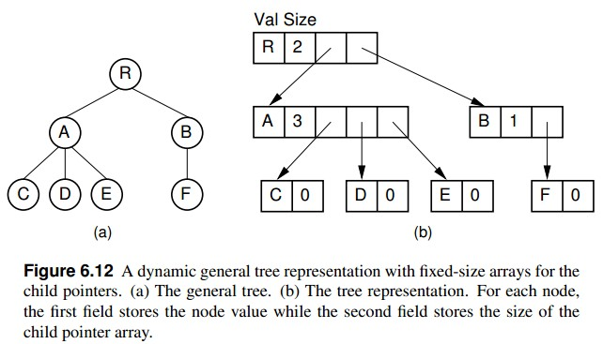
Dynamic Node Implementations

Slide 32
Dynamic Node Implementations
This approach assumes that the number of children is known when the node is created, which is true for some applications but not for others.
It also works best if the number of children does not change. If the number of children does change (especially if it increases), then some special recovery mechanism must be provided to support a change in the size of the child pointer array.
One possibility is to allocate a new node of the correct size from free store and return the old copy of the node to free store for later reuse. This works especially well in a language with built-in garbage collection such as Java.

Slide 33
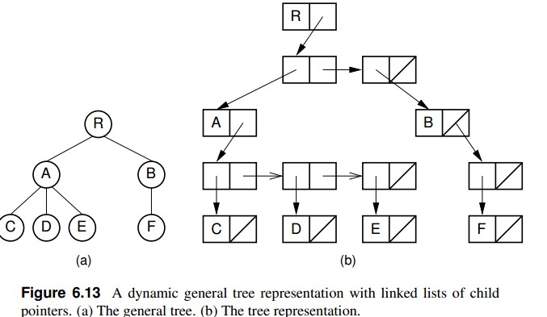
Dynamic Node Implementations

Slide 34
Sequential Tree Implementations
Sequential tree implementation stores a series of node values with the minimum information needed to reconstruct the tree structure.
This approach has the advantage of saving space because no pointers are stored. It has the disadvantage that accessing any node in the tree requires sequentially processing all nodes that appear before it in the node list. In other words, node access must start at the beginning of the node list, processing nodes sequentially in whatever order they are stored until the desired node is reached.
Thus, one primary virtue of the other implementations discussed in this section is lost: efficient access to arbitrary nodes in the tree.

Slide 35
Sequential Tree Implementations
Sequential tree implementations are ideal for archiving trees on disk for later use because they save space, and the tree structure can be reconstructed as needed for later processing.
Sequential tree implementations can be used to serialize a tree structure.
Serialization is the process of storing an object as a series of bytes, typically so that the data structure can be transmitted between computers.
This capability is important when using data structures in a distributed processing environment.

Slide 36
Converting forest to binary tree
The “left-child/right-sibling” implementation stores a fixed number
of pointers with each node. This can be readily adapted to a dynamic implementation. In essence, we substitute a binary tree for a general tree. Each node of the “left-child/right-sibling” implementation points to two “children” in a new binary tree structure.
The left child of this new structure is the node’s first child in the general tree. The right child is the node’s right sibling. We can easily extend this conversion to a forest of general trees, because the roots of the trees can be considered siblings.

Slide 37
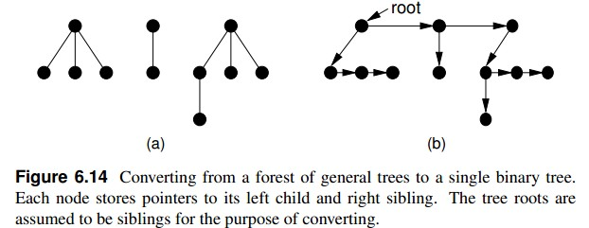
Converting forest to binary tree

Slide 38
Converting forest to binary tree
Here we simply include links from each node to its right sibling and remove links to all children except the leftmost child. Figure 6.15
shows how this might look in an implementation with two pointers at each node. The implementation of Figure 6.15 only requires two pointers per node.
The representation of Figure 6.15 is likely to be easier to implement, space efficient, and more flexible than the other implementations presented in this section.

Slide 39
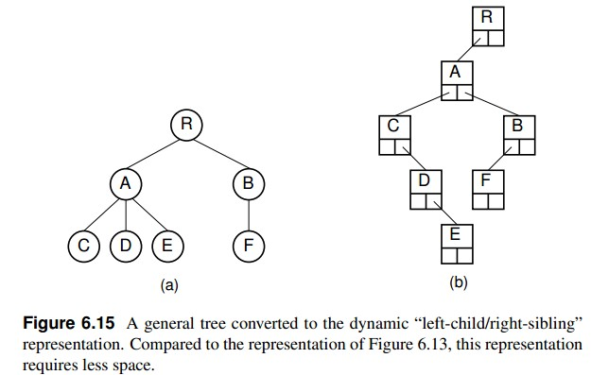
Converting forest to binary tree

Slide 40
-End-

