Slide 1
Unit 4 Singly Linked List
Notes:
课时数：2学时
1st lesson

Slide 2
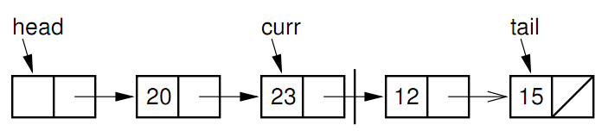
Introduction
Array
successive items locate a fixed distance
disadvantage
  data movements during insertion and deletion
  waste space in storing n ordered lists of varying size
possible solution
  linked list

Slide 3
Linked List
A linked list is made up of a series of objects, called the nodes of the list.
The linked list uses dynamic memory allocation

Slide 4
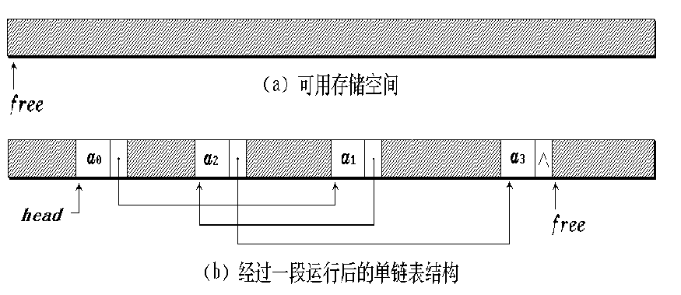
Singly linked list storage mapping

Slide 5
Liear list (ZHAO,QIAN,SUN,LI,ZHOU,WU,ZHENG,WANG)
data
next
address
head
1
LI
43
7
QIAN
13
H
13
SUN
1
31
19
WANG
NULL
25
WU
37
31
ZHAO
7
37
ZHENG
19
43
ZHOU
25
H
ZHAO
QIAN
SUN
LI
ZHOU
WU
ZHENG
WANG
^

Slide 6
Singly linked Link List(one-way list)
// Singly linked list node
template <typename E> class Link {
public:
E element; // Value for this node
Link *next; // Pointer to next node in list
// Constructors
Link(const E& elemval, Link* nextval =NULL)
{ element = elemval; next = nextval; }
Link(Link* nextval =NULL) { next = nextval; }
};
node
Element next

Slide 7
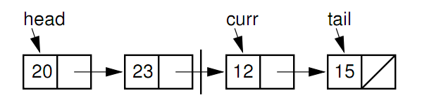
Singly linked Link List
head: a pointer point to the list’s first node.
tail: a pointer is kept to the last link of the list.
curr: a pointer indicate the current element.
cnt: the length of the list

Slide 8
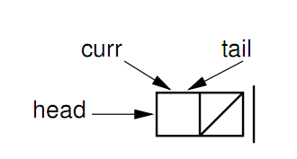
Singly linked List
header node: an additional node before the first element node of the list.
The header node saves coding effort because we no longer need to consider special cases for empty lists or when the current position is at one end of the list.

Slide 9
Linked List Class (1)
template <typename E> class LList: public List<E> {
private:
Link<E>* head; // Pointer to list header
Link<E>* tail; // Pointer to last element
Link<E>* curr; // Access to current element
int cnt; // Size of list
void init() { // Intialization helper method
curr = tail = head = new Link<E>;
cnt = 0; }

Slide 10
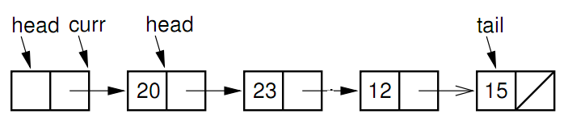
Linked List Class (2)
void removeall() { // Return link nodes to free store
while(head != NULL) {
curr = head;
head = head->next;
delete curr;
}
}

Slide 11
Linked List Class (3)
public:
LList(int size=defaultSize) { init(); } // Constructor
~LList() { removeall(); } // Destructor
void print() const; // Print list contents
void clear() { removeall(); init(); } // Clear list

Slide 12
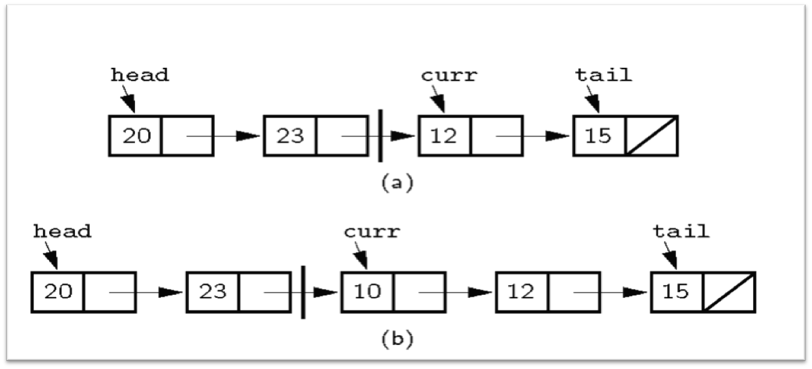
Insertion
A faulty linked-list implementation where curr points directly to the current node.
Notes:
Naïve approach: Curr points to first node in right partition. We want to insert 10 at the beginning of the right partition. No access if available to the node with value 23. How can we do the insert?

Slide 13
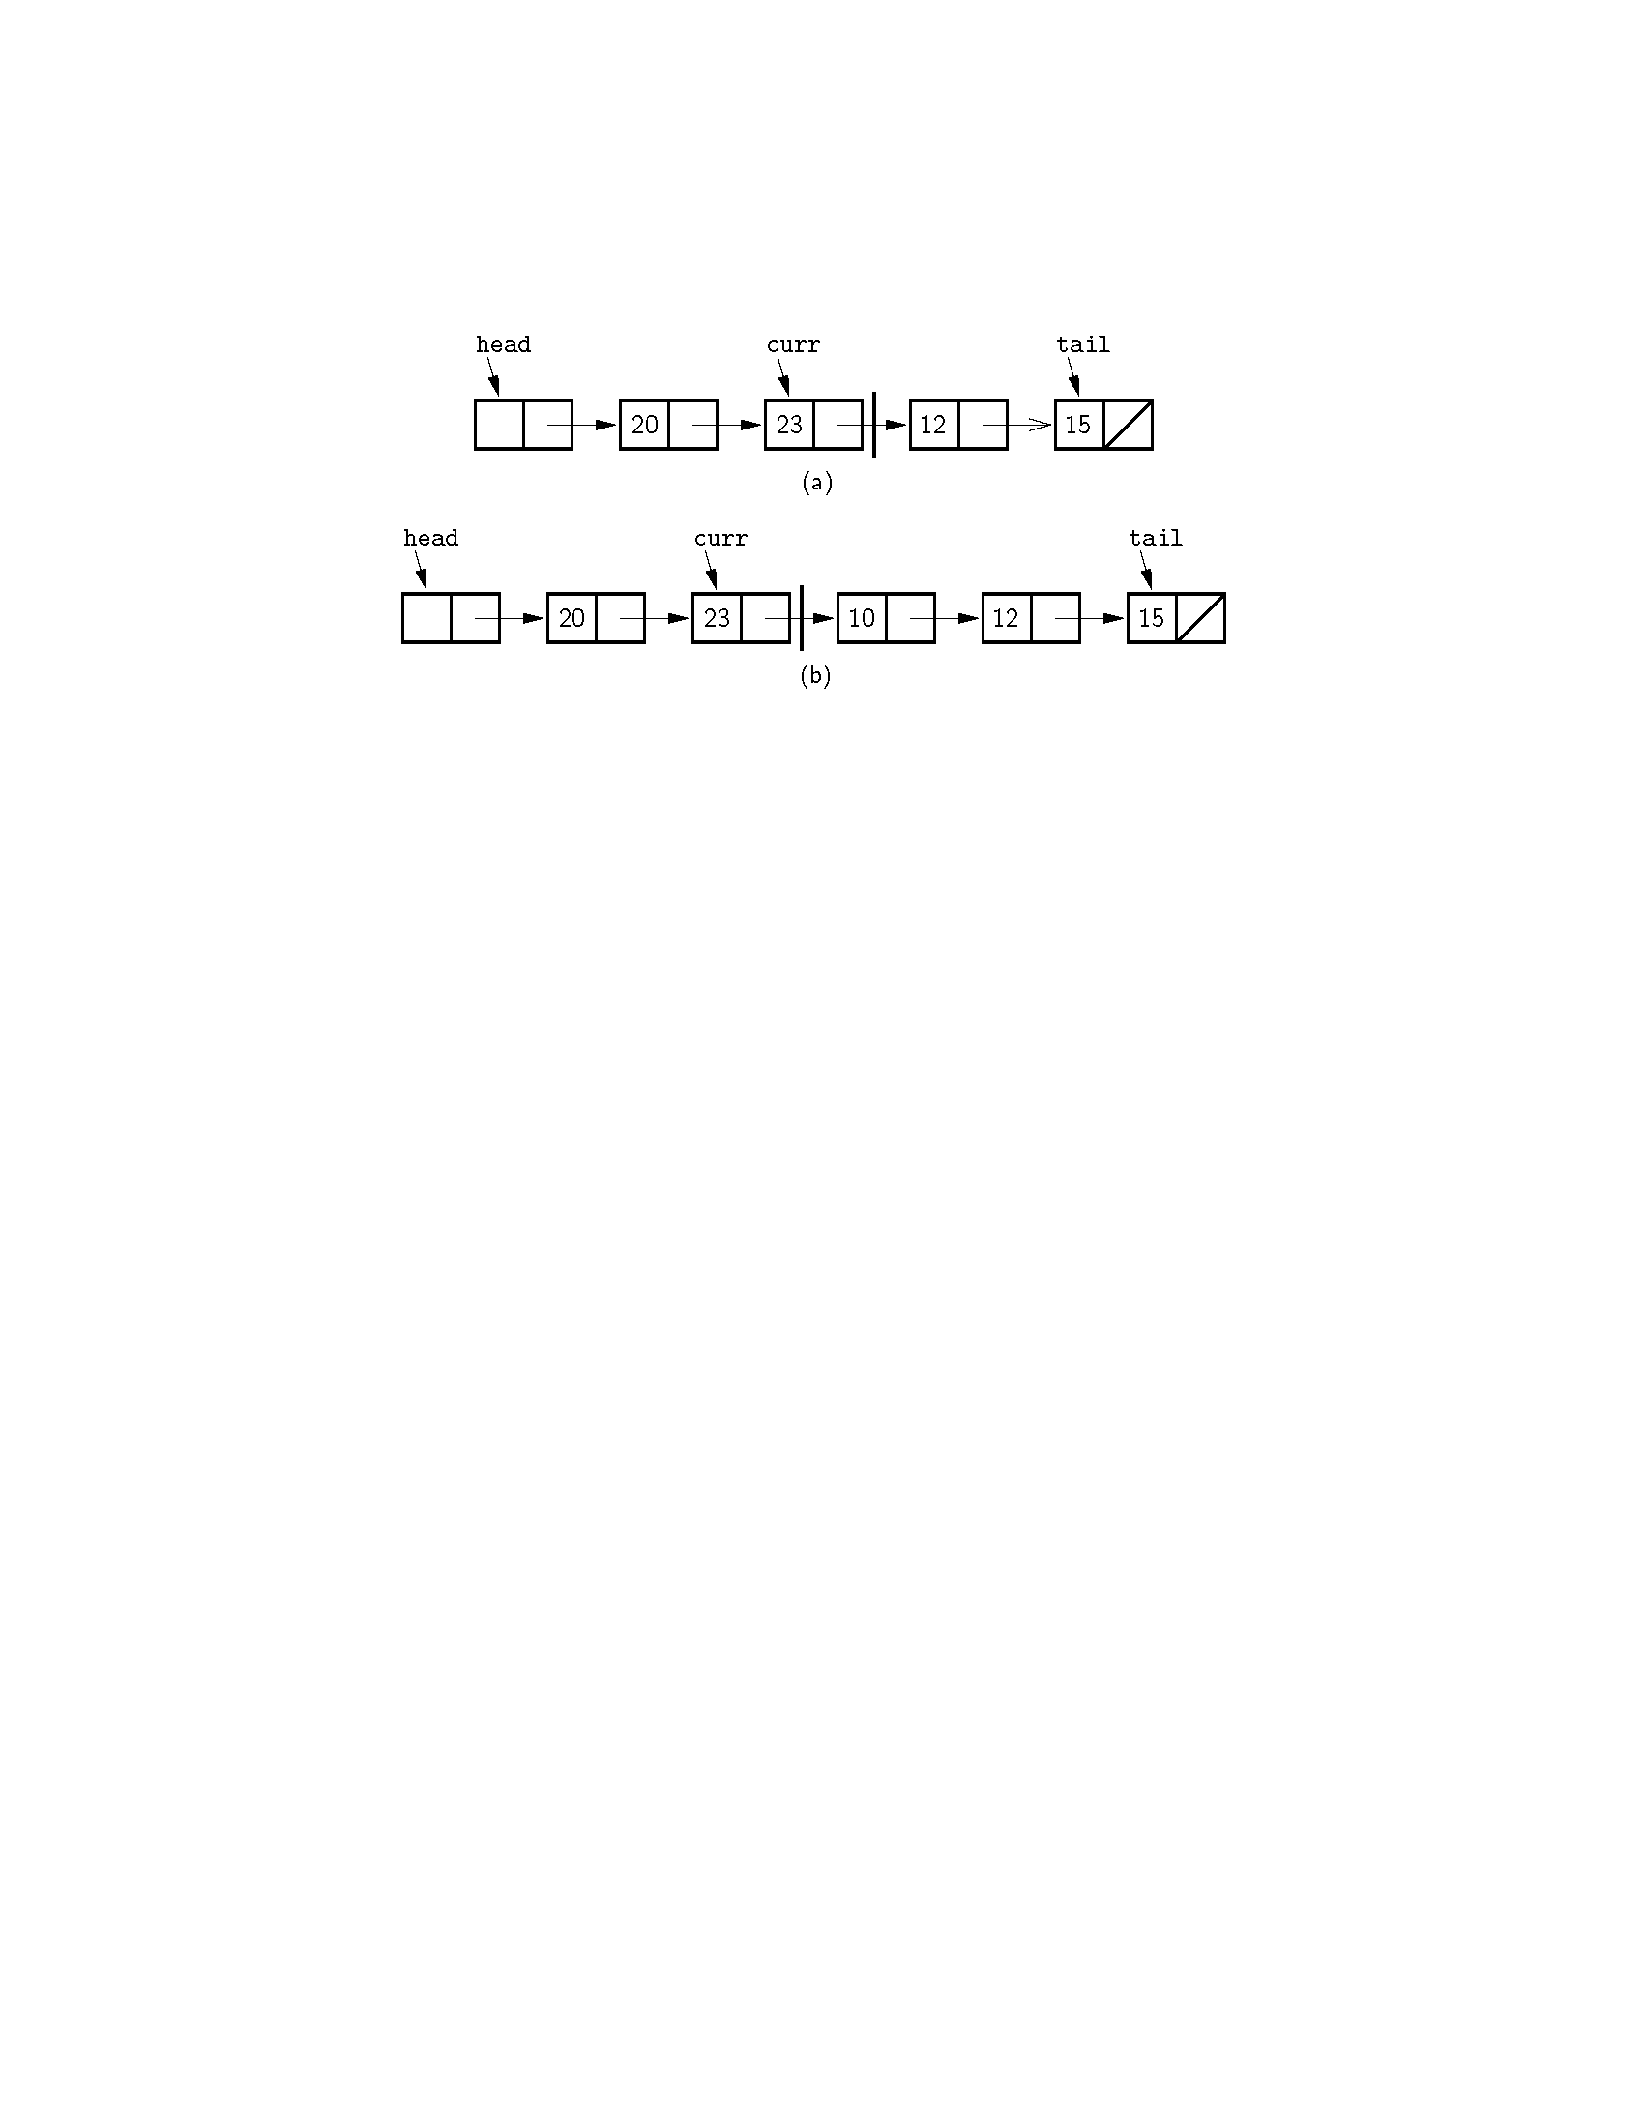
Insertion
Insertion using a header node, with curr pointing one node head of the current element.
Notes:
Alternative Implementation: Curr points to the node preceding the actual first node in the right partition. Now we can do the insert. Also note use of the header node. The header node eliminates special cases in the code.

Slide 14
Insertion
Inserting a new element is a three-step process:
First, the new list node is created and the new element is stored into it.
Second, the next ﬁeld of the new list node is assigned to point to the current node (the one after the node that curr points to).
Third, the next ﬁeld of node pointed to by curr is assigned to point to the newly inserted node.

Slide 15
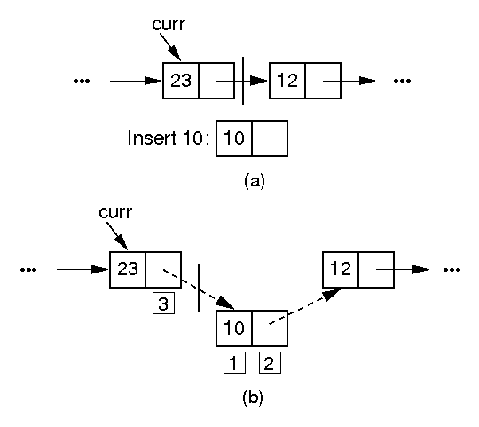
Insertion
curr->next = new Link<E>(it, curr->next);
The linked list insertion process.

Slide 16
Insertion
// Insert "it" at current position
void insert(const E& it) {
curr->next = new Link<E>(it, curr->next);
if (tail == curr) tail = curr->next; // New tail
cnt++;
}

Slide 17
Append
void append(const E& it) { // Append "it" to list
tail = tail->next = new Link<E>(it, NULL);
cnt++;
}

Slide 18
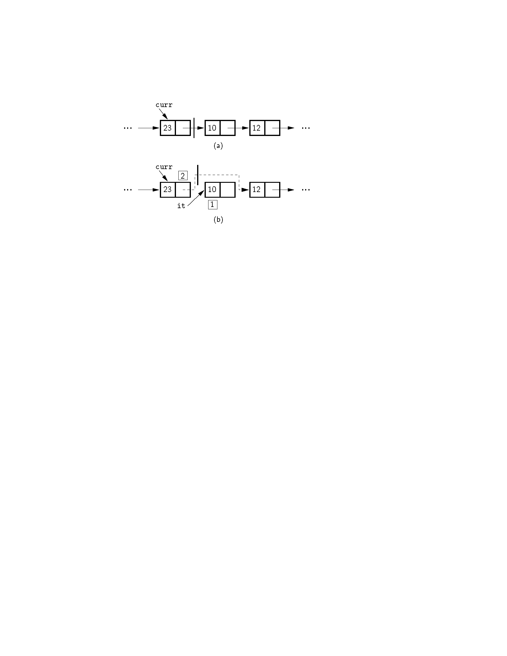
Removal
The linked list removal process.

Slide 19
Remove
// Remove and return current element
E remove() {
Assert(curr->next != NULL, "No element");
E it = curr->next->element; // Remember value
Link<E>* ltemp = curr->next; // Remember link node
if (tail == curr->next) tail = curr; // Reset tail
curr->next = curr->next->next; // Remove from list
delete ltemp; // Reclaim space
cnt--; // Decrement the count
return it;
}

Slide 20
MoveToStart & MoveToEnd
void moveToStart() // Place curr at list start
{ curr = head; }
void moveToEnd() // Place curr at list end
{ curr = tail; }

Slide 21
Prev
// Move curr one step left; no change if already at front
void prev() {
if (curr == head) return; // No previous element
Link<E>* temp = head;
// March down list until we find the previous element
while (temp->next!=curr) temp=temp->next;
curr = temp;
}

Slide 22
Next / Length
// Move curr one step right; no change if already at end
void next()
{ if (curr != tail) curr = curr->next; }
int length() const { return cnt; } // Return length

Slide 23
Get/Set Position
// Return the position of the current element
int currPos() const {
Link<E>* temp = head;
int i;
for (i=0; curr != temp; i++)
temp = temp->next;
return i;
}

Slide 24
Get/Set Position
// Move down list to "pos" position
void moveToPos(int pos) {
Assert ((pos>=0)&&(pos<=cnt), "Position out of range");
curr = head;
for(int i=0; i<pos; i++) curr = curr->next;
}

Slide 25
GetValue
const E& getValue() const { // Return current element
Assert(curr->next != NULL, "No value");
return curr->next->element;
}

Slide 26
Move
head
curr
move(1)
head
curr

Slide 27
Move
Move(pos)
head
curr
temp
Link<E>* temp = curr->next;
curr->next = temp->next;
moveToPos(pos);
temp->next = curr->next;
curr->next = temp;

Slide 28
Comparison of Implementations
Array-Based Lists:
Insertion and deletion are O(n).
Prev and direct access are O(1).
Array must be allocated in advance.
No overhead if all array positions are full.
Linked Lists:
Insertion and deletion are O(1).
Prev and direct access are O(n).
Space grows with number of elements.
Every element requires overhead.
Notes:
Applies to both average and worst cases.

Slide 29
Space Comparison
“Break-even” point:
DE = n(P + E);
n = DE
P + E
E: Space for data value.
P: Space for pointer.
D: Number of elements in array.

Slide 30
Space Example
Array-based list: Overhead is one pointer (4 bytes) per position in array – whether used or not.
Linked list: Overhead is two pointers per link node
  one to the element, one to the next link
Data is the same for both.
When is the space the same?
  When the array is half full

Slide 31
Exercise
Write a function to merge two sorted linked lists. The input lists have their elements in sorted order, from lowest to highest. The output list should also be sorted from lowest to highest. Your algorithm should run in linear time on the length of the output list.

Slide 32
Exercise
void merge(LList<int> *p1,LList<int> *p2)
{
p1->moveToStart();
p2->moveToStart();
while((p1->currPos()!=p1->length())&&(p2->currPos()!=p2->length()))
{if(p1->getValue()<p2->getValue())
p1->next();
else p1->insert(p2->remove());
}
if(p2->currPos()!=p2->length()) p1->insert(p2->remove());
}}}

Slide 33
Freelists
The C++ free-store management operators new and delete are relatively expensive to use.System new and garbage collection are slow.
Instead of making repeated calls to new and delete, the Link class can handle its own freelist.
A freelist holds those list nodes that are not currently being used.

Slide 34
Freelists
A freelist holds those list nodes that are not currently being used.
When a node is deleted from a linked list, it is placed at the head of the freelist.
When a new element is to be added to a linked list, the freelist is checked to see if a list node is available. If so, the node is taken from the freelist. If the freelist is empty, the standard new operator must then be called.

Slide 35
Approach to implement freelists
One approach would be to create two new operators to use instead of the standard free-store routines new and delete.
This requires that the user’s code, such as the linked list class implementation of Figure 4.8, be modiﬁed to call these freelist operators.

Slide 36
Approach to implement freelists
A second approach is to use C++ operator overloading to replace the meaning of new and delete when operating on Link class objects.
In this way, programs that use the LList class need not be modiﬁed at all to take advantage of a freelist. Whether the Link class is implemented with freelists, or relies on the regular free-store mechanism, is entirely hidden from the list class user.

Slide 37
Link Class Extensions
// Singly linked list node with freelist support
template <typename E> class Link {
private:
static Link<E>* freelist; // Reference to freelist head
public:
E element; // Value for this node
Link* next; // Point to next node in list

Slide 38
Implementation for the Link class with a freelist
// Constructors
Link(const E& elemval, Link* nextval =NULL)
{ element = elemval; next = nextval; }
Link(Link* nextval =NULL) { next = nextval; }

Slide 39
Implementation for the Link class with a freelist
void* operator new(size_t) { // Overloaded new operator
if (freelist == NULL) return ::new Link; // Create space
Link<E>* temp = freelist; // Can take from freelist
freelist = freelist->next;
return temp; // Return the link
}

Slide 40
Implementation for the Link class with a freelist
// Overloaded delete operator
void operator delete(void* ptr) {
((Link<E>*)ptr)->next = freelist; // Put on freelist
freelist = (Link<E>*)ptr;
}
};

Slide 41
Implementation for the Link class with a freelist
// The freelist head pointer is actually created here
template <typename E>
Link<E>* Link<E>::freelist = NULL;

Slide 42
Reference
P103----P112

Slide 43
-End-

