Slide 1
Searching(2)

Slide 2
outline
Binary Search Trees (BST)
Balanced trees
  AVL tree

Slide 3
A Taxonomy of Trees
General Trees – any number of children / node
Binary Trees – max 2 children / node
  Heaps – parent < (>) children
  Binary Search Trees

Slide 4


BST：Motivation
Binary search For sorted array search
  search： ，fast
  insertion ： on average，slow
    once the proper location for the new record in the sorted list has been found, many records might be shifted to make room for the new record.
Is there some way to organize a collection of records so that inserting records and searching for records can both be done quickly?

Slide 5
Binary Search Trees
Binary search tree (BST)
  Every element has a unique key.
  The keys in a nonempty left subtree (right subtree) are smaller (larger) than the key in the root of subtree.
  The left and right subtrees are also binary search trees.
if the BST nodes are printed using an inorder traversal, the resulting enumeration will be in sorted order from lowest to highest.

Slide 6
Binary Search Trees
Binary Search Trees (BST) are a type of Binary Trees with a special organization of data.
This data organization leads to complexity for searches, insertions and deletions in certain types of the BST (balanced trees).
  O(h) in general

Slide 7
Binary Search Algorithm
Binary Search algorithm of an array of sorted items reduces the search space by one half after each comparison
34
41
56
63
72
89
95
0 1 2 3 4 5 6
34
41
56
72
89
95
0 1 2
4 5 6
72
95
34
56
4 6
0 2

Slide 8
Organization Rule for BST
the values in all nodes in the left subtree of a node are less than
the node value
the values in all nodes in the right subtree of a node are greater
than the node values
63
41
89
72
95
34
56

Slide 9
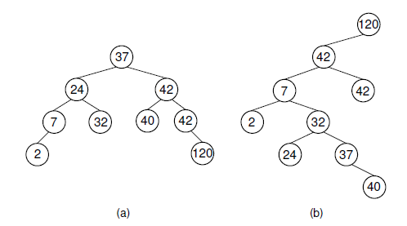
BST Example
The shape of a BST depends on the order in which elements are inserted.
Notes:
The shape of a BST depends on the order in which elements are inserted.
A new element is added to the BST as a new leaf node, potentially increasing the depth of the tree.
It is possible for the BST containing n nodes to be a chain of nodes with height n.
In general, it is preferable for a BST to be as shallow as possible. This keeps the average cost of a BST operation low.

Slide 10
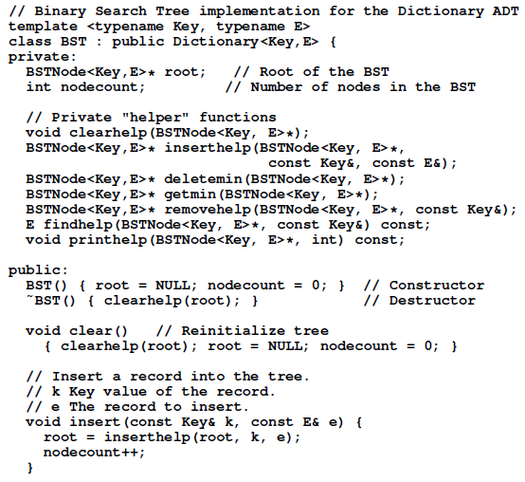
BST：Implementation

Slide 11
BST Operations: Insertion
method insert(key)
places a new item near the frontier of the BST while retaining its organization of data:
  starting at the root it probes down the tree till it finds a node whose left or right pointer is empty and is a logical place for the new value
  uses a binary search to locate the insertion point
  is based on comparisons of the new item and values of nodes in the BST
    Elements in nodes must be comparable!

Slide 12
Insertion in BST - Example
Case 1: The Tree is Empty
Set the root to a new node containing the item
Case 2: The Tree is Not Empty
Call a recursive helper method to insert the item
10 > 7
10 > 9
10
7
5
9
4
6
8
10

Slide 13
Insertion in BST - Pseudocode
if tree is empty
create a root node with the new key
else
compare key with the top node
if key = node key
replace the node with the new value
else if key > node key
compare key with the right subtree:
if subtree is empty create a leaf node
else add key in right subtree
else key < node key
compare key with the left subtree:
if the subtree is empty create a leaf node
else add key to the left subtree

Slide 14
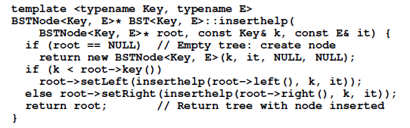
BST: Insertion

Slide 15
BST Operations: Search
Searching in the BST
method search(key)
implements the binary search based on comparison of the items in the tree
the items in the BST must be comparable (e.g integers, string, etc.)
The search starts at the root. It probes down, comparing the values in each node with the target, till it finds the first item equal to the target. Returns this item or null if there is none.

Slide 16
Search in BST - Pseudocode
if the tree is empty
return NULL
else if the item in the node equals the target
return the node value
else if the item in the node is greater than the target return the result of searching the left subtree
else if the item in the node is smaller than the target return the result of searching the right subtree

Slide 17
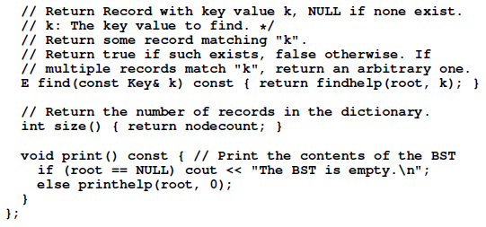
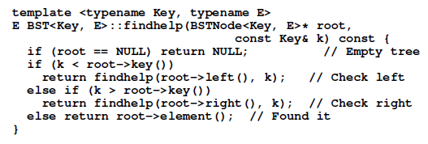
Search in BST - implementation

Slide 18

Search in BST - Example
Search for 35，95
50
50
30
80
30
80
20
40
90
20
40
90
35
85
35
85
32
88
32
88

Slide 19
BST Operations: Removal
removes a specified item from the BST and adjusts the tree
uses a binary search to locate the target item:
  starting at the root it probes down the tree till it finds the target or reaches a leaf node (target not in the tree)
removal of a node must not leave a ‘gap’ in the tree,

Slide 20
Removal in BST - Pseudocode
method remove (key)
I if the tree is empty return false
II Attempt to locate the node containing the target using the binary search algorithm
if the target is not found return false
else the target is found, so remove its node:
Case 1: if the node has 2 empty subtrees
replace the link in the parent with null
Case 2: if the node has a left and a right subtree
- replace the node‘s value with the max value in the left subtree
- delete the max node in the left subtree

Slide 21
Removal in BST - Pseudocode
Case 3: if the node has no left child
- link the parent of the node
to the right (non-empty) subtree
Case 4: if the node has no right child
- link the parent of the target
to the left (non-empty) subtree

Slide 22
Removal in BST: Example
Case 1: removing a node with 2 EMPTY SUBTREES
parent
7
cursor
5
9
4
6
8
10
7
Removing 4
replace the link in the parent with null
5
9
6
8
10

Slide 23
Removal in BST: Example
Case 2: removing a node with 2 SUBTREES
- replace the node's value with the max value in the left subtree
- delete the max node in the left subtree
What other element
can be used as
replacement?
Removing 7
cursor
cursor
7
6
5
9
5
9
4
6
8
10
4
8
10

Slide 24
Removal in BST: Example
Case 3: removing a node with 1 EMPTY SUBTREE
the node has no left child:
link the parent of the node to the right (non-empty) subtree
parent
parent
7
7
cursor
5
9
cursor
5
9
6
8
10
6
8
10

Slide 25
Removal in BST: Example
Case 4: removing a node with 1 EMPTY SUBTREE
the node has no right child:
link the parent of the node to the left (non-empty) subtree
Removing 5
parent
parent
7
cursor
7
cursor
5
9
5
9
4
8
10
4
8
10

Slide 26
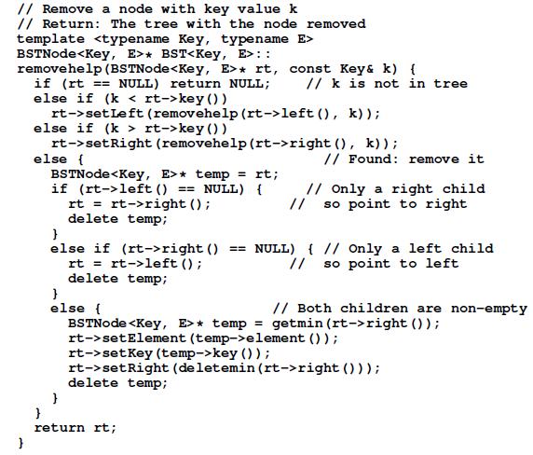
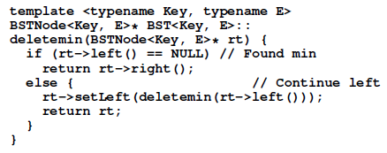
Removal in BST: implementation

Slide 27
Analysis of BST Operations
The complexity of operations get, insert and remove in BST is (h) , where h is the height.
when the tree is balanced. The updating operations cause the tree to become unbalanced.
The tree can degenerate to a linear shape and the operations will become

Slide 28
Balanced Trees
BST has a high risk of becoming unbalanced, resulting in excessively expensive search and update operations.
Solutions :
to adopt another search tree structure such as the 2-3 tree or the binary trie.
to modify the BST access functions in some way to guarantee that the tree performs well.
  requiring that the BST always be in the shape of a complete binary tree requires excessive modification to the tree during update
If we are willing to weaken the balance requirements, we can come up with alternative update routines that perform well both in terms of cost for the update and in balance for the resulting tree structure, e.g., the AVL tree.

Slide 29

The AVL tree
The AVL tree (named for its inventors Adelson-Velskii and Landis) : a BST with the following additional property:
  For every node, the heights of its left and right subtrees differ by at most 1.
if a AVL tree contains n nodes, then it has a depth of at most
. As a result, search for any node will cost , and if the updates can be done in time proportional to the depth of the node inserted or deleted, then updates will also cost , even in the worst case.
The key to making the AVL tree work is to alter the insert and delete routines so as to maintain the balance property.
  implement the revised update routines in time.

Slide 30
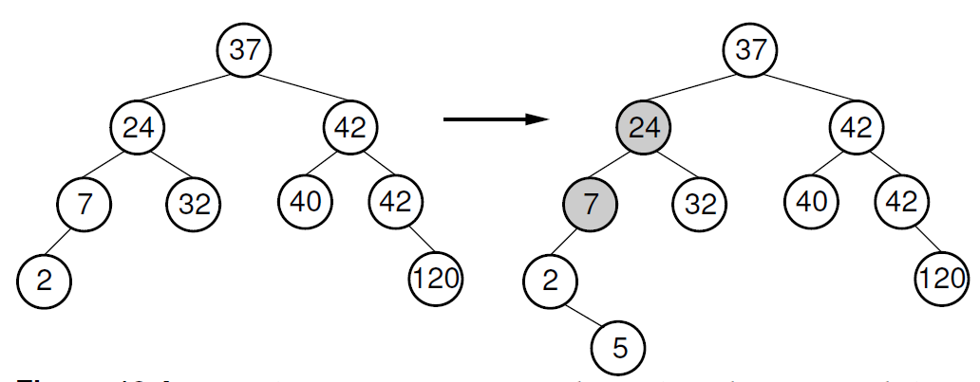
Insertion in AVL tree: Example
After inserting the node with value 5, the nodes with values 7 and 24 are no longer balanced.
For the bottommost unbalanced node, call it S, there are 4 cases:
1. The extra node is in the left child of the left child of S.
2. The extra node is in the right child of the left child of S.
3. The extra node is in the left child of the right child of S.
4. The extra node is in the right child of the right child of S.
Cases 1 and 4 are symmetrical, as are cases 2 and 3.
Note also that the unbalanced nodes must be on the path from the root to the newly inserted node

Slide 31
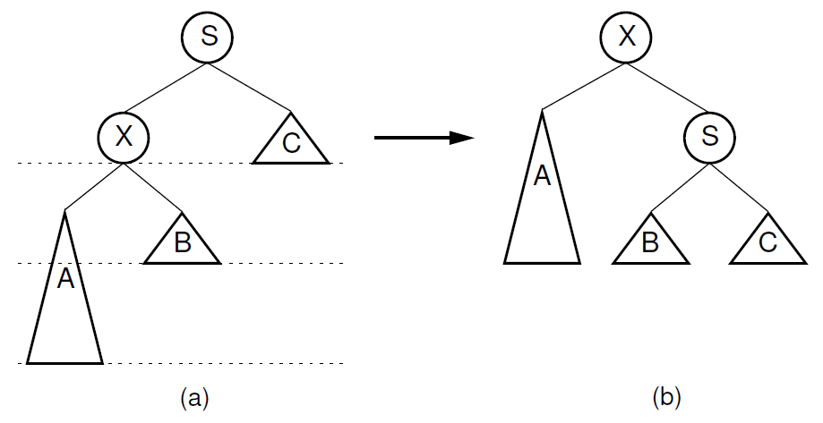
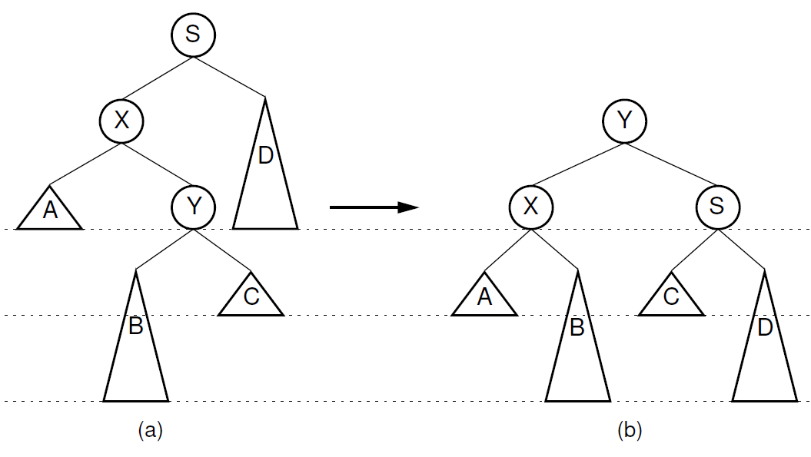
How to balance the tree in O(log n) time?
using a series of local operations known as rotations
For case 1 and case 4: single rotation
For case 2 and case 3: double rotation

Slide 32
Operations in AVL tree
Insertion algorithm:
begin with a normal BST insert
Then as the recursion unwinds up the tree, perform the appropriate rotation on any node that is found to be unbalanced.
Deletion is similar
  consideration for unbalanced nodes must begin at the level of the deletemin operation.

Slide 33
References
Data Structures and Algorithm Analysis Edition 3.2 (C++ Version)
  P.168-185
  P.442-445

