Slide 1
Sorting(3)

Slide 2
Outline
Heapsort
Binsort and Radixsort
Comparison of Sorting Algorithms

Slide 3
Heaps
A heap is a data structure that defined by two properties:
it is a complete binary tree
  its height is guaranteed to be the minimum possible. In particular, a heap containing n nodes will have a height of
the values stored in a heap are partially ordered. This means that there is a relationship between the value stored at any node and the values of its children.
There are two variants of the heap, depending on the definition of this relationship:
  MinHeap: key(parent) ≤ key(child)
  MaxHeap: key(parent) >= key(child)]
Note : there is no necessary relationship between the value of a node and that of its sibling in either the min-heap or the max-heap.

Slide 4
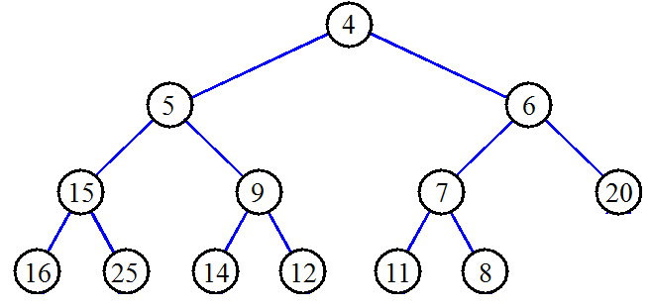
Heap : Example
Minheap

Slide 5
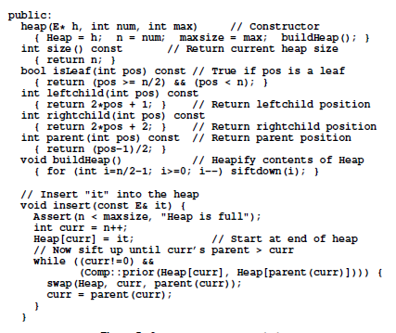
Building a heap (call insert())
insert the elements one at a time.
Each call to insert takes time in the worst case, because the value being inserted can move at most the distance from the bottom of the tree to the top of the tree.
Thus, to insert n values into the heap, if we insert them one at a time, will take time in the worst case.

Slide 6
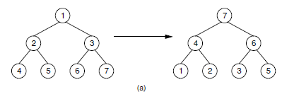
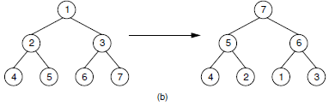
Building a heap (a faster way)
all n values are available at the beginning of the building process.
(a) This heap is built by a series of nine exchanges in the order (4-2), (4-1), (2-1), (5-2), (5-4), (6-3), (6-5), (7-5), (7-6).
(b) This heap is built by a series of four exchanges in the order(5-2), (7-3), (7-1), (6-1).
different arrangement
Same input
different heaps
How do we pick the best rearrangement?

Slide 7

A good arrangement algorithm(call siftdown())
Suppose that the left and right subtrees of the root are already heaps, and R is the name of the element at the root.
In this case there are two possibilities.
(1) Value(R) ≥Value(children) :construction is complete.
(2) Value(R) <one or both of Value( children): R should be exchanged with the child that has greater value.
  The result will be a heap, except that R might still be less than one or both of its (new) children.
  In this case, we simply continue the process of “pushing down” R until it reaches a level where it is greater than its children, or is a leaf node. This process is implemented by the private method siftdown(next slide).

Slide 8
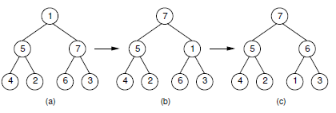
Siftdown operation
The subtrees of the root are assumed to be heaps.
The partially completed heap.
(b) Values 1 and 7 are swapped.
(c) Values 1 and 6 are swapped to form the final heap.

Slide 9
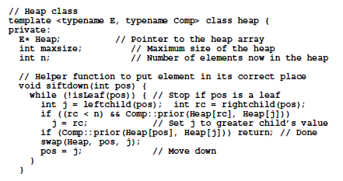
siftdown ()

Slide 10
The cost of buildHeap
Cost(buildheap)=is the sum of all cost(siftdown)
Each siftdown operation can cost at most the number of levels it takes for the node being sifted to reach the bottom of the tree.
So, this algorithm takes time in the worst case.

Slide 11
Heap removal
Removing the maximum (root) value from a heap containing n elements requires
  maintain the complete binary tree shape,
    by moving the element in the last position in the heap (the current last element in the array) to the root position.
  the remaining n-1 node values conform to the heap property.
    If the new root value is not the maximum value in the new heap, use siftdown to reorder the heap.
the cost of deleting the maximum element is in the average and worst cases, since the heap is log n levels deep,

Slide 12
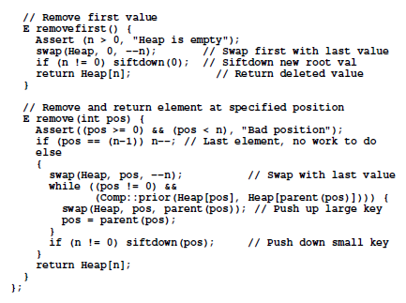
removefirst()& remove()

Slide 13
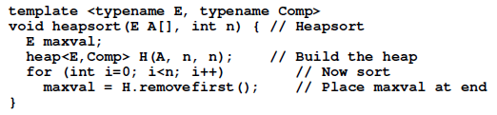

Heapsort
Cost of heapsort:
in the worst, average, and best cases.
  building the heap takes O(n) time
  n deletions of the maximum element each take (log n) time

Slide 14
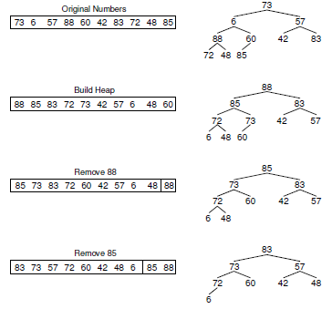
Heapsort:example
…

Slide 15


Binsort
The most basic example :
to sort a permutation of the numbers 0 through n-1,
key values are used to assign records to bins.
extremely efficient algorithm, taking time regardless of the initial ordering of the keys.
far better than the performance of any sorting algorithm that we have seen so far.
The only problem is that this algorithm has limited use because it works only for a permutation of the numbers from 0 to n-1.
Each bin contains one key value.

Slide 16
Bucket sort: A generalization to Binsort
Each bucket contains multiple key values
  Assumption: the keys are in the range [0, N)
  Basic idea:
    1. Create N linked lists (buckets) to divide interval [0,N) into subintervals of size 1
    2. Add each input element to appropriate bucket
    3. Concatenate the buckets
  Expected total time is (n + N), with n = size of original sequence
    if N is → sorting algorithm in !

Slide 17
Radix Sort
Intuitively, you might sort on the most significant digit, then the second most significant, etc.
Key idea: sort the least significant digit first
  RadixSort(A, k)
  for i=1 to k
  StableSort(A) on digit k

Slide 18


Radix Sort
What sort will we use to sort on digits?
Bucket sort is a good choice:
  Sort n numbers on digits that range from 1..N
  Time: O(n + N)
Each pass over n numbers with k digits takes time
so total time
  When d is constant and k=O(n), takes time

Slide 19
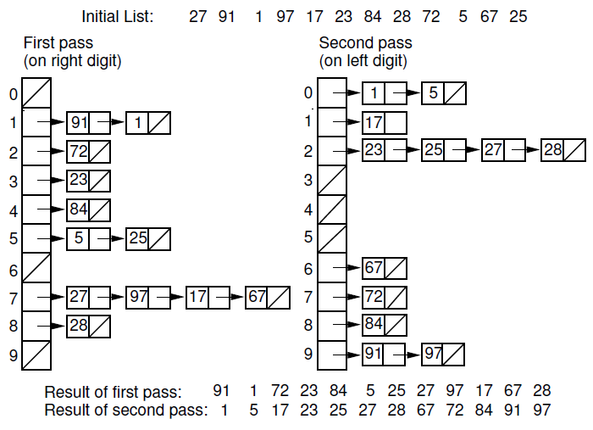
Radix Sort Example

Slide 20
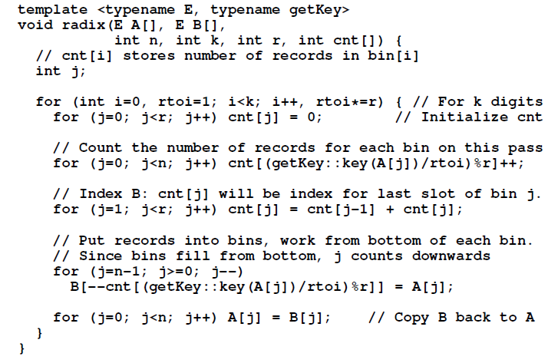
Radix Sort Implementation

Slide 21
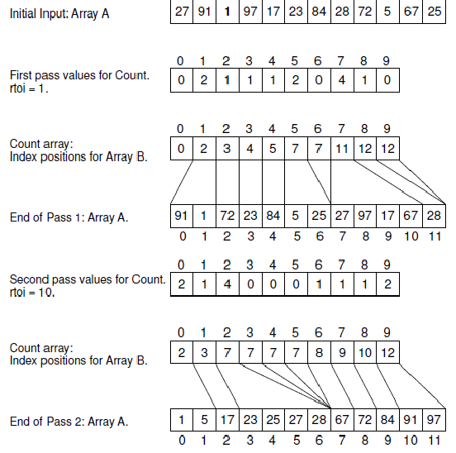
Radix()

Slide 22
Radix Sort
In general, radix sort based on bucket sort is
  Asymptotically fast (i.e. , )
  Simple to code
  A good choice

Slide 23
Comparison of Sorting Algorithms
Performance factors:
⑴Running time;
⑵Space；
⑶Stability；
⑷Simple；

Slide 24


Comparison of Running Time
Sorting Algorithms | Average | Best | Worst
Insertion sort
Shellsort
Bubblesort
Quicksort
Selection sort
Heapsort
Mergesort
Radixsort

Slide 25
Comparison of Space
Sorting Algorithms | Auxiliary space
Insertionsort | O(1)
Shellsort | O(1)
Bubblesort | O(1)
Quicksort | O(logn) ~O(n)
Selectionsort | O(1)
Heapsort | O(1)
Mergesort | O(n)
Radixsort | O(n)

Slide 26
Comparison of Stability
（1）Stable Algorithms
  Insertion sort
  Bubble sort
  Selection sort
  Merge sort
  Radix sort
（2）Unstable Algorithms:
  Shell sort
  Quick sort
  Heap sort

Slide 27
Comparison of Simpleness
（1）Simple Algorithms:
  Insertion sort
  Selection sort
  Bubble sort
  Radix sort
（2）Not simple Algorithms:
  Shell sort
  Heap sort
  Quick sort

Slide 28
References
Data Structures and Algorithm Analysis Edition 3.2 (C++ Version)
  P.178-185, 251-259

