Slide 1
Mushroom Classification
(Edible vs Poisonous) on the Secondary Mushroom Dataset
Student: Hamidreza Bahmanyar
Professor: Dr. Stefano Lodi
University of Bologna – Big Data Analytics and Text Mining
2026

Slide 2
Paper:
Wagner, D., Heider, D., & Hattab, S. (2021, April 14). Mushroom data creation, curation, and simulation to support classification tasks. Scientific Reports.
Dataset:
UCI Machine Learning Repository. Secondary Mushroom Dataset (ID 848). Available at:
https://archive.ics.uci.edu/dataset/848/secondary+mushroom+dataset

Slide 3
Problem description & motivation
Goal:
Predict whether a mushroom is edible (e) or poisonous (p) from attribute-based (tabular) descriptors.
Why a New Dataset?
The classic UCI 1987 mushroom dataset is widely used but is limited in diversity (few species/families) and can make the task appear “too easy”; the Secondary Mushroom Dataset was created to be a more realistic, broader benchmark using a reproducible workflow.

Slide 4
Dataset Overview & Key Challenges
Secondary Mushroom Dataset (UCI):
Binary target: edible (e) vs poisonous (p)
Created from a curated “primary” dataset and simulated into a larger “secondary” dataset
Reported to be not linearly separable; tree ensembles perform strongly
Key challenges:
Look-alike species: small attribute differences can change the label
Mostly categorical features: requires careful preprocessing/encoding
Non-linear interactions: effective models must capture feature interactions

Slide 5
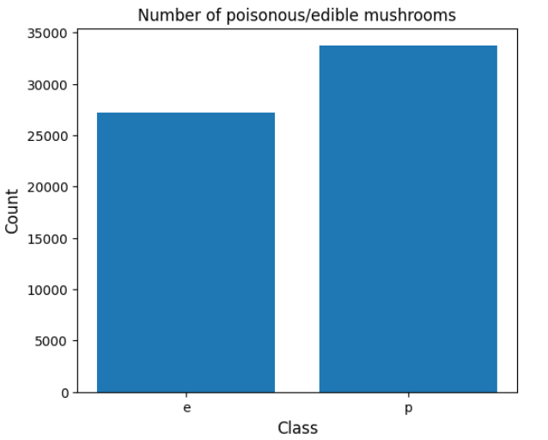
Dataset statistics:
Dataset size:
Rows: 61,069
Columns: 21
Features:
Target: class ∈ {e, p}
Numeric: cap-diameter, stem-height, stem-width
Categorical: Remaining Features
Class Balance:
edible (e): 27,181
poisonous (p): 33,742

Slide 6
Experimental Setting:
Environment:
Google Colab
Compute
CPU: 2 vCPUs (Intel Xeon @ 2.20 GHz, x86_64)
Virtualization: KVM
Memory:
VM RAM: ~12.7 GB
Peak observed usage during runs: ~3.2 GB
Tools:
PySpark / Spark ML
Numpy
Pandas
Matplotlib

Slide 7
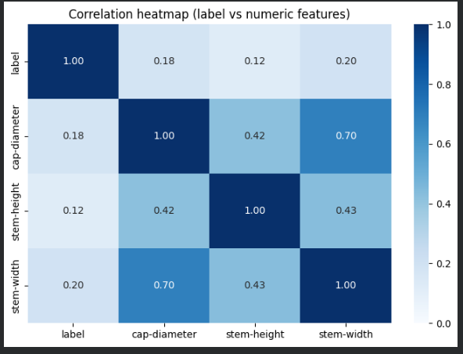
Numerical Correlation Heatmap
Correlation heatmap for label + numeric features (cap-diameter, stem-height, stem-width).
Label correlations are weak (≈0.12–0.20) → no strong linear relation with any single numeric feature.
Strongest numeric relation: cap-diameter vs stem-width ≈ 0.70.
Numeric features alone show limited direct linear association with the class, so classification likely depends on non-linear effects and categorical interactions.

Slide 8
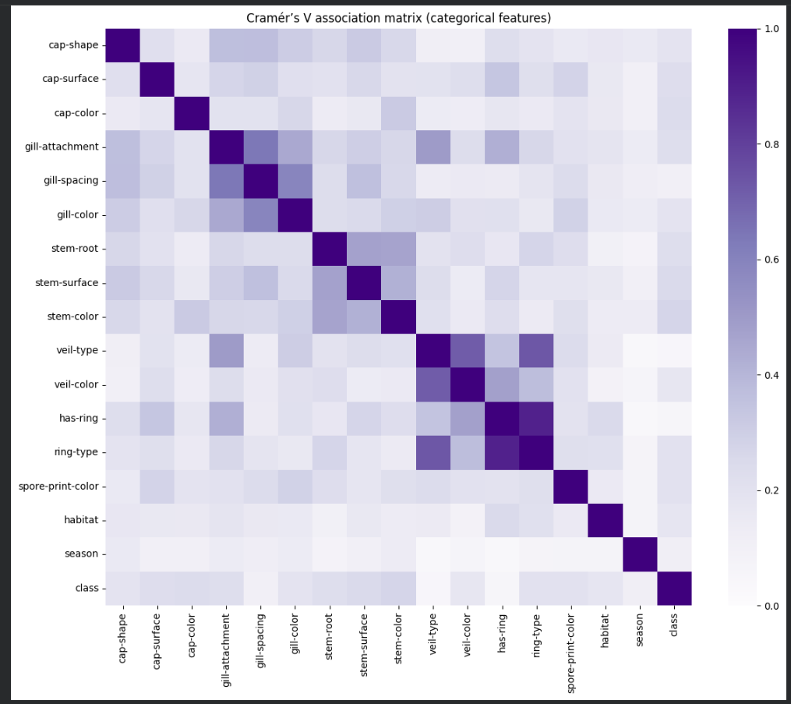
Categorical Associations (Cramér’s V)
Full pairwise Cramér’s V matrix for categorical features (0–1 association).
Clear clusters: gill features, veil-type ↔ veil-color, has-ring ↔ ring-type (strongest).
Most other pairs are weak → features provide mostly complementary information.
Most categorical pairs show weak–moderate association, but a few strong clusters exist (e.g., ring and veil features), suggesting classification benefits from models that capture non-linear feature interactions.”

Slide 9
Data preprocessing pipeline (Spark ML):
Steps:
Load secondary_data.csv (separator ;, schema inference)
Remove duplicates (found 146 duplicates, then dropped them)
Handle missing values
Encode categorical features:
  StringIndexer → OneHotEncoder
Assemble feature vector (VectorAssembler)
Train/test split (80/20)
Raw CSV
Clean
Encode
Train/Split
Assemble
Model
Metrics

Slide 10
Tree-based Models (Course Project)
Models:
Decision Tree (maxDepth=20)
Random Forest (maxDepth=12)
Gradient-Boosted Trees (maxDepth=8, maxIter=100, stepSize=0.1)
Test-set performance (from your notebook outputs):
Decision Tree: 99.792%, F1 0.99792
Random Forest: 99.250%, F1 0.99250
Gradient-Boosted Trees: 99.975%, F1 0.99975 (best)
Tree ensembles dominate → consistent with the paper’s claim that the dataset benefits from non-linear decision boundaries.

Slide 11
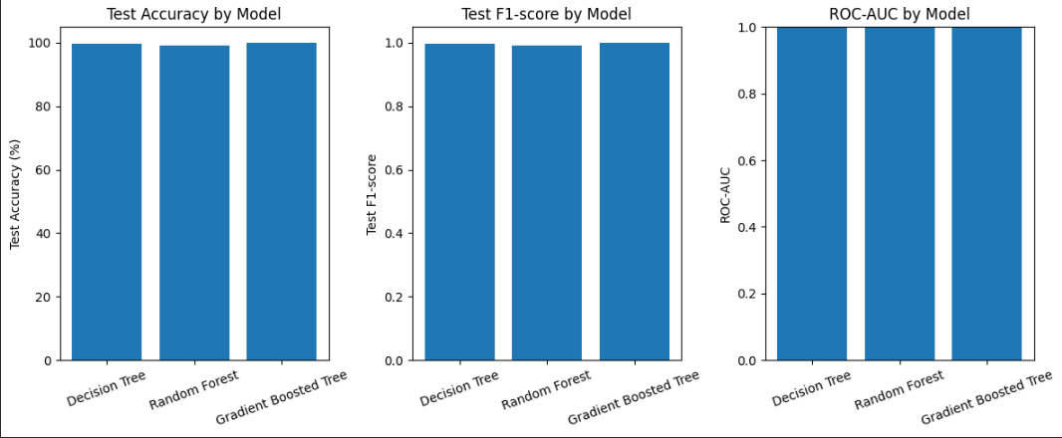
Decision Tree, Random Forest, and Gradient-Boosted Tree all achieve near-perfect test performance (Accuracy/F1 ≈ 1.0), with GBT being marginally the strongest overall.

Slide 12
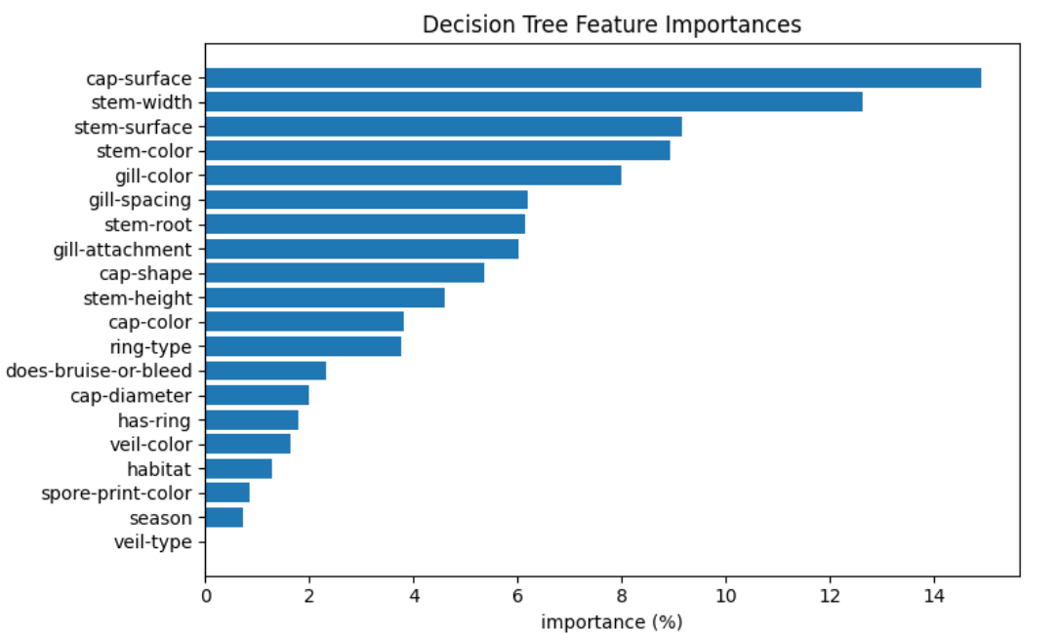
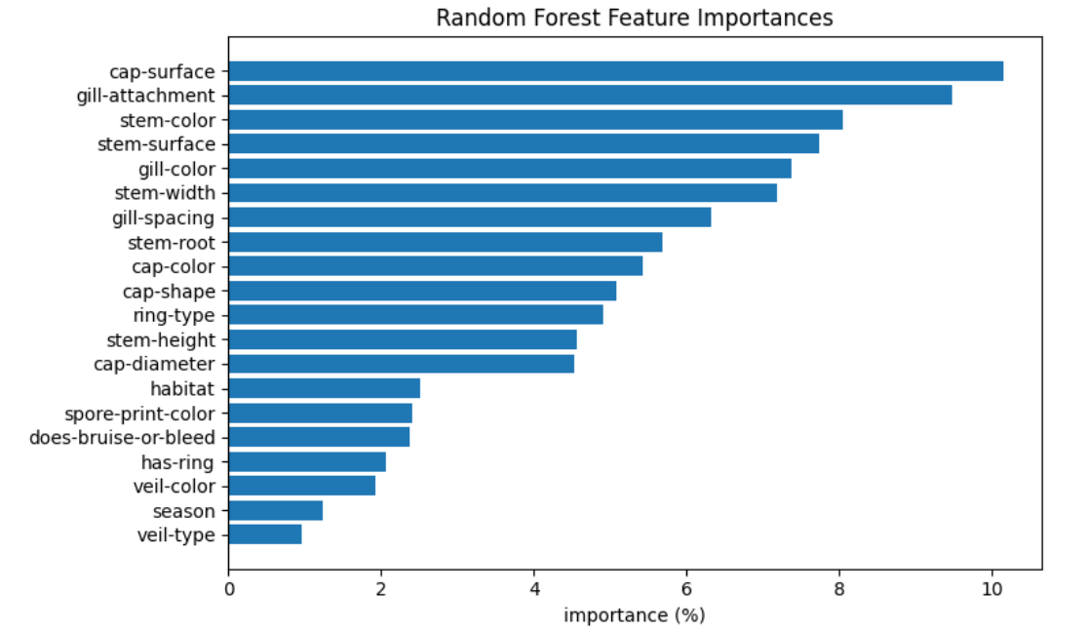
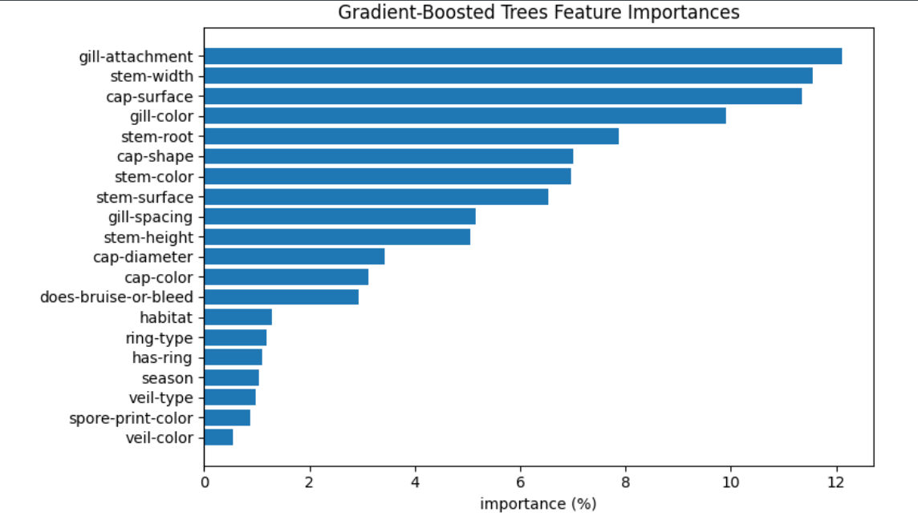
Tree Models: Feature Importances DT vs RF vs GBT
Feature importances are largely consistent across the three tree models, with cap/gill/stem-related attributes contributing most to the final decision.

Slide 13
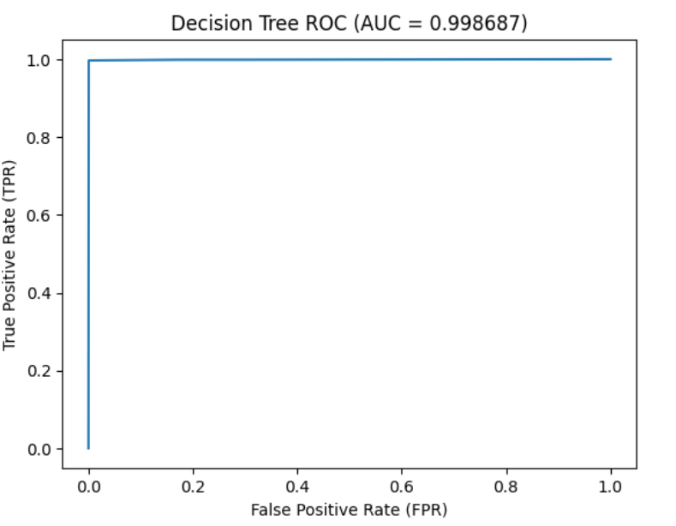
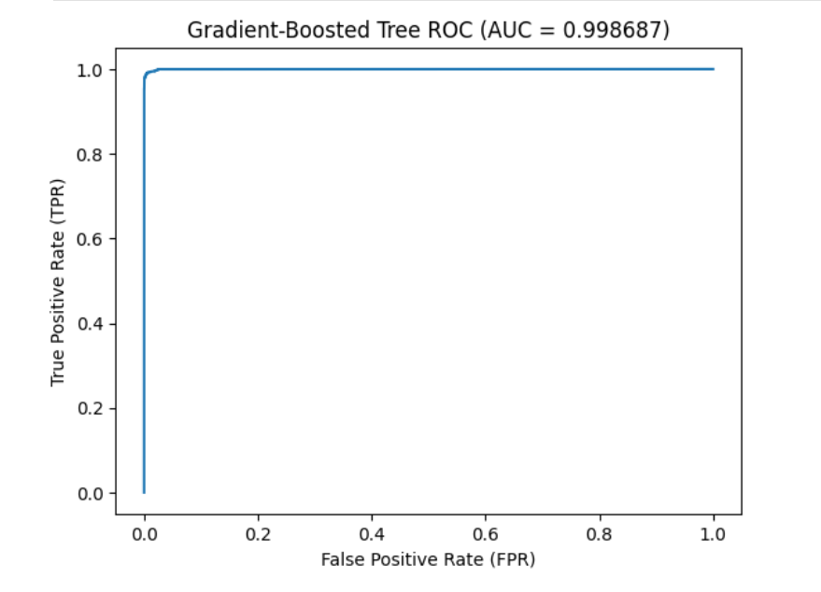
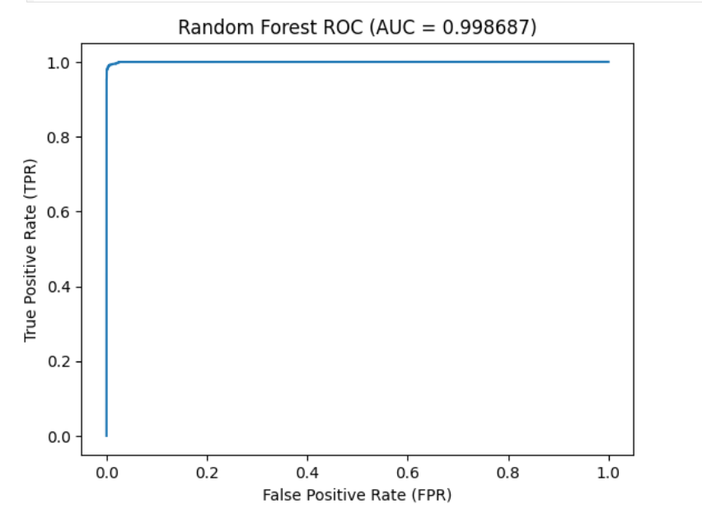
Tree Models: ROC Curves DT vs RF vs GBT
The ROC curves are essentially identical and hug the top-left corner (AUC ≈ 0.999), indicating excellent discrimination across thresholds for all three tree models.

Slide 14
Linear & Probabilistic Models (Project Work)
Models:
Logistic Regression (maxIter= 300, regParam= 0.001)
Linear SVM (maxIter= 500, regParam= 0.0001)
Naive Bayes (smoothing= 1.0)
Test-set performance (from your printed table):
Linear SVM: 88.213% accuracy, 0.88227 F1, ROC-AUC 0.929
Logistic Regression: 86.696% accuracy, 0.86709 F1, ROC-AUC 0.936
Naive Bayes: 76.050% accuracy, 0.75965 F1, ROC-AUC 0.839
Linear models perform reasonably well → consistent with the idea that a linear boundary captures part of the structure, but the remaining gap suggests important non-linear interactions.

Slide 15
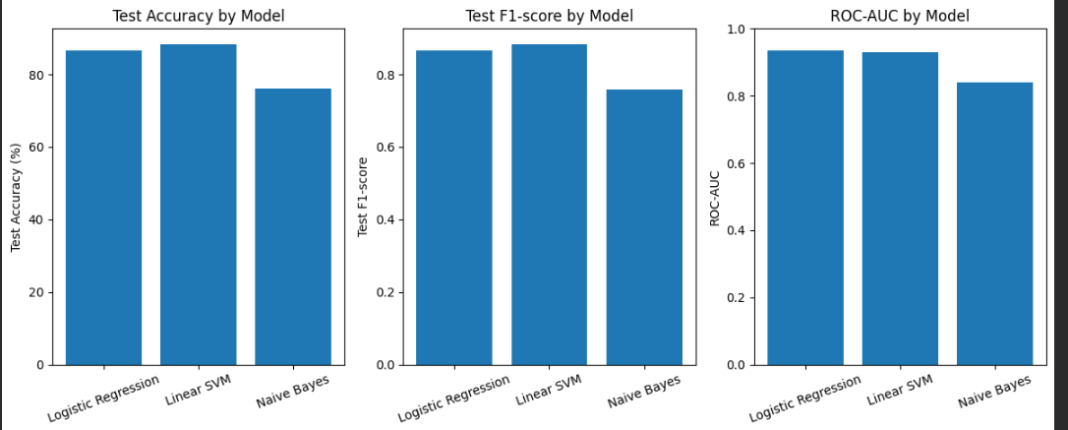
Linear SVM achieves the best Accuracy/F1, while Logistic Regression has the highest ROC–AUC; Naive Bayes is clearly weaker across all metrics.

Slide 16
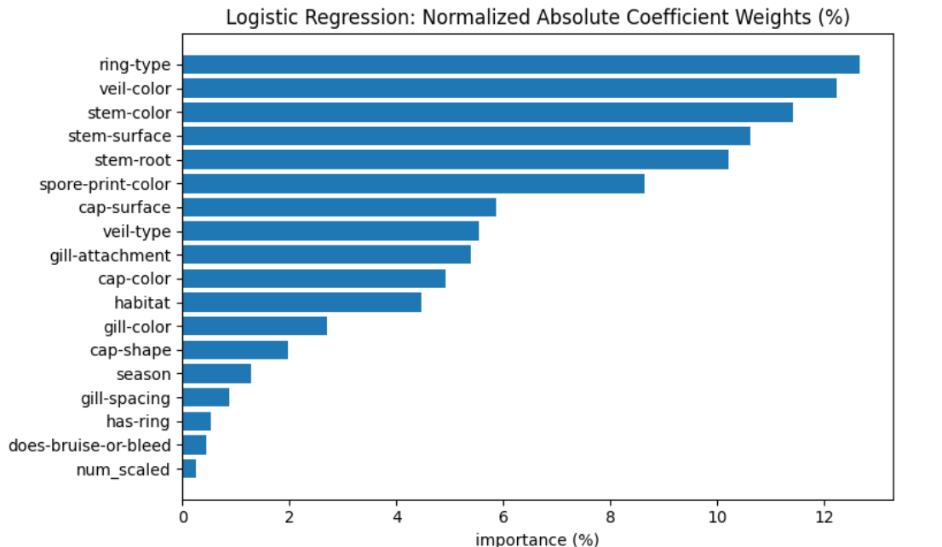
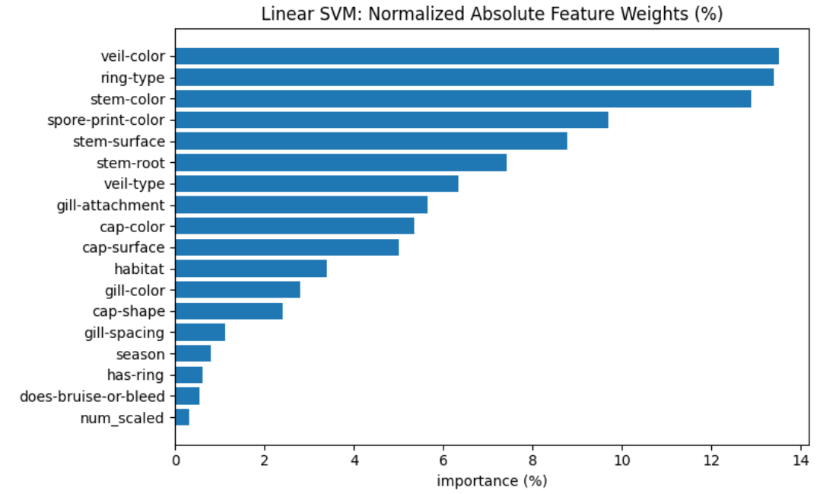
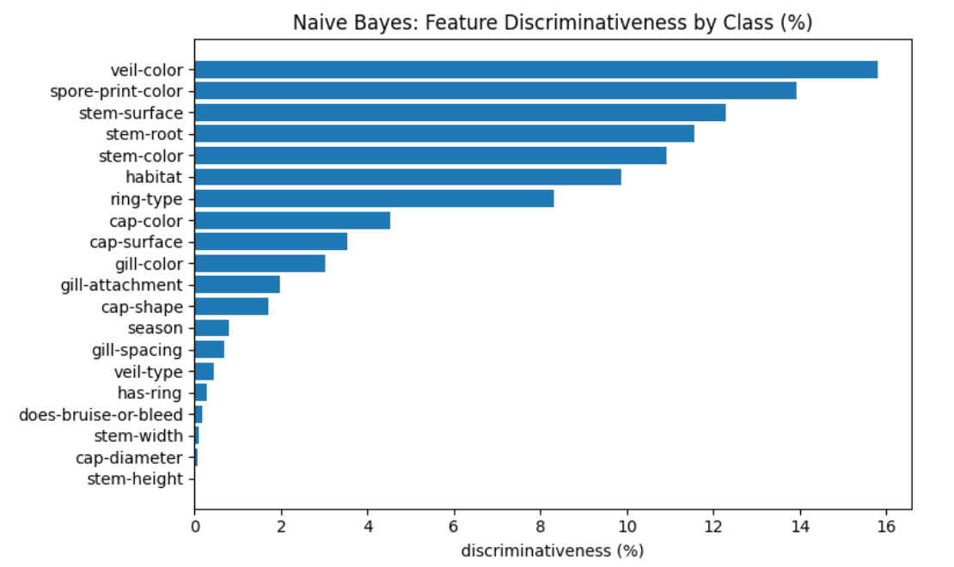
Linear & Probabilistic Models: Feature Weights LR vs Linear SVM vs Naive Bayes
Across the baseline models, the strongest signals consistently come from ring/veil, stem, and spore-print attributes, while the numeric features contribute relatively little—helping explain why linear models perform well but still trail tree ensembles

Slide 17
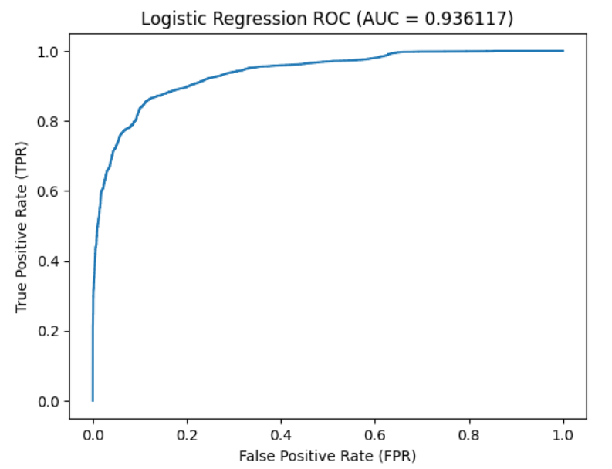
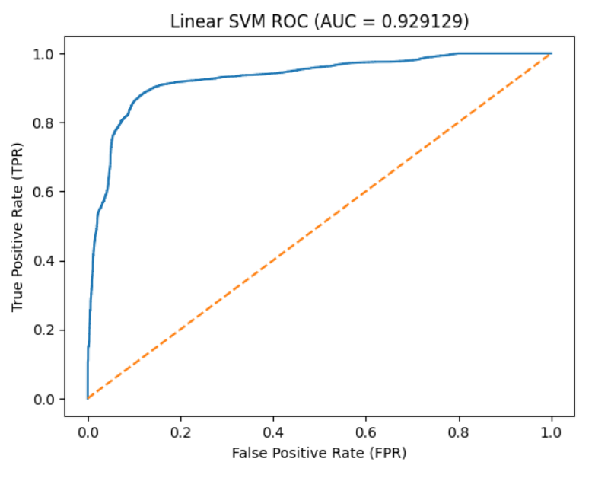
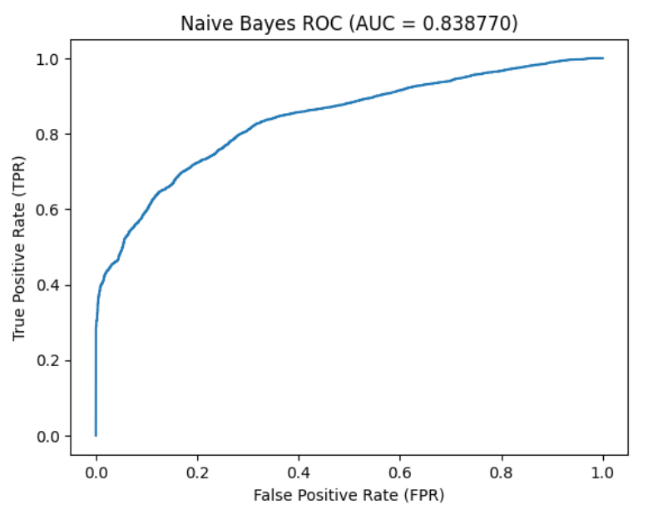
Linear & Probabilistic Models: ROC Curves (LR vs Linear SVM vs Naive Bayes)
ROC curves show that LR and Linear SVM separate the classes well across thresholds (AUC ≈ 0.93), whereas Naive Bayes is less discriminative (AUC ≈ 0.84)

Slide 18

Final discussion & conclusion
Tree-based models dominate
All tree models achieve >99% accuracy and >0.99 F1.
Best overall: GBT (99.975% accuracy, 0.99975 F1)
Next: Decision Tree (99.792%, 0.99792), Random Forest (99.250%, 0.99250).
Linear / probabilistic models (lower performance)
Linear SVM: 88.2% acc, 0.88 F1, ~0.93 ROC–AUC (best among linear).
Logistic Regression: 86.7% acc, 0.87 F1, ~0.94 ROC–AUC (slightly higher AUC than SVM).
Naive Bayes: lowest (76.1% acc, 0.76 F1, ~0.84 ROC–AUC).
Why are tree models so strong?
Non-linear interactions between many categorical attributes.
Dataset is simulated/structured in a way that can make classification very learnable.

