Slide 1
Overview of SSO Protocols
Hamza Ghariani
4/28/2023

Slide 2
01
Introduction to SSO
Brief overview of SSO and its benefits
Importance of SSO in modern-day security

Slide 3

—DEFINITION
Single Sign-On allows users to authenticate once and access multiple applications without having to re-enter credentials

Slide 4
Benefits of SSO
IMPROVED SECURITY
USER EXPERIENCE
PRODUCTIVITY

Slide 5

IMPORTANCE
As cyber attacks become more sophisticated, SSO helps organizations protect against unauthorized access to their systems.

Slide 6
02
RADIUS
Definition of RADIUS
Explanation of how RADIUS works with a client-server model
Example use cases for RADIUS in enterprise environments

Slide 7

Definition of RADIUS
Remote Authentication Dial-In User Service is a client-server protocol used to authenticate and authorize remote users

Slide 8
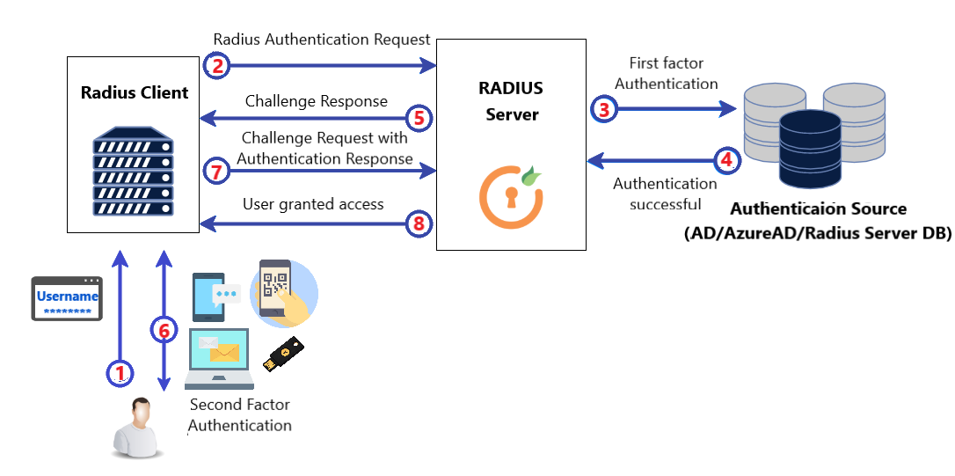
HOW IT WORKS
A user requests access to a network, and the RADIUS client sends a request to the RADIUS server, which authenticates the user and sends an accept or reject message to the client.

Slide 9
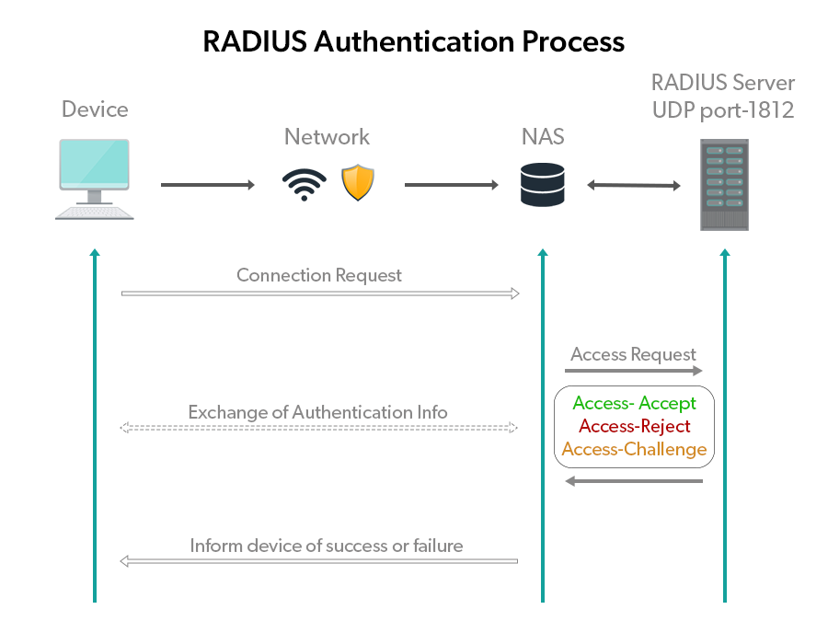
Example use case for RADIUS

Slide 10
03
TACACS+
Definition of TACACS+
Explanation of how TACACS+ separates authentication, authorization, and accounting functions
Example use cases for TACACS+ in network devices management

Slide 11
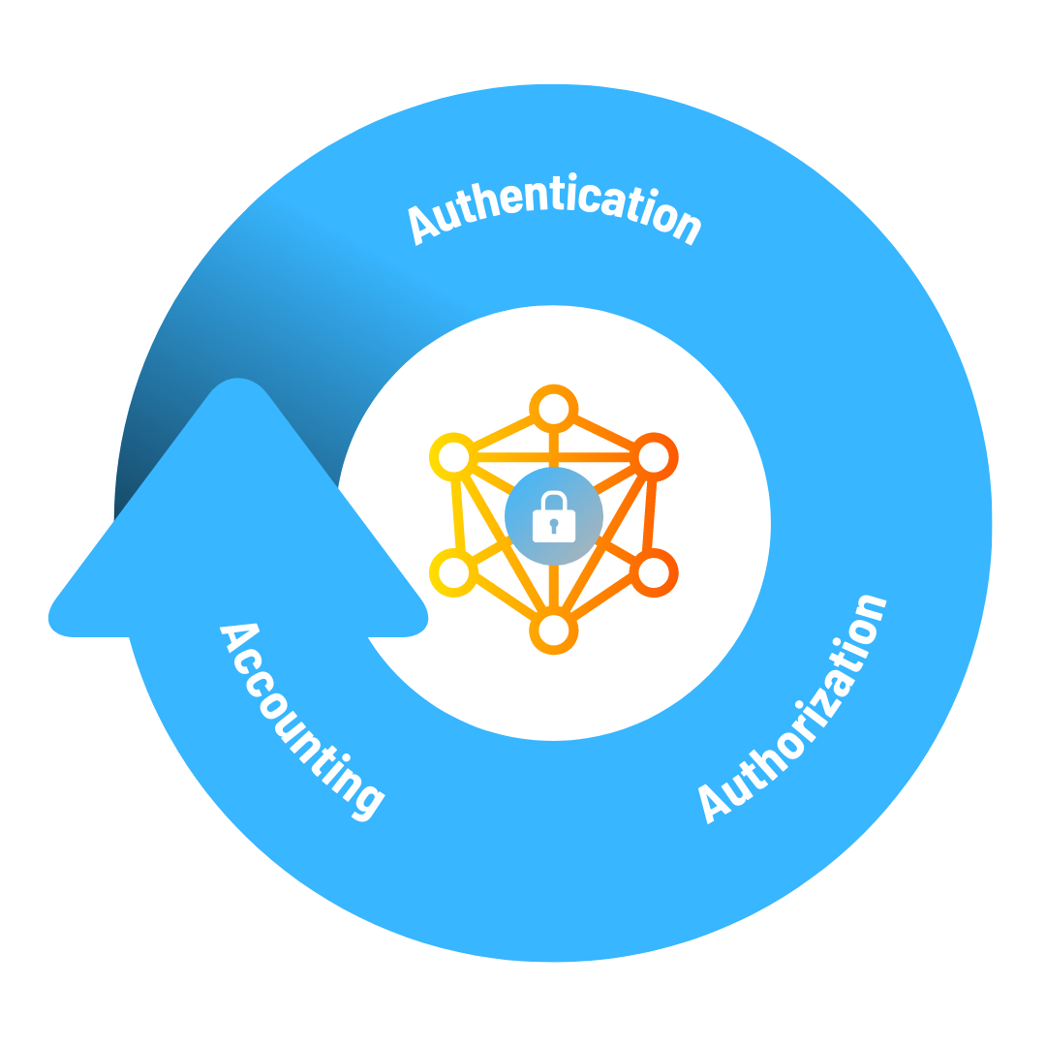
Definition of TACACS+
Terminal Access Controller Access-Control System Plus is a protocol used to authenticate and authorize network devices management

Slide 12
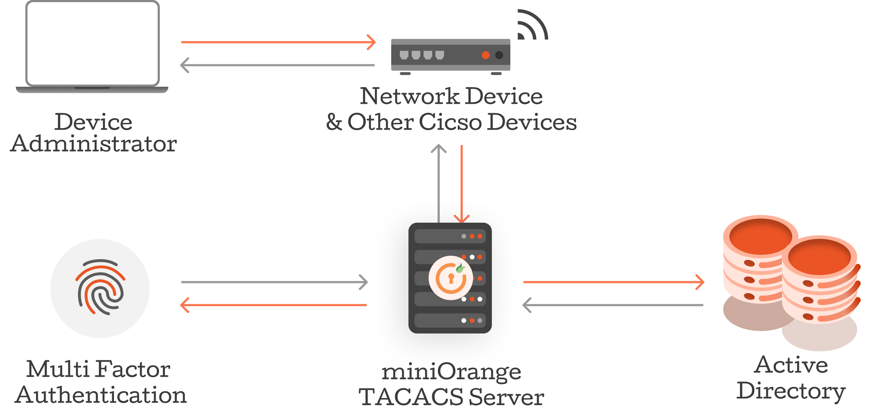
HOW IT WORKS
TACACS+ separates the three functions, allowing for granular control over who can access what resources and what actions they can perform.

Slide 13
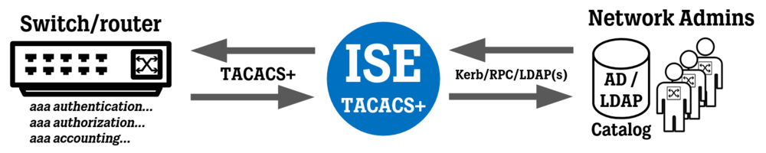
Example use case for TACACS+

Slide 14
04
KERBEROS
Definition of Kerberos
Explanation of how Kerberos uses symmetric key cryptography to provide secure authentication over a non-secure network
Example use cases for Kerberos in enterprise environments

Slide 15

Definition of Kerberos
Kerberos is a network authentication protocol that uses symmetric key cryptography to provide secure authentication over a non-secure network

Slide 16
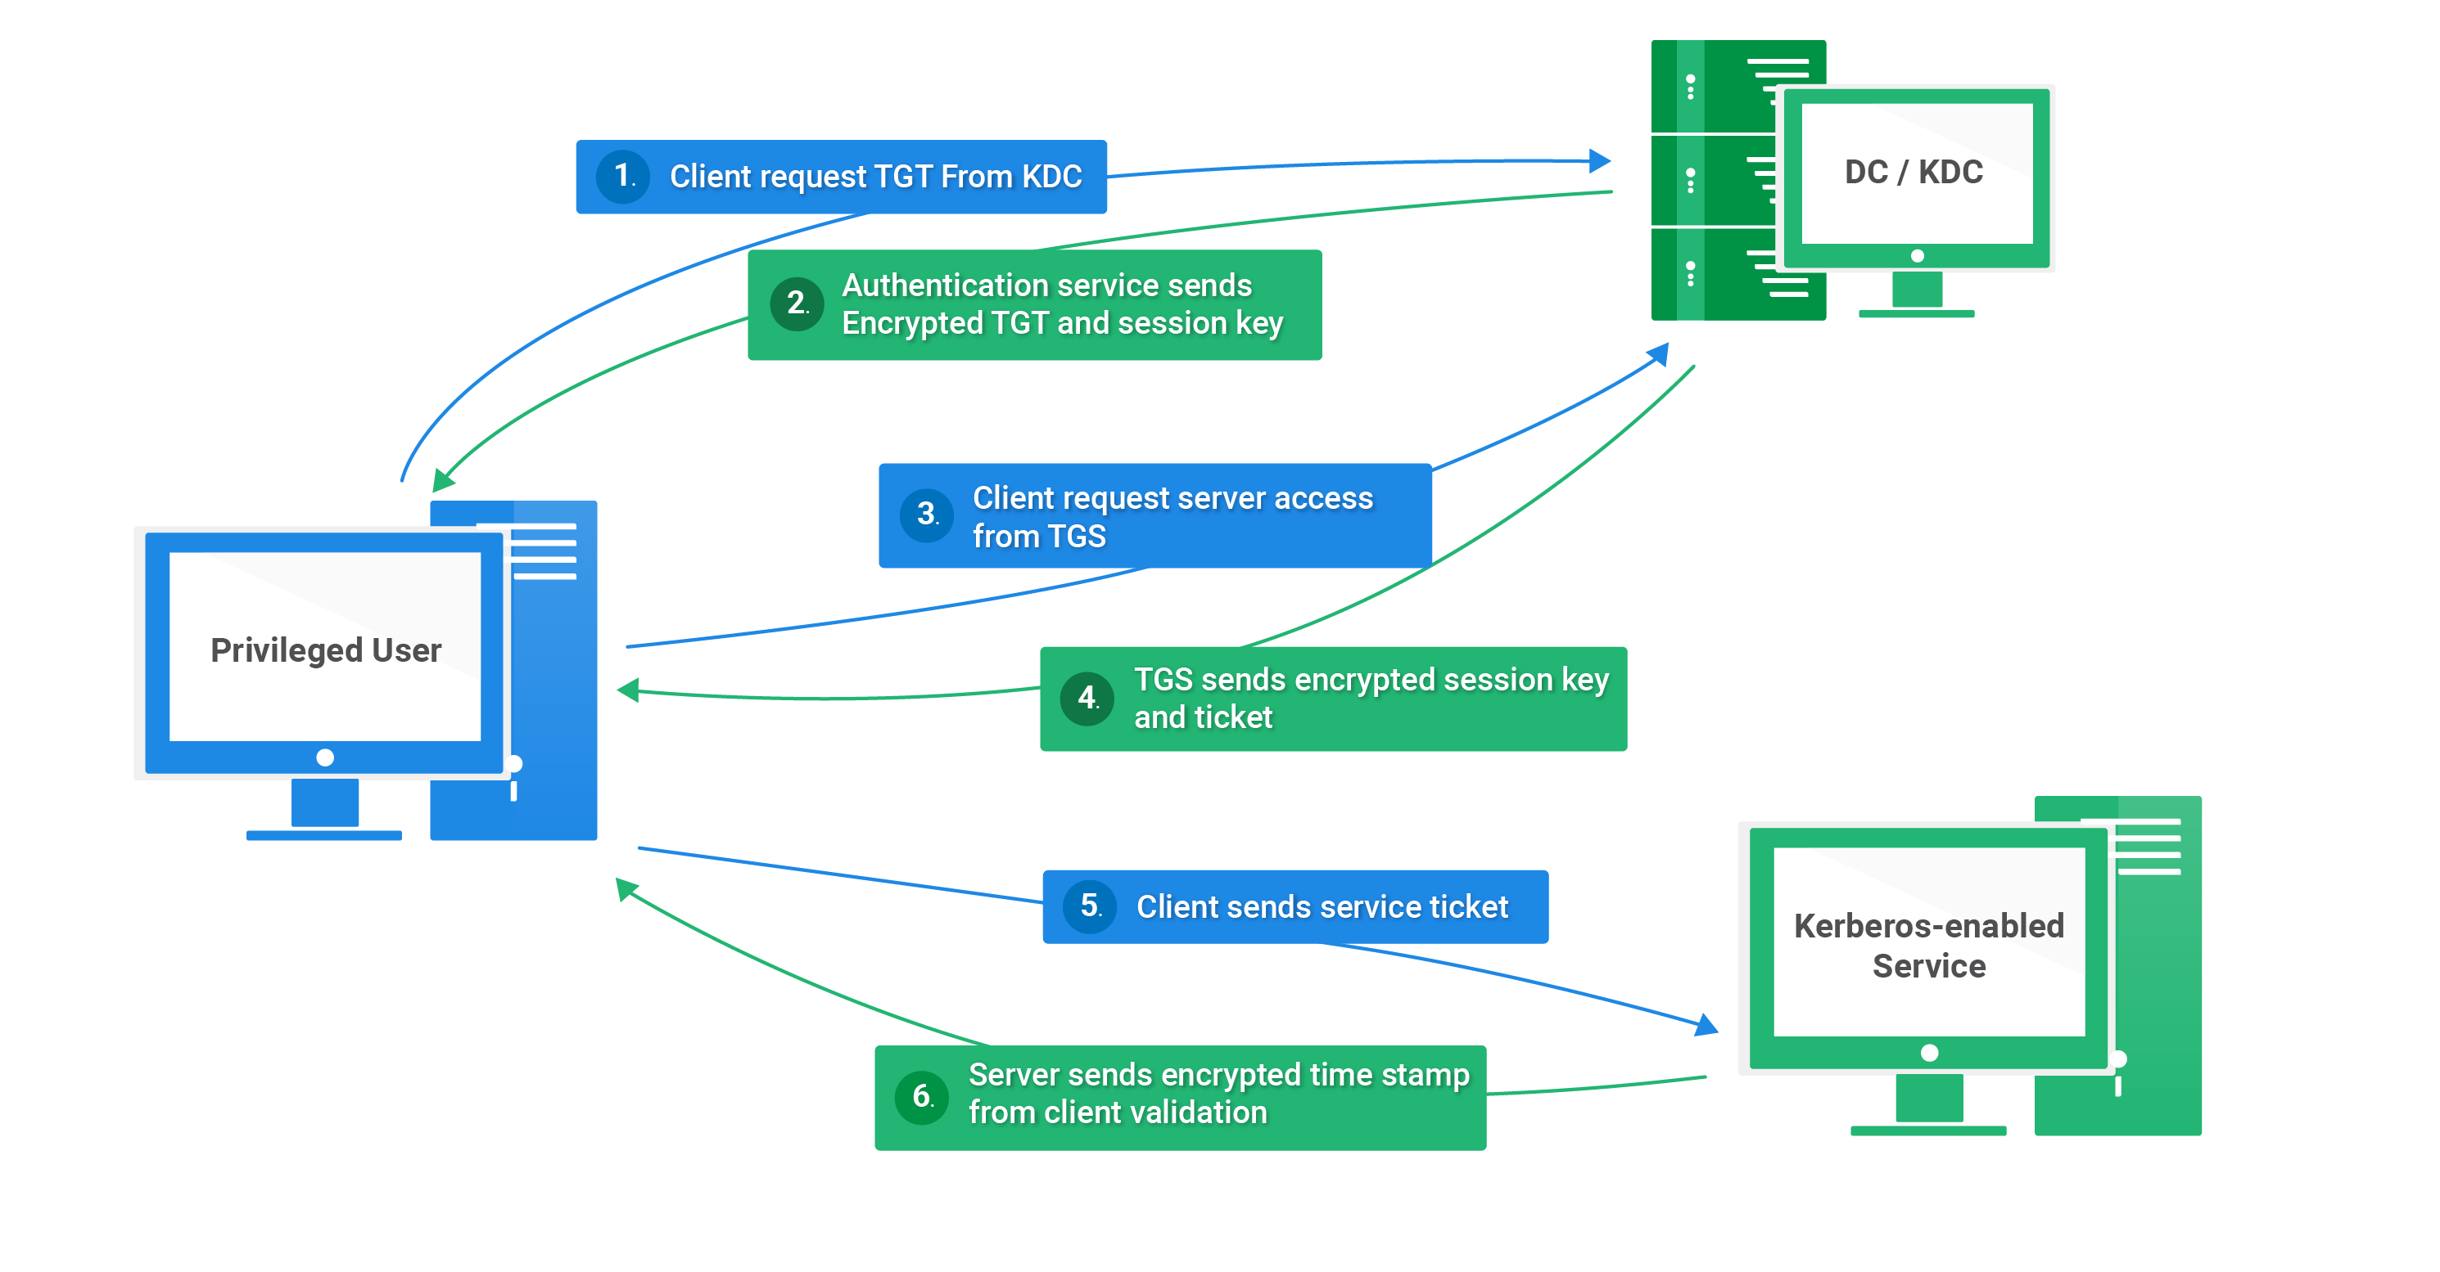
HOW IT WORKS
Kerberos uses a trusted third party, the Key Distribution Center, to generate and distribute session keys to the client and server.

Slide 17
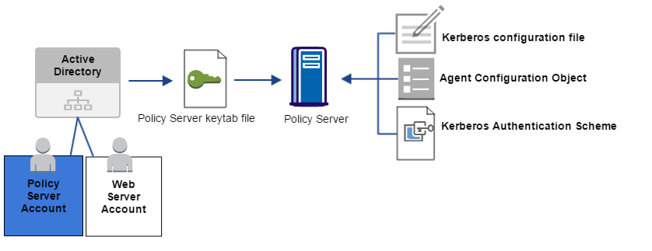
Example use case for Kerberos

Slide 18
05
WS-TRUST
Definition of WS-Trust
Explanation of how WS-Trust allows different STS to exchange security tokens
Example use cases for WS-Trust in SSO across multiple applications and services

Slide 19

Definition of WS-Trust
Web Services Trust Protocol is a protocol that allows different Security Token Services (STS) to exchange security tokens

Slide 20
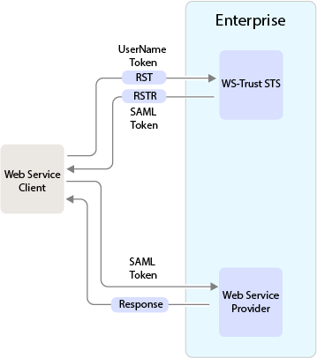
HOW IT WORKS
WS-Trust provides a framework for requesting, issuing, and validating security tokens for web services.

Slide 21
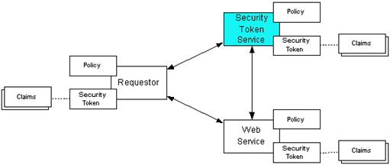
Example use case for WS-TRUST

Slide 22
06
OPENID
Definition of OpenID Connect
Explanation of how OpenID Connect provides SSO for web-based applications and its relation to OAuth 2.0
Example use cases for OpenID Connect in web-based applications

Slide 23

Definition of OPENID
OpenID Connect is a simple identity layer on top of the OAuth 2.0 protocol used for SSO in web-based applications

Slide 24
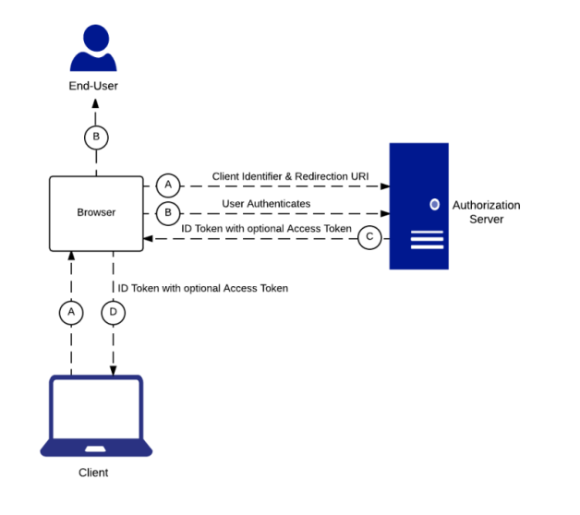
HOW IT WORKS
OpenID Connect extends OAuth 2.0 to add authentication capabilities, allowing users to log in to multiple applications using a single set of credentials.

Slide 25
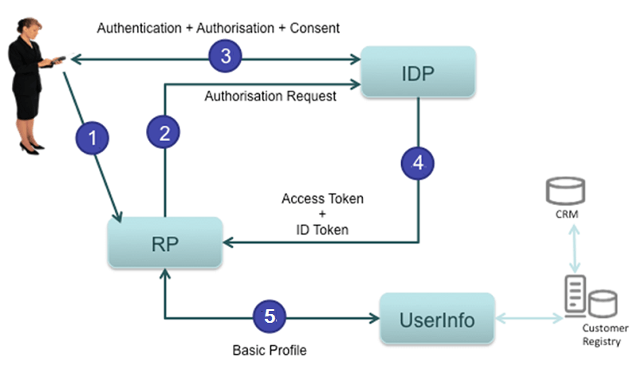
Example use case for OPENID

Slide 26
07
OAUTH
Definition of OAuth
Explanation of how OAuth provides delegated authorization for web-based applications
Example use cases for OAuth in granting access to user resources to third-party applications

Slide 27
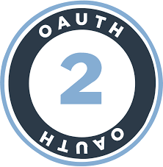
Definition of OAUTH
OAuth is an authorization protocol used to grant access to user resources to third-party applications without sharing credentials

Slide 28
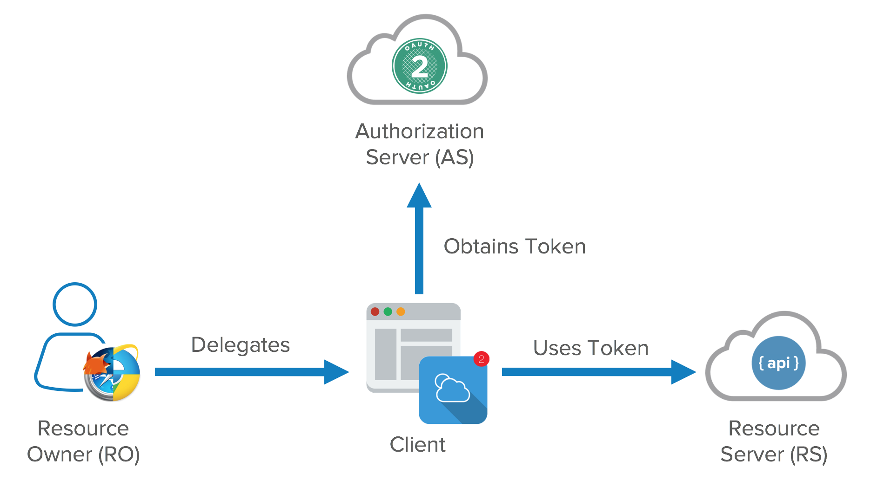
HOW IT WORKS
OAuth allows users to grant access to their resources to third-party applications without sharing their credentials, providing a secure and convenient way to share data.

Slide 29
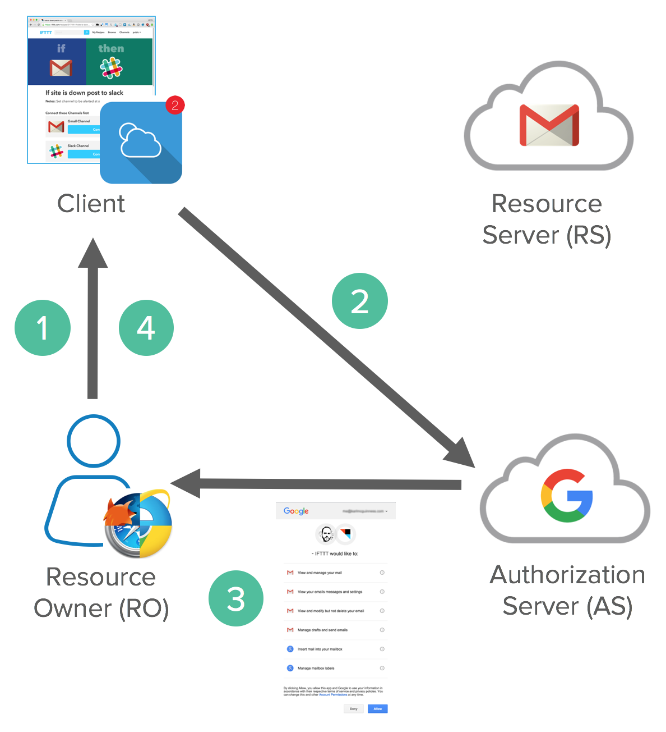
Example use case for OPENID

Slide 30
08
SAML
Definition of SAML
Explanation of how SAML provides SSO for web-based applications through the exchange of authentication and authorization data
Example use cases for SAML in web-based applications

Slide 31

Definition of SAML
Security Assertion Markup Language is an XML-based protocol used for exchanging authentication and authorization data between parties

Slide 32
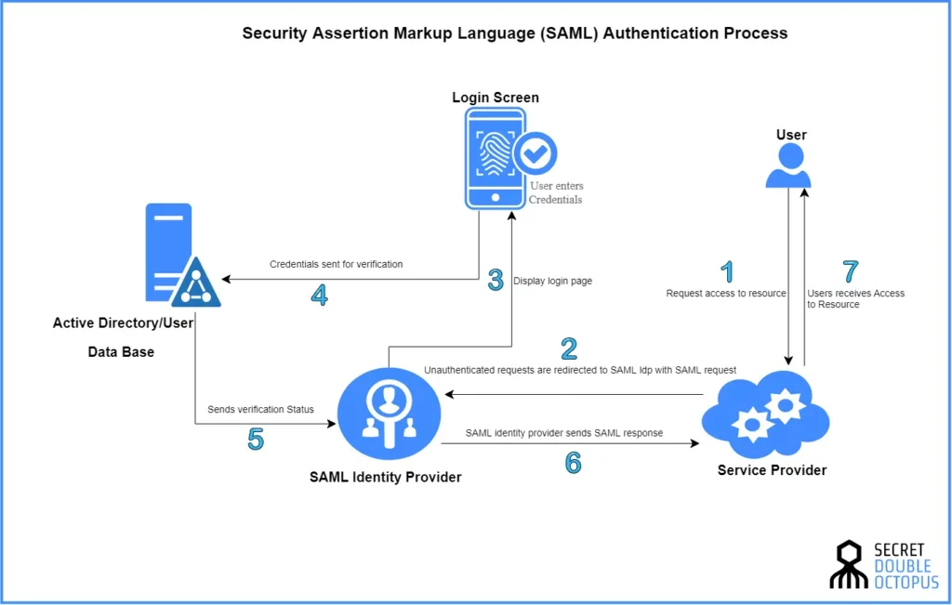
HOW IT WORKS
SAML allows users to authenticate once and access multiple applications in different domains, providing a seamless user experience.

Slide 33
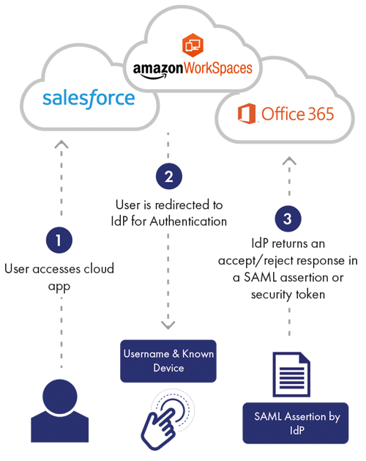
Example use case for SAML

Slide 34
SUMMARY

Slide 35
In summary, these SSO protocols provide various ways for organizations to authenticate and authorize users, grant access to resources, and ensure secure and seamless access across multiple applications and services. Depending on the organization's needs, they can choose the appropriate protocol or combination of protocols to implement their SSO solution.

Slide 36
THANK YOU
Link

