Slide 1

HAMZA GHARIANI 4 NIDS 1

Slide 2
Threats and Vulnerabilities
IN VIRTUALIZED ENVIRONMENTS

Slide 3
PLAN
01
02
03
04
INTRODUCTION
Explanation of Virtualization
SECURITY CHALLENGES
Threads and Vulnerabilities in Virtualized Environments
COMMON SECURITY RISKS
Examples of Security Risks
SECURITY BEST PRACTICES
Examples of Security Best Practices

Slide 4
01
Introduction to Virtualization

Slide 5
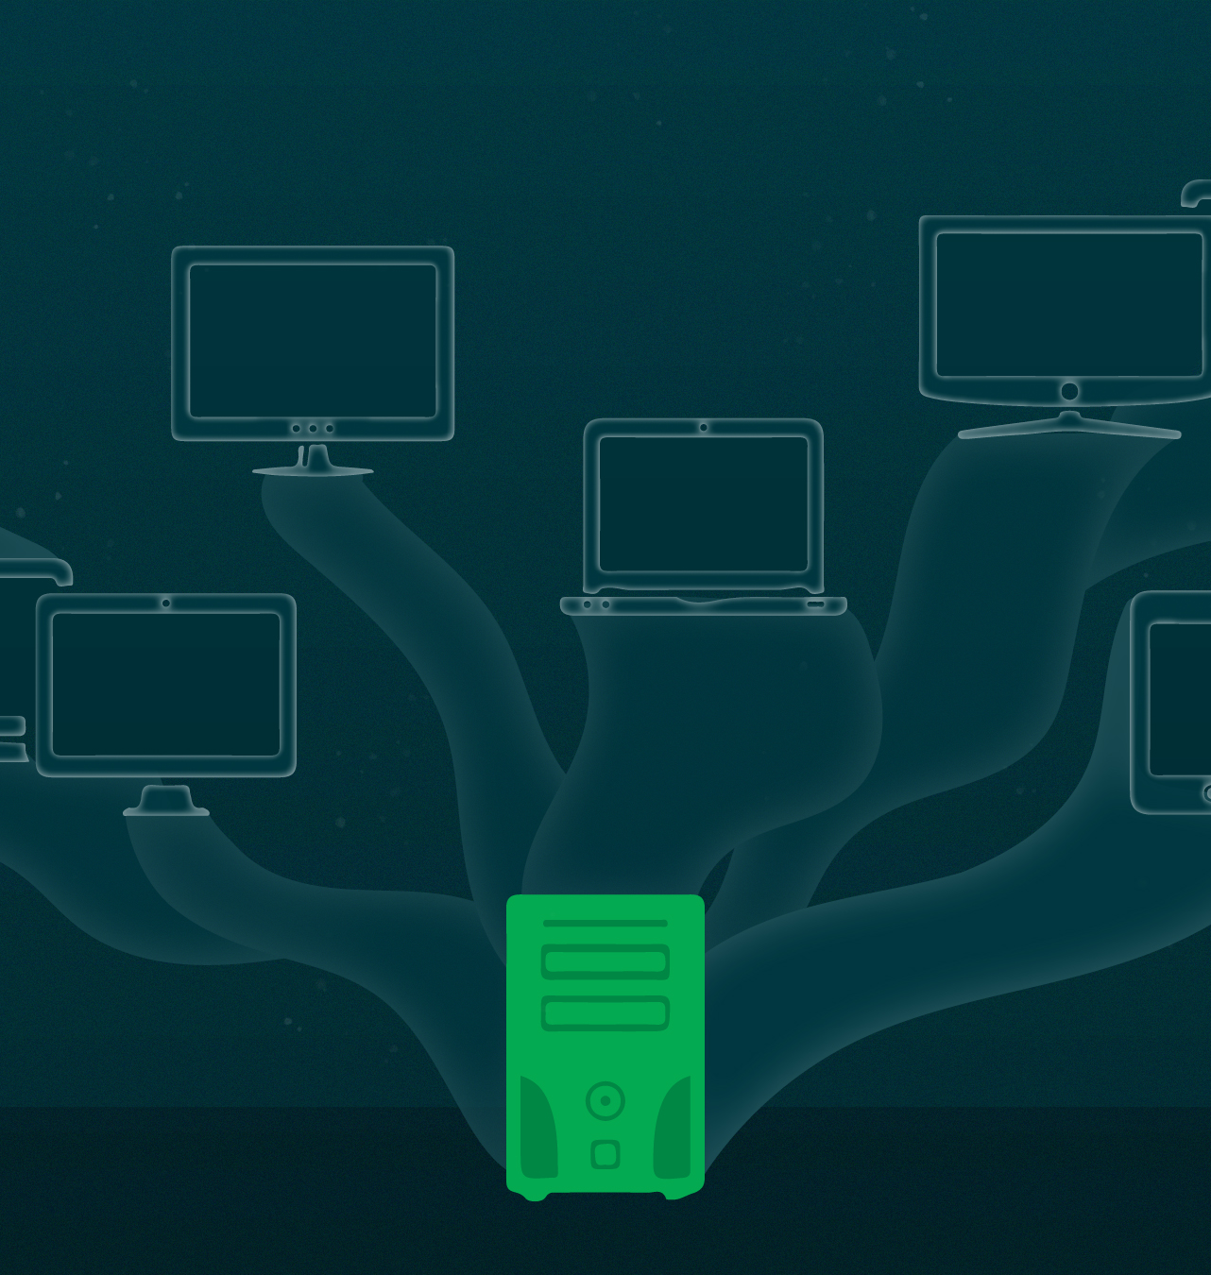
VIRTUALIZATION
1.1
Virtualization uses software to create an abstraction layer over computer hardware that allows the hardware elements of a single computer—processors, memory, storage and more—to be divided into multiple virtual computers, commonly called virtual machines (VMs).

Slide 6
VIRTUALIZATION TYPES
1.2
Server Virtualization
Storage Virtualization
Network Virtualization
The process of dividing a physical server into multiple unique and isolated virtual servers
The pooling of physical storage from multiple storage devices into what appears to be a single storage device
Abstracting network resources that were traditionally delivered in hardware to software
Application Virtualization
Desktop Virtualization
Data Virtualization
Process that duplicates an interfaced style of communication between an application and an operating system
Technology that lets users simulate a workstation load to access a desktop from a connected device
Gives users fast access to data housed throughout the enterprise

Slide 7
Virtual Machine (VM) Architecture
1.3
Hosted Architecture
Bare-metal Architecture
The guest operating system runs on the top of the hypervisor and host operating system and access the host resources through the latter.
The guest operating system runs on the top of the hypervisor that in turn runs directly on the host hardware and mediates the access requests for the host resources.

Slide 8
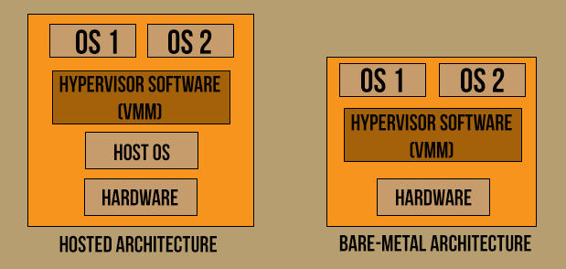
HOSTED VS BARE-METAL
1.4
Real time
Customization

Slide 9
02
Introduction to Security in Virtualized Environments

Slide 10

Security in Virtualized Environments
2.1
Virtualized security, or security virtualization, refers to security solutions that are software-based and designed to work within a virtualized IT environment. This differs from traditional, hardware-based network security, which is static and runs on devices such as traditional firewalls, routers, and switches.

Slide 11
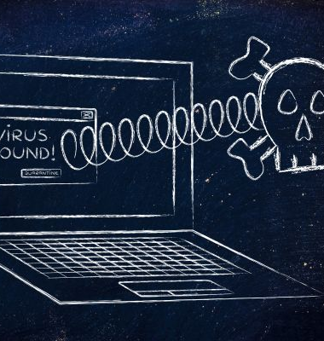
Threats and Vulnerabilities in Virtualized Environments
2.2
Virtual machines are also susceptible to viruses, malware, and ransomware attacks. These attacks can come from infected VM images or from users without proper security training. Once a VM is infected, it can spread malware across the entire virtual infrastructure without adequate isolation and security controls.

Slide 12
Virtualized Environments Attacks
2.3
Examples of Threats and Vulnerabilities in Virtualized Environments
Virtual Machine Escape Attacks | An exploit in which the attacker runs code on a VM that allows an operating system running within it to break out and interact directly with the hypervisor
Hypervisor Attacks | An attack that exploits vulnerabilities in the program by a hacker that works to share multiple operating systems with a single processor of devices
VM Sprawl | A phenomenon that occurs when the number of virtual machines (VMs) on a network reaches a point where administrators can no longer manage them effectively
Resource Exhaustion | Computer security exploits that crash, hang, or otherwise interfere with the targeted program or system
Data Breaches | An incident wherein information is stolen or taken from a system
VM Monitoring | An attack in order to monitor virtual machines

Slide 13
03
Common Security Risks

Slide 14
Virtualized Environments Risks
3.1
Host System Attacks
Network-Based Attacks
Insider Threats
Malware Attacks
Data Loss and Leakage
Configuration and Management Issues

Slide 15
04
Security Best Practices

Slide 16
Solving high-risk actions
4.1
VM HARDING
NETWORK
Stripping unnecessary software from a system
Dividing a network into multiple segments
HYPERVISOR
AUTHENTIFICATION
Ensuring the hypervisor
Determines who is allowed to access certain data, apps, and resources

Slide 17
Solving high-risk actions
4.2
UPDATES
LOGS
Software and operating system (OS) updates
Identify the source and the extent of compromise
MONITORING
RECOVERY
Identify patterns of activity on your networks
Anticipates and addresses technology-related disasters

Slide 18
05
CONCLUSION

Slide 19
In light of all the facts mentioned and discussed, we can conclude that virtualization is a pressing matter at hand. To grow in a continuously evolving marketplace, we need to keep pace with emerging trends.

