Slide 1
I2C-UART Debugger
Embedded Communication Debugging System Using Raspberry Pi

Slide 2
Problem Statement
In embedded systems, communication protocols like I2C and UART are widely used.
Debugging these protocols is difficult and time-consuming due to:
Hardware-level issues (wiring, pull-ups, noise)
Communication failures (NO ACK, data loss)
Lack of real-time visibility
Existing tools are often:
Expensive (logic analyzers)
Complex to use
Need a low-cost, real-time debugging solution

Slide 3
Project Objective
To design a multi-protocol debugging system using Raspberry Pi
To detect and analyze I2C and UART communication errors
To provide real-time results via:
OLED Display
Terminal
Web Dashboard
To build a scalable and modular debugging tool
To simplify debugging for embedded engineers and students

Slide 4
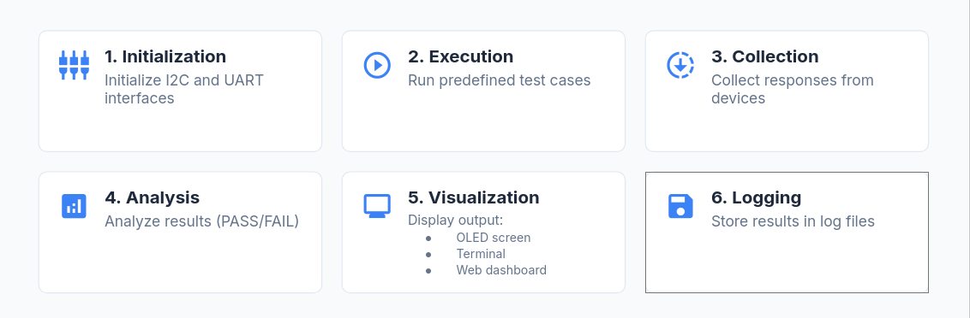
Workflow Overview

Slide 5
Algorithm
Start program
Initialize I2C bus and UART port
For each protocol:
Run test cases
Capture response
Check conditions:
If response valid → PASS
Else → FAIL
Display results:
Print on terminal
Show on OLED
Send to web server
Save results in log file
Repeat for continuous monitoring

Slide 6
Output
Terminal Output:
Displays detailed test results
Example:
NO ACK: FAIL
BUS STUCK: PASS
OLED Display:
Shows real-time status
Compact and hardware-level output
Web Dashboard:
Live monitoring using Flask
View logs remotely
Log Files:
Stores all test results
Used for debugging and analysis

Slide 7
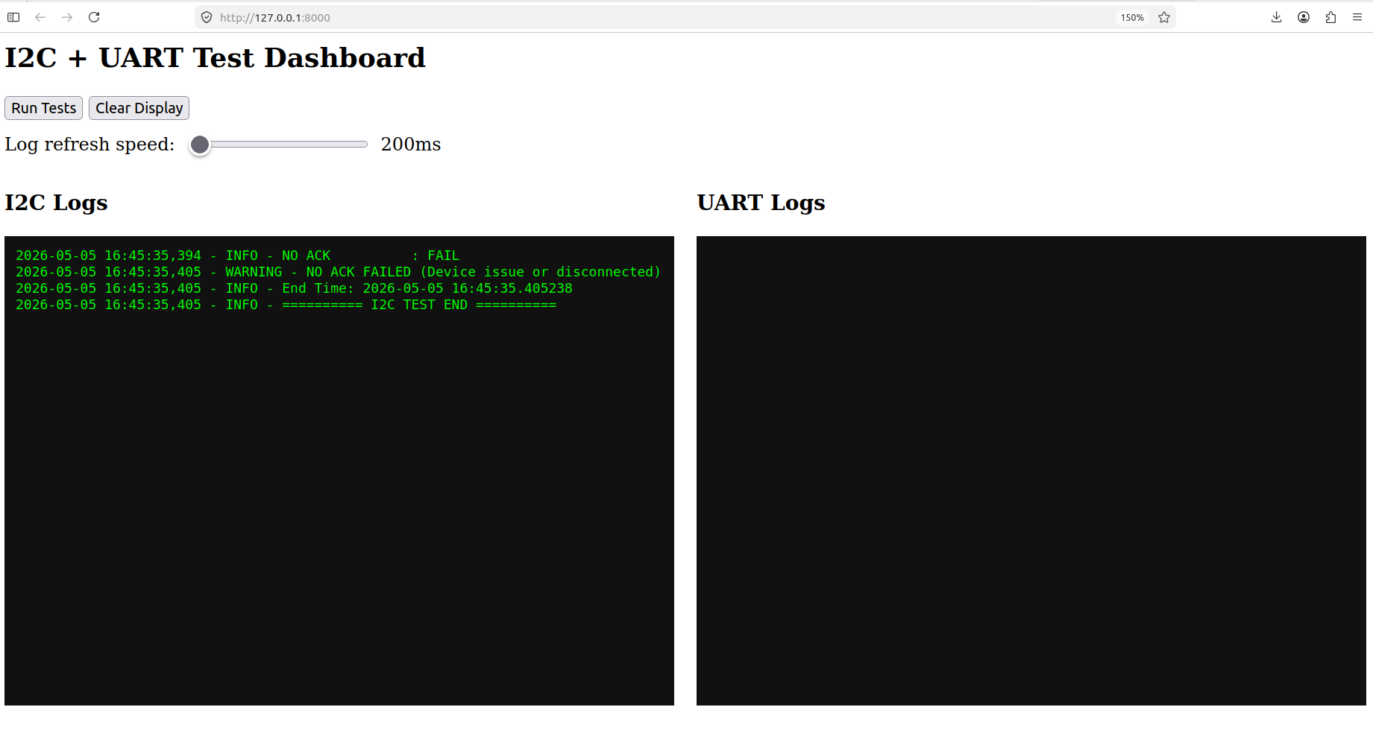
Web Dashboard

Slide 8
Key Features
Multi-protocol debugging (I2C + UART)
Real-time OLED display
Flask web dashboard
Parallel execution of tests
Log file generation

Slide 9
Future Enhancement
Add support for SPI communication protocol
Improve user interface of web dashboard
Add real-time graphs for better visualization
Implement alert system for error detection
Enable remote access for monitoring over network
Optimize system for faster performance

Slide 10
Conclusion
Developed an efficient debugging tool for I2C and UART
Reduced manual debugging effort
Provides real-time and accurate results
Useful for embedded and IoT development

Slide 11
Thank You

