Slide 1
Toko-Hunt
Recommendation System, Comparison Shopping Engine, E-commerce

Slide 2
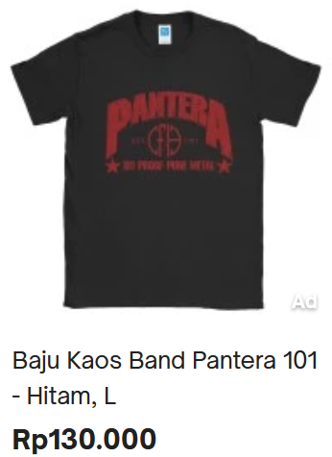
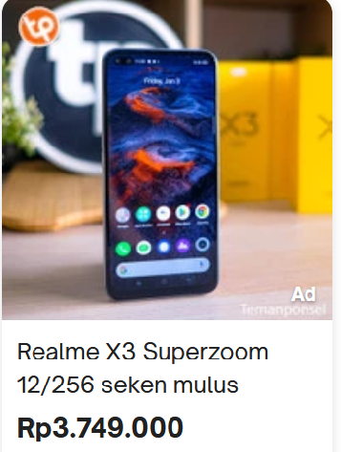
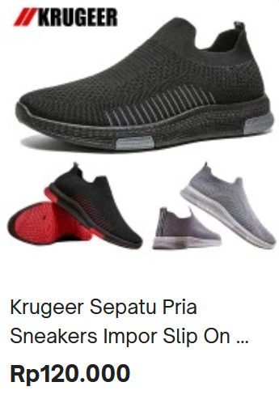
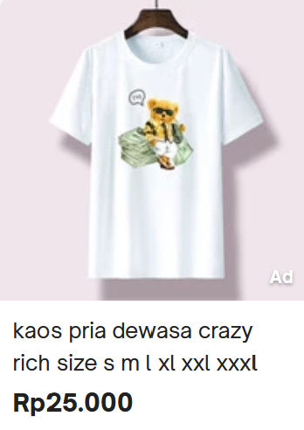
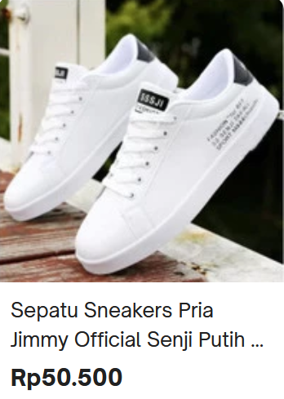
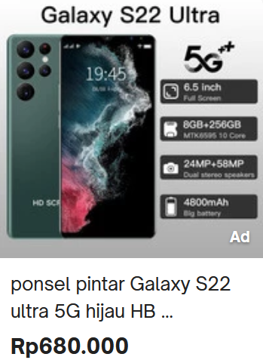
Background
In the era of e-commerce customer can gain access to a lot information regarding a product, but sometimes to much information can be overwhelming

Slide 3
Objective
Building a recommendation system to lessen the user information taking when deciding to purchase a product online

Slide 4

Timeline Project
Activity | 25 | 26 | 27 | 28 | 29 | 30 | 31
Brainstorming Project Idea
Pitching Idea with Instructor
Web Scraping
Data Preprocessing
Building the Algorithm
Frontend & Backend Development
Evaluation

Slide 5
How the model works
Input
Regex
Count Vectorizer
Cosine Similarity
Recommendation
Query
Compile

Slide 6


Demo

Slide 7
Chalenges
Web Scraping
Data Quantity
Data does not have a uniform format so it takes an extra step to preprocess
The data used in this project are only 4000 data and limited product variety
Time Constraint
Limited Data
The project only have 7 days to finish and most of the time are spent doing web scrapping and data preprocessing
Since we only use the data available from the web scraping we lack the data to make comprehensive recommendation

Slide 8


Succes Story
Model are capable of recommending best price range of a product
Scraped 3000+ product data from e-commerce platform
Creating an interactive frontend that can display comprehensive recommendation
Model are capable of giving best store recommendation

Slide 9
Stretch Goal
Scrape data from a variety of e-commerce platform
Scrape data with more product variety
Scrape more data of store with lower rating for better comparison
Make a categorization for newcomers store
We would like to access
Integrate with e-commerce database to be able to recommend their product
Implementing computer vision for product that are hard to describe by text

Slide 10


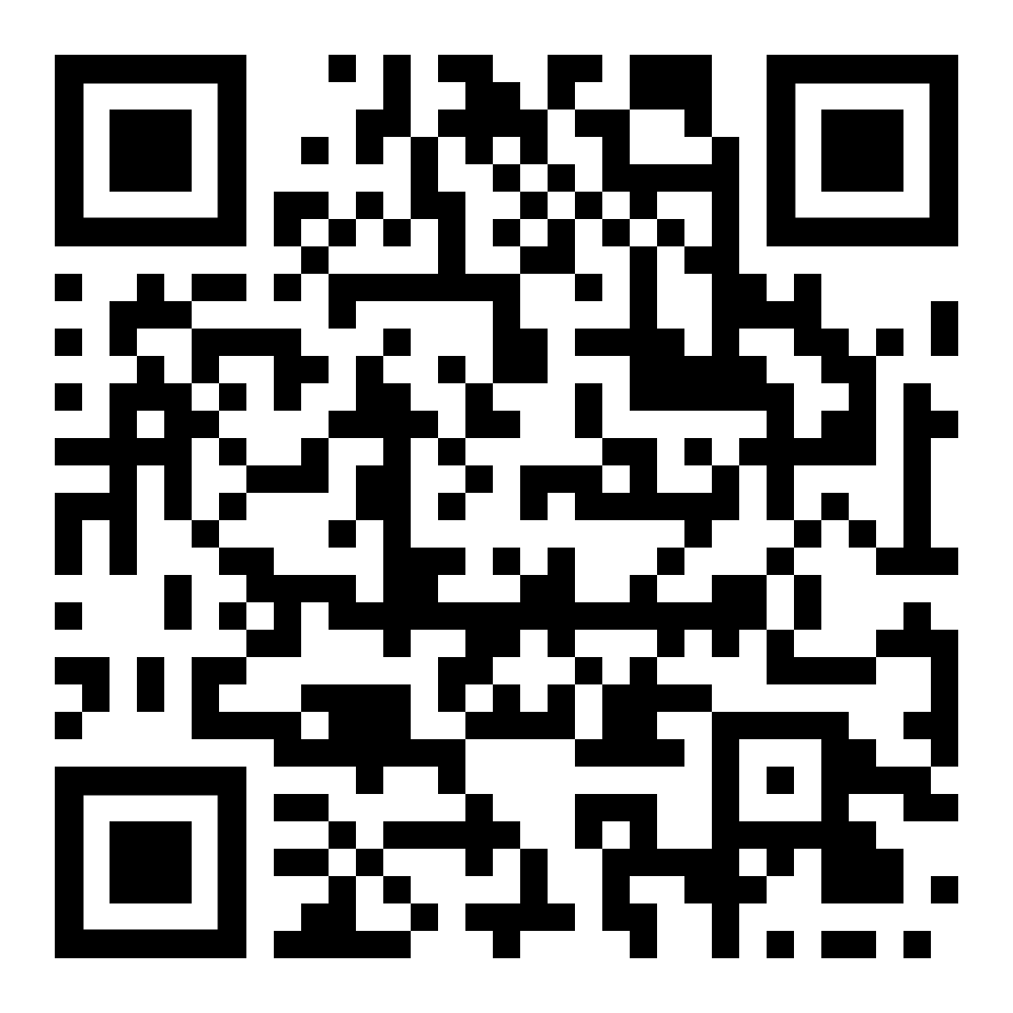
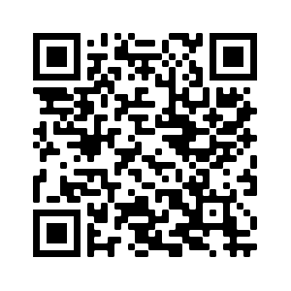

Our Team
Bandoro
Muhamad Bagus Septian

Slide 11
Thank You

